Slide 1
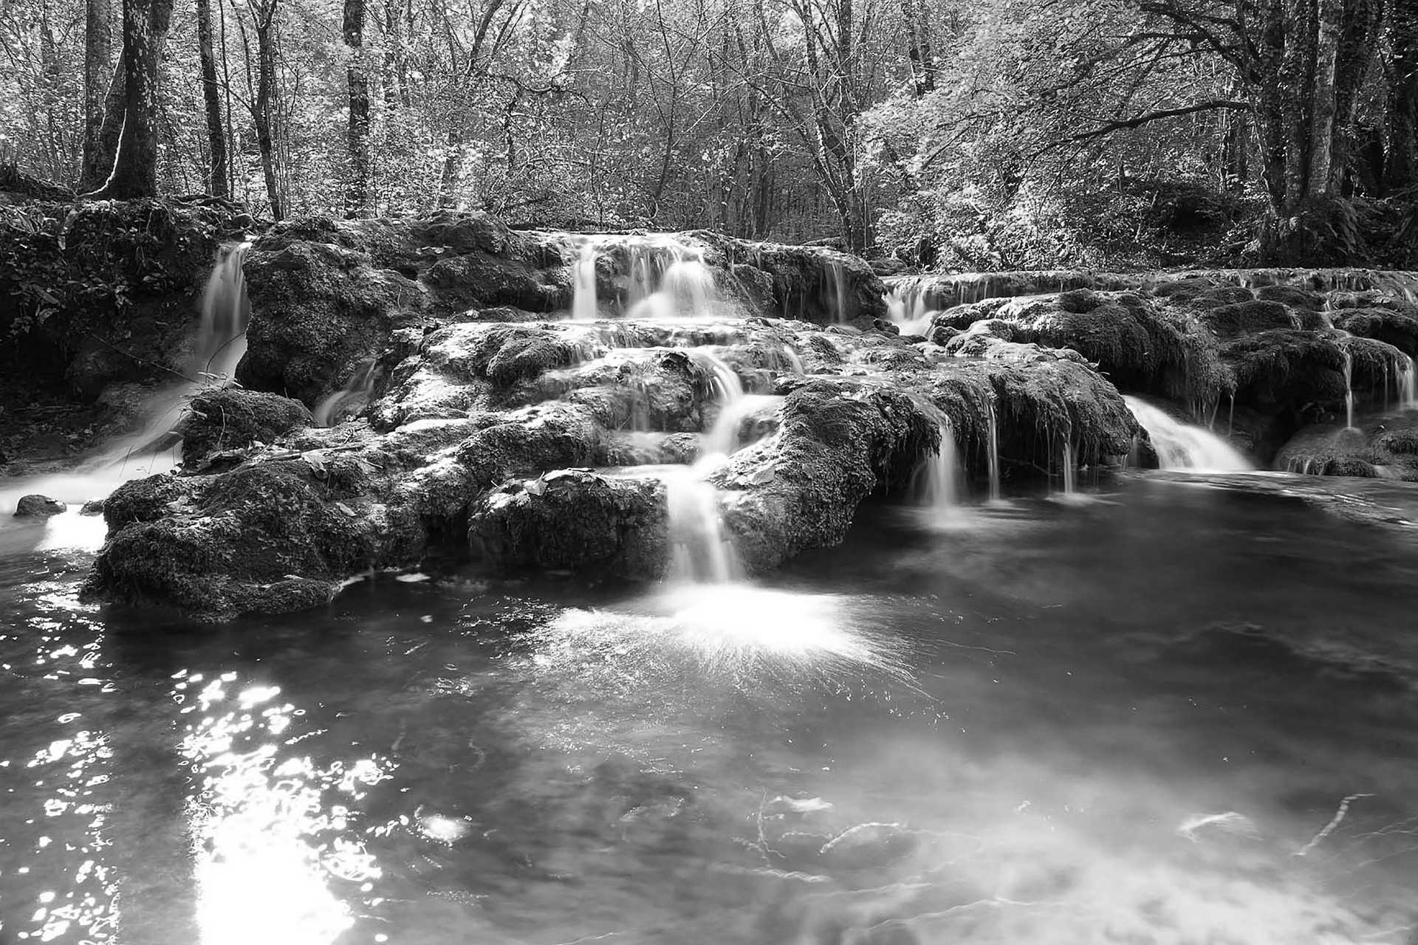

Implementing Your Pollution Prevention & Good Housekeeping Program
May 6, 2026
Amy L. Harvell, CHMM, RPC // Environmental Services Sr. Project Manager
© 2025 Copyright Wessler Engineering

Slide 2
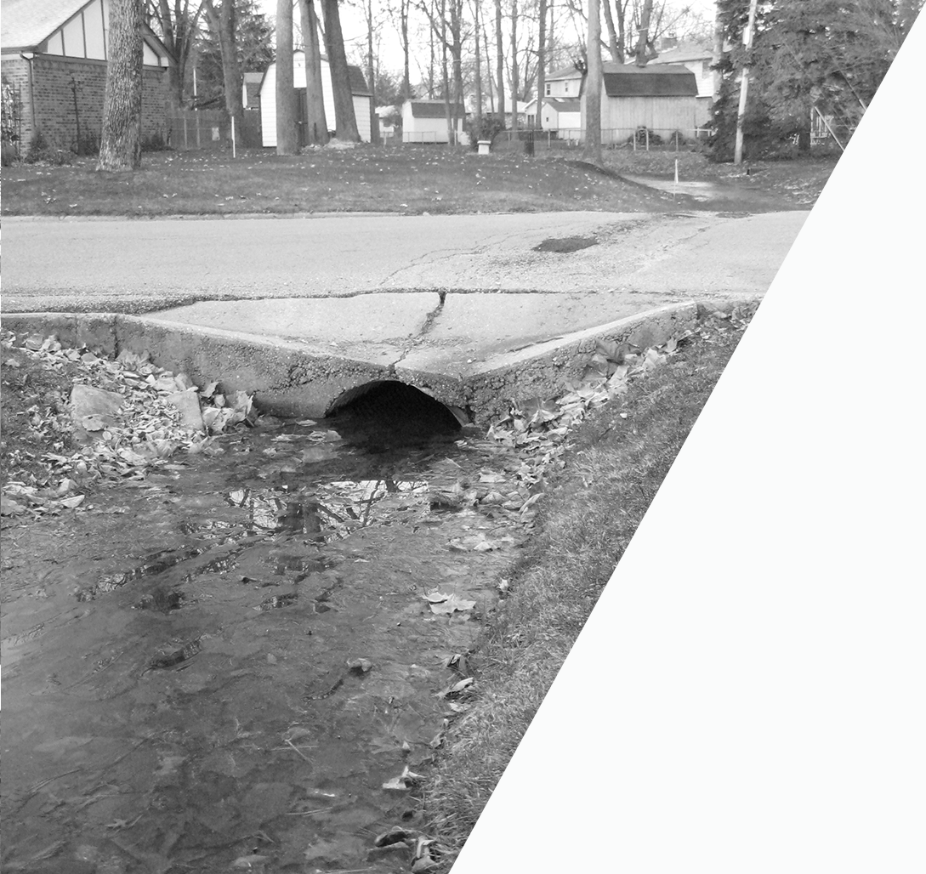

Presentation Scope
Pollution Prevention & Good Housekeeping:
Goal to reduce pollutants generated from municipal operations and activities
By Identifying:
Decision Process
Pollutant Sources
Subject Facilities
Activities & Schedules
Through Implementing:
Operations & Maintenance (O&M) Plan
Performance Standards
Best Management Practices (BMPs)
Training
Stormwater Pollution Prevention Plans (SWPPPs)
© 2025 Copyright Wessler Engineering​
Notes:
The good thing about your MS4 Program is that it is YOURS – you determine what is in it, who is responsible, and how it is implemented. Don’t get me wrong, yes, all the requirements need to be included, but it is not a cookie-cutter program, one size does not fit all. There are 400 to 500 MS4s in Ohio, all at varying degrees of population, funding, number of personnel, and implementation stage. So, find what works for you…get examples from other MS4s, stormwater associations, and conferences and piece together what works best for your program.
Additionally, with a new permit coming out soon, it may be a good time to reevaluate for municipal operations program.

Slide 3

Requirements
Overview
Operation & Maintenance Plan
Training program & materials
List of MS4 owned/operated facilities under NPDES Industrial Stormwater General Permit or an Individual Permit
Documentation of decision process
Incorporation of performance standards (e.g., by activity, TMDLs, etc.)
Stormwater Pollution Prevention Plans (SWPPPs)
Annual Reporting
© 2025 Copyright Wessler Engineering​
Notes:
If you are just starting out, all of this can be overwhelming, but separating the pieces out be the requirements helps. I recommend starting with the decision process. As you go through it, most of the requirements fall into place.

Slide 4
Decision Process -> Requirements
What do you document?
Specific municipal operations that are generating pollution
Responsible individuals
Measurable goals
Measures to control pollution
Specific Performance Standards & Individual BMPs
Activity procedures –> schedules, waste disposal, tracking
Applicable annual training –> general and task-specific
Methods to evaluate implementation
Tracking for Annual Report
© 2025 Copyright Wessler Engineering​
Notes:
By going through the decision process, you can organize the various municipal activities that are already occurring. I encourage MS4 Coordinators to sit down with each department supervisor and discuss their activities and educate them on how each impacts stormwater.
Start with the BIG picture, get organized, then dive into the details.

Slide 5
Decision Process
Organization:
How are we doing things now?
Do you have a current system?
  Will it work for MS4 needs?
How many people need to access it?
Documenting the decision process
  Word/Excel
  Software/databases
  Correlate with GIS mapping
  Work orders that tracks employee tasks
  Good old-fashioned pen & paper
© 2025 Copyright Wessler Engineering​
Notes:
The next question is – what does this look like? How am I documenting my decision process?
Start with – what are we doing now?
This you can discuss with each department. Can you use what is already there to make tracking and documentation less cumbersome…some people do not like change.
You may end up with an MS4 Program being tracked by several methods.

Slide 6
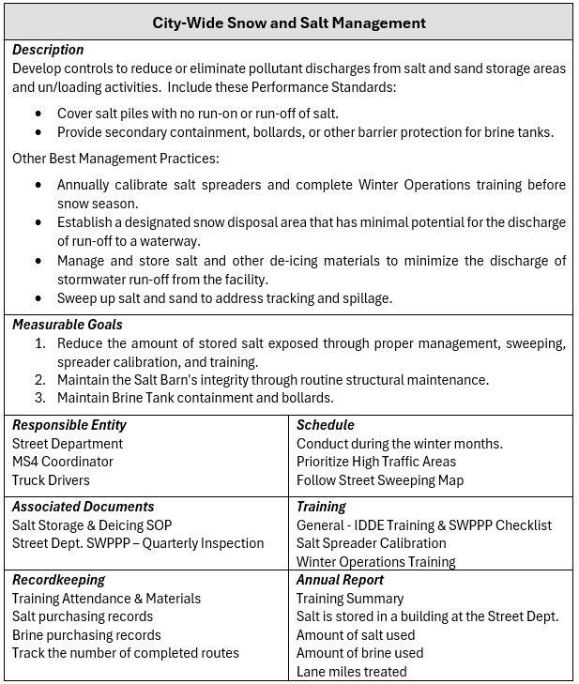
Decision Process
One-pagers
  Important information on 1 page
  Easy to update and revise
  Good method to organize thoughts
© 2025 Copyright Wessler Engineering​
Notes:
Here is one idea on how to organize your program. Set up a template page with all the requirements.
Don’t worry, You might not have all the information when you start

Slide 7
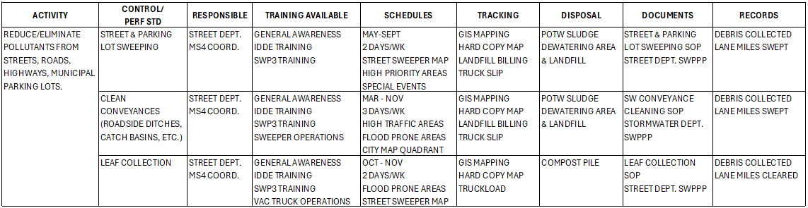
Decision Process
Spreadsheets
  Use multiple tabs to keep all information and support documents in 1 file
  Use links to accompanying documents in the spreadsheet or SharePoint file
  To the point – less descriptive
© 2025 Copyright Wessler Engineering​
Notes:
My brain loves spreadsheets. I set my whole MS4 Programs in multi-tabbed spreadsheets with hyperlinks to a tracking form or SOP the spreadsheet or in a SharePoint folder.
A big benefit with spreadsheets is that you could set one up for each municipal department with their schedules, activities, training, and tracking that they can actively use to enter data and then review it for Annual Reporting.
There is no confusion on what exactly they need to do.

Slide 8
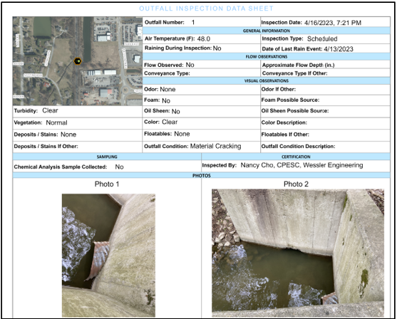
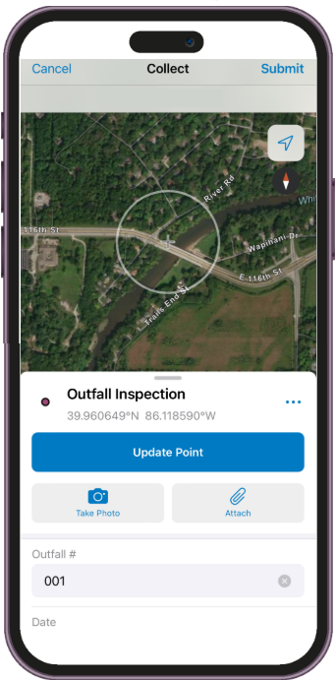

Decision Process
GIS Mapping & Apps
Need an app for that? Wessler GIS can help.
© 2025 Copyright Wessler Engineering​
Notes:
If you already have an existing GIS mapping system, determine if it can be expanded for MS4 needs. One of the great things about GIS (and I am not an expert on it) is the ability to log data to a specific property or a piece of infrastructure – manhole, inlet. Plus with a phone or tablet and Wi-Fi service, it is portable and user-friendly.
If you have some talented GIS personnel, it is possible to incorporate your dry weather screening, illicit discharge complaints and investigations, and post-construction water quality and quantity units and inspections into GIS.

Slide 9
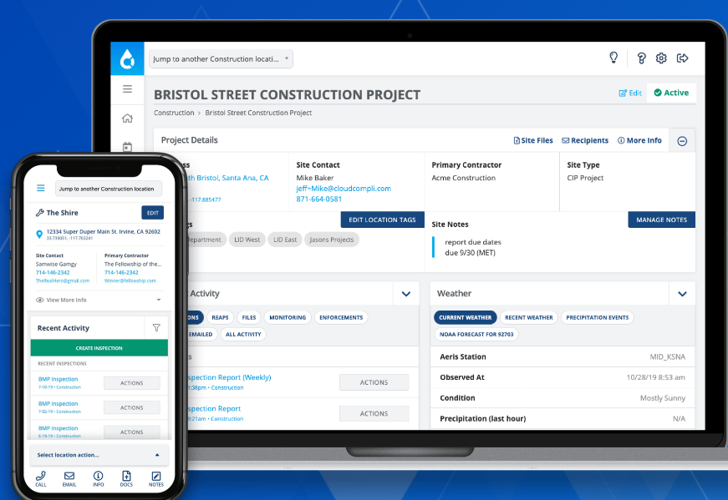
Decision Process
Databases/software
  Ziptility
  CivicPlus
  SwiftComply
  Cloud Compli
  2NFORM
  PermiTrack
  Many more…
Is one already in use by another department?
© 2025 Copyright Wessler Engineering​
Notes:
Databases or software programs are another option. A benefit is that they are typically connected to a GIS system, multi-user access, and can be used for multiple compliance programs (FOG, Pretreatment, etc.). That way the cost of them can be spread out over several departments.
The downside to me is ensuring personnel know how to use it – not everyone is tech savvy and some of us, including me, have our limits.

Slide 10

Subject Facilities & Pollutant Sources
Parks & Recreation
Water/Wastewater/Stormwater
Animal Waste
Facility Location (floodway)
Fuels, Chemicals, Fertilizers, Pesticides, etc.
Special Events
Food Trucks
Pool/Splash Park Discharge
Fuels/Chemicals
Vehicle & Equip. Washing
On-Site Maintenance
Infrastructure Maintenance & Construction
Stockpiles
Outside Storage
Street/Highway
Administration & All Sites
Fuels/Chemicals
Salt & Other Stockpiles
Vehicle & Equip. Washing
On-Site Maintenance
Infrastructure Maintenance & Construction
Outside Storage
Litter
Grass Clippings
General Trash
Parking Lot Drips & Debris
© 2025 Copyright Wessler Engineering​
Notes:
So now that you have figured out how your program is going to look and be tracked, you can start working on the STUFF that makes up the program, meaning the operations that are generating pollution and the controls in place.
Here is an example of activities at 3 different facilities and one that encompasses more general sites.

Slide 11
Street/Highway Activity Sources
Streets & Roads
Internal Construction Projects
Repairs
Snow Removal
Fertilizers/pesticides/herbicides
Litter
Erosion Control
Surplus stockpiles
Permitting
Stormwater Conveyances
Vehicle & Equipment
Creeks
Catch basins/Inlets
Roadside Ditches
Yard Waste
Leaf Collection
Repairs
Chemicals & Wastes
Bulk Fueling Operations
Washing
© 2025 Copyright Wessler Engineering​

Slide 12
Maintenance Schedules
ON-GOING & AS NEEDED | WINTER | SPRING | SUMMER | FALL
Respond to complaints | Planning/Budgets | Litter collection from snow piles | Sediment removal from system | Leaf collection
Repair storm damage/hot spots | Targeted inspections of trouble areas | Inspect/clean catch basins & inlets | Televise pipes as needed | Debris removal
Illicit discharge investigations | Snow storage areas Salt/sand tracking | Dry weather insp. Post-Con BMP insp. | Construction projects | Parking lot & street sweeping
Recordkeeping | Employee Training | Repair riprap, headwalls, channels | Street sweeping | Winter operations training
Facility cleaning & organization | MS4 Annual Report preparation | Parking lot & street sweeping | Invasive species removal, mowing | Documentation
© 2025 Copyright Wessler Engineering​
Notes:
For schedules for municipal operations, start with the big picture…Divide schedules by seasons. Put monthly, weekly, daily schedules in SOPs or in work orders.

Slide 13
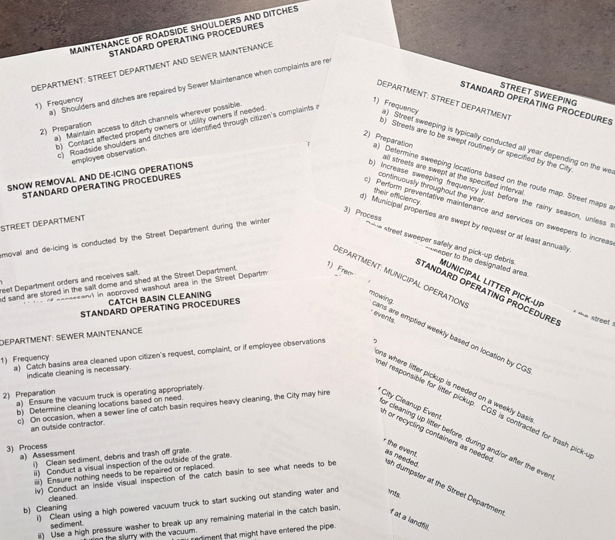
Decision Process
Now the details…
Standard Operating Procedures (SOPs) as part of O&M Plan
Fine tune a schedule
Assign responsibilities
Measurable goals
© 2025 Copyright Wessler Engineering​

Slide 14
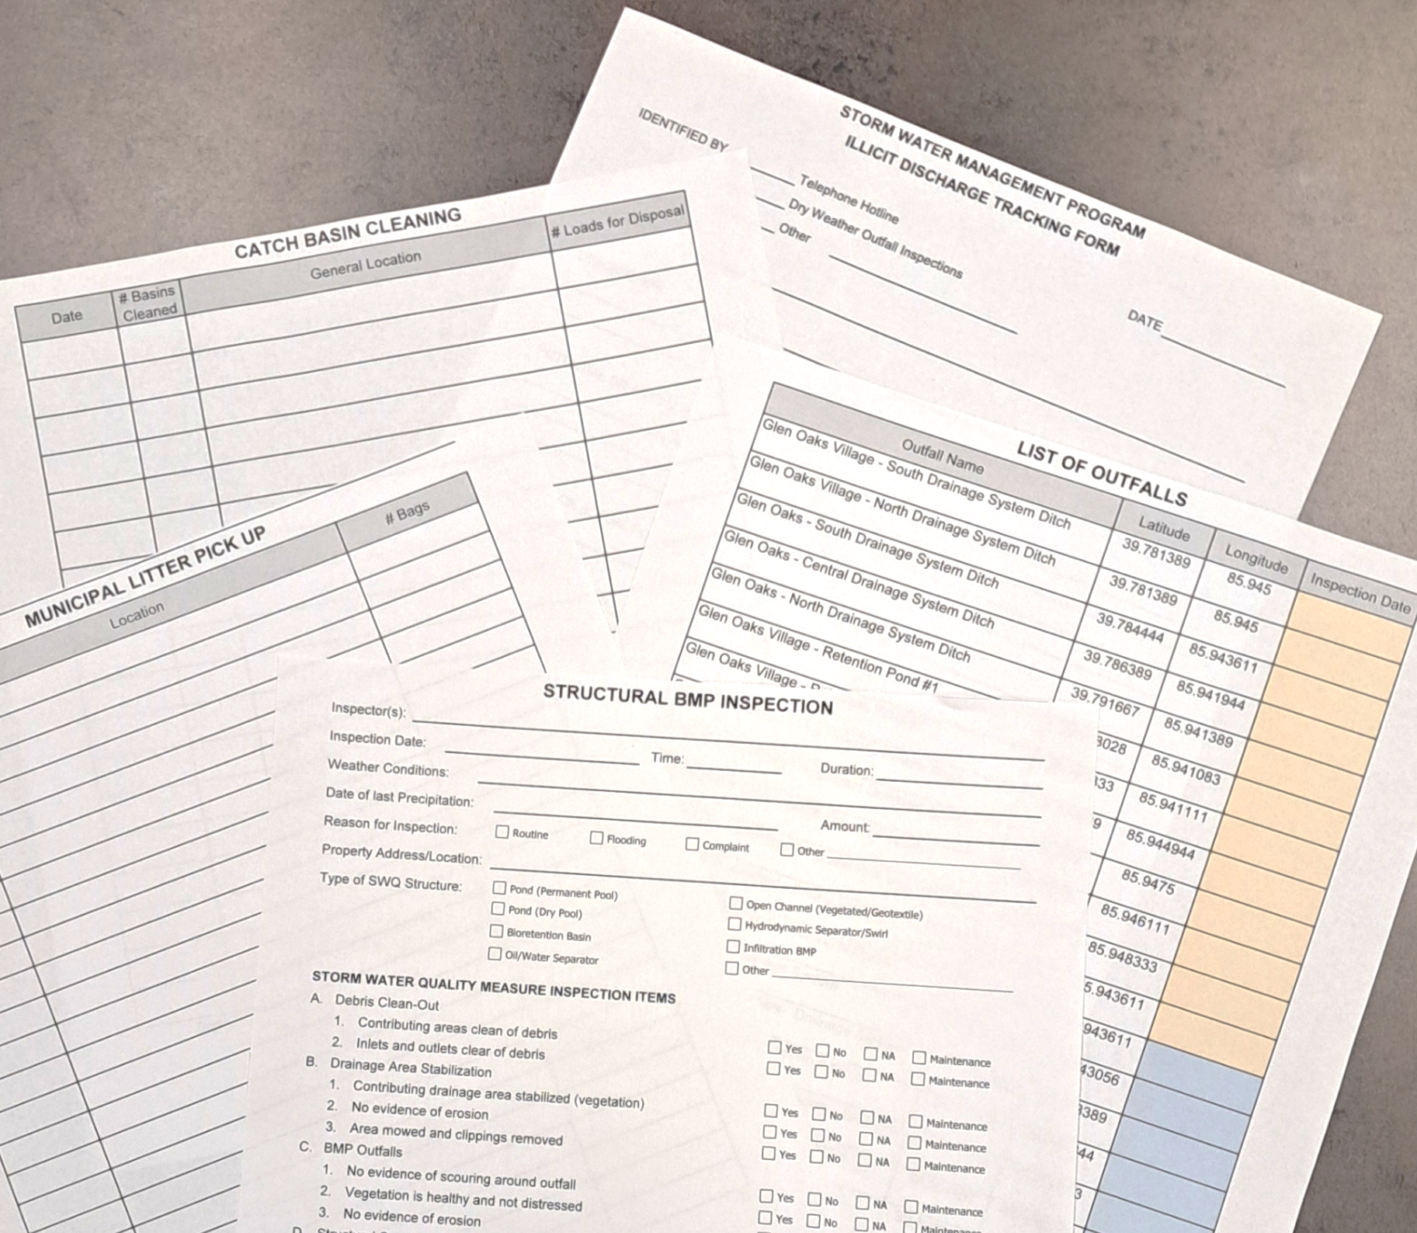
Decision Process
Log sheets, inspection forms and checklists
Can always upgrade later!
© 2025 Copyright Wessler Engineering​

Slide 15
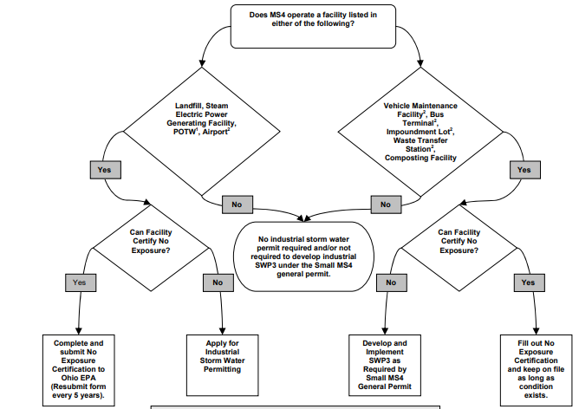
Facility SWPPPs
List of MS4 owned/operated facilities under NPDES Industrial Stormwater General Permit or an Individual Permit
Ohio EPA / Divisions & Offices / Surface Water / Permitting/ Small Municipal Separate Storm Sewer Systems (MS4s) - General Permit
Guidance for MS4 Operated Industrial Facilities
© 2025 Copyright Wessler Engineering​
Notes:
Another key aspect of the municipal operations program is the development of SWPPPs for the facilities that need them.
If you need help determining if a site needs an Industrial coverage or a SWPPP, OEPA has this nice flow chart.

Slide 16
Facility
SWPPPs
Don’t reinvent the wheel…Use and revise existing templates to meet the requirements and your needs
  Ohio EPA Industrial SWPPP Template
  Central Massachusetts Regional Stormwater Coalition
  Indiana Association for Floodplain and Stormwater Management
© 2025 Copyright Wessler Engineering​
Notes:
There are many SWPPP templates on the internet, here are a couple sites. Pull together the parts that work for you for your SWPP.

Slide 17
Method to document the site’s activities, processes, and operations in greater detail
Contents:
  Facility map showing drainage patterns, storage areas, building locations, etc.
  Map of storm system and outfalls
  Identification of activities, chemical storage practices, and proper handling
  Best management practices
  Spill response and emergency procedures
  Proper disposal of waste
  Training
  Inspections
Facility
SWPPPs
© 2025 Copyright Wessler Engineering​

Slide 18
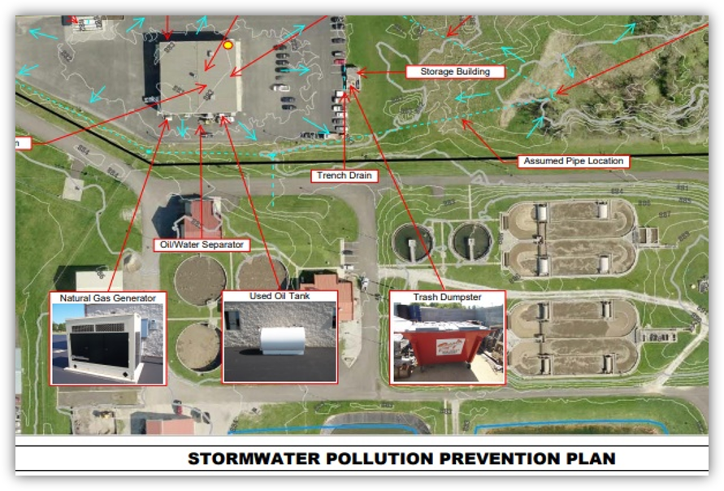
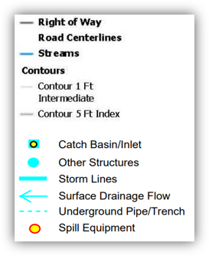
Facility
SWPPPs
© 2025 Copyright Wessler Engineering​

Slide 19
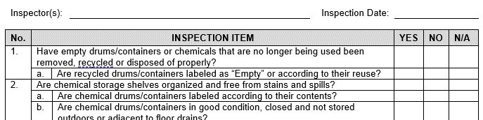
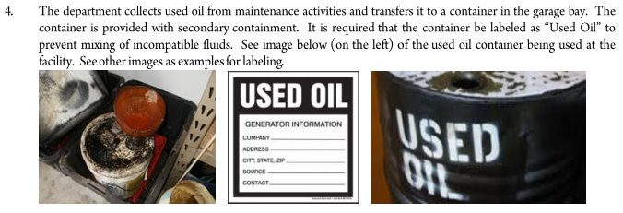
Facility SWPPPs
© 2025 Copyright Wessler Engineering​
Notes:
Be sure to document your observations AND the corrective actions

Slide 20
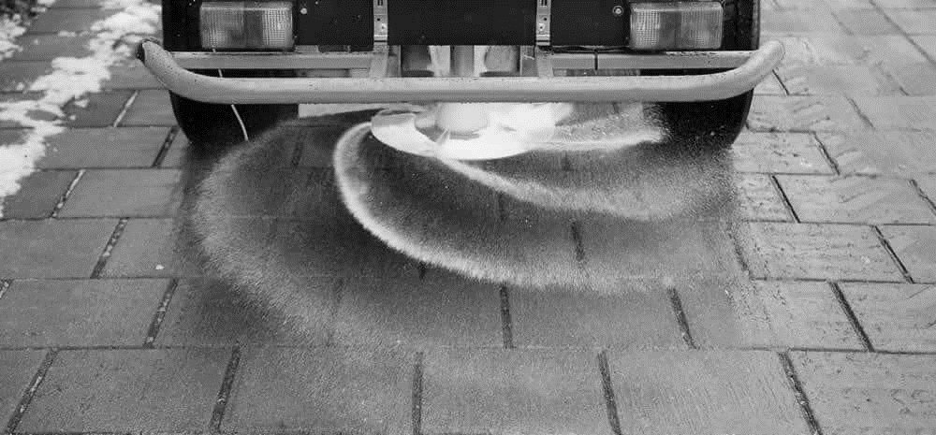
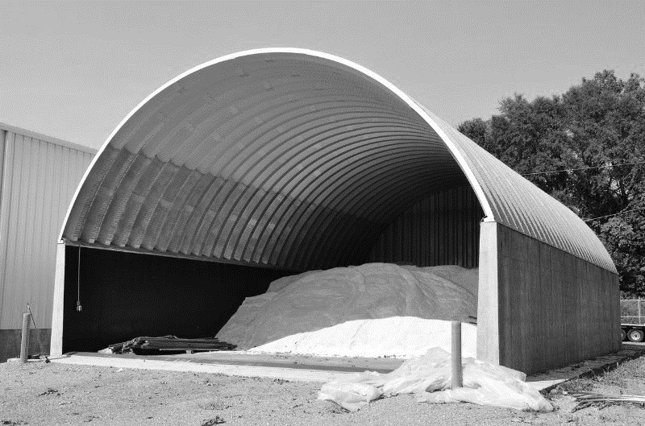
Salt Storage & Deicing Activities
Controls/Performance Standards:
  Cover salt storage areas with no run-on or run-off
  Secondary containment or barrier protection for liquid deicers
  Calibrate salt spreaders so only the amount needed is applied
BMPs:
  Push salt back from the entrance
  Manage tracking on vehicle tires
  Clean up spills
© 2025 Copyright Wessler Engineering​
Notes:
We will move into some of the specific BMPS and performance standards. The details of these activities can be listed in your decision process, SOPs, or SWPPPs.

Slide 21
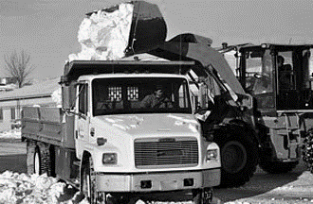
Snow
Disposal
Area
Occurs when snow must be relocated
Does not include snow plowing to the sides of the street
BMPs:
  Select a location where snow melt will infiltrate & minimal potential for runoff
  No direct runoff to a storm conveyance or waterway
  Collect litter and debris after the snow melts
  Do not locate in a Water Source Protection Area (wellhead)
© 2025 Copyright Wessler Engineering​

Slide 22
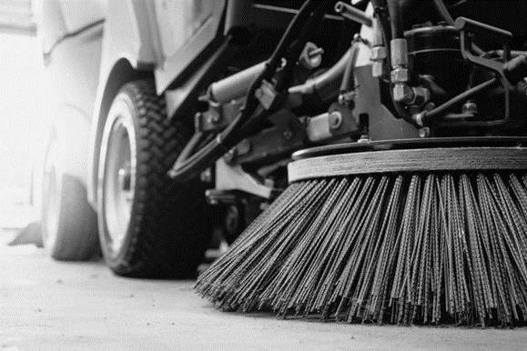
Street and
Parking Lot
Sweeping
Include these details in an SOP:
Schedule & Route
  Prioritize streets & roads with heavy traffic
  Municipal parking lots start & end of season ​
  Use GIS Map to establish route by quadrants​
  May–September –> Minimum 2/year
  Special event sweeping –> before & after
Dewatering methods (if needed) & final disposal
Tracking –> debris collected and/or lane miles
Annual Report –> amount collected & disposal location
© 2025 Copyright Wessler Engineering​

Slide 23
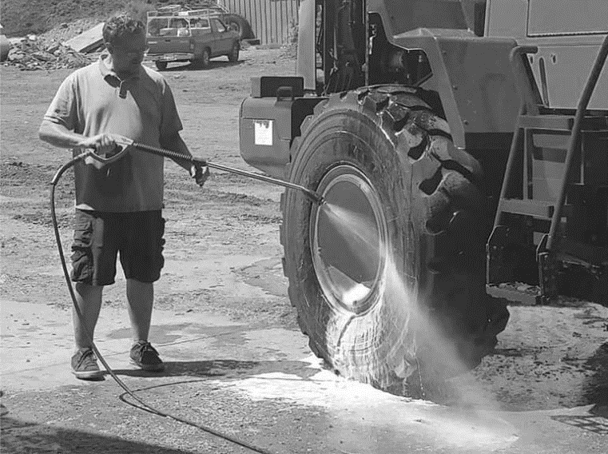
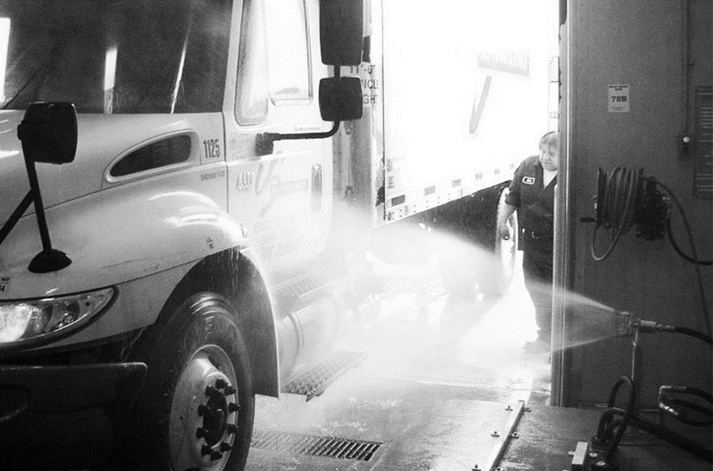
Wash Water BMPs
Outdoor Washing –> no detergents or soaps
Vehicle & Equipment Washing
  Indoors with floors to sanitary, preferably with oil/water and sand interceptors
  Commercial car wash
Equipment might include:
  Street Sweeper
  Salt Spreaders & Snowplows
  Trailers
  Excavators
© 2025 Copyright Wessler Engineering​

Slide 24
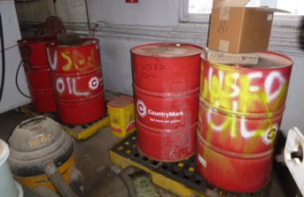
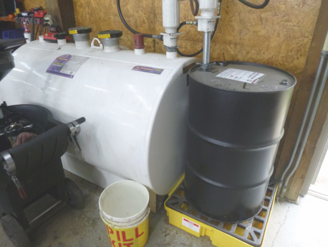
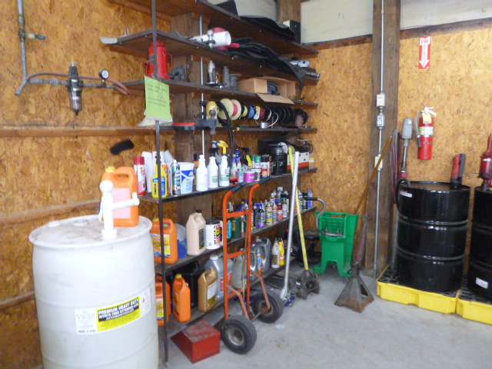
Chemical Storage BMPs
Storage and Handling:
  Store chemical containers indoors where practical
  Store containers away from heavy traffic areas and garage doors or entries
  Place containers that are in use on spill pallets
  Label all containers with the contents
  Maintain spill equipment and absorbents
Waste Materials:
  Proper labeling
  Proper disposal methods or use of a company
  Maintain waste manifests
© 2025 Copyright Wessler Engineering​

Slide 25
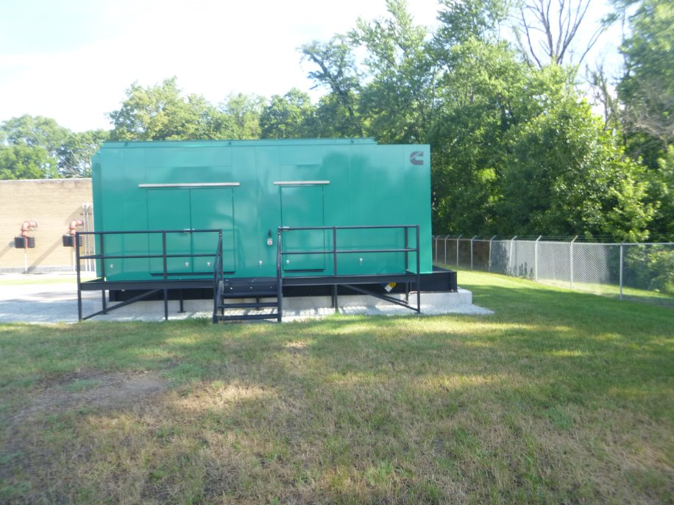
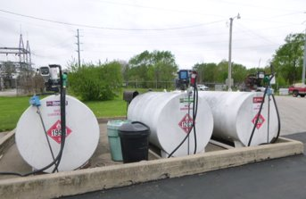
Bulk Fueling BMPs
Conduct with site personnel & truck driver
Do not leave during transfers
Cover any adjacent storm drains with a mat
Ensure the emergency brake is enabled or use wheel chocks
Maintain plenty of spill equipment in the area
Inspect tanker and/or vehicles for leaks before departure
© 2025 Copyright Wessler Engineering​

Slide 26
Training
General
  Basic Awareness
  Illicit Discharge Identification
Site Specific
  Facility SWPPP
  Emergency Response
  Spill Clean Up
  Chemical Management
Task Specific
  Standard Operating Procedures
  Salt Spreader Calibration
  Vehicle Maintenance
  Landscaping & Grounds Maintenance
  Erosion & Sediment Control Measures
  IDDE Investigations
  Vehicle Fueling
  Road Patching
  Shoulder Maintenance
  Tree Cutting
© 2025 Copyright Wessler Engineering​

Slide 27
Training
Online sources – and typically FREE
  US EPA NPDES Stormwater Webcasts – IDDE and task-specific
  Toledo Metropolitan Area Council of Governments – municipal operations (YouTube videos TMACOGtube)
  Clark County, Washington – basics to task-specific
  (YouTube videos ClarkCoWa)
  Virginia Department of Transportation – task-specific on road maintenance
  (YouTube videos vdotweb)
© 2025 Copyright Wessler Engineering​

Slide 28

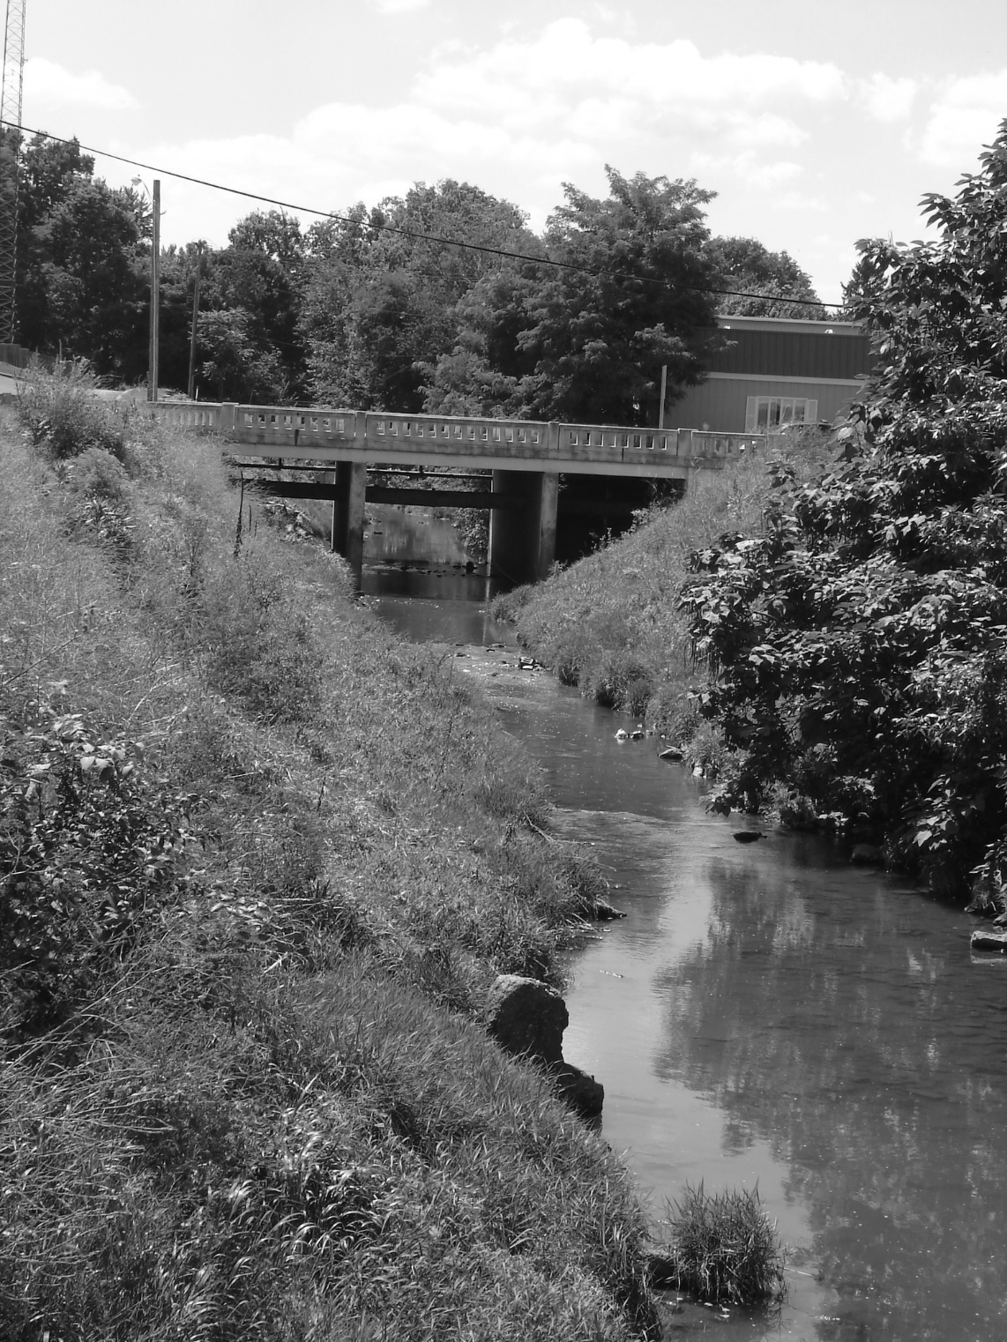

ABOUT WESSLER
Working with our clients to provide a better quality of life by improving and preserving water resources.
There is no water problem we can’t solve together.
Amy L. Harvell, CHMM, RPC
Environmental Services Sr. Project Manager
Phone: 317-788-4551
E-mail: amyh@wesslerengineering.com
www.wesslerengineering.com
© 2025 Copyright Wessler Engineering​

