Slide 1
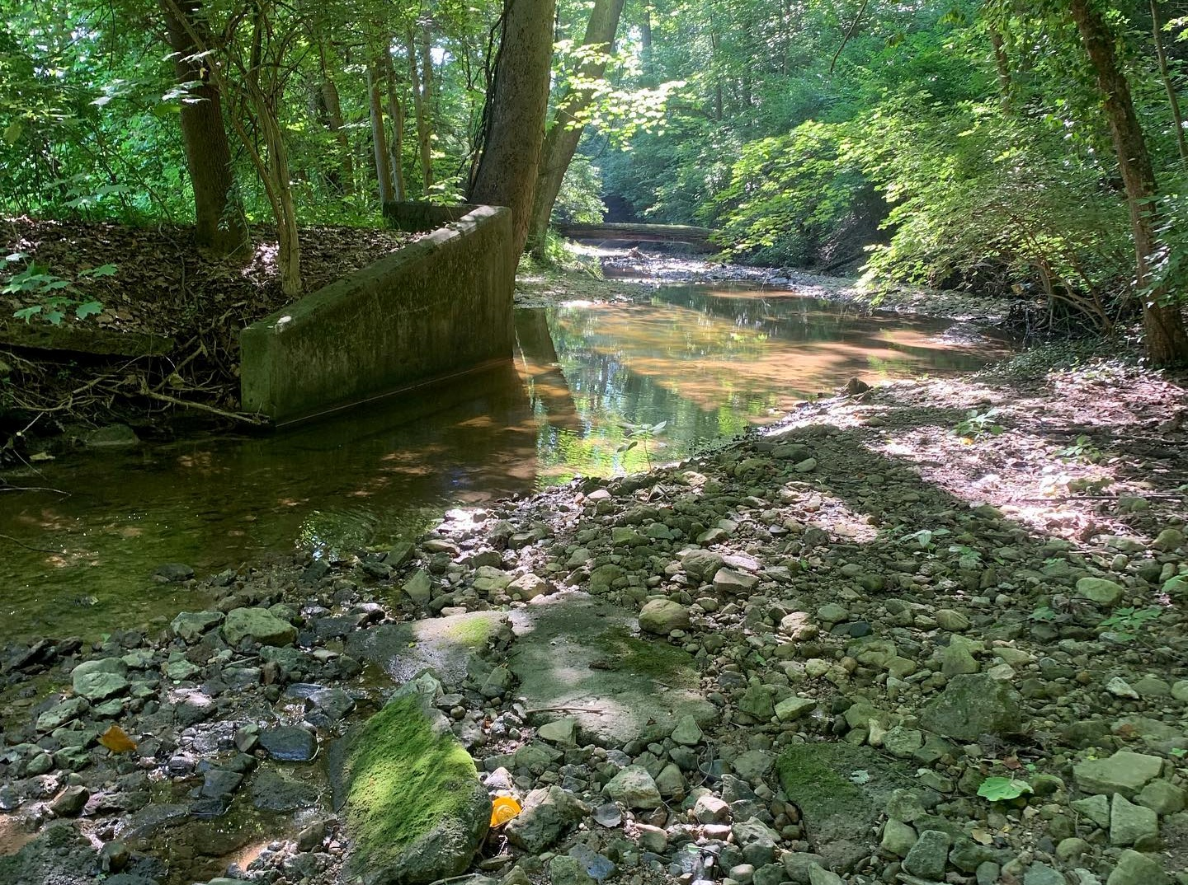
Illicit Discharge Detection and Elimination (IDDE):
Dayton & Toledo

Slide 2
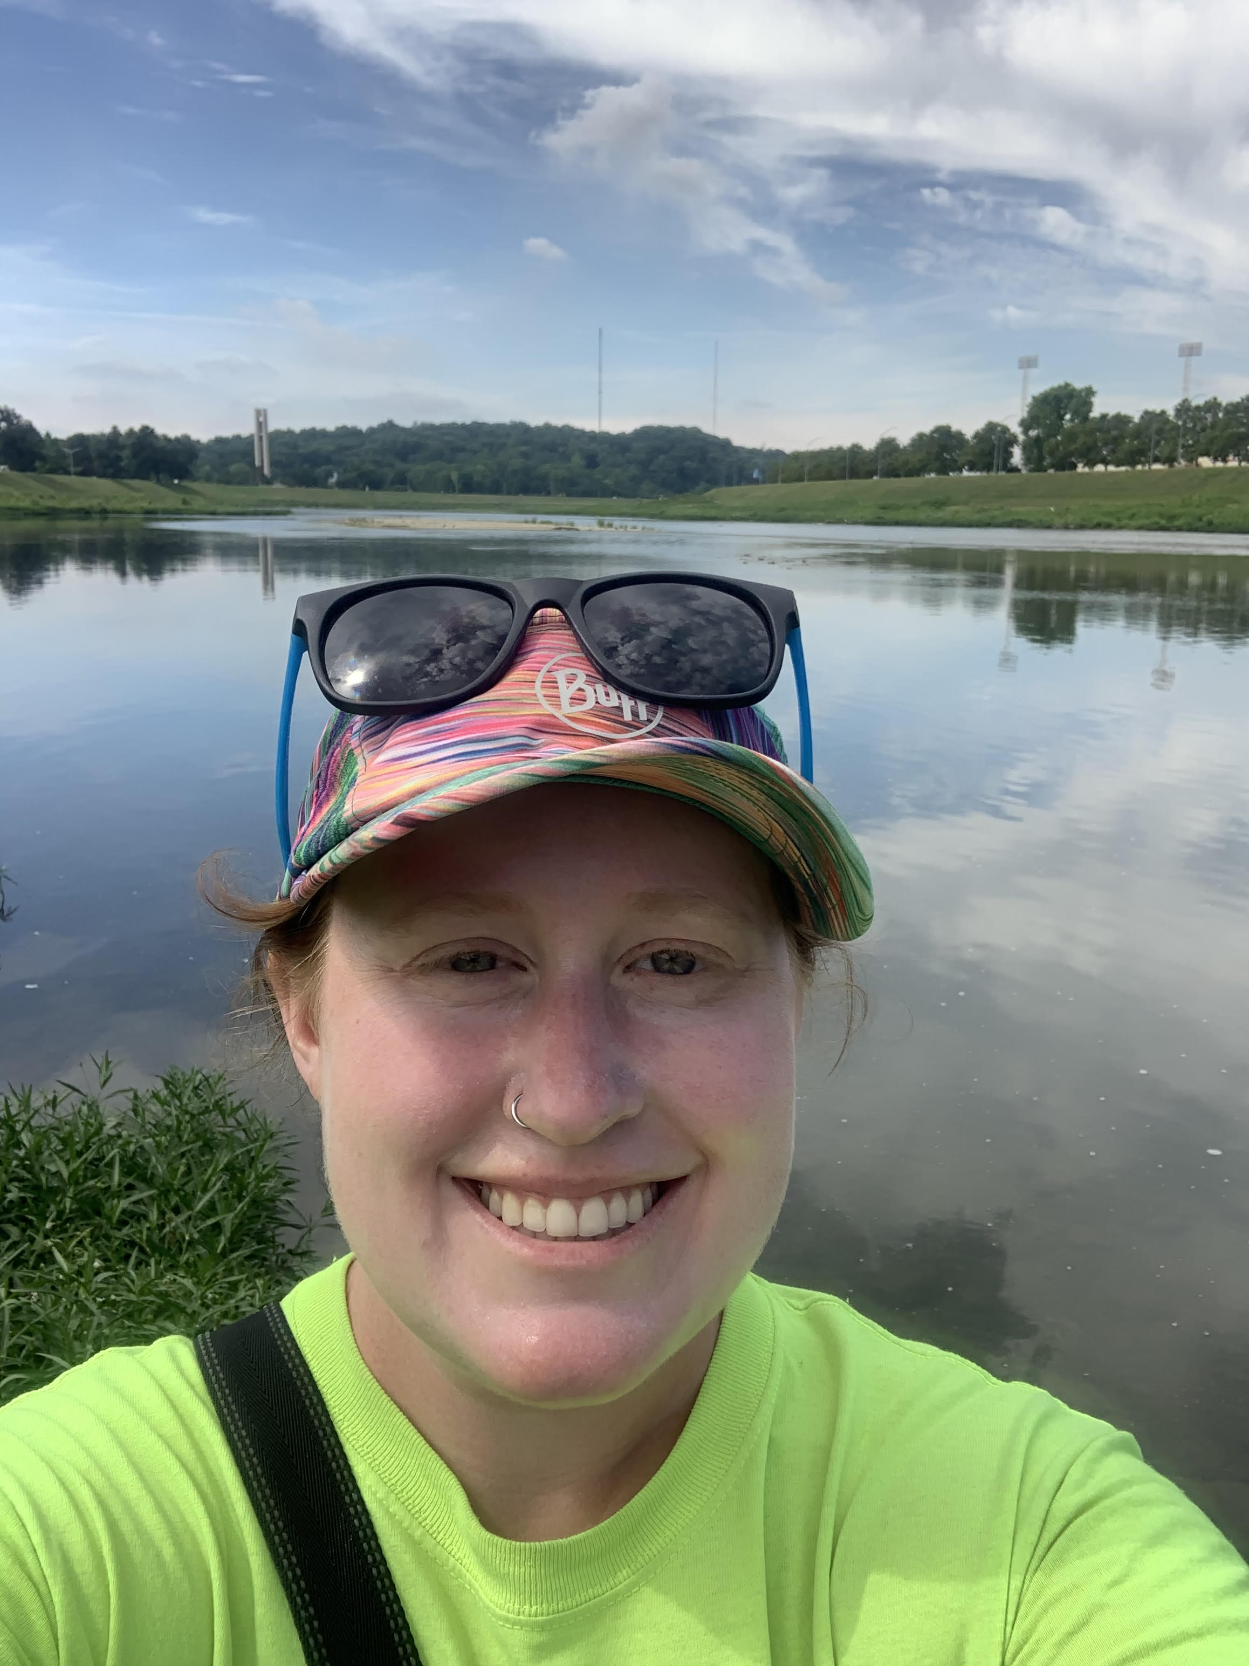
Introduction
Katie Norris
Environmental Scientist
City of Dayton, Dept of Water, Division of Environmental Mgmt
Stormwater compliance for the City of Dayton
12 years

Slide 3
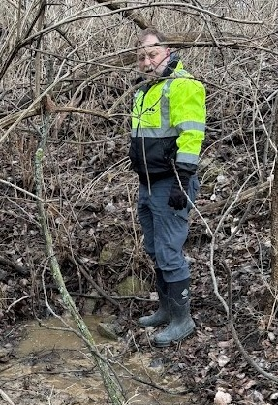
Introduction
Todd Haggard
Sr. Environmental Specialist
Sampling technician, stormwater inspector, to IDDE program lead
13 years

Slide 4
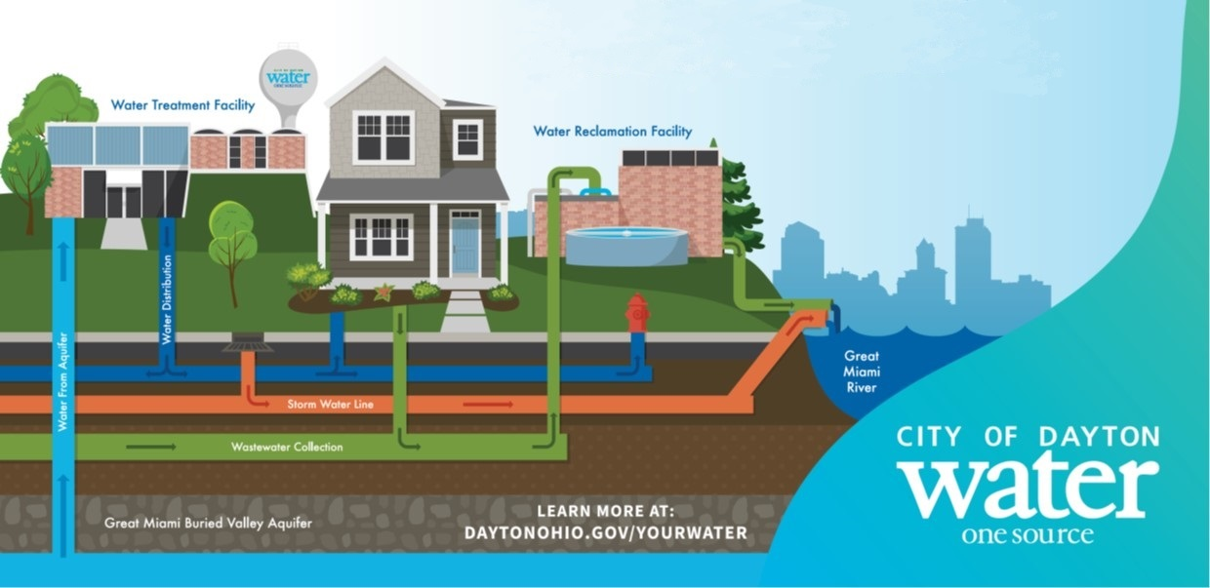
Dayton, Ohio
56.96 square miles
Population: 137,644
Phase I MS4
NPDES Permit
462 Outfalls

Slide 5


Toledo, Ohio
80.49 square miles of land
3.43 square miles of water
84.12 total
Population: 265,638
462 Outfalls

Slide 6
Permits Requirements
Comprehensive Map
Home Sewage Treatment System
IDDE ordinance and enforcement
Training
Complaints
Program with plan to detect, track, and eliminate
  Dry weather screening
  Prioritization
  Evaluation of program and goals
Phase II has the same requirements

Slide 7
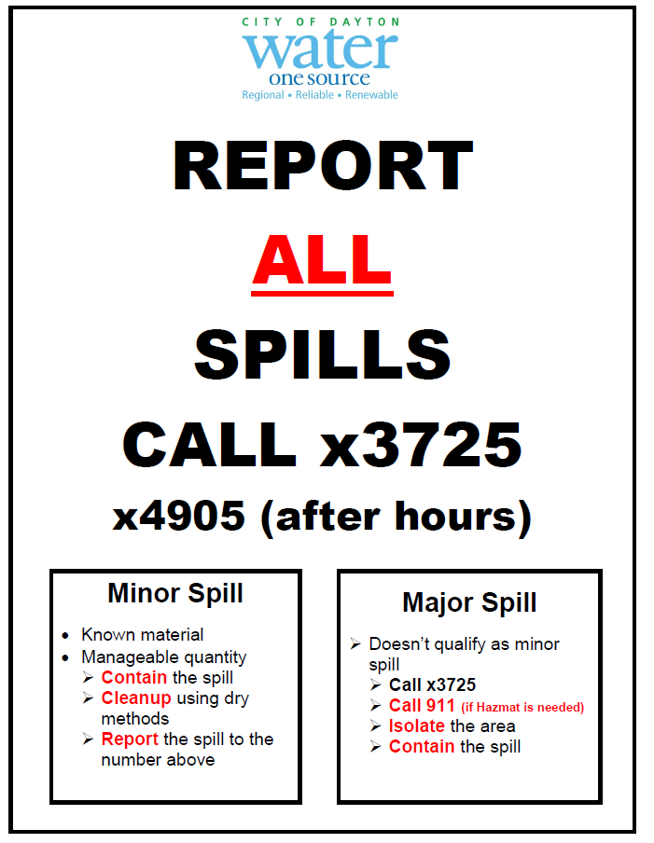
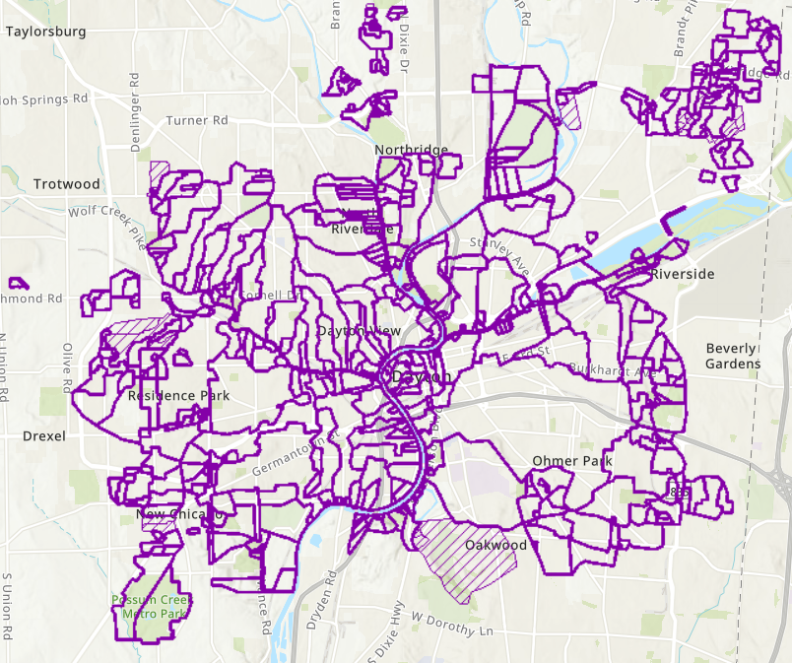
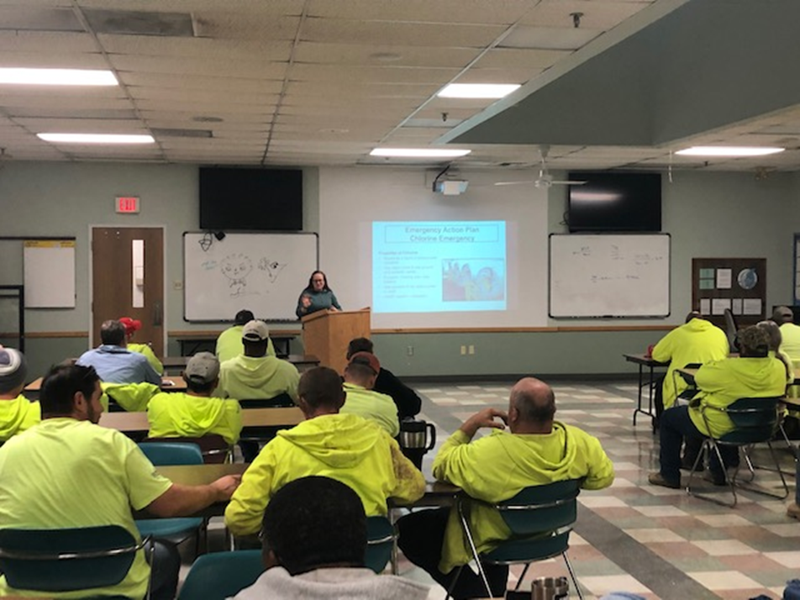
Dayton Phase I MS4 IDDE
Permit Requirements
462 Outfalls
Notes:
Permit Requirements
Comprehensive Map
HSTS
IDDE ordinance and enforcement
Training, Complaints
Program with plan to detect, track, and eliminate
Dry weather screening
Prioritization
Evaluation of program and goals

Slide 8
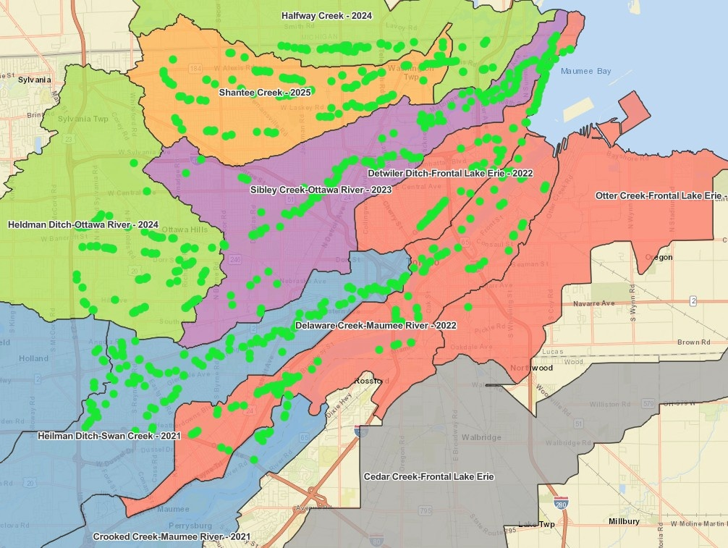
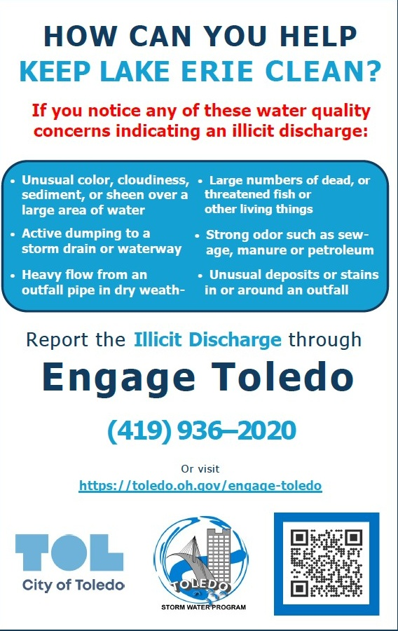
Toledo Phase I MS4 IDDE
Permit requirements
See something, say something!
858 Outfalls

Slide 9
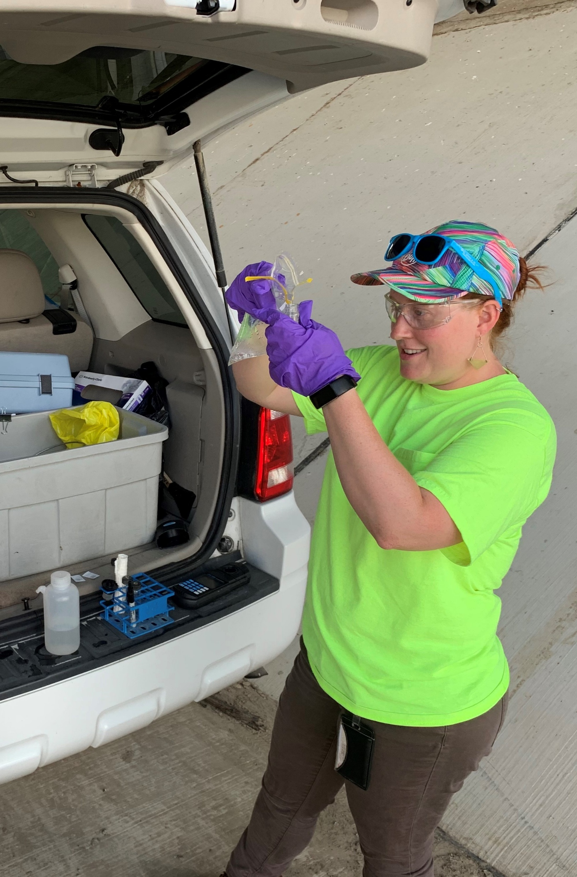
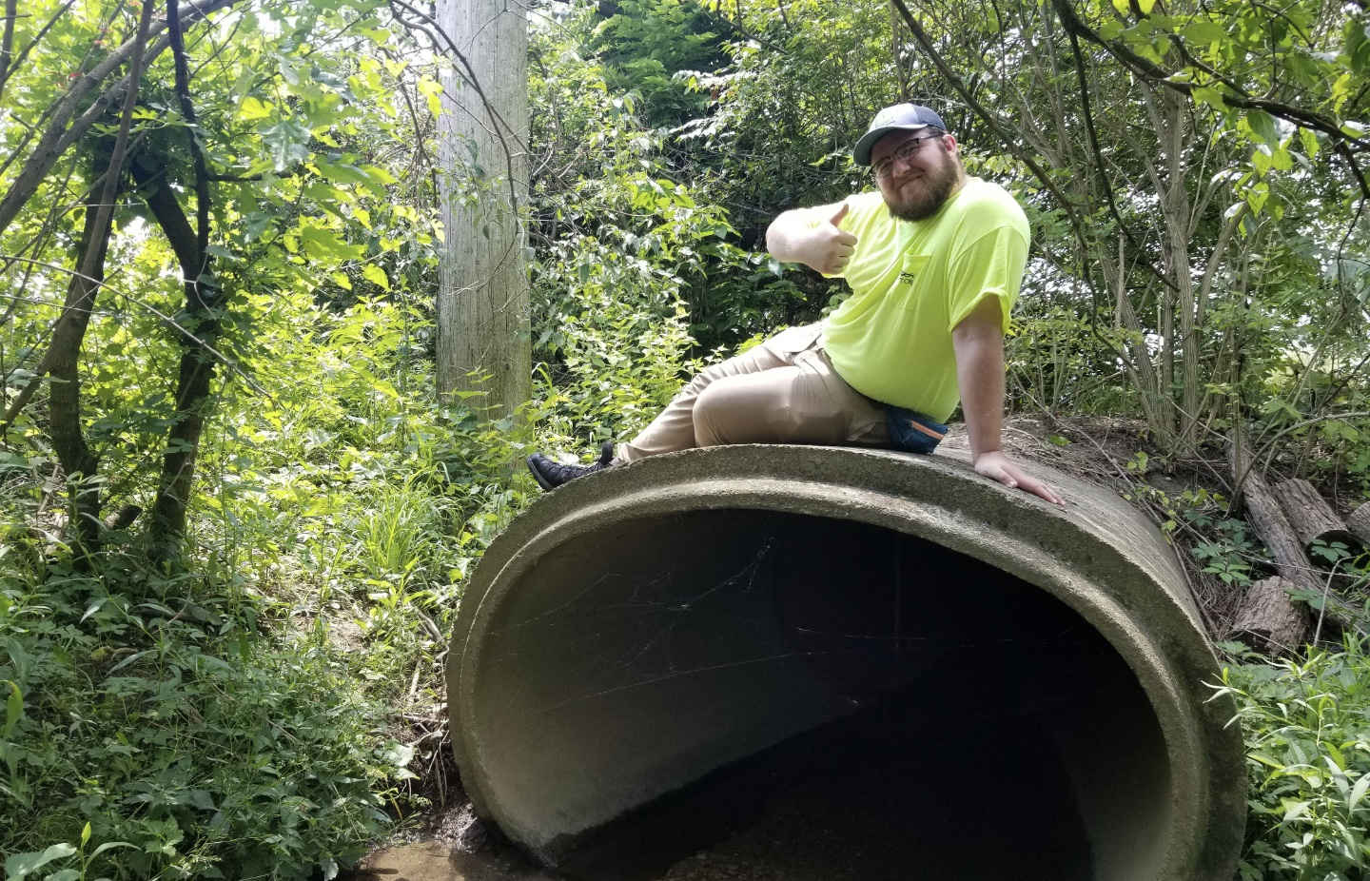
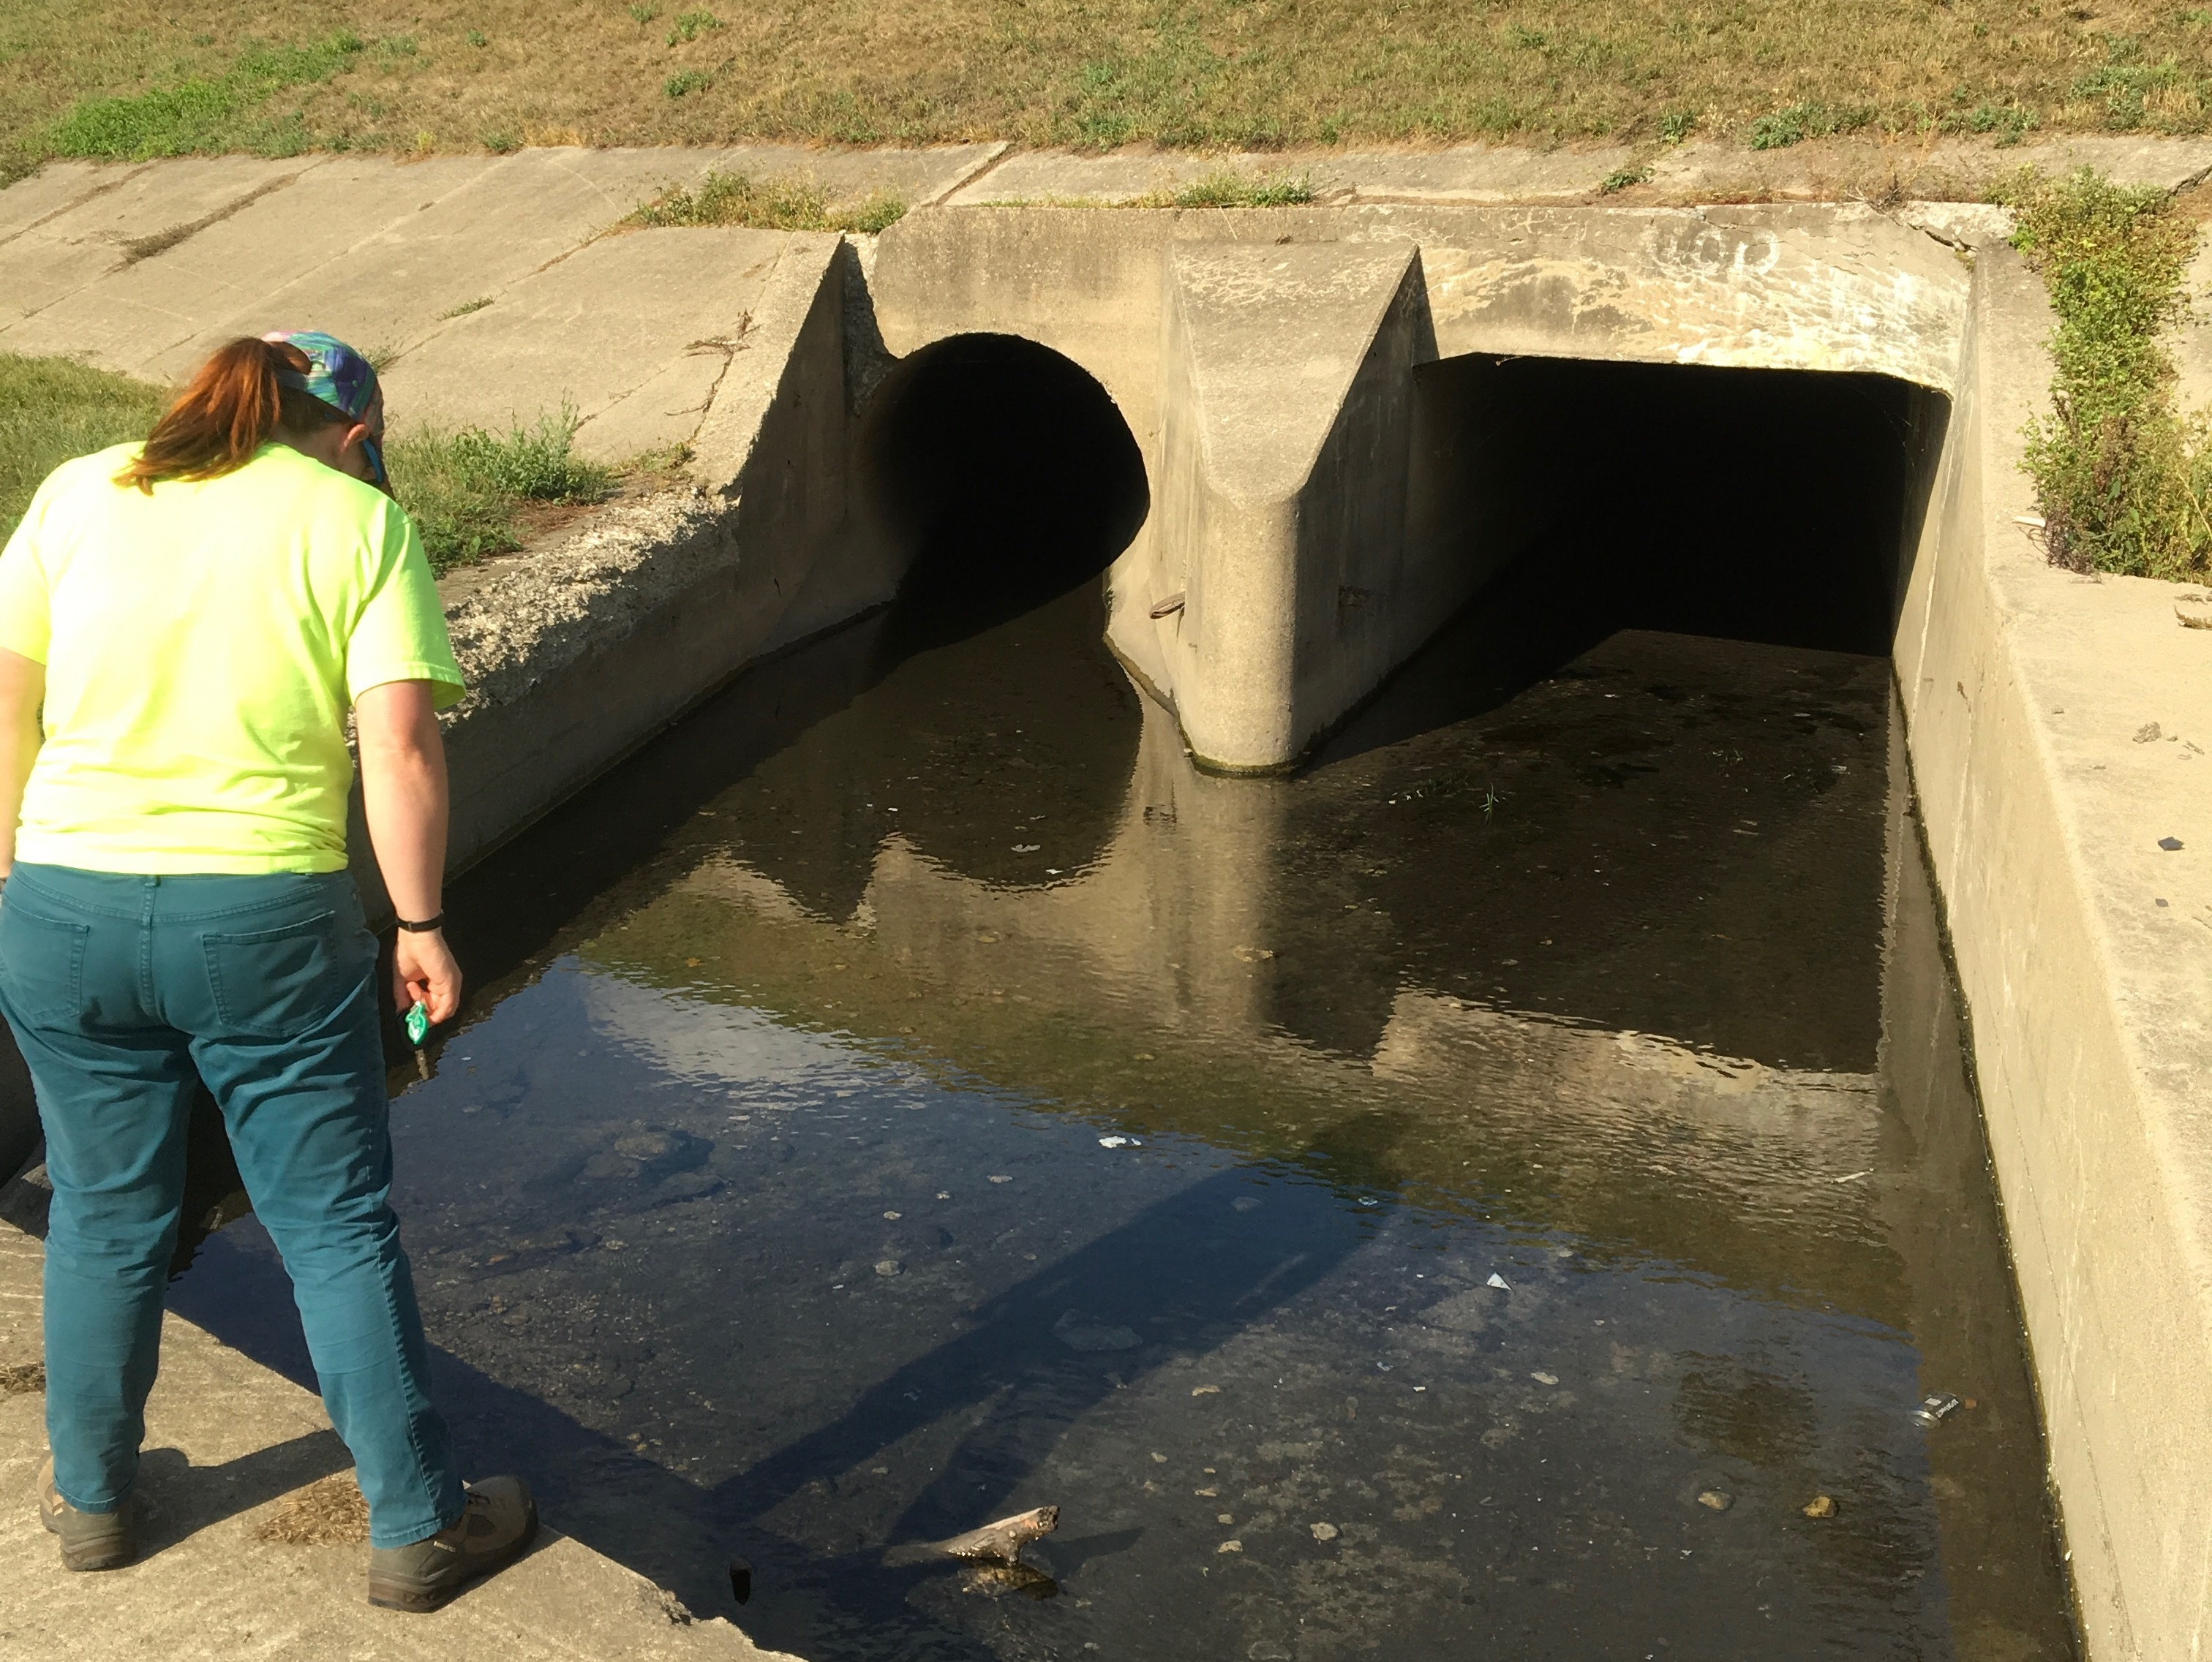
Dayton Sample and Data Collection

Slide 10
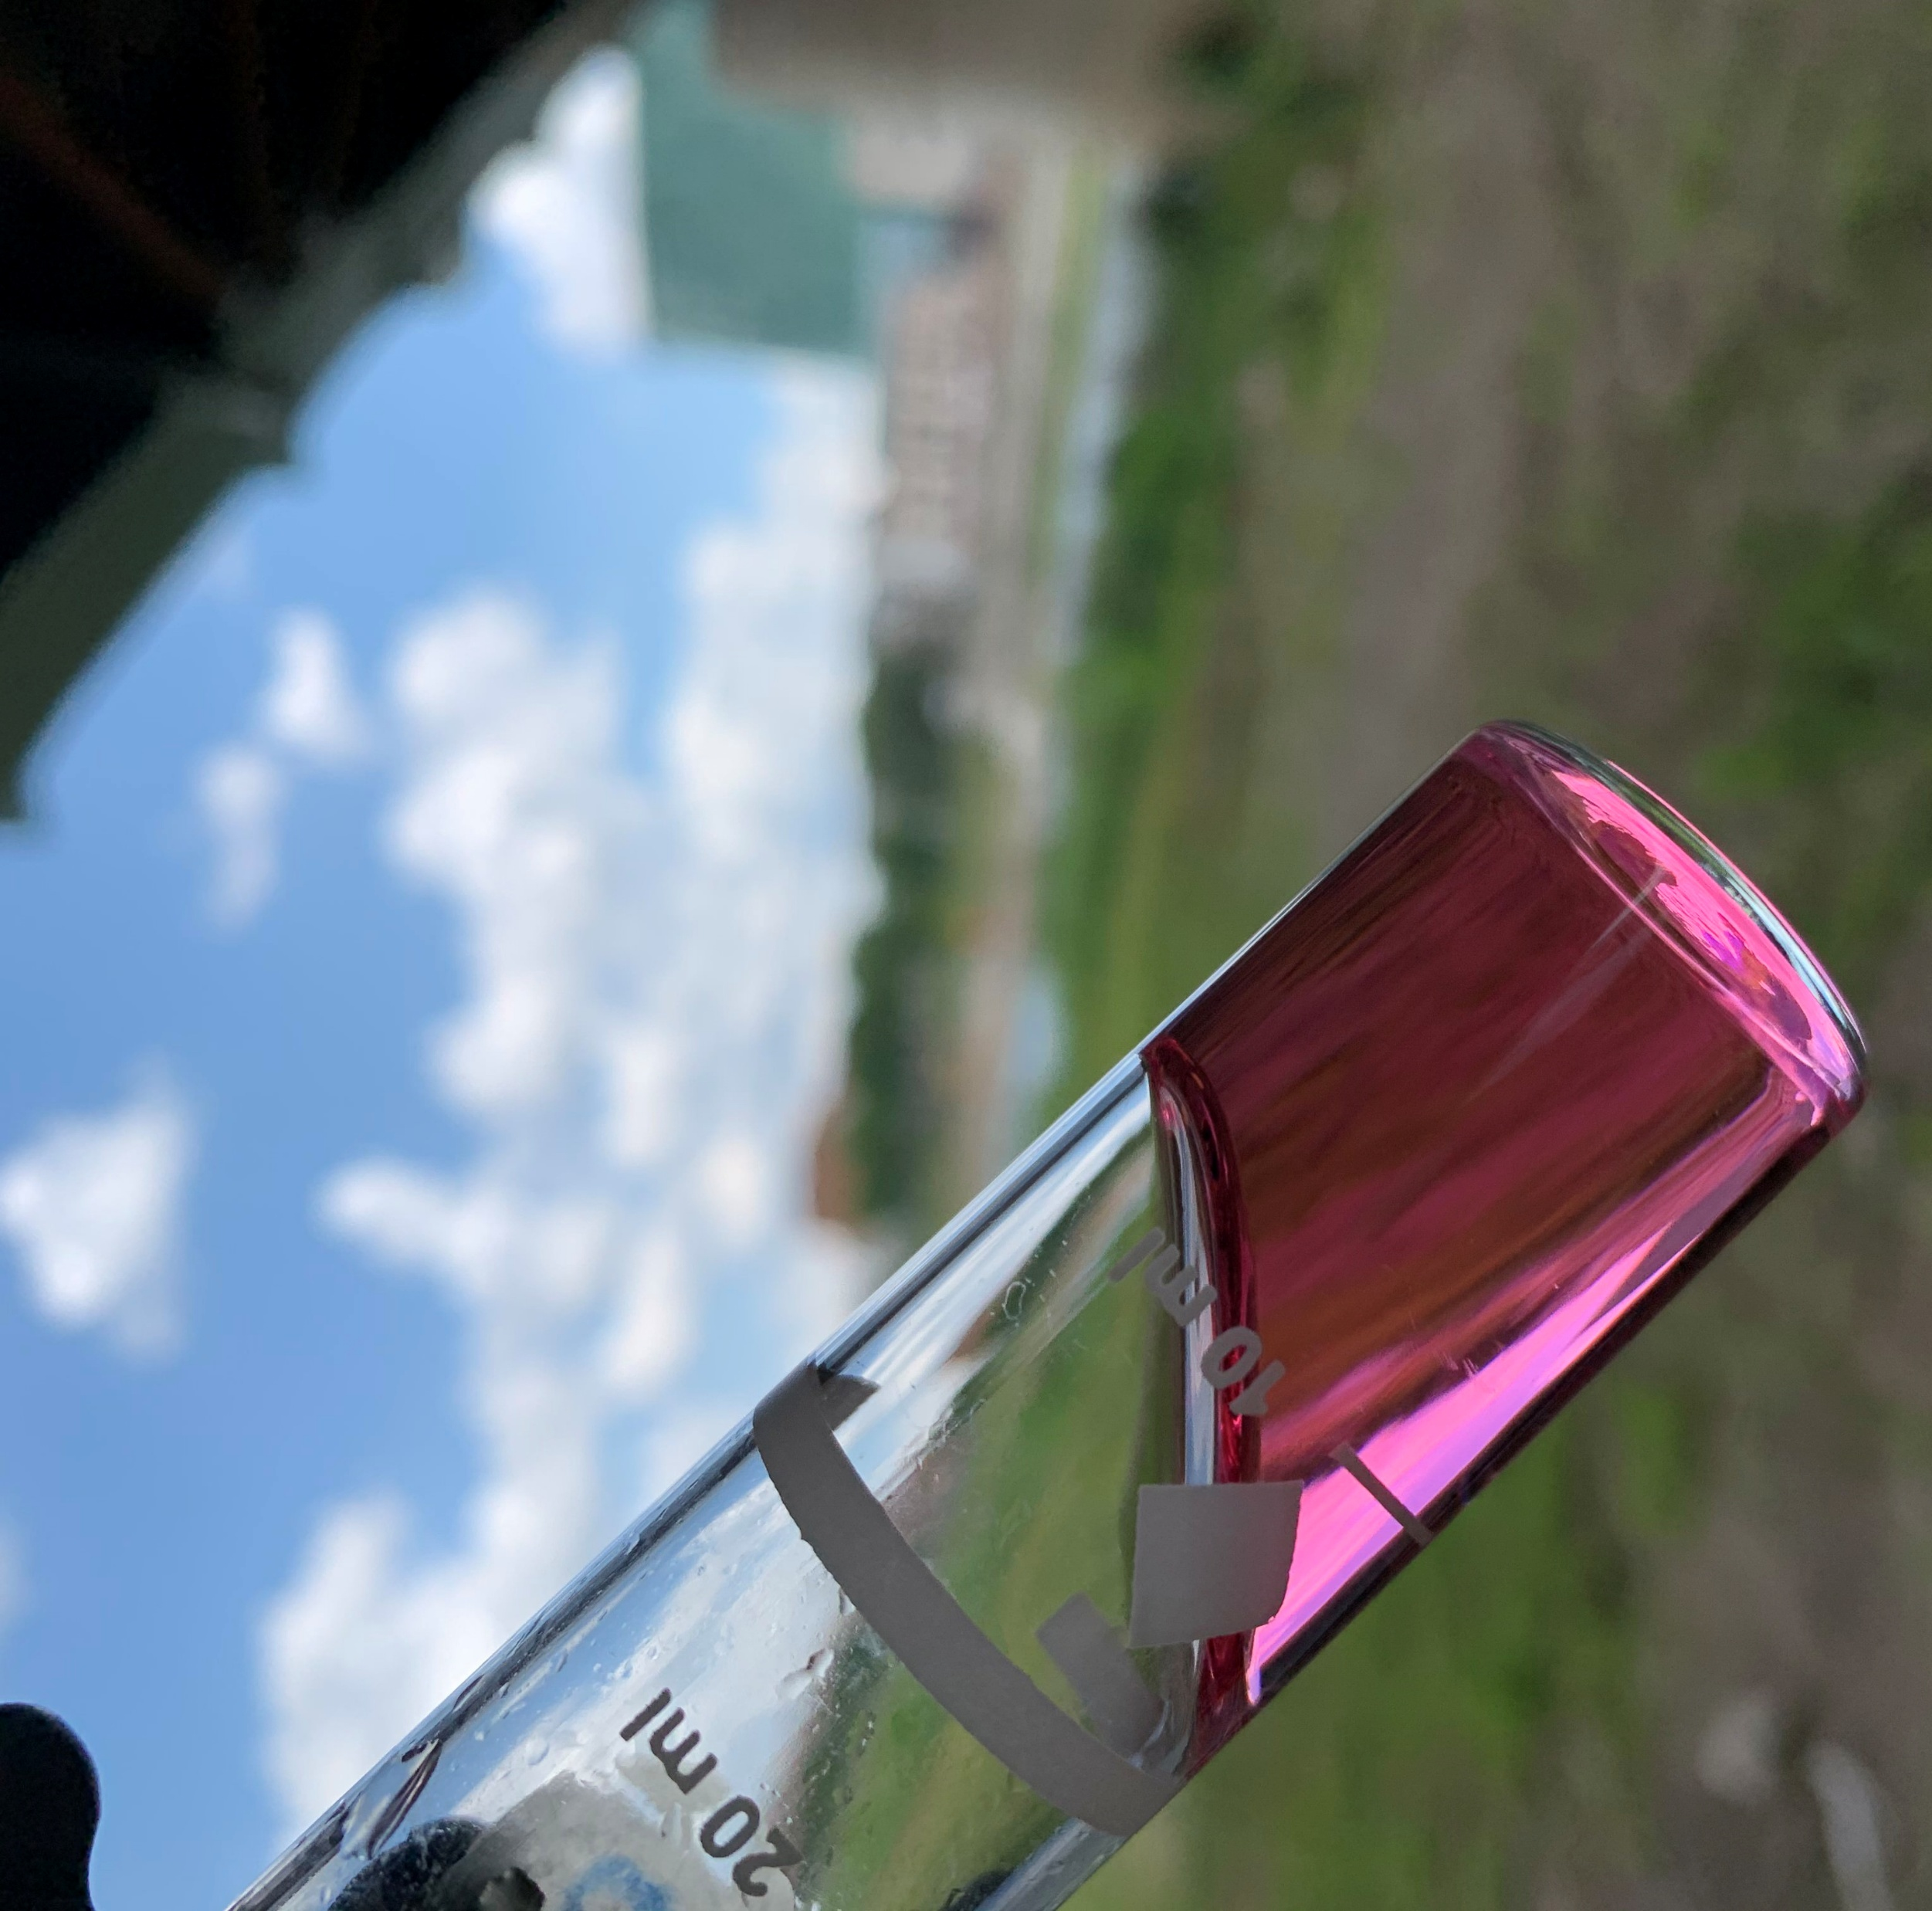
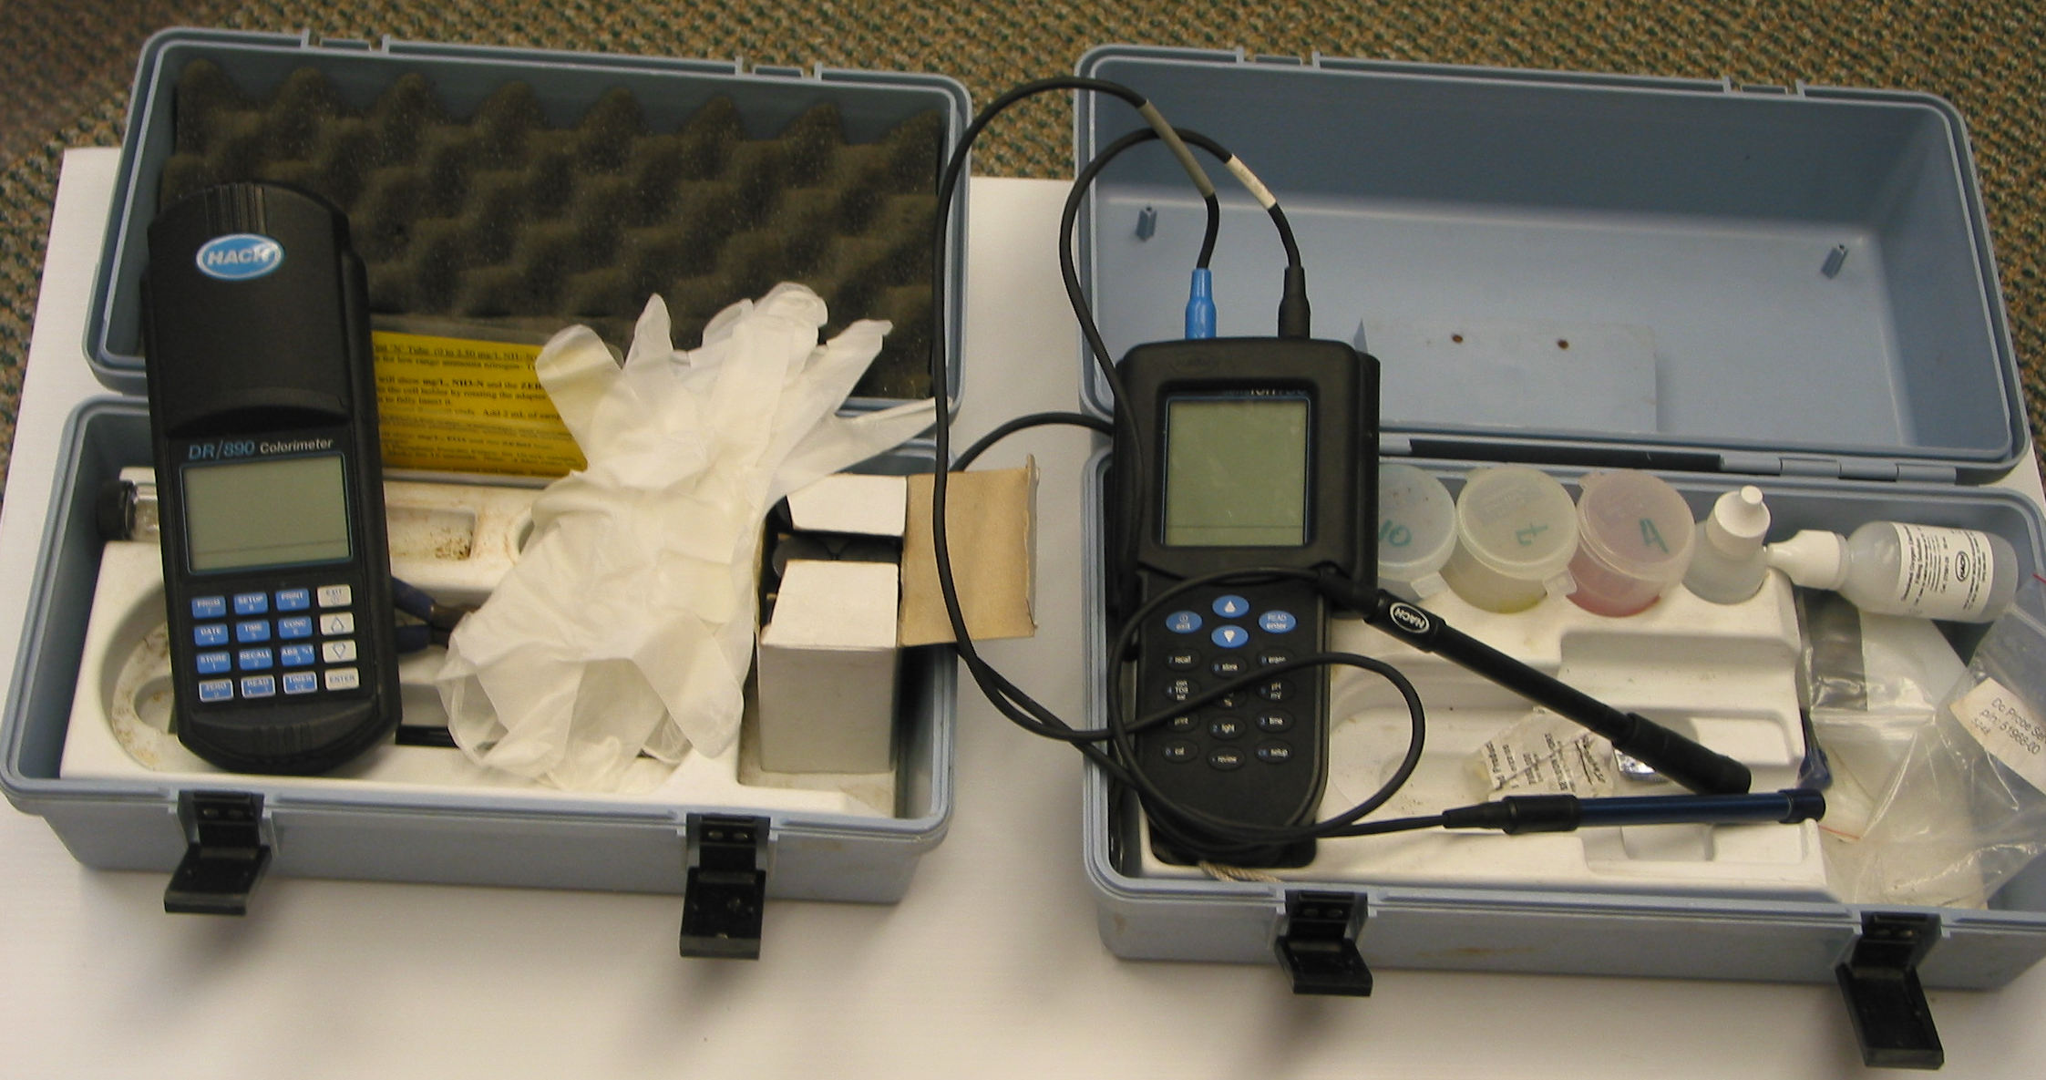
Dayton Action Levels for Parameters
Field Parameters
pH outside 6.9-8.5 range
Dissolved Oxygen < 5mg/L
Nitrate > 10mg/L
Ammonia > 0.3mg/L
Orthophosphate > 0.3mg/L
Total Chlorine > 0.5mg/L
Temperature – no action level
Lab Parameters (if needed)
Fecal > 200 CFU/100mL
eColi > 10,000 CFU
Fluoride >0.8mg/L
Hardness > 285mg/L
Surfactants >0.2mg/L

Slide 11
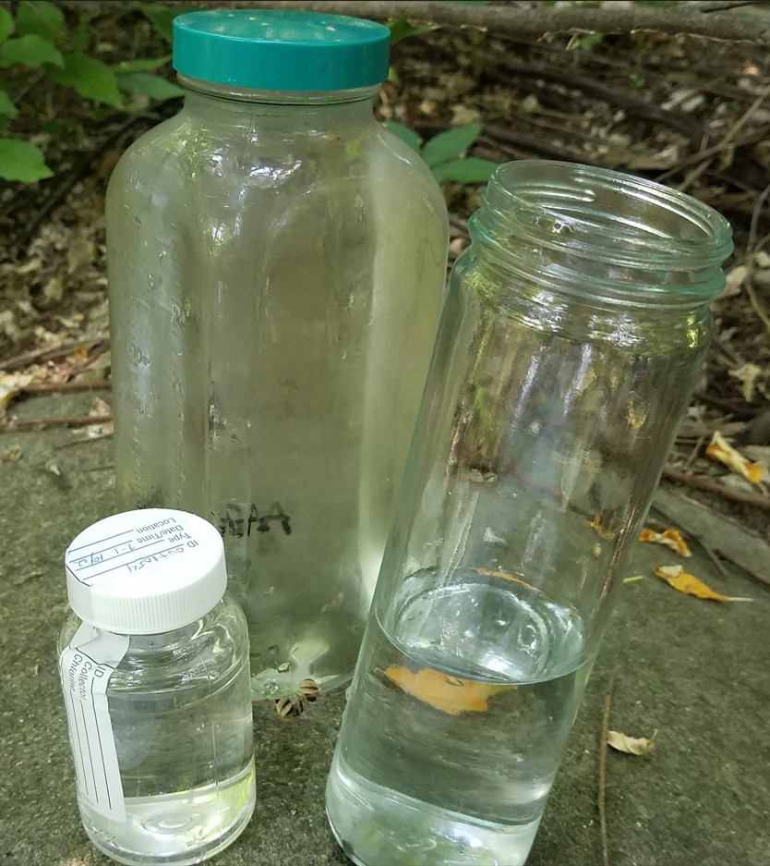
Toledo Sampling and Data Collection
Field Parameters:
  Oakton Env. Express- temperature, pH, conductivity,
  Hach Flow meter- flow in GPD
  Hanna kit- Chlorine
One Liter sample: flouride, hardness, ammonia, detergents and phosphorus (in house lab)
Bacteria sample: total coliform and E.Coli (Water Treatment lab)

Slide 12
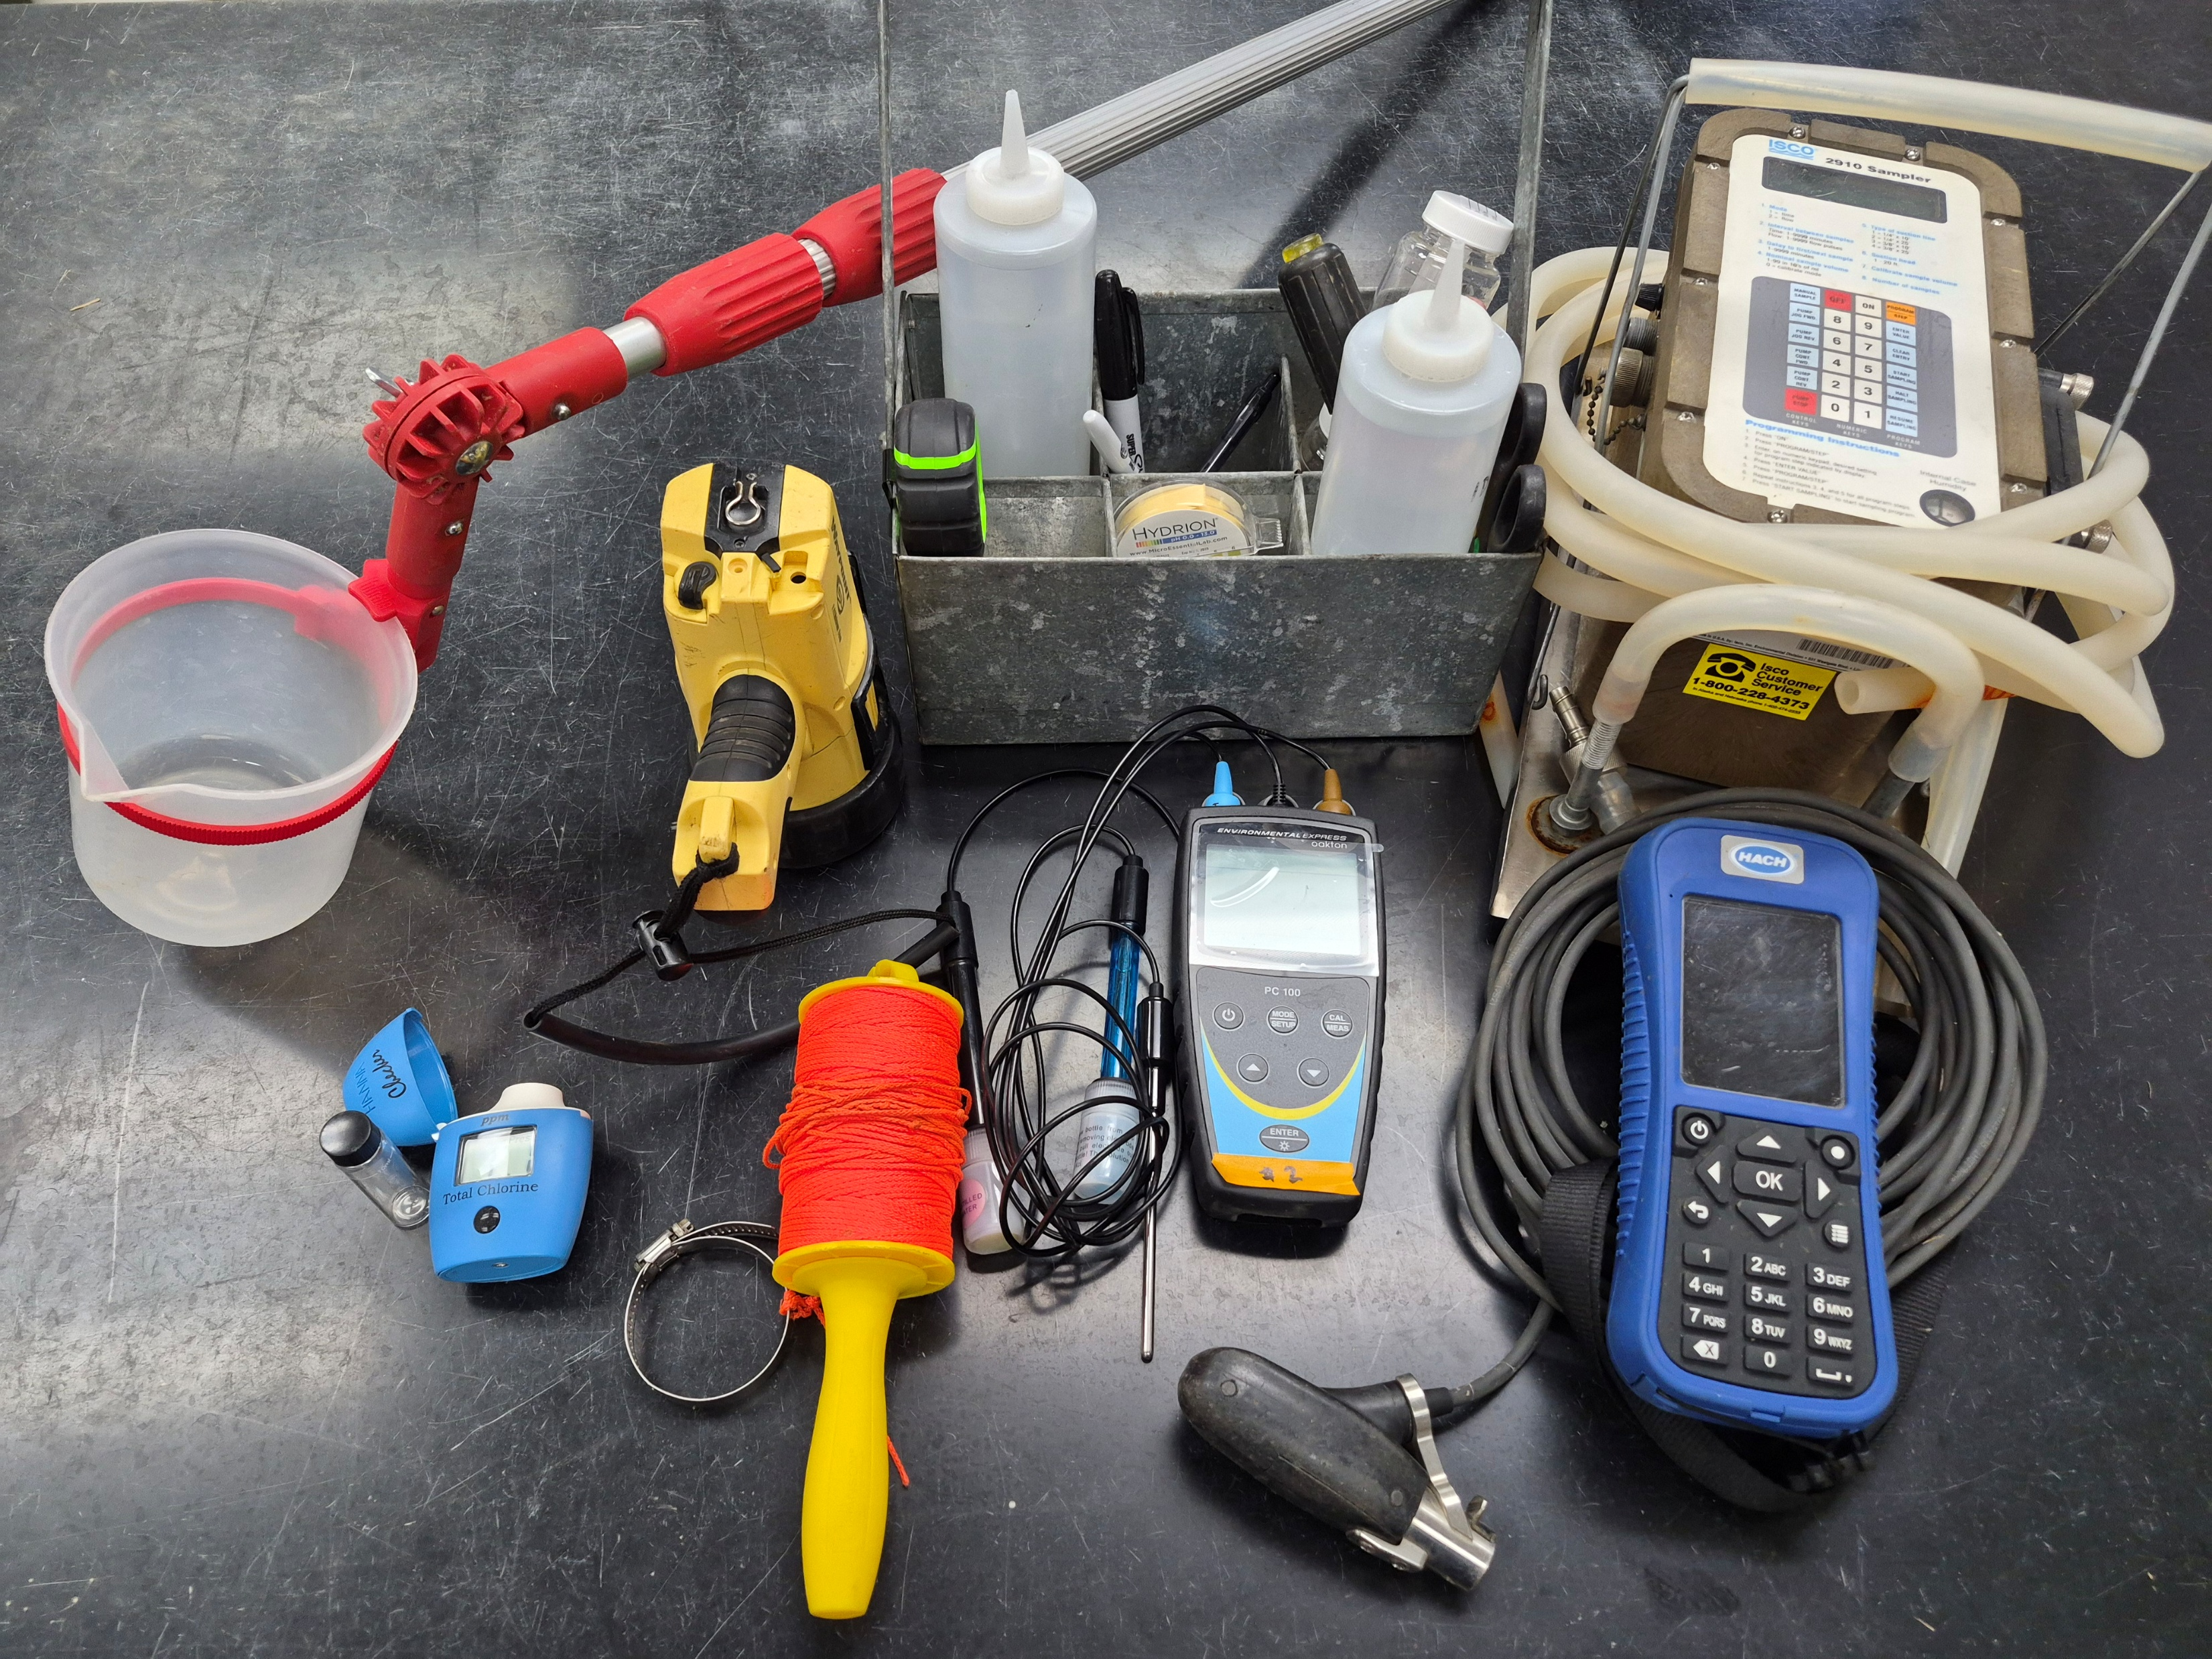
Toledo Sampling Equipment

Slide 13
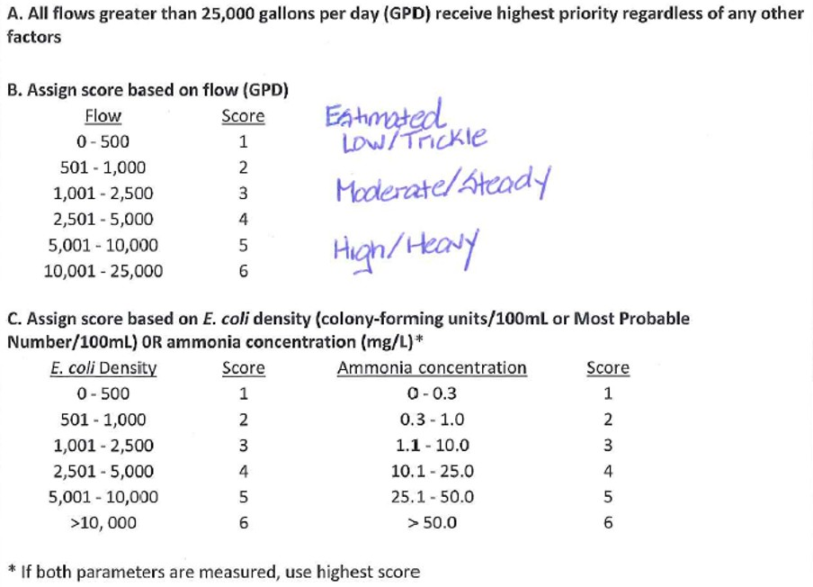
Toledo Prioritization

Slide 14
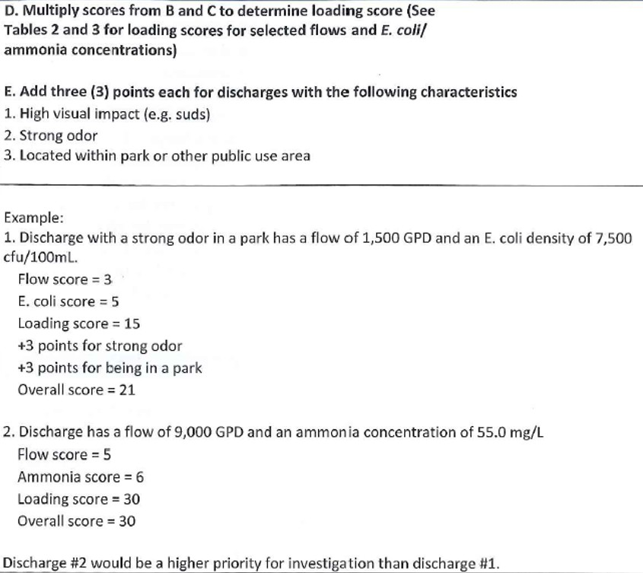
Toledo Prioritization

Slide 15
Phase II Example: Warren County SWCD
The 72 Hr. Rainfall map, from the National Weather Service
ESRI Fieldmaps
  inventory stormwater outfalls
  navigate to the outfalls
  enter inspection data and track inspections and flows
First inspection of the outfall
  turbidity tube to determine water color and clarity
  check for ammonia using the HACH wet chem method
YSI multi parameter probe to measure pH, conductivity, dissolved oxygen.
Coordinate with the Health Department for bacteria analysis (total coliforms and e. Coli).
Lessons learned/ improvements: Adding surfactant field test for 2026

Slide 16
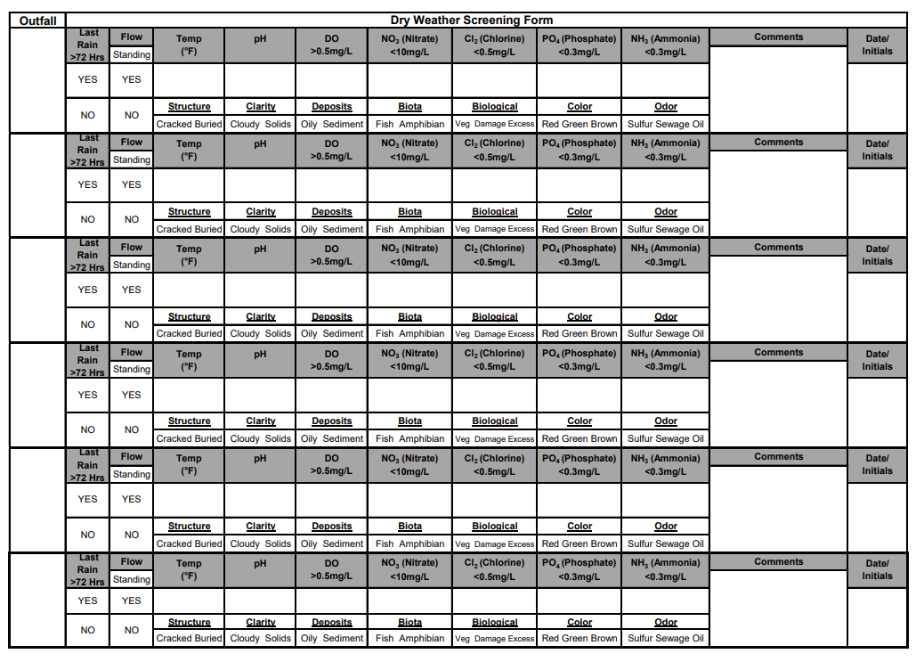
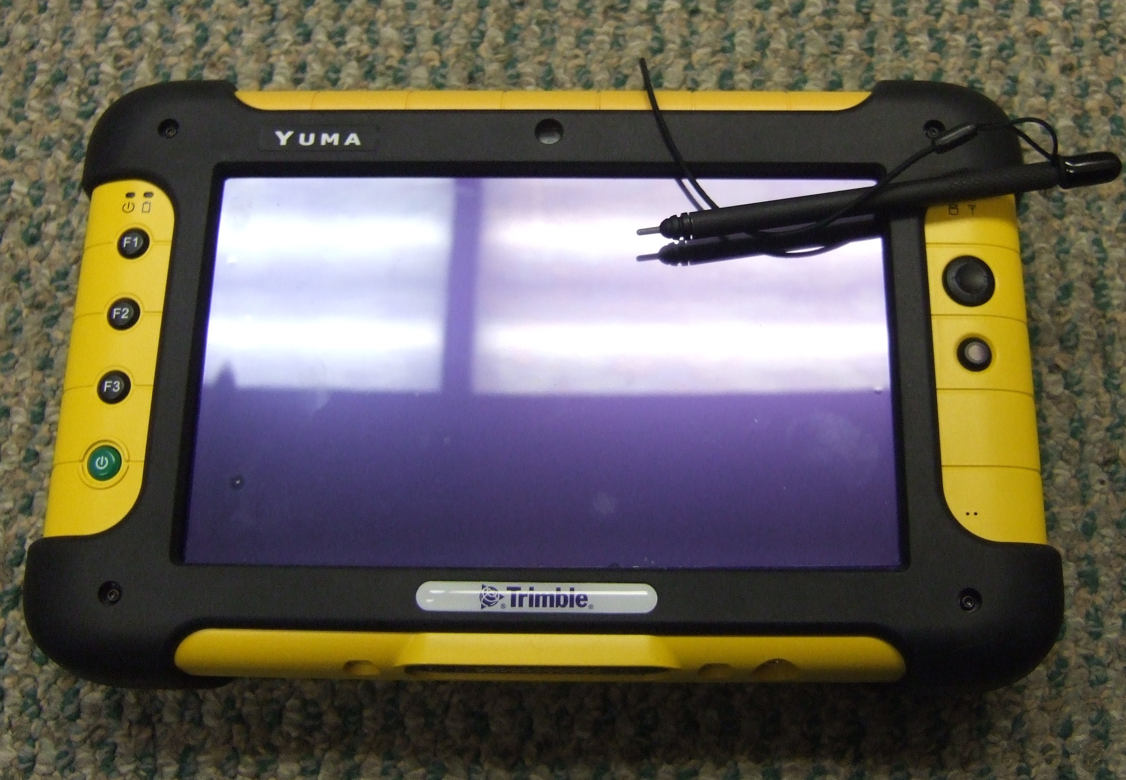
Dayton Before the Field Maps App

Slide 17
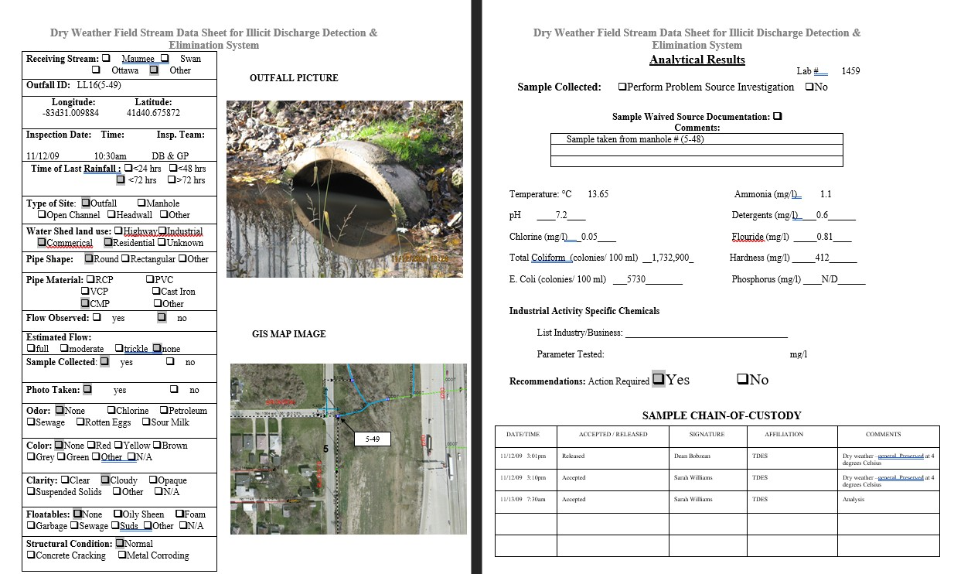
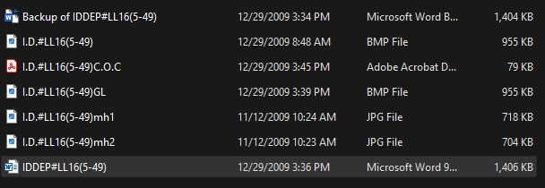
Toledo Before the Field Maps and Survey123

Slide 18

Dayton FieldMaps App Demo

Slide 19
Toledo Dry Weather Form/Survey 123
FieldMaps to locate outfall
Links to Survey123 inspection form
https://drive.google.com/file/d/1SMf--2aZ-nccCXFEMrnCuc5beVecSv1K/view?usp=drive_link

Slide 20
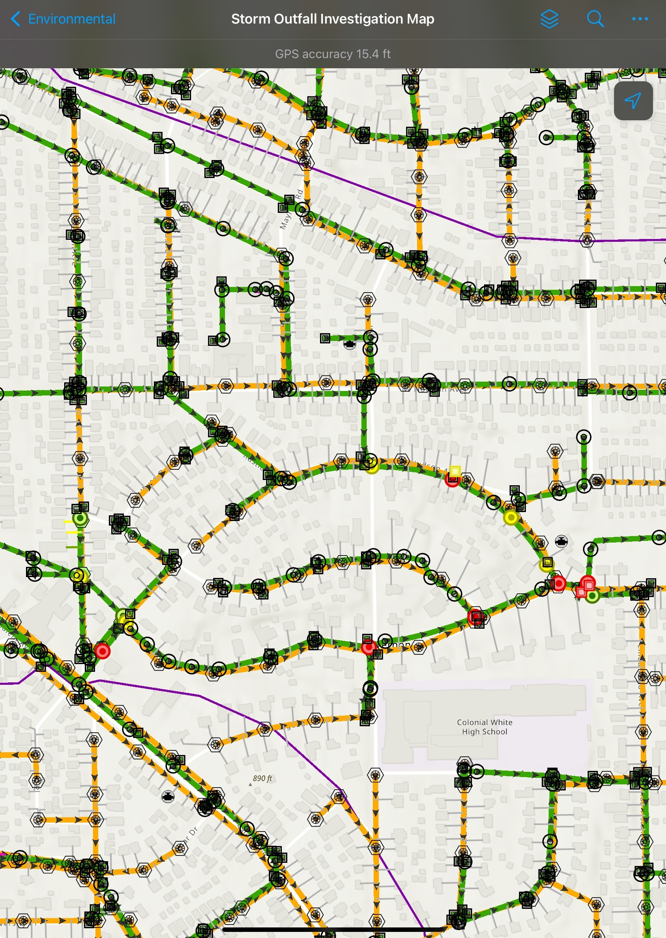
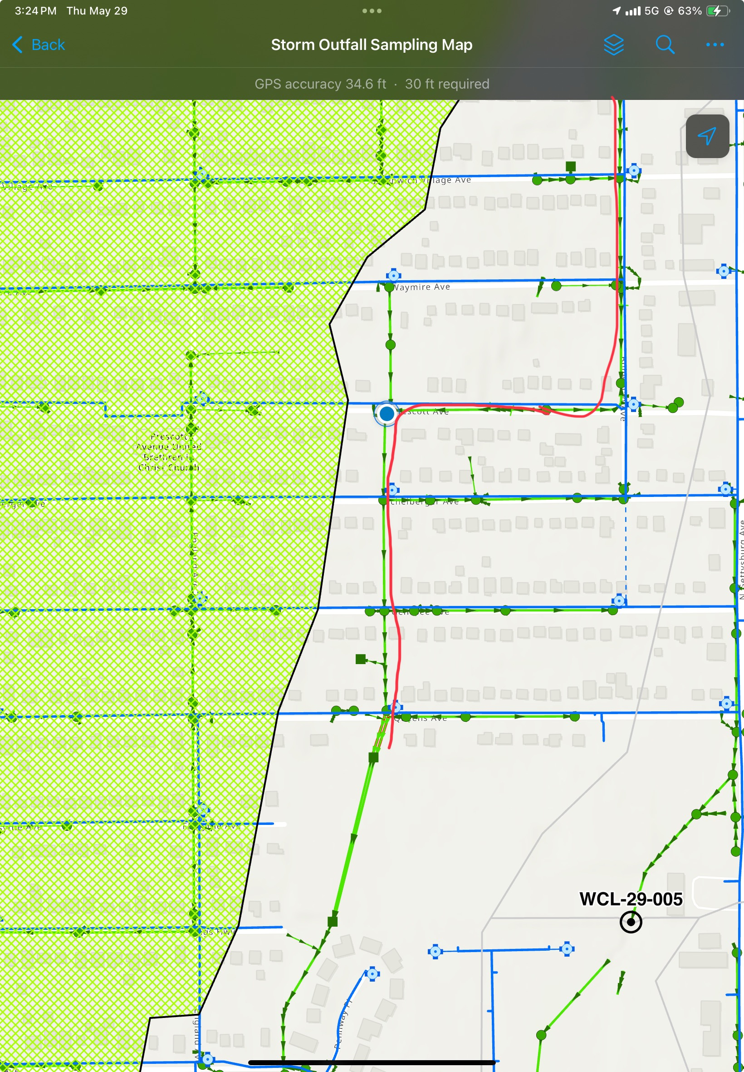
Dayton IDDE tracking

Slide 21
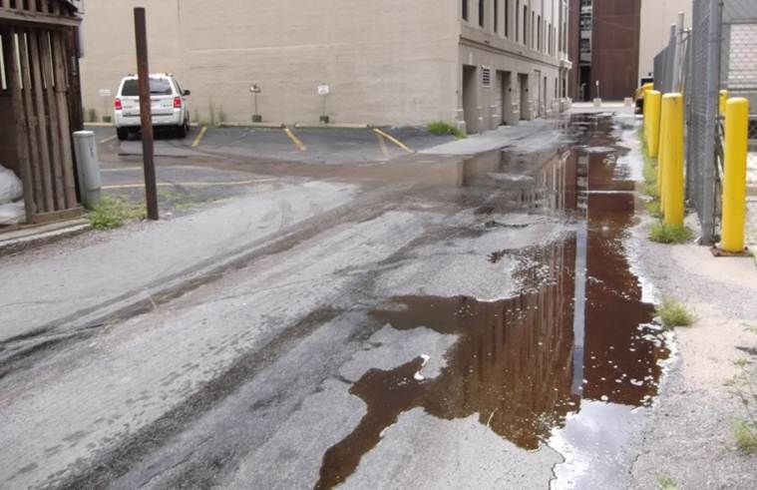
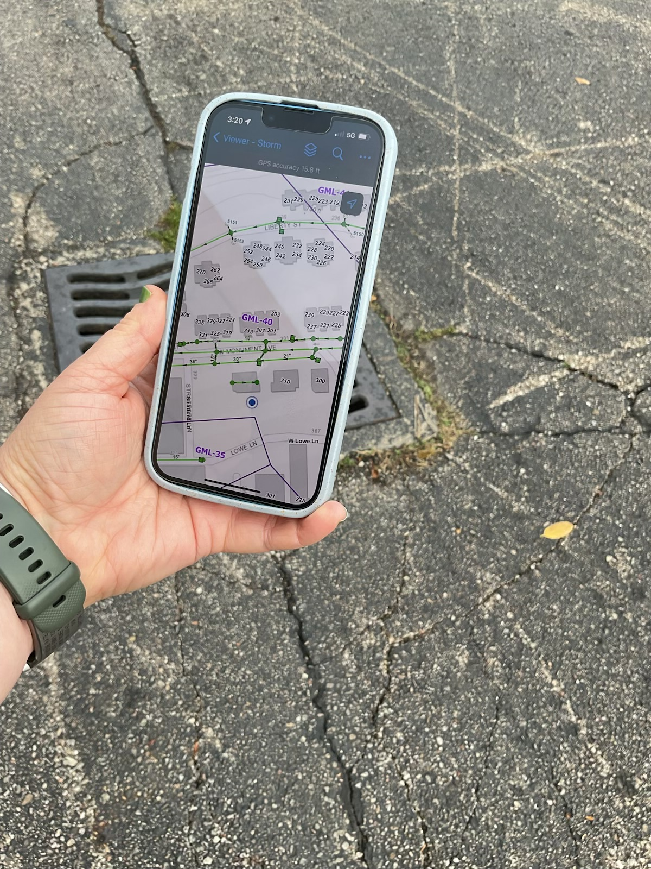
Also Used for Spill/Emergency Responses

Slide 22
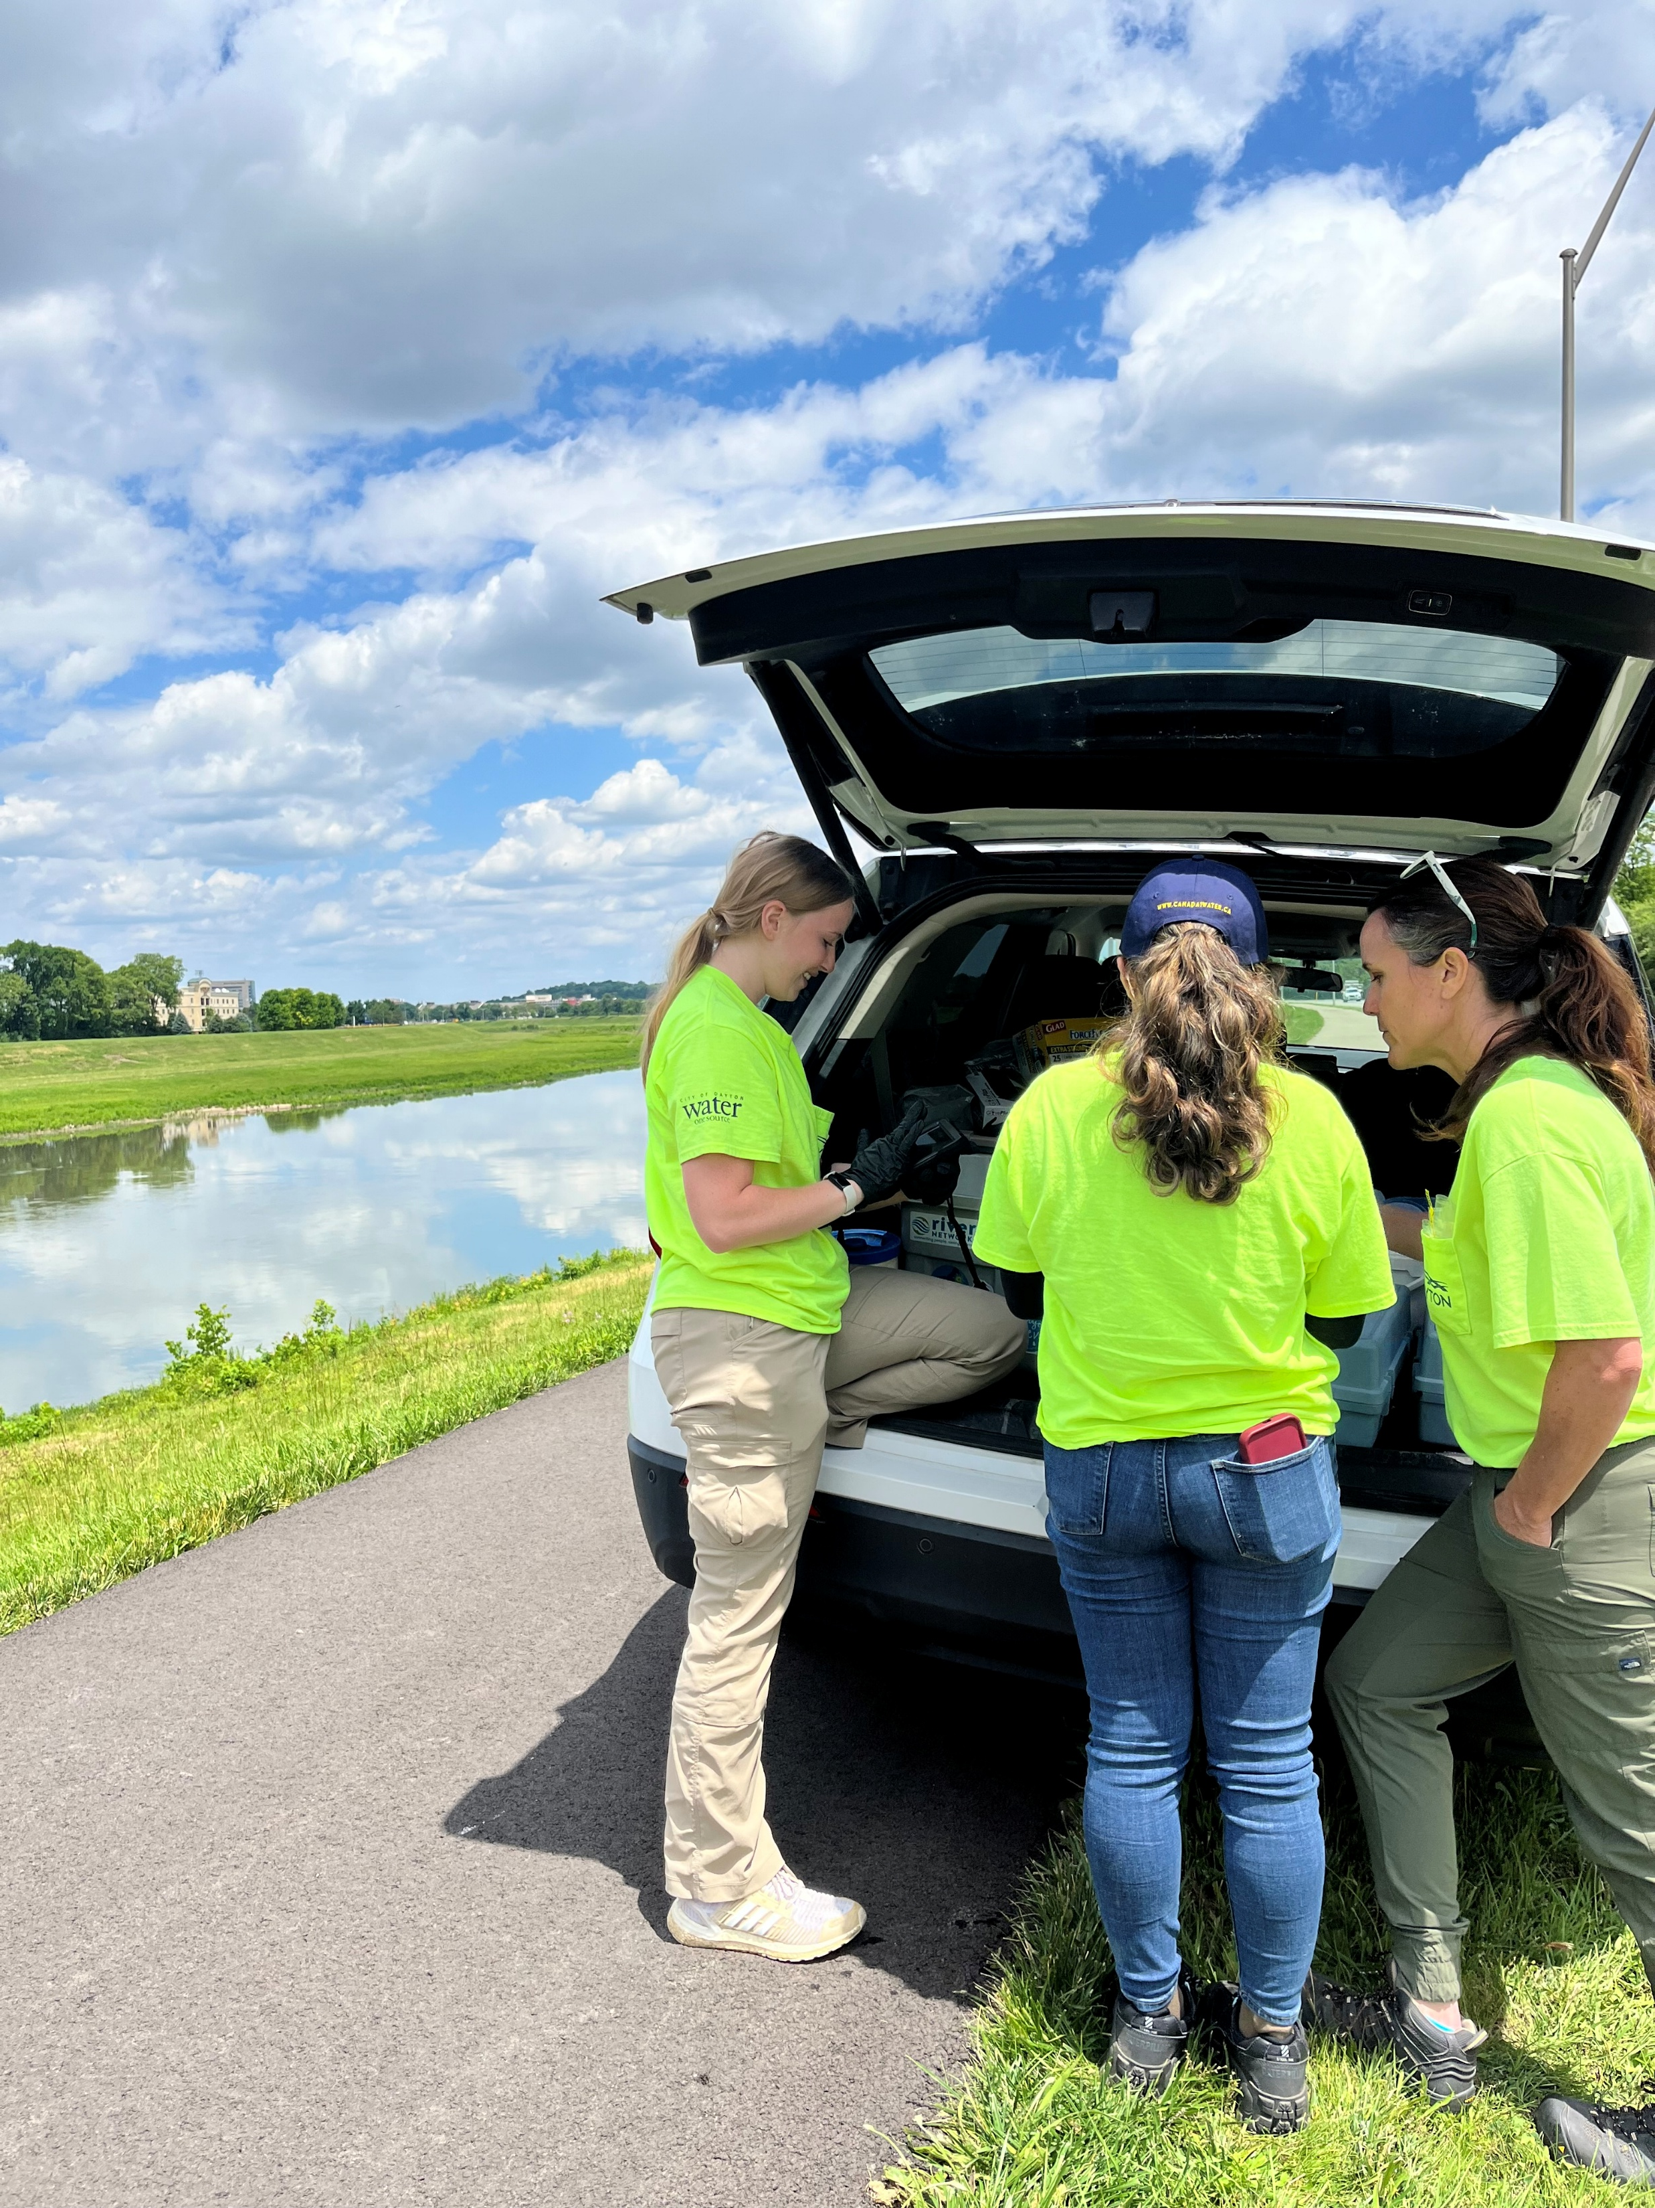
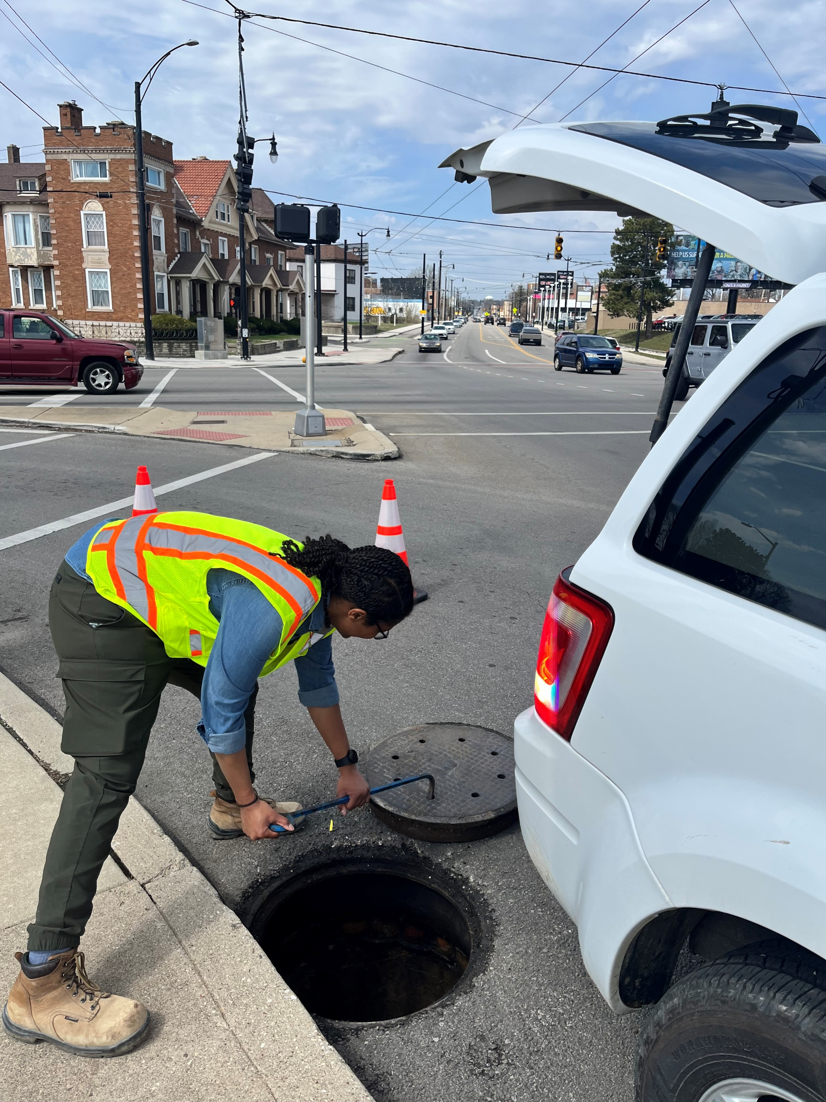
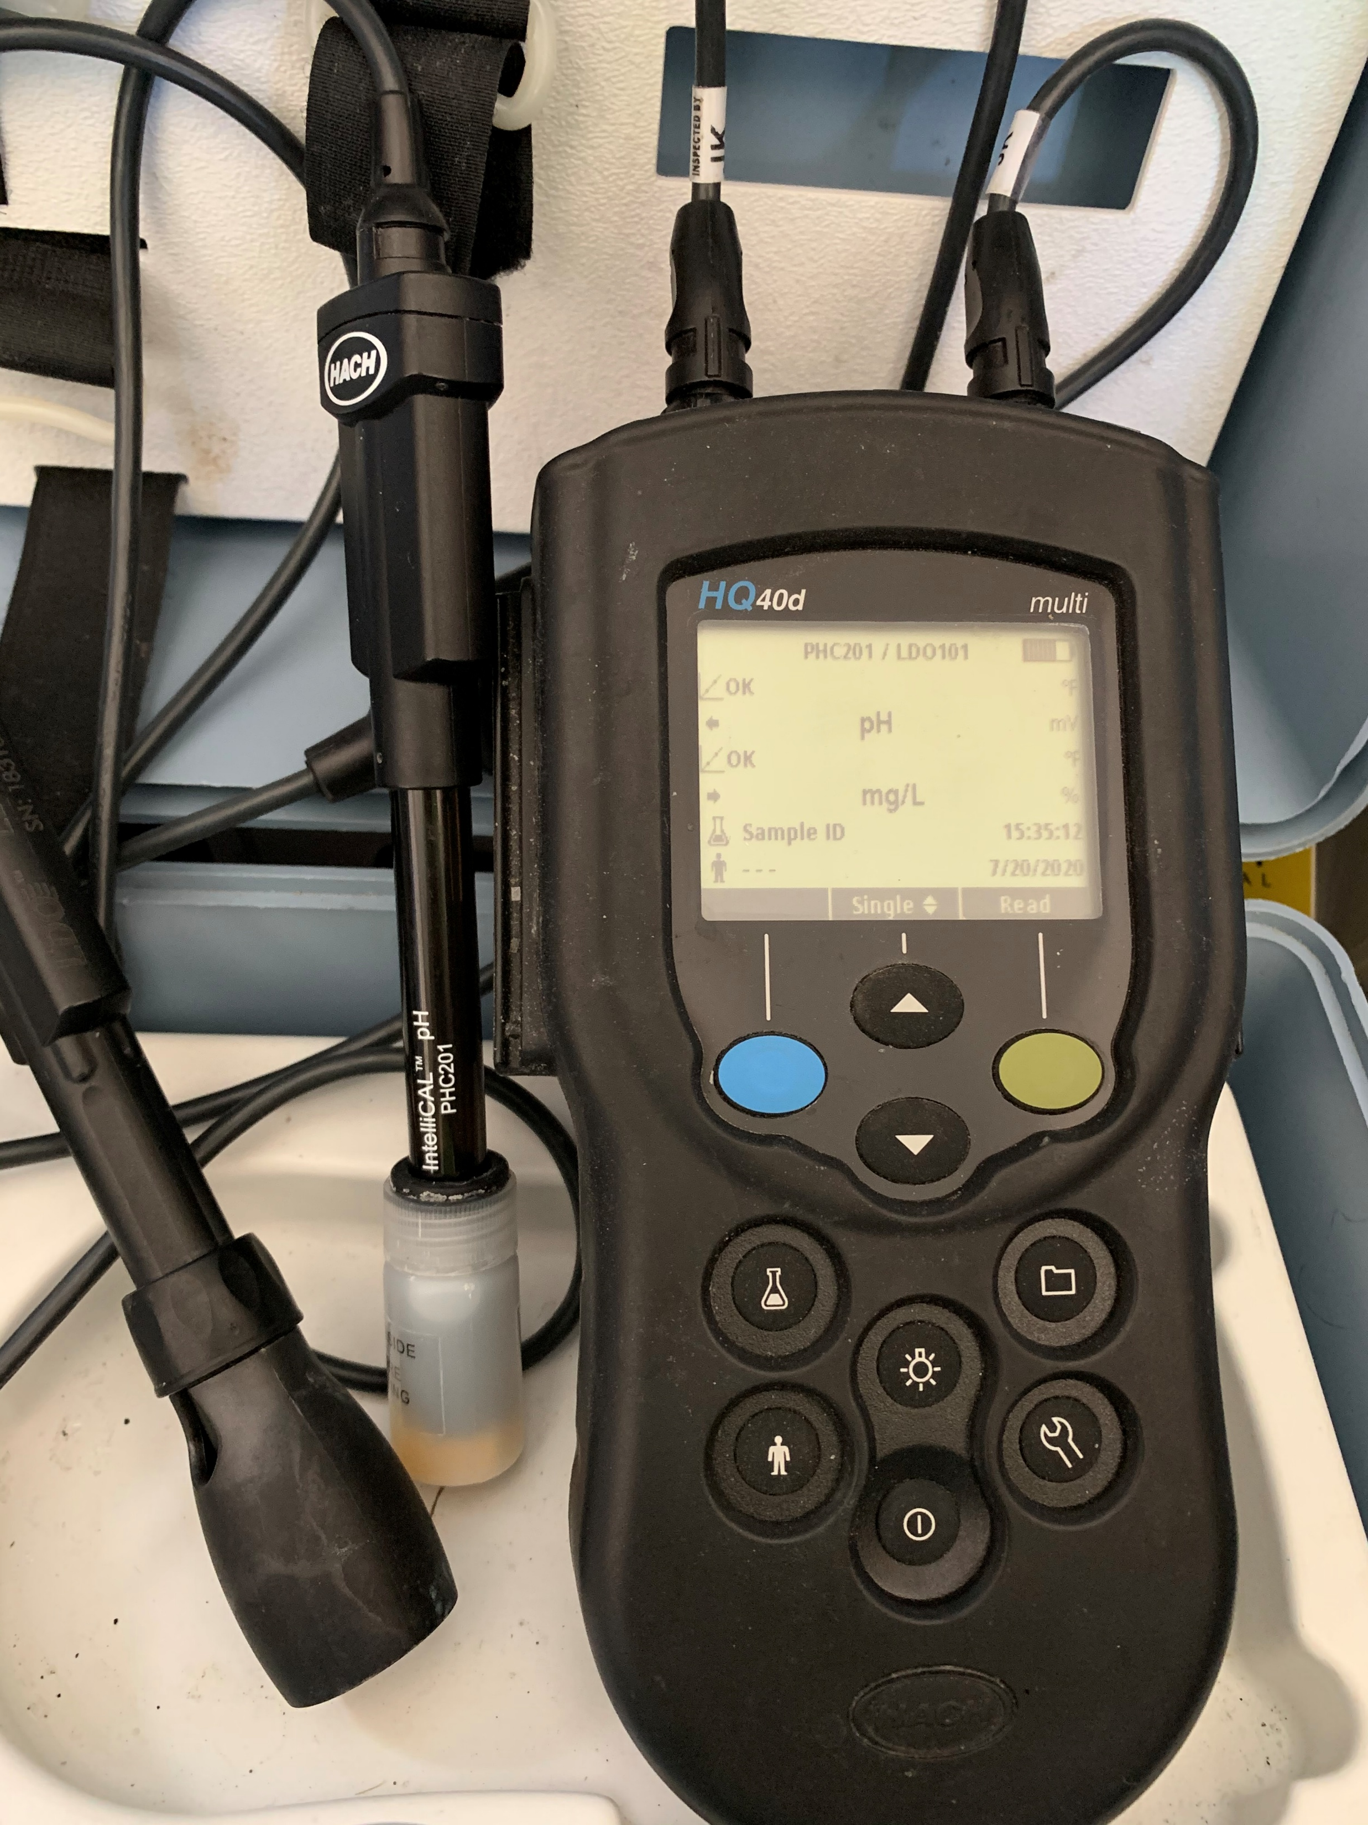
Tracking – How to LOOK effectively
Notes:
Manholes
Sampling
Facility Inspections

Slide 23
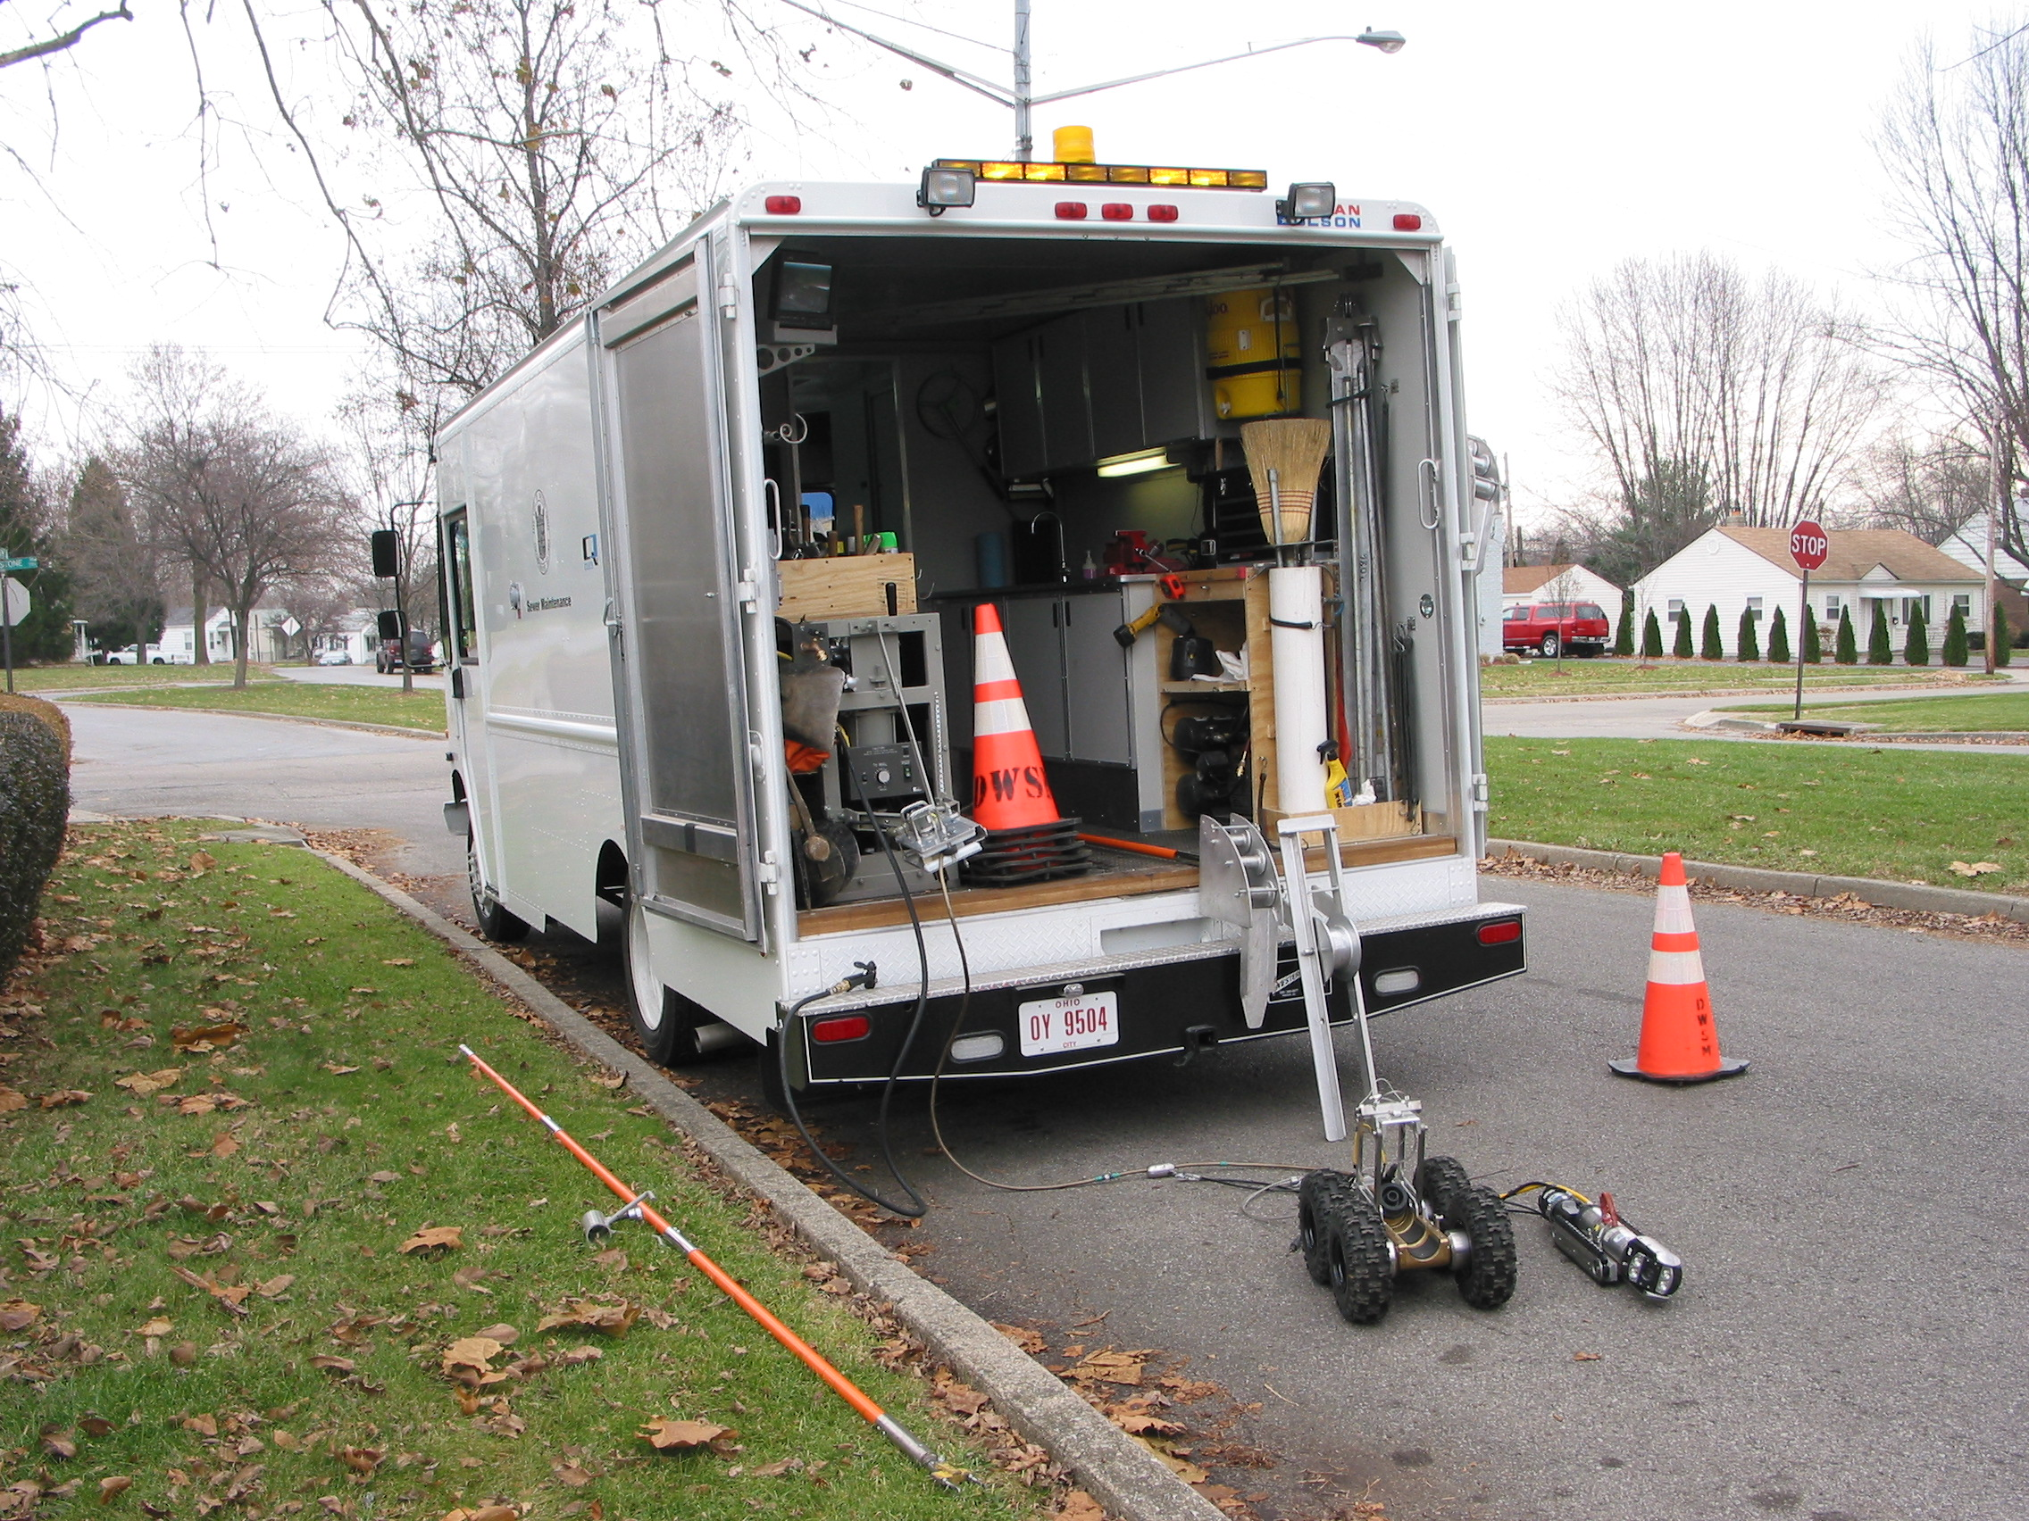
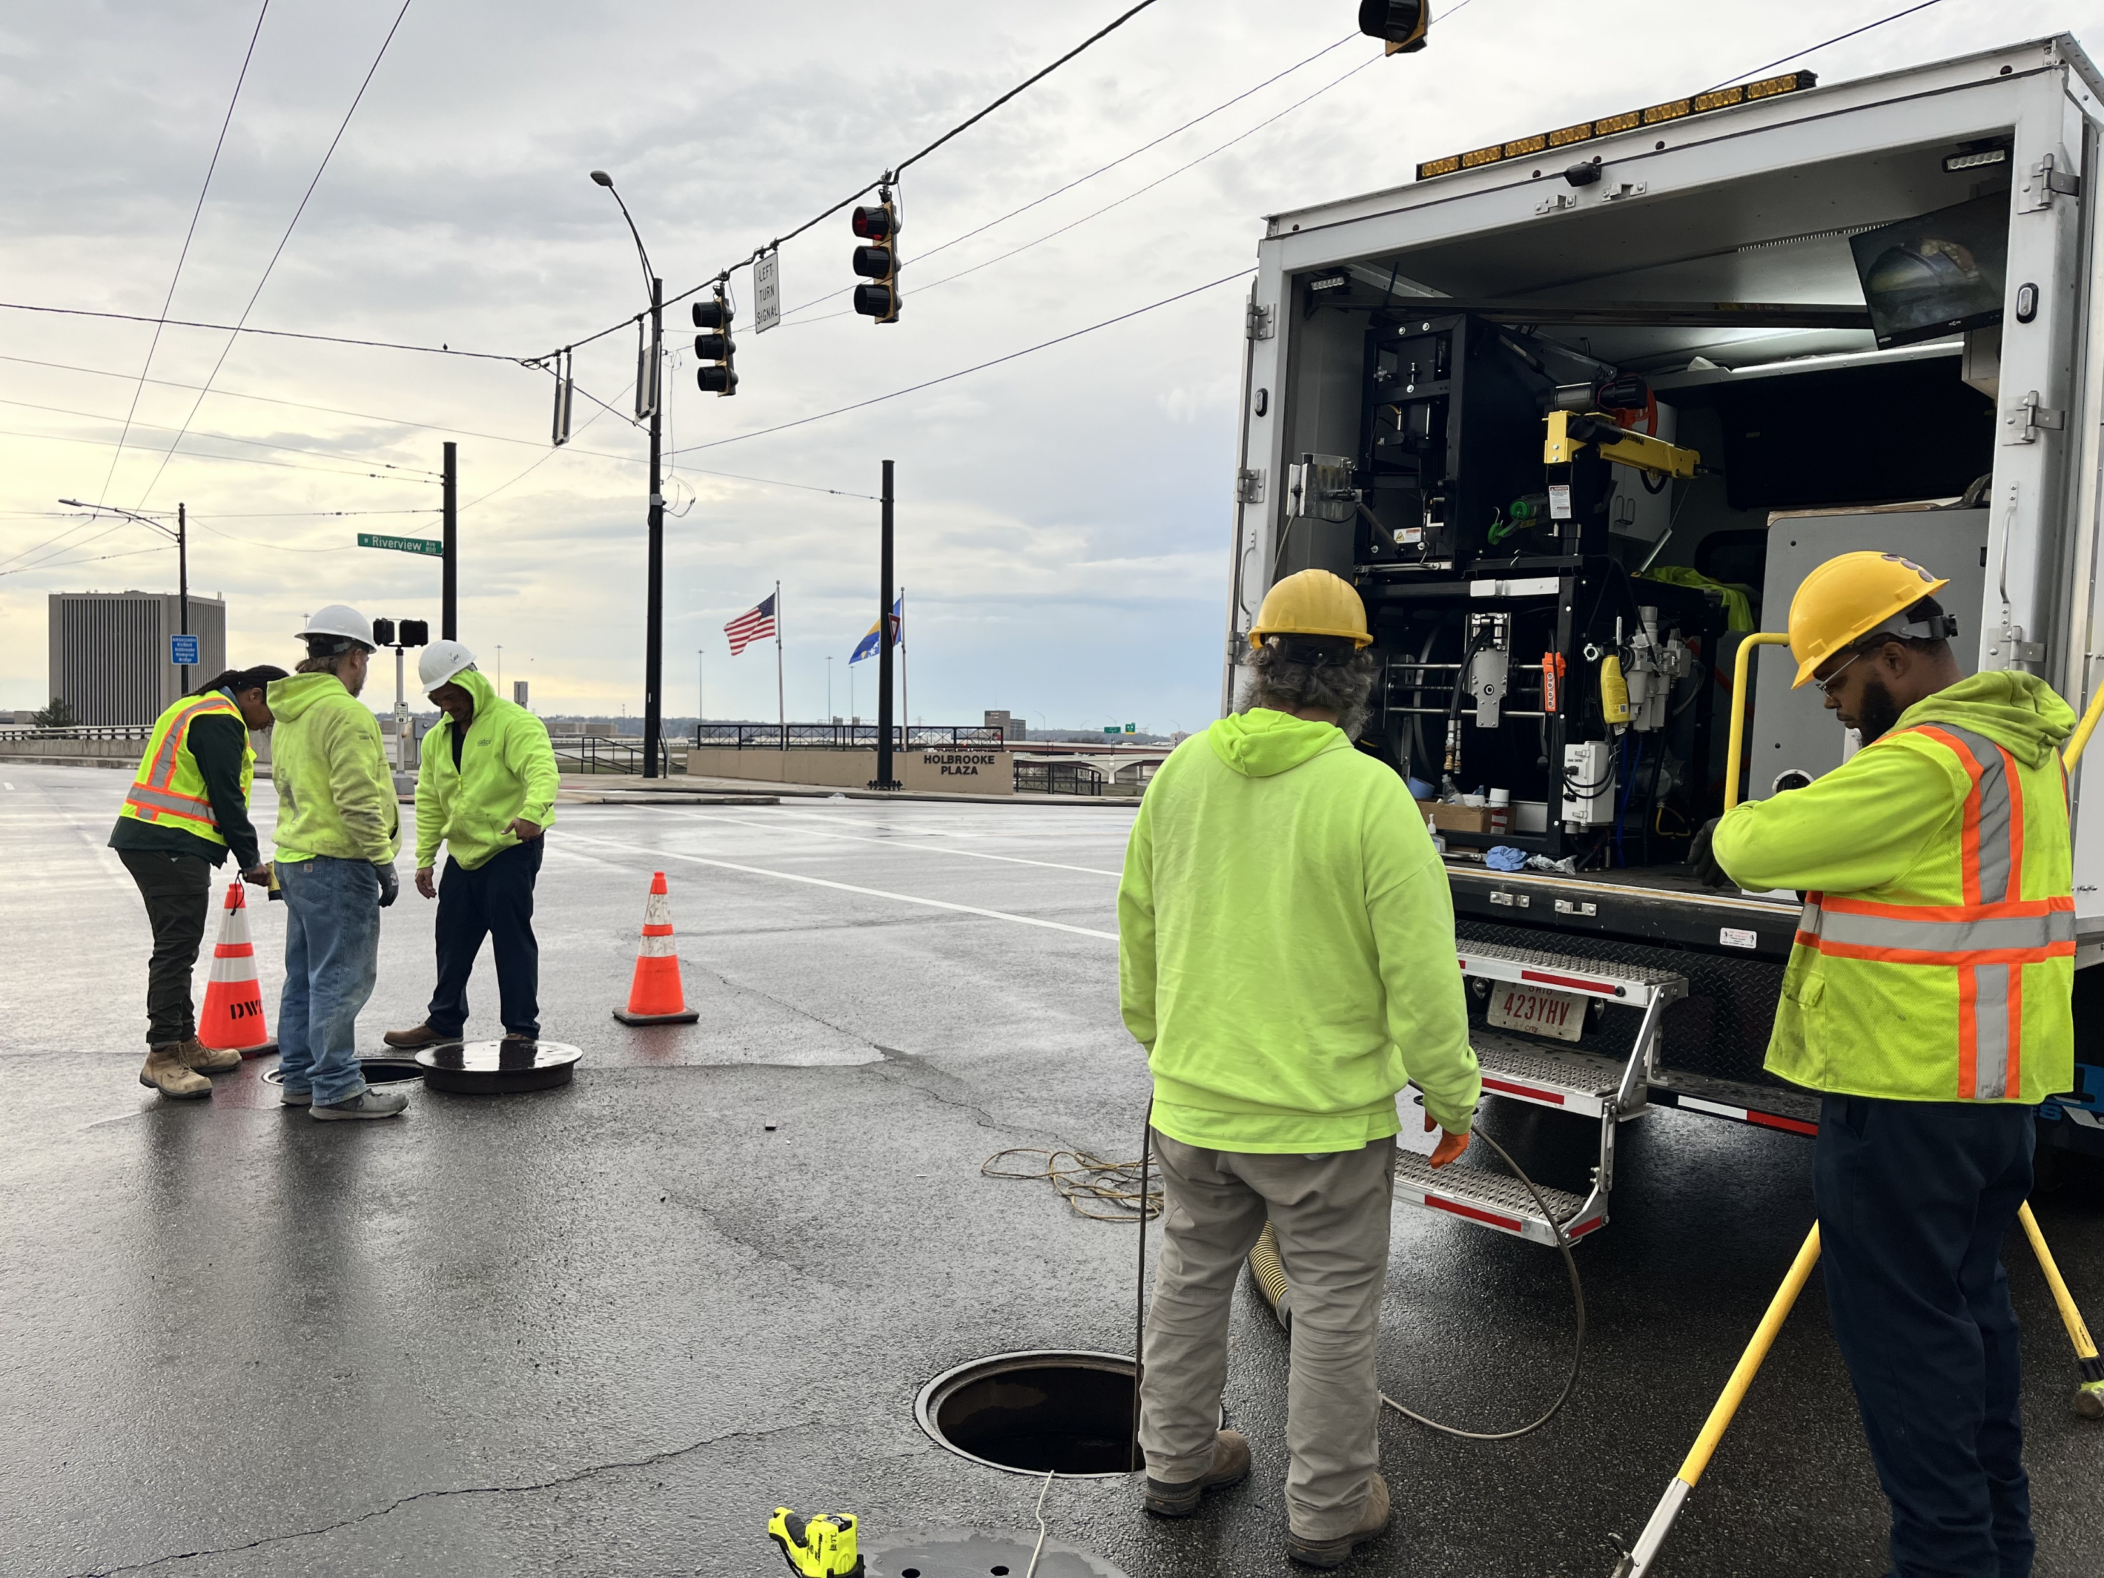
Dayton CCTV

Slide 24
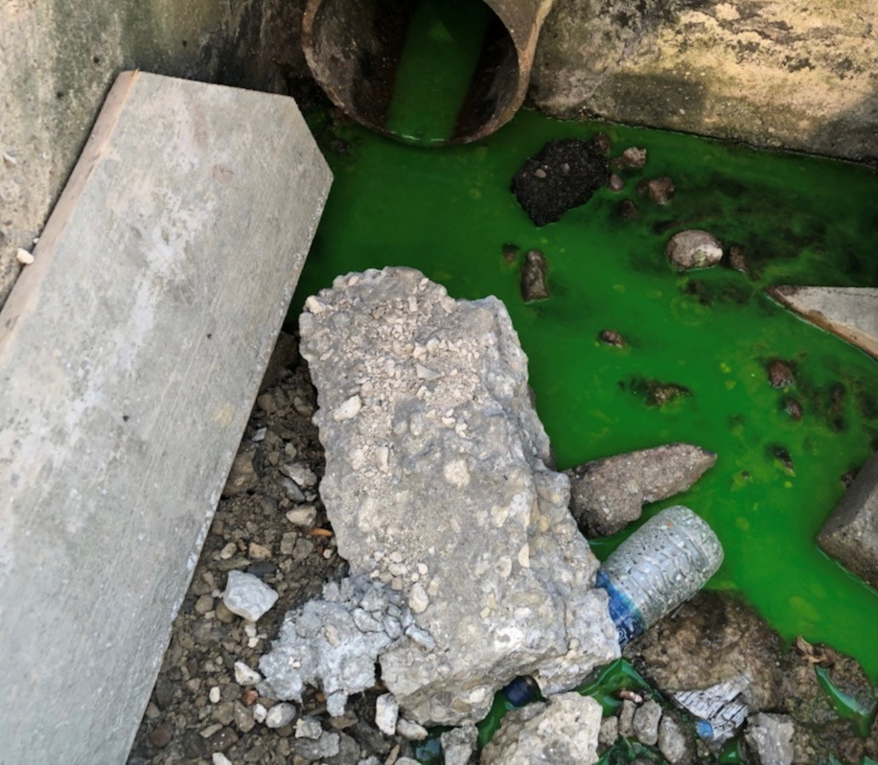
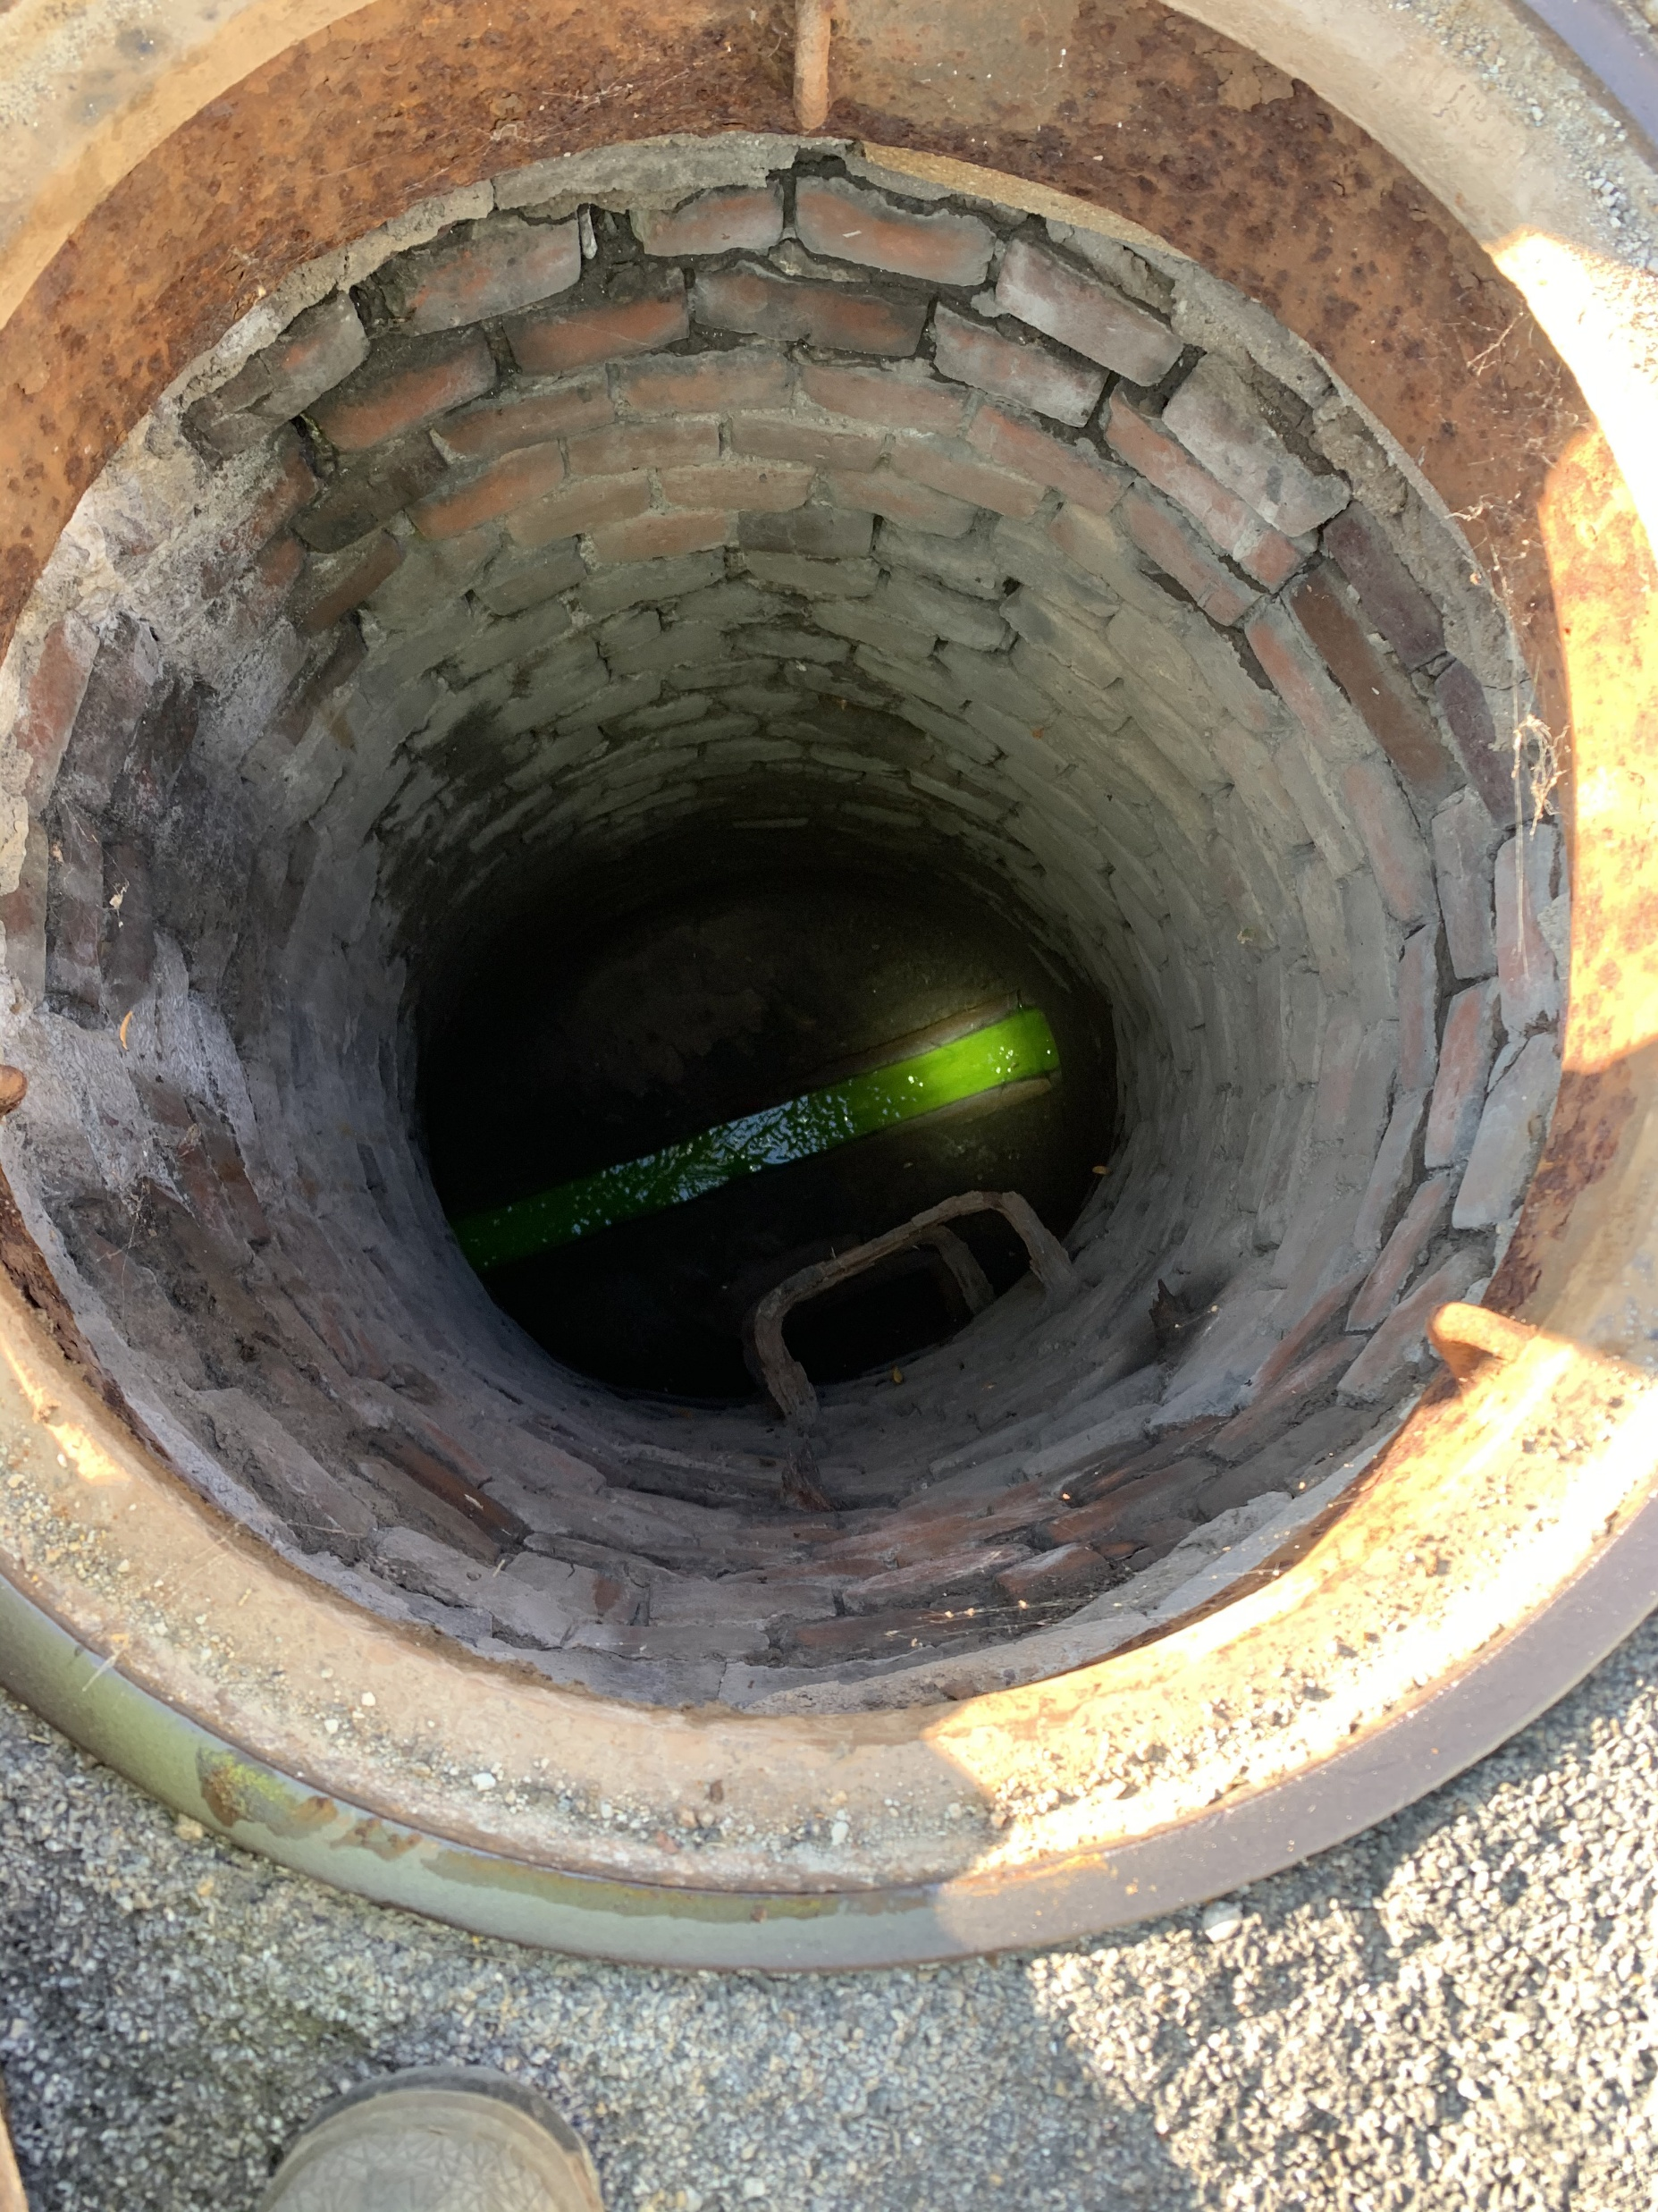
Dye Testing &
Facility Inspections

Slide 25
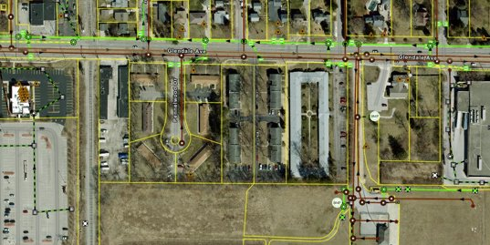
Toledo Investigation Form
Field Maps to locate asset
Links to Survey123 Form
https://drive.google.com/file/d/1DIG6BLFESQeu2P-xNciFglrNskv8NY-l/view?usp=drive_link

Slide 26
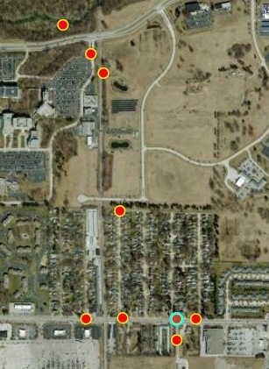
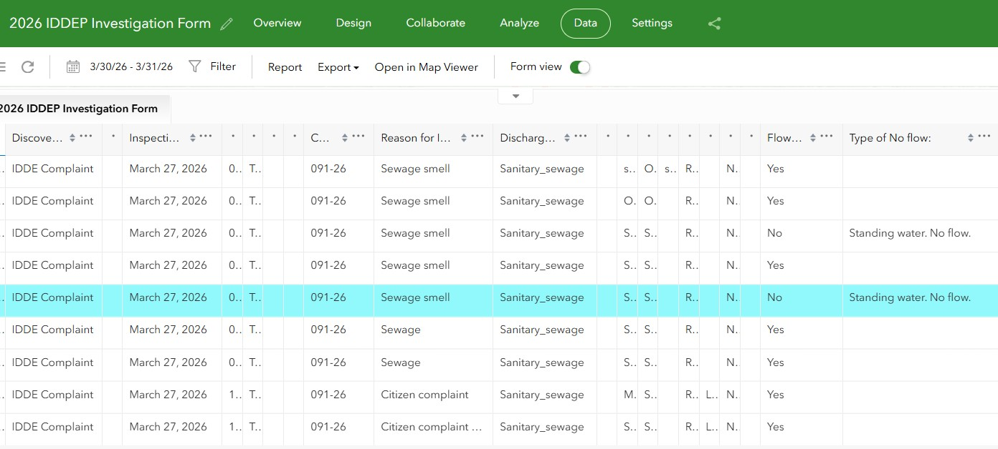
Toledo Investigation Data
Survey123 mapping
Survey123 data/analysis

Slide 27
Toledo Tracking Tools
Nose- follow the odor
Eyes- follow the flow
Dye- Dye Test Form
Bacteria sample- Sanitary leaks
Chlorine kit- water main breaks

Slide 28
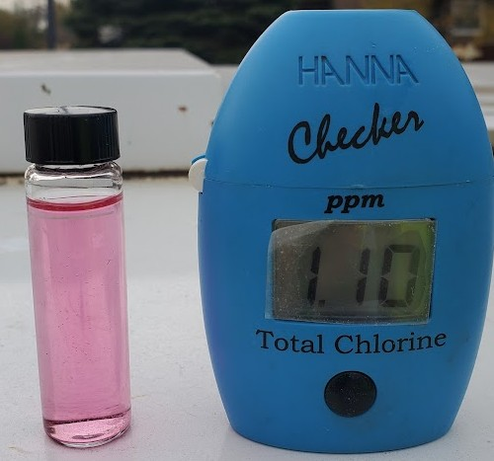
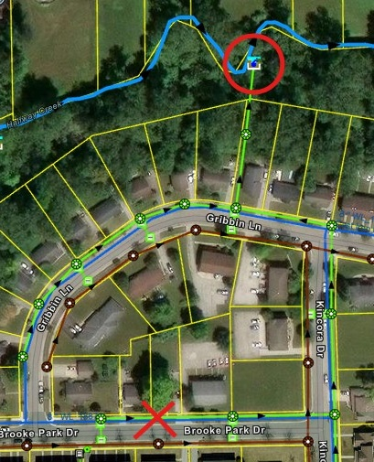
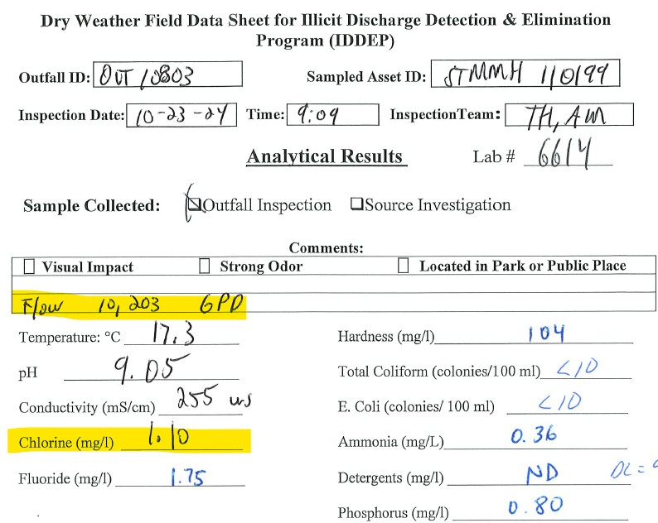
Toledo Tracking

Slide 29
Break for Hands-On Tools Demo
  iPads
  Sampling supplies
  Hach meters
  Dye
  Flashlights
  Rope
  Pick
  Flow meter

Slide 30
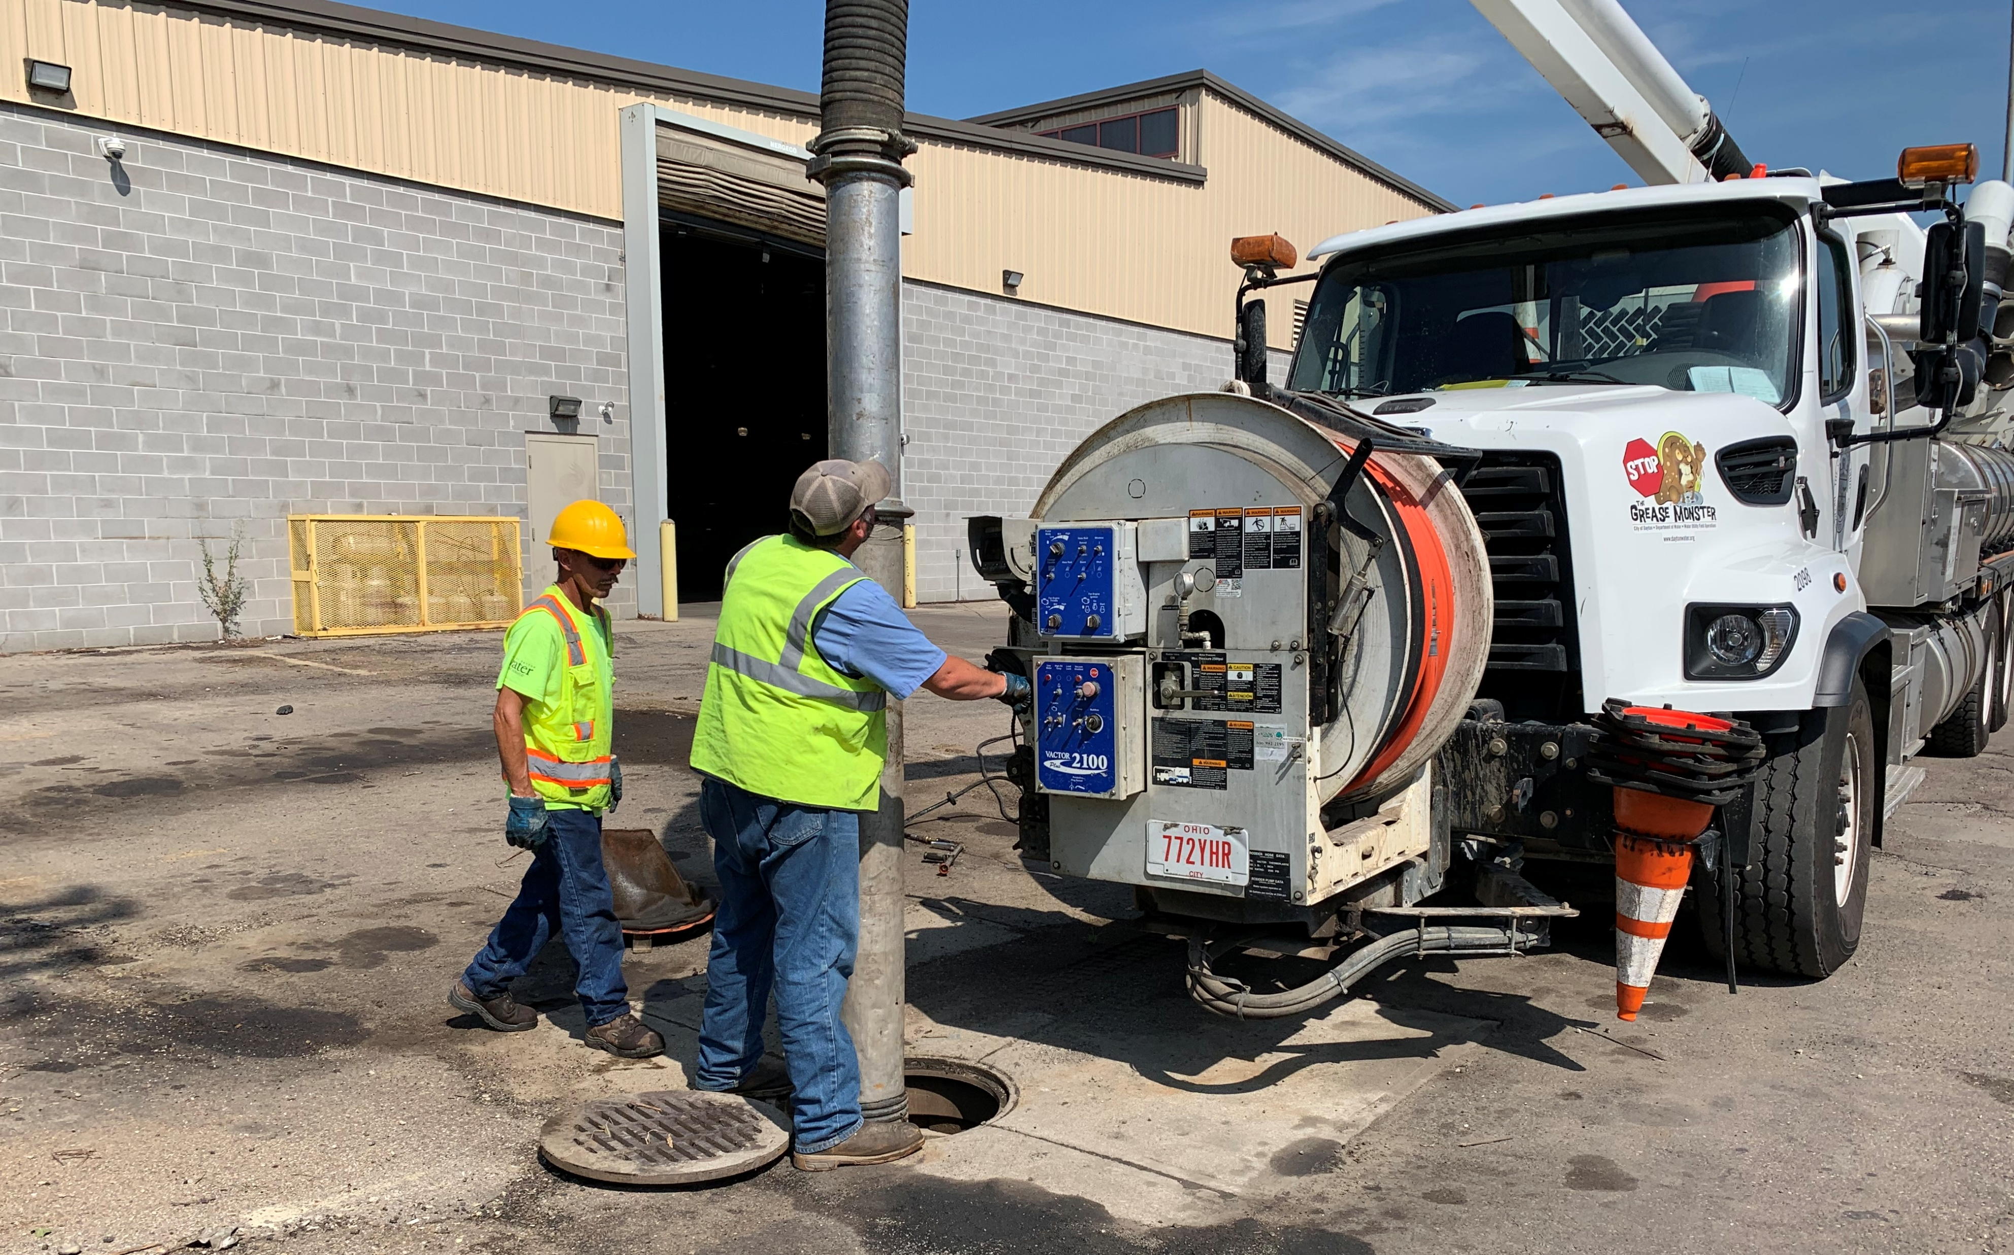
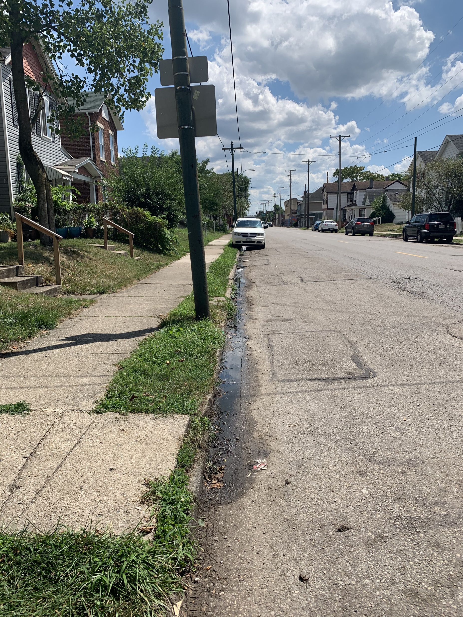
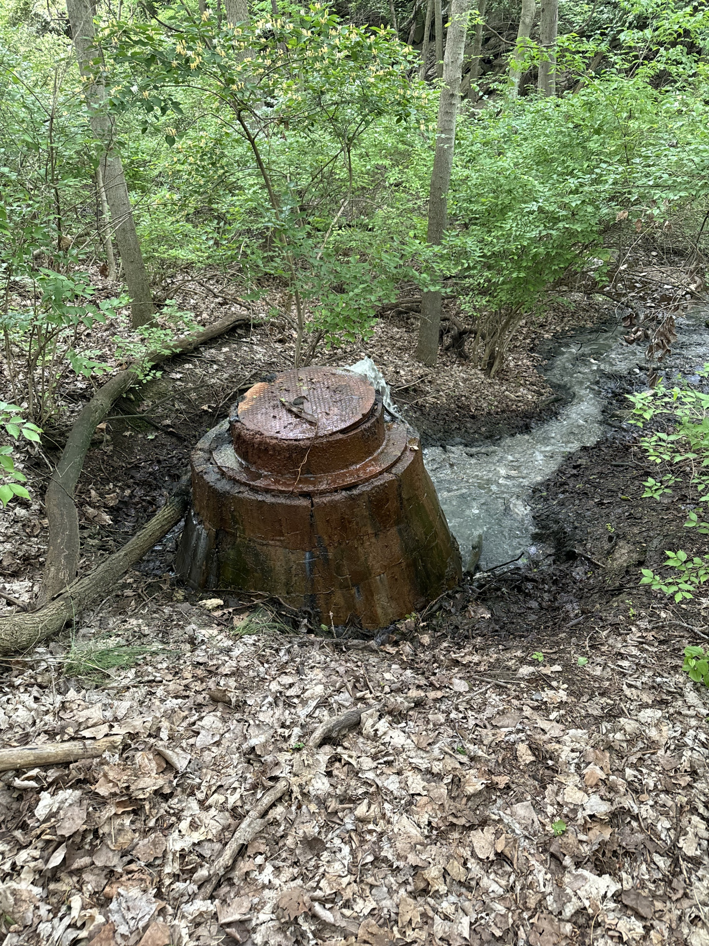
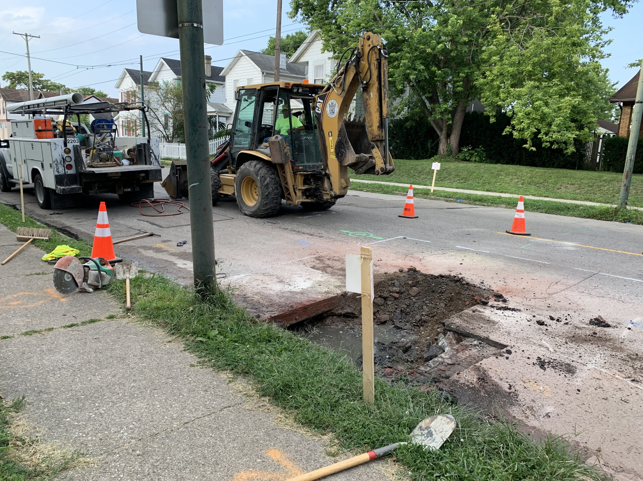
Dayton Elimination Examples
Notes:
Types we’ve found: recurring water leaks, poop fountain, zombie outfalls, bricks missing, illegal connections, laterals leaking,
Enforcement options

Slide 31
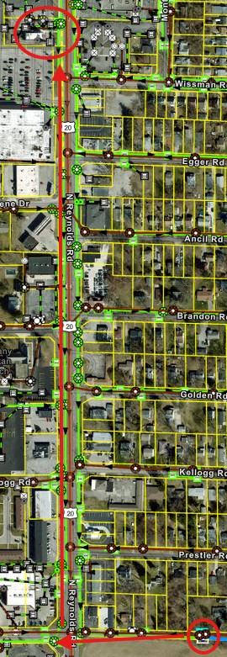
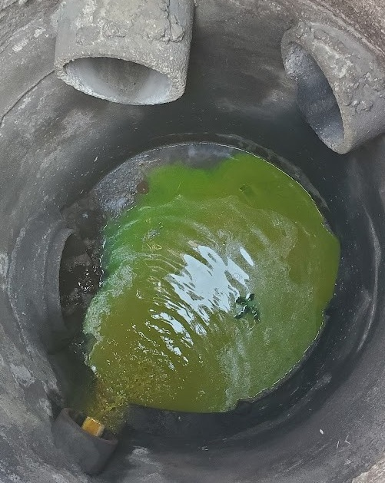
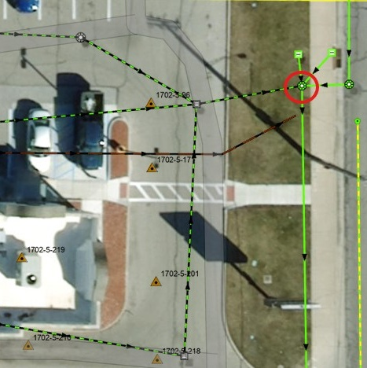
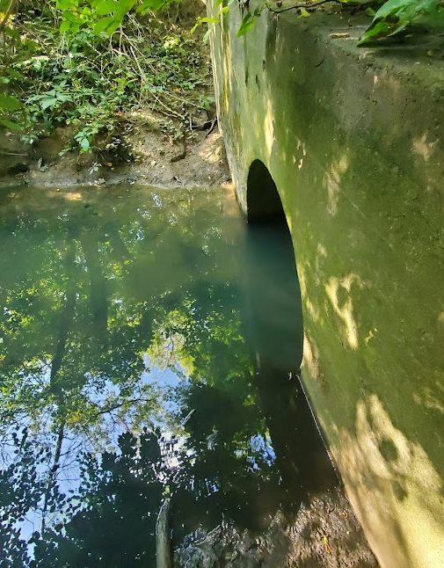
Toledo Tracking and Elimination Example

Slide 32
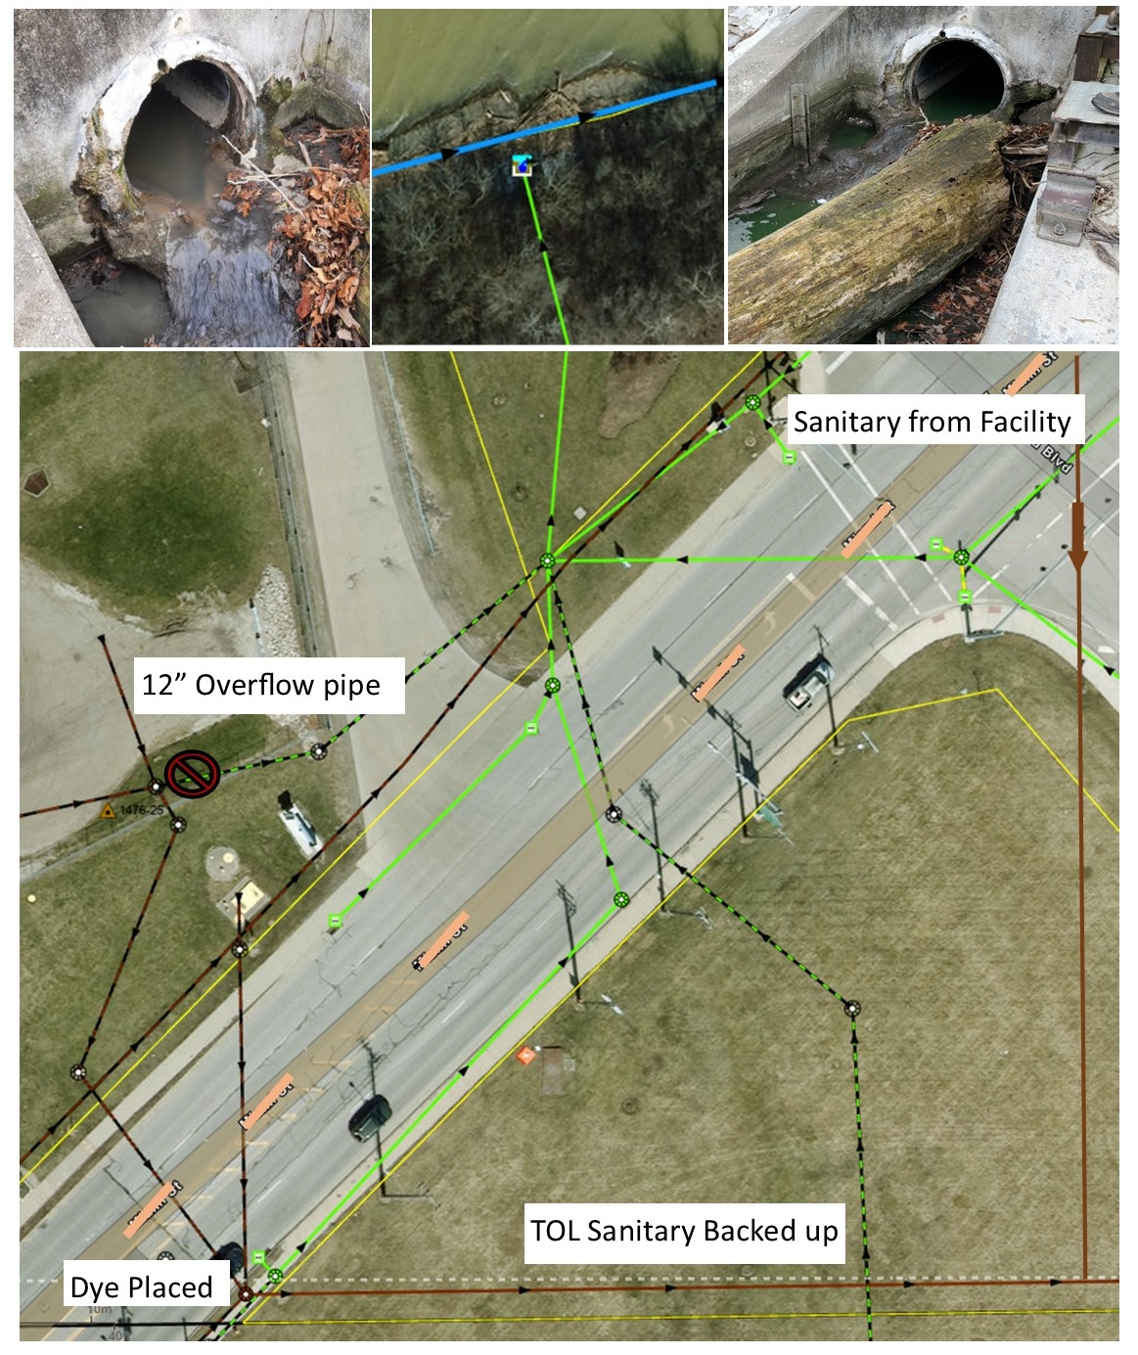
Toledo
Elimination Example
Sanitary dor, suds, gray, cloudy, high dry weather flow at outfall
Dye tested
West facility plugged overflow
TOL jetted sanitary line
East facility re-evaluted their Fats, Oils and Grease complaince

Slide 33
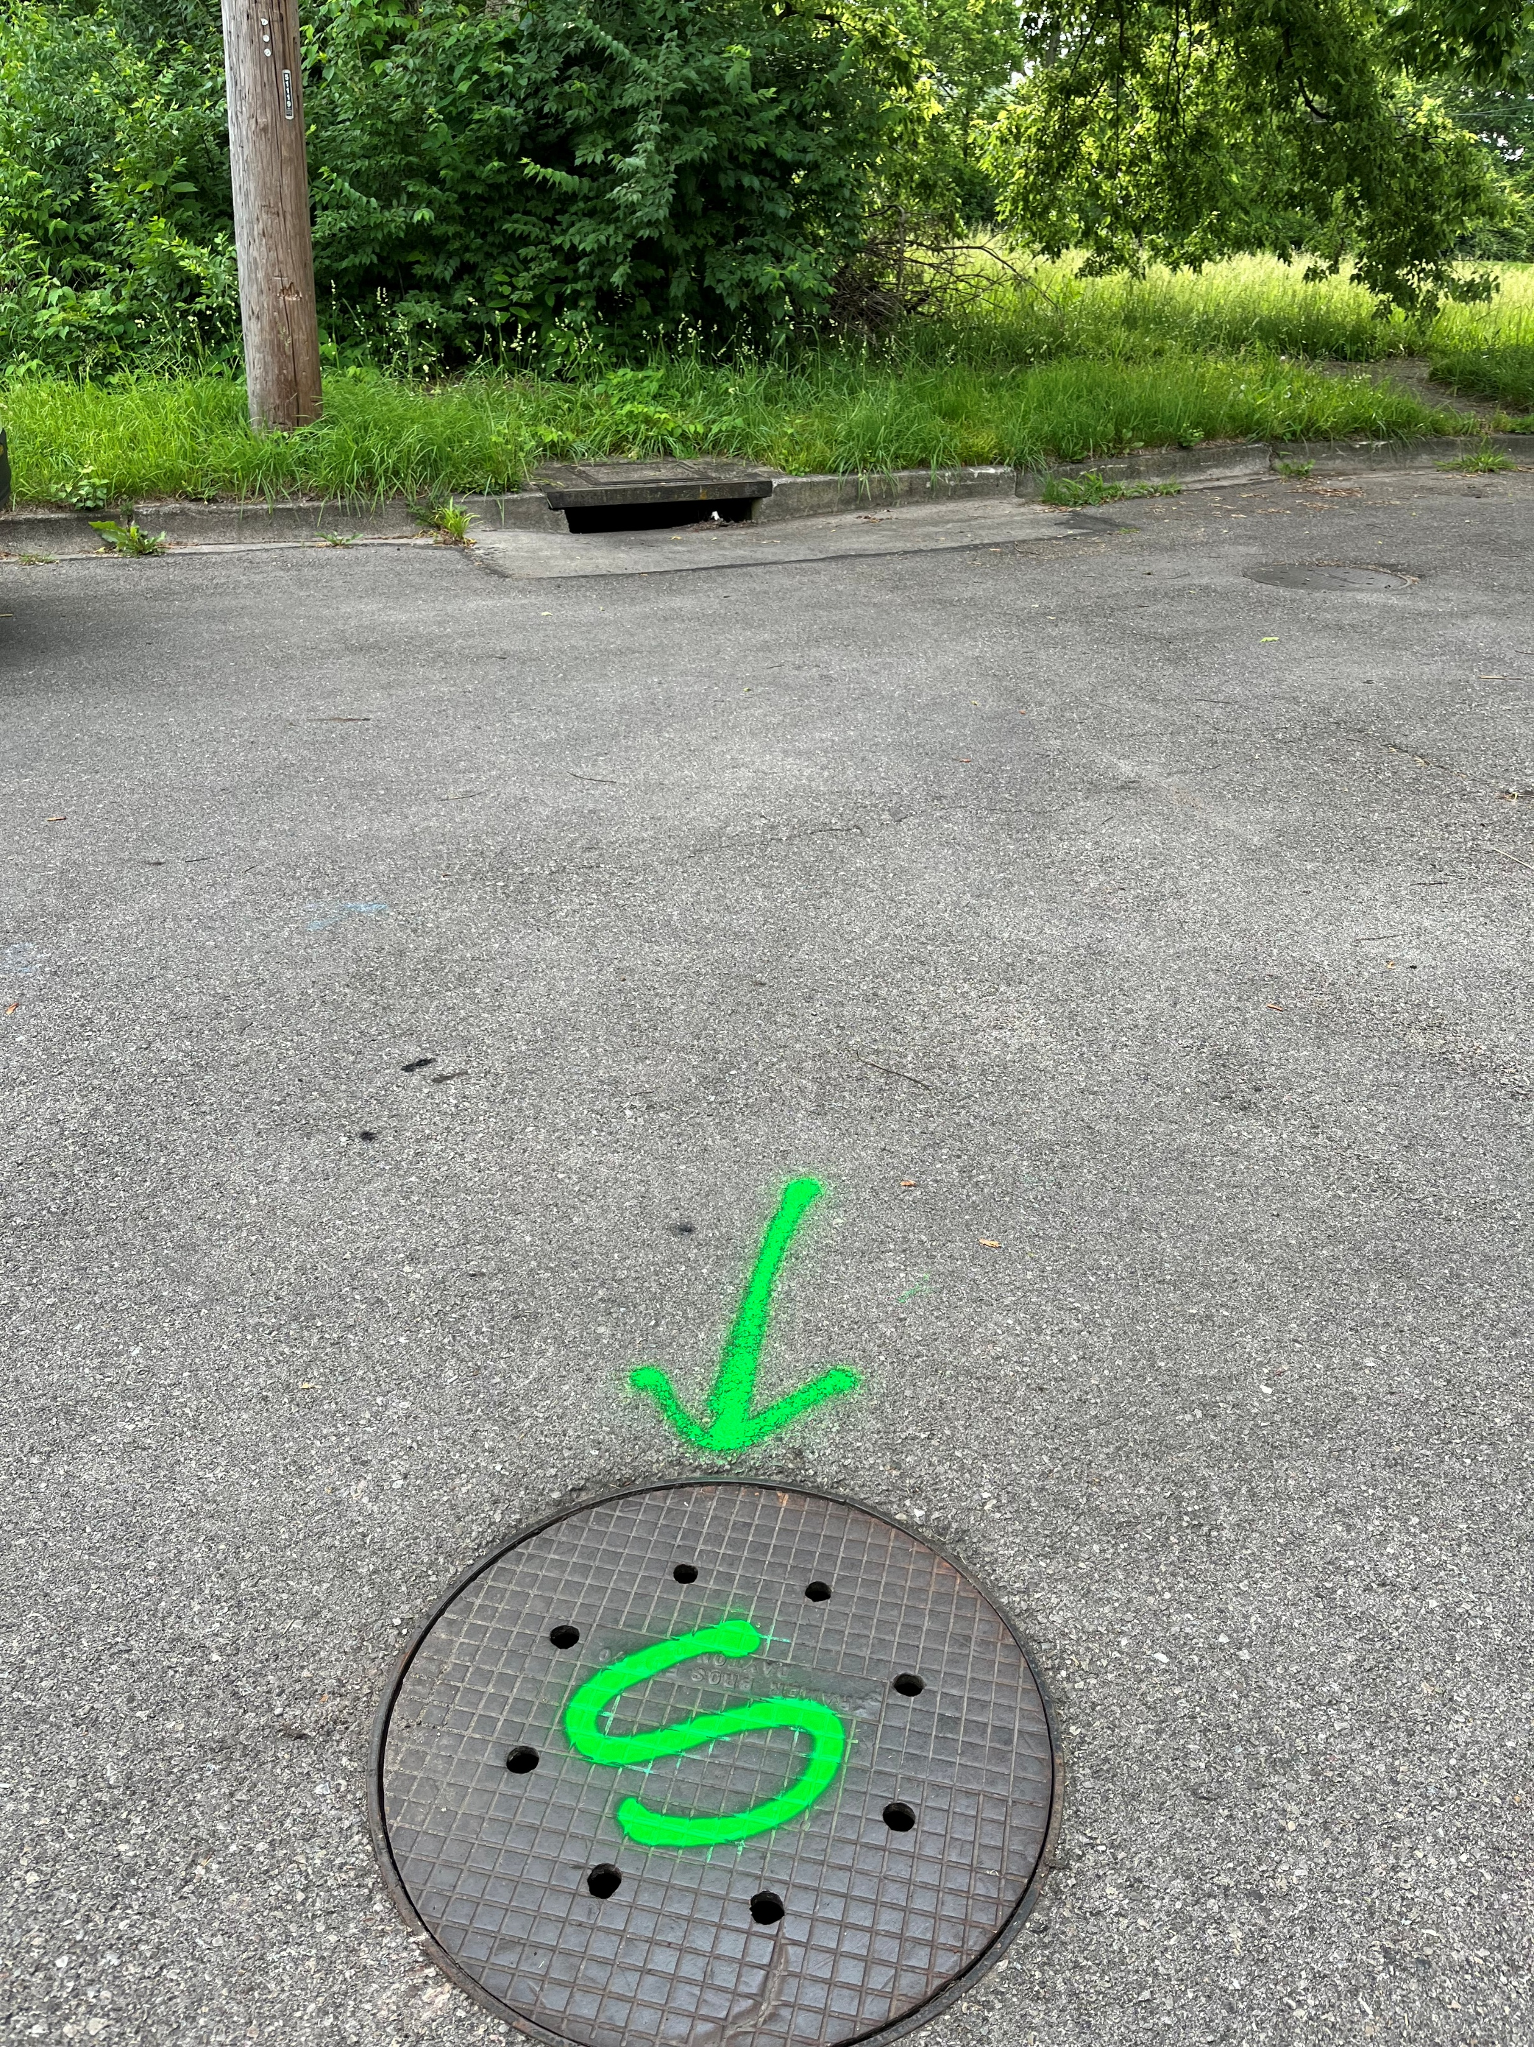
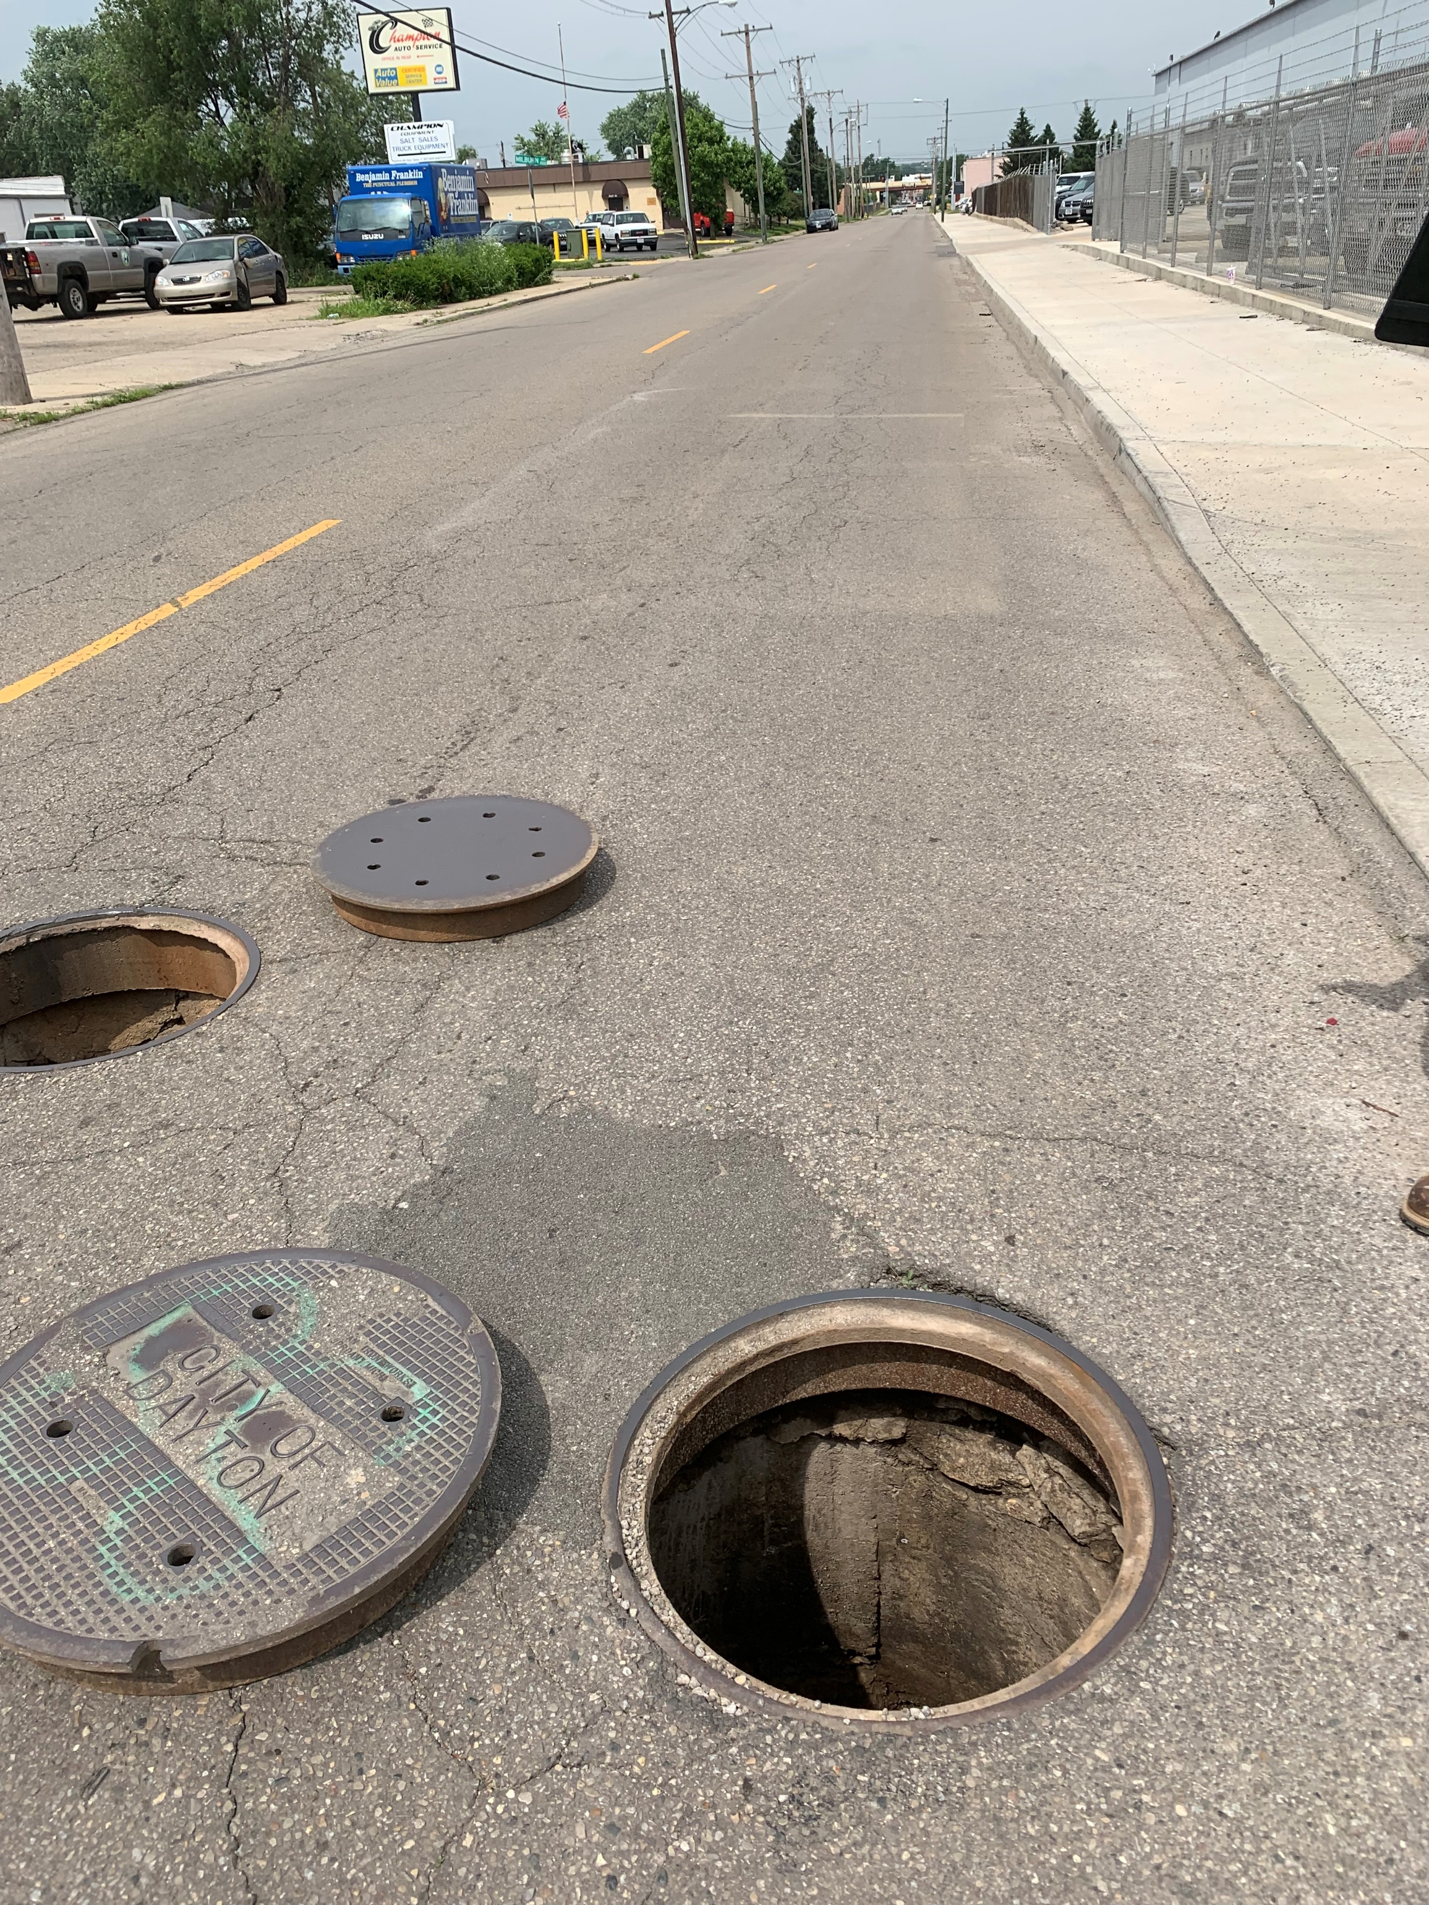
Question Your Assumptions!

Slide 34
Combined Lessons Learned
Mapping and Digital Tools
Digital and accurate maps is key to IDDE and investigations
Switching to digital data collection = great!
Start with the tools you have
Build relationship with GIS experts
Revisit the tool, make it an interative process
  Shading, new fields, updated dashboard, etc

Slide 35
Combined Lessons Learned
Investigations and Elimination
Question your assumptions
Effectively use the tools you have
Document progress (permit required)
Follow the flow or odor
Build working relationships with other City or County departments (Sewers, Engineering, Local Health Dept, EPA, neighboring MS4s, etc)
Notes:
Todd

Slide 36
Future Plans
Dayton
Network analysis on GIS maps – track flow
Updating GIS maps based on ground truthing
Toledo
Improve elimination process with other City divisions
Contracts for CCTV and smoke testing
Both
Improve recordkeeping on investigations/elimination

Slide 37
How do you do IDDE?
Katie Norris, Environmental Scientist
  Katie.Norris@daytonohio.gov
Todd Haggard, Sr. Environmental Specialist
  todd.haggard@toledo.oh.gov

