Slide 1
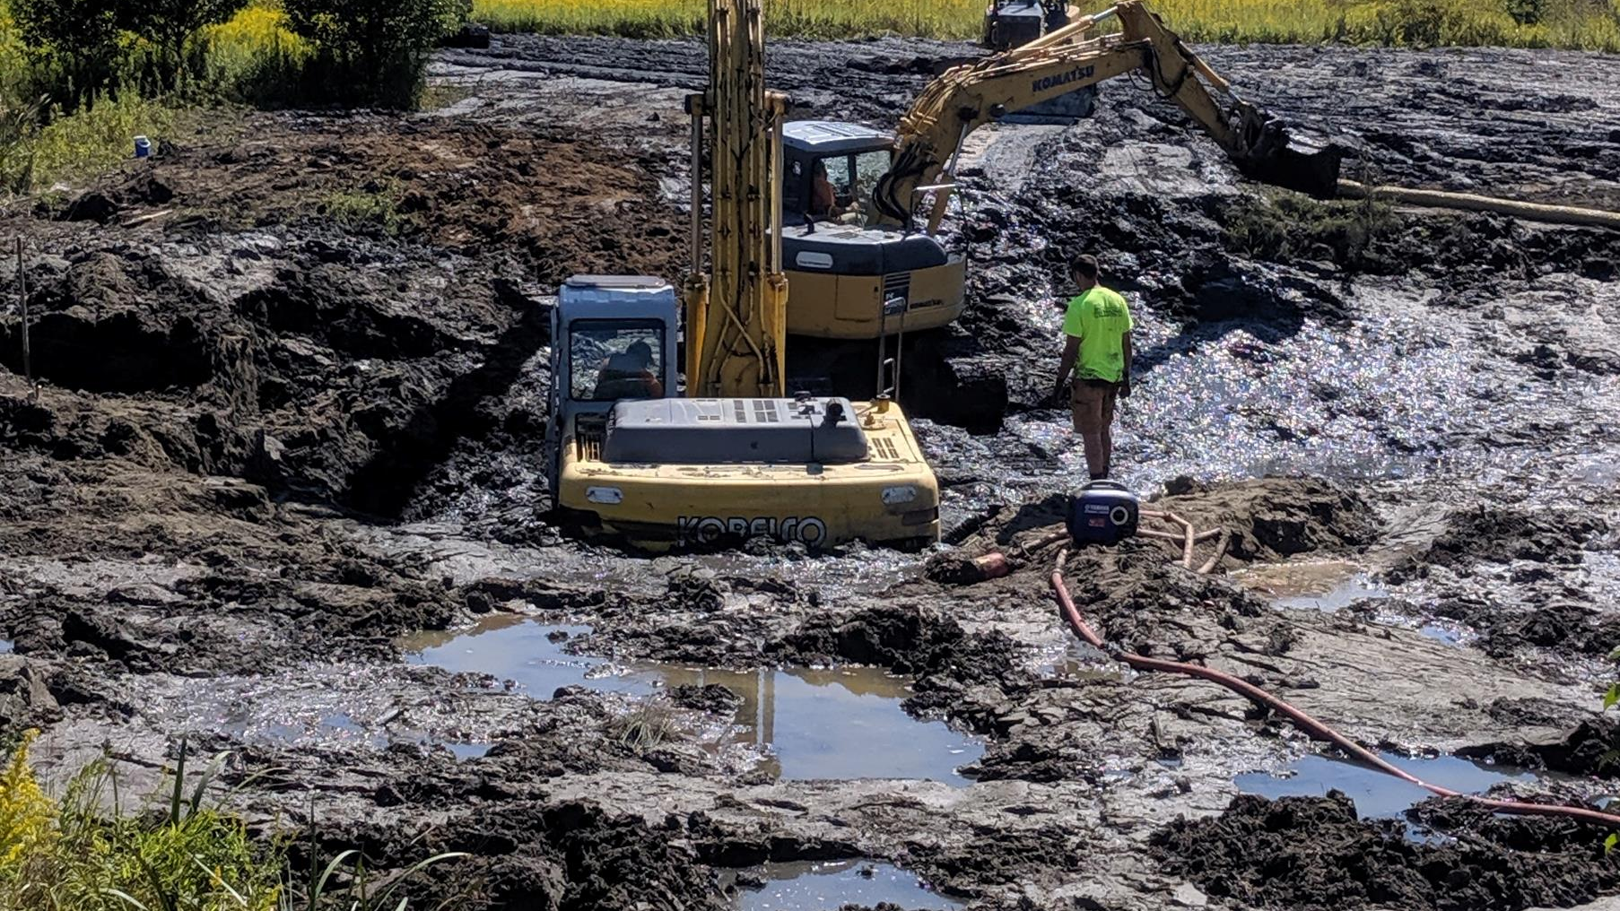
Components of a Successful Stormwater Program
Lessons Learned from 23 Years of Imperfection

Slide 2
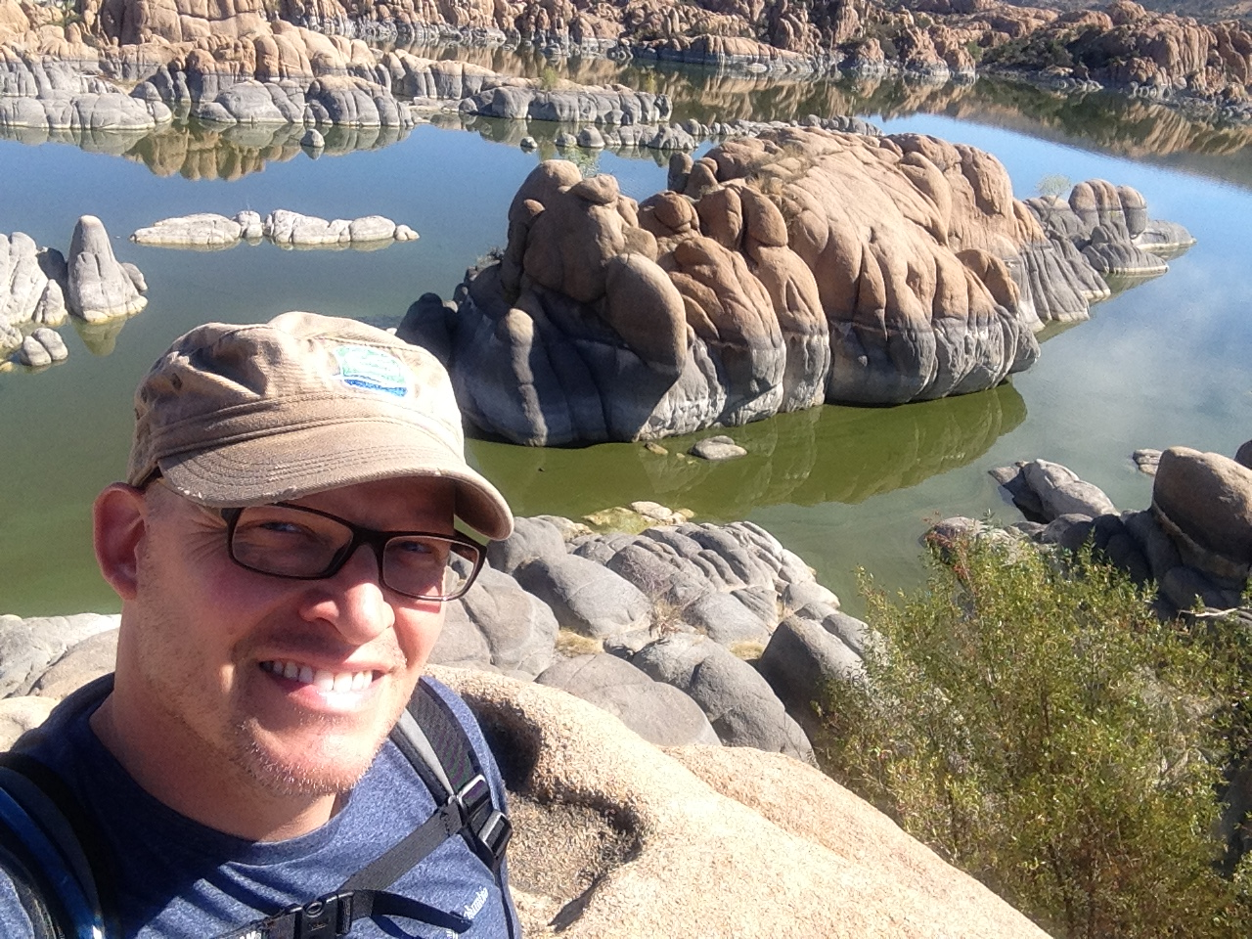
Brian Prunty, CPSWQ

Slide 3

Disclaimer
There are always exceptions to the rules
Contact your OEPA stormwater representative & your law director
Stormwater isn’t black & white… grey area
We are not perfect, keep evolving and learning
There’s more than one way to do something
NETWORK!
This permit is about expired

Slide 4
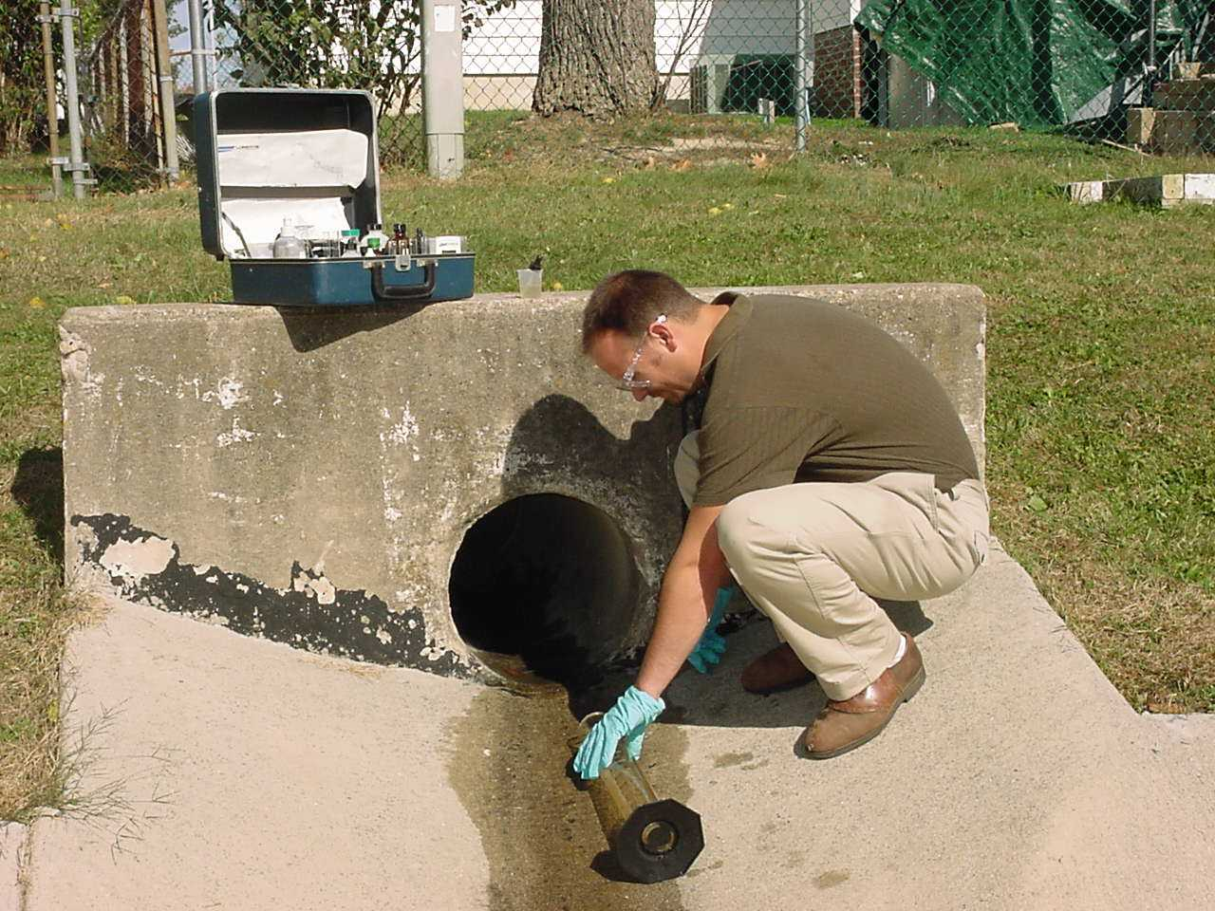
Summit Soil and Water Conservation District
Assist 29 MS4 operators
(13) cities, (6) villages, (9) townships and (1) county
County Permit and (11) co-permittees
(17) individual permits
Perform assistance on MCMs 1,2,4,5,6
No experience with watershed individual construction permits

Slide 5
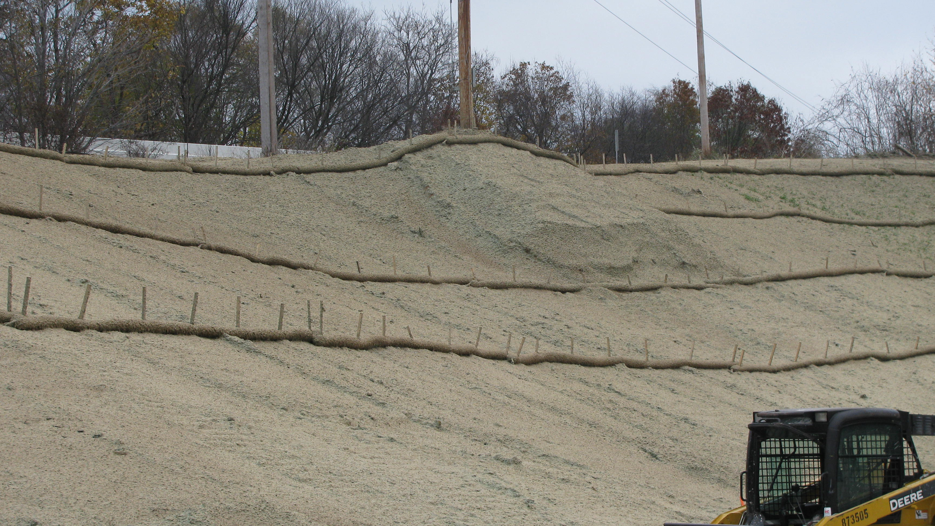
Minimum Control Measure #4 Active Construction

Slide 6
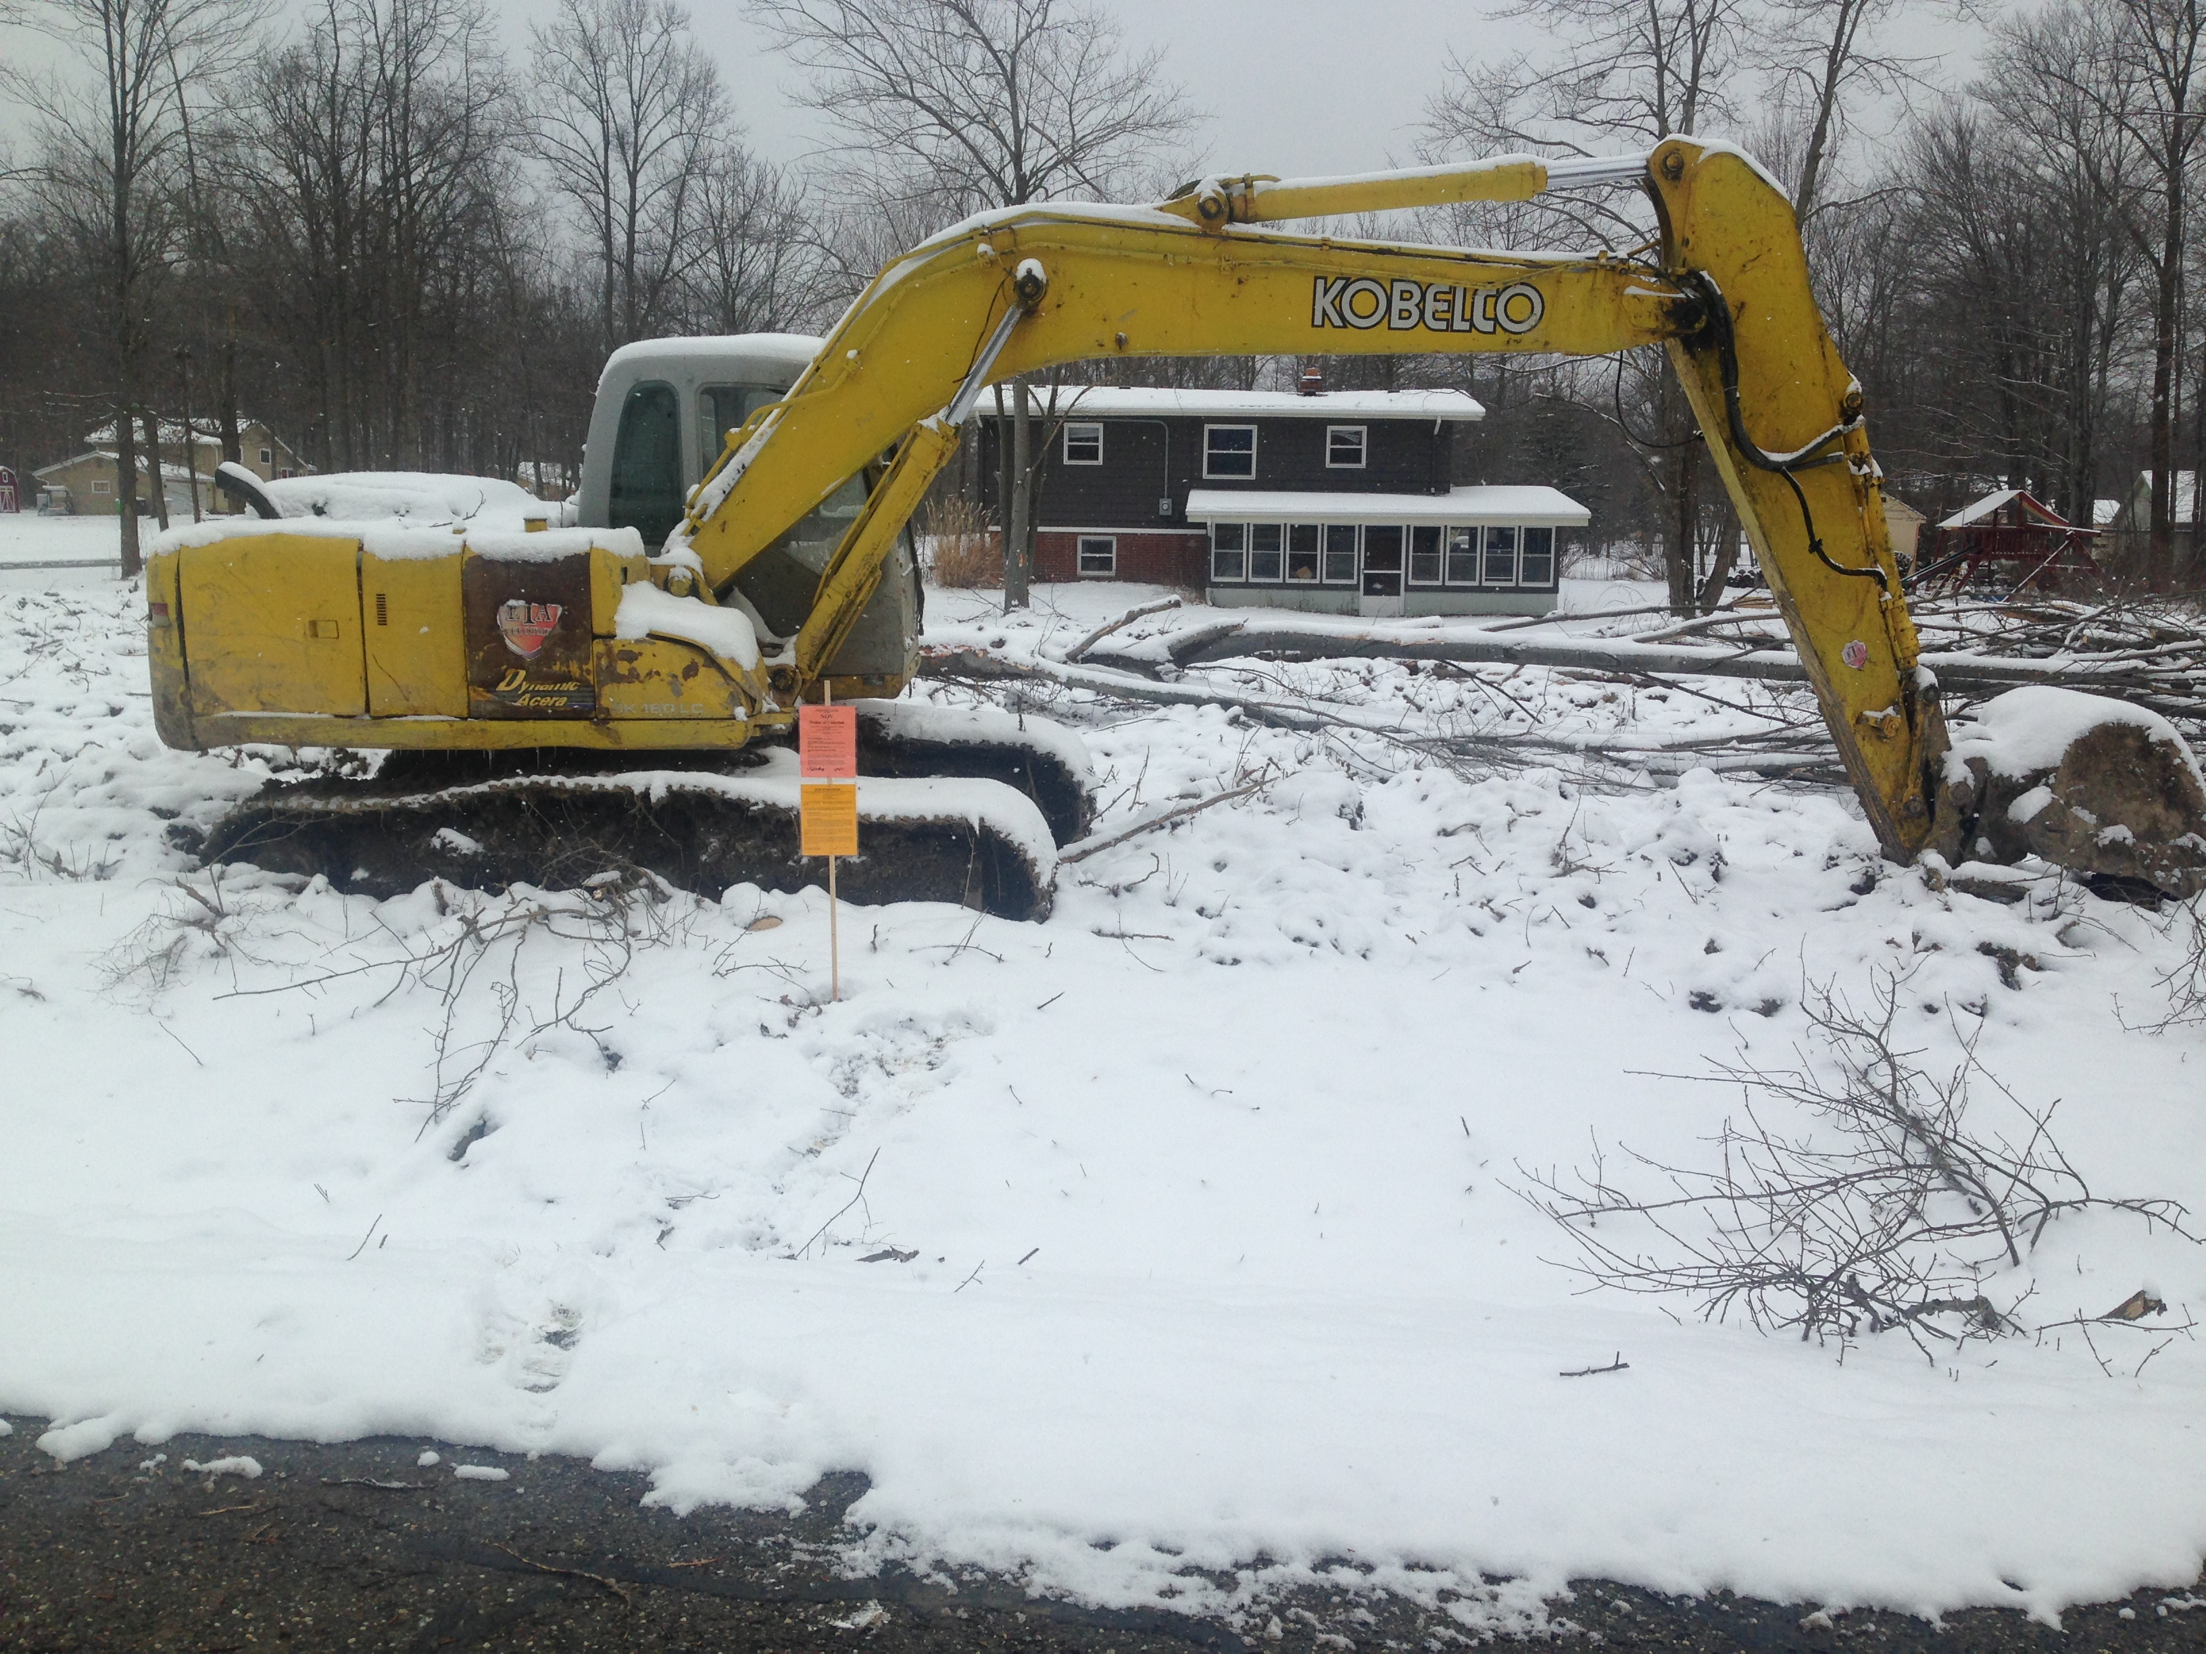
Requirements:
Regulatory mechanism
Operators to implement BMPs
Procedures for review
Procedures for receipt of public information
Procedures for inspections, enforcement and prioritize inspections
Ensuring compliance

Slide 7
Performance Standards:
Your regulatory mechanism shall at least meet the General Construction Permit
Pre-construction review procedure requirements, software, checklist and documentation of communication
Ensure compliance through inspections, schedules, software, checklist and communication
Total Maximum Daily Load (TMDL) minimum 14-day inspection requirement
Annual reporting requirements

Slide 8
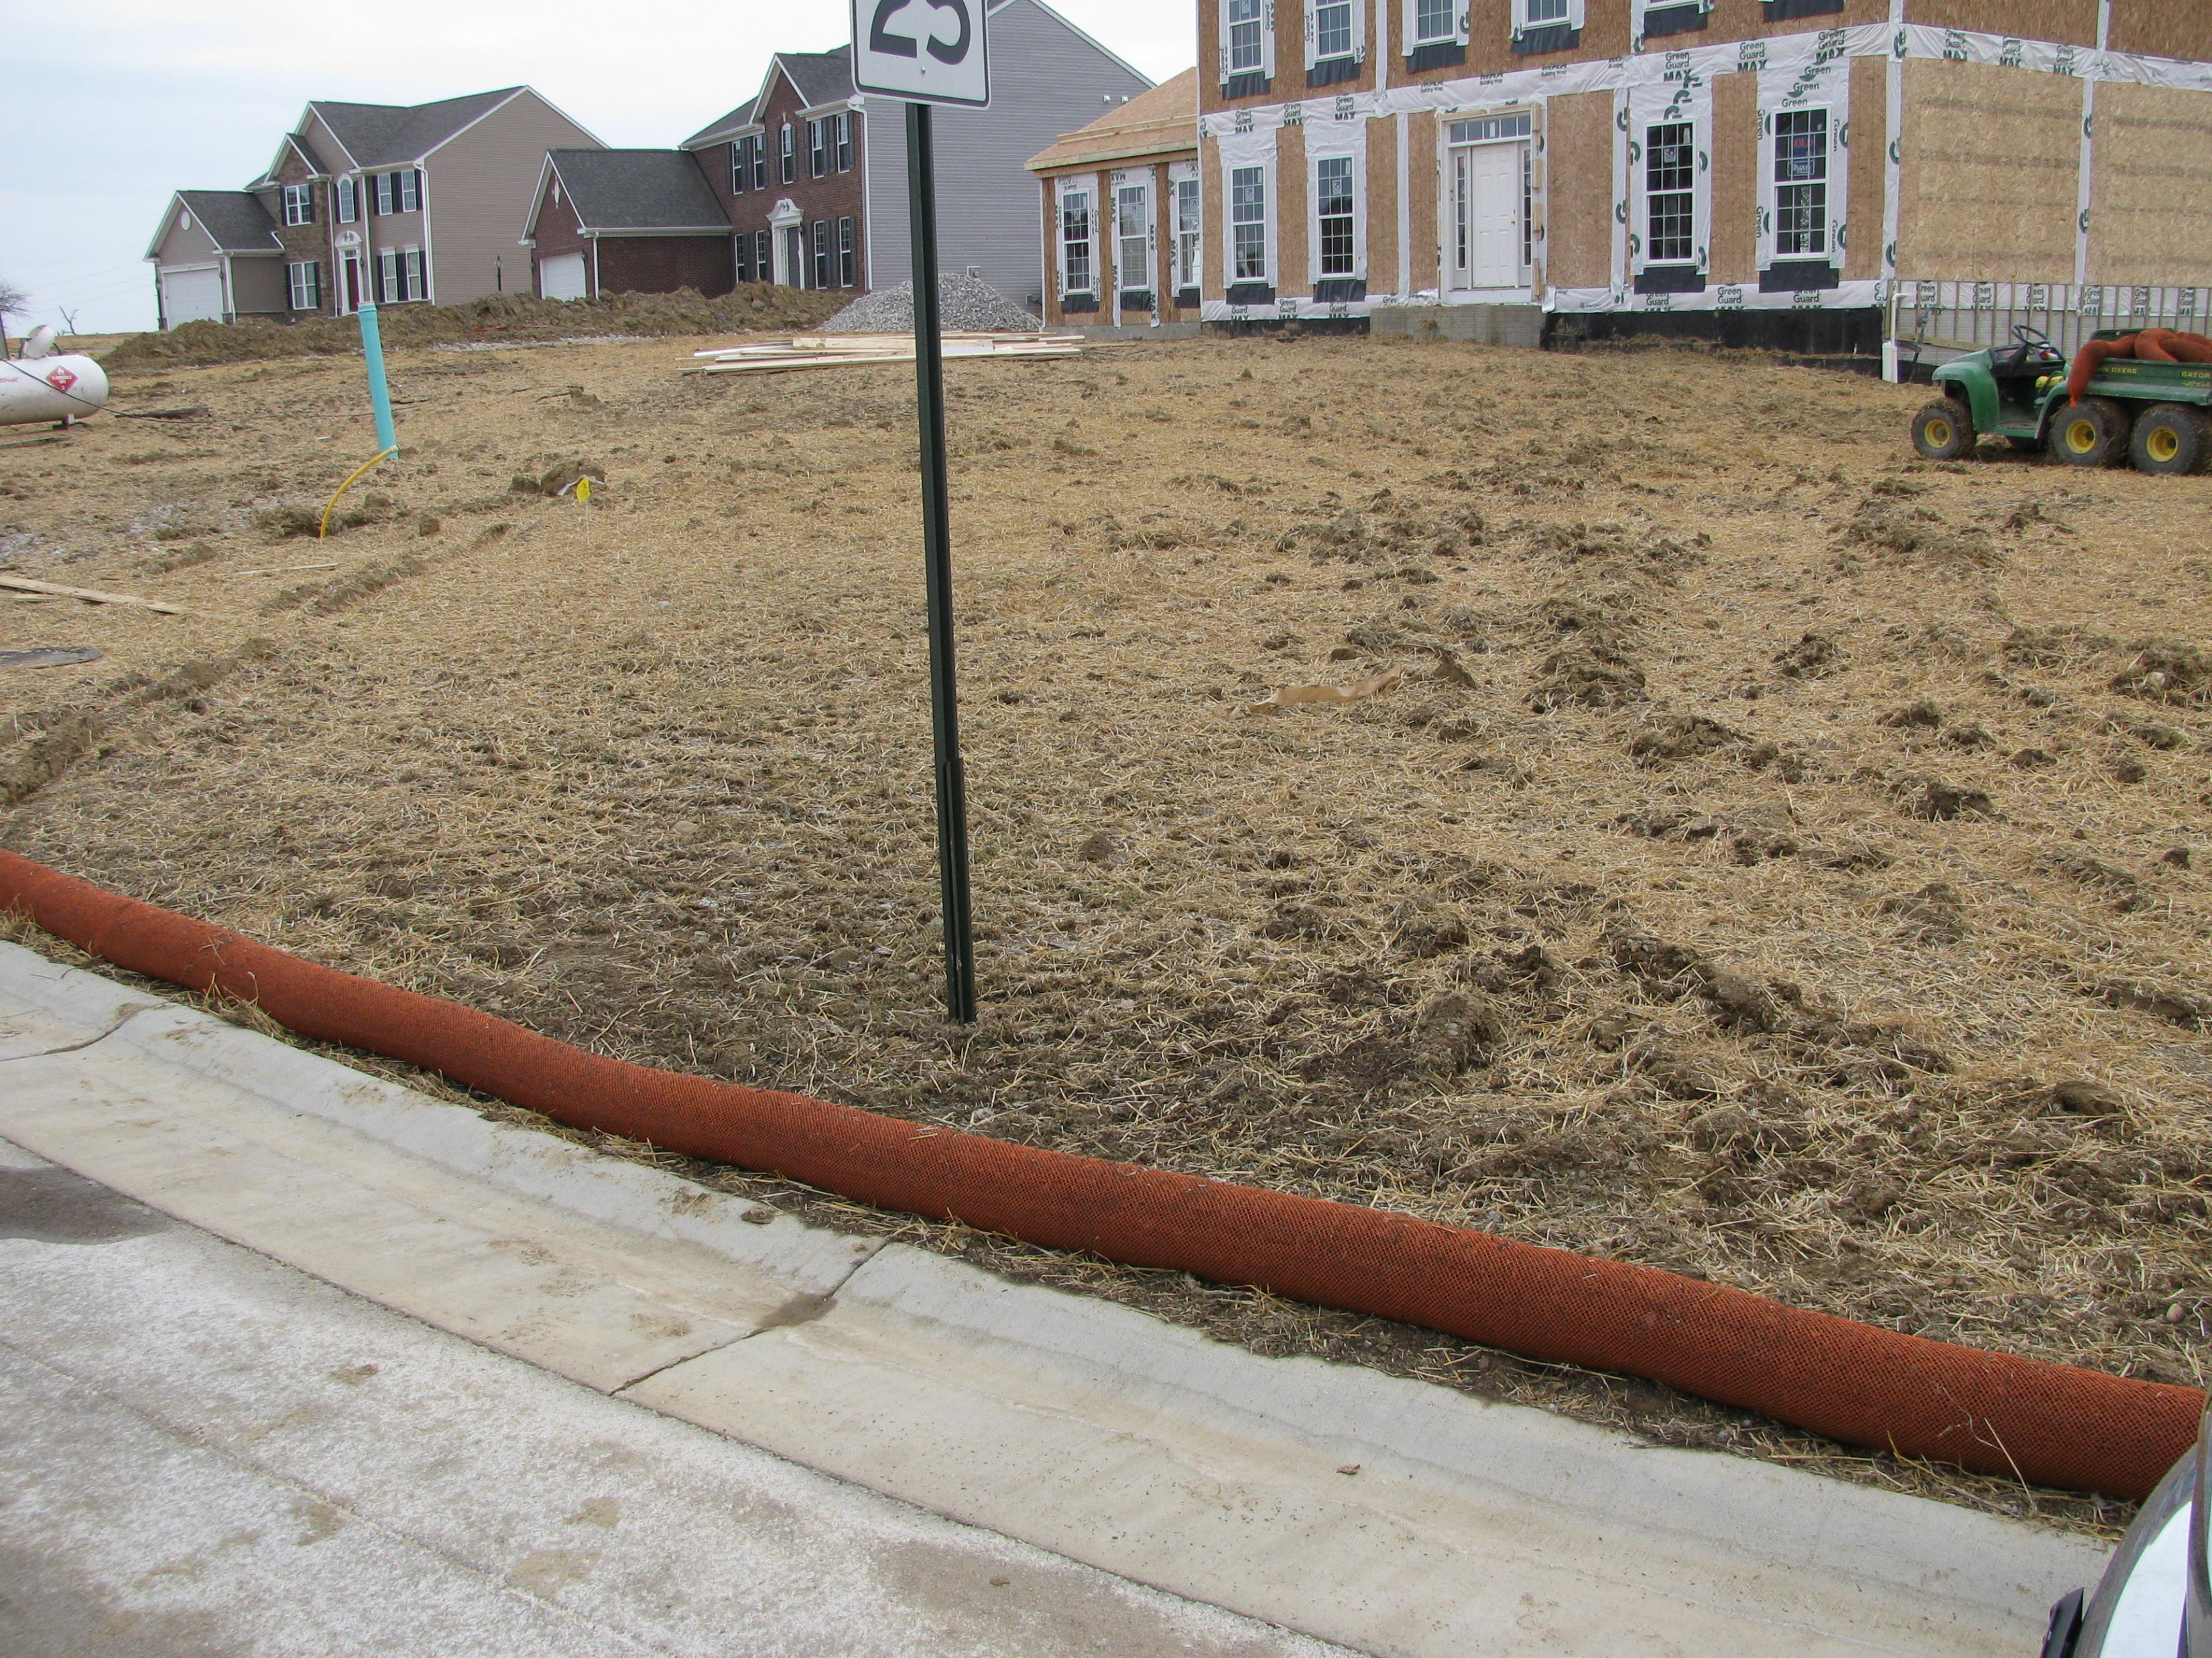
We perform…
Stormwater Pollution Prevention Plan (SWP3) reviews
Host preconstruction meetings
Conduction inspections and send reports
Maintain database, and inspection and review checklists
Escalate enforcement or issue stop work orders
Set inspection frequency
Perform final inspection and terminating site

Slide 9
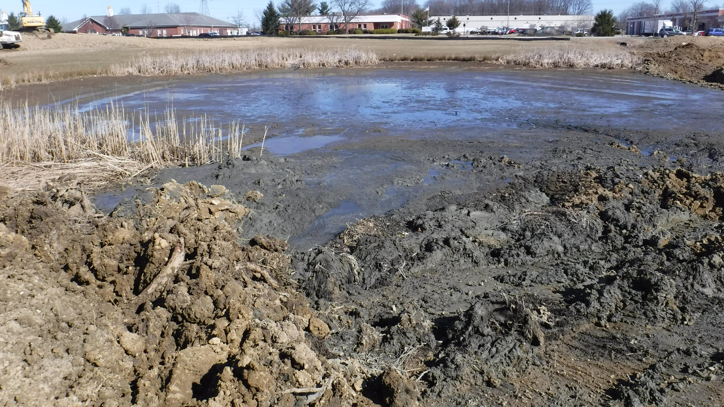
Know this Golden Rule….
One acre or greater of disturbance or part of a larger common plan of development of for sale.

Slide 10
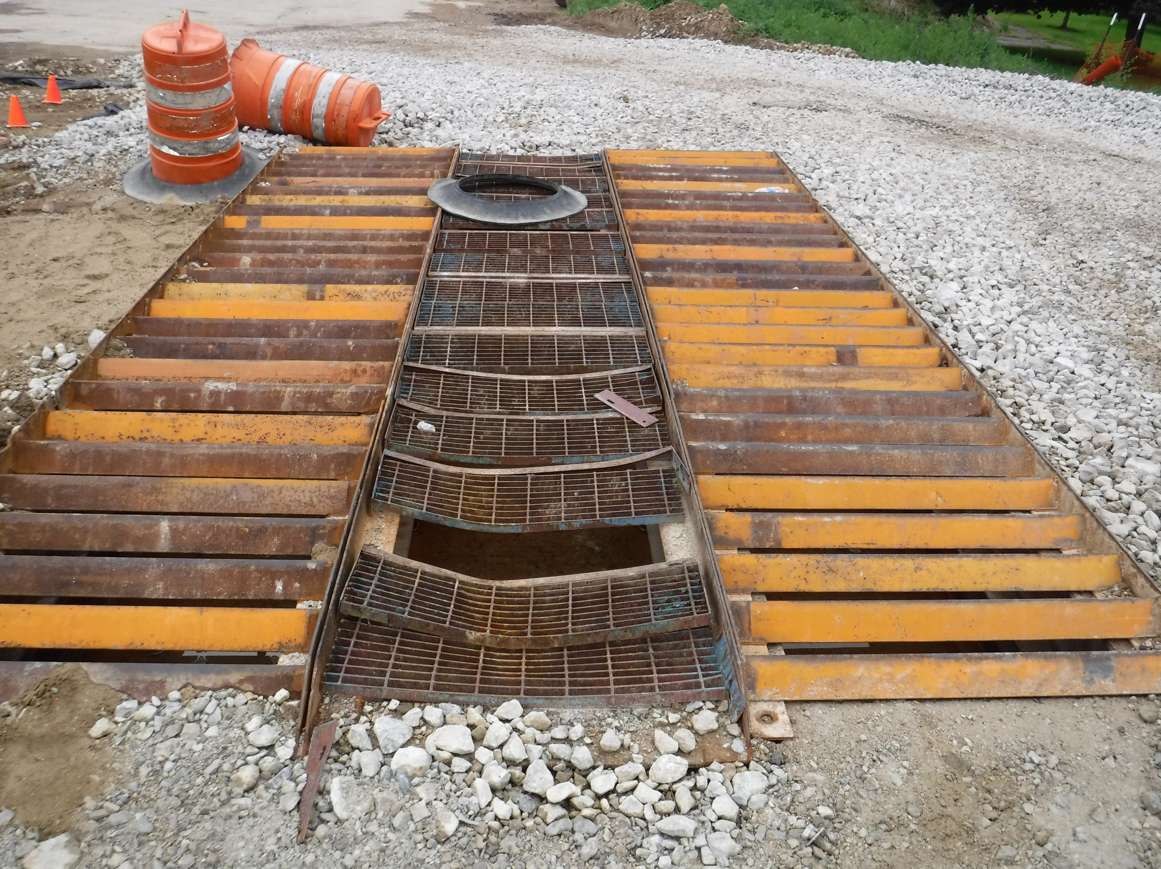
Regulatory Mechanism
County & Townships
City & Villages
ORC 307.79
SWCD Administrator of SCCO 941
Immediate stop work orders, NOVs, re-inspections fees, & seek injunctions
SCEO has authority via SCCO 942 & SCCO 943
SWCD is written into their Regulations
Ultimately, they are responsible for enforcement
SWCD can issue NOVs but can’t stop work and law director of community prosecutes

Slide 11
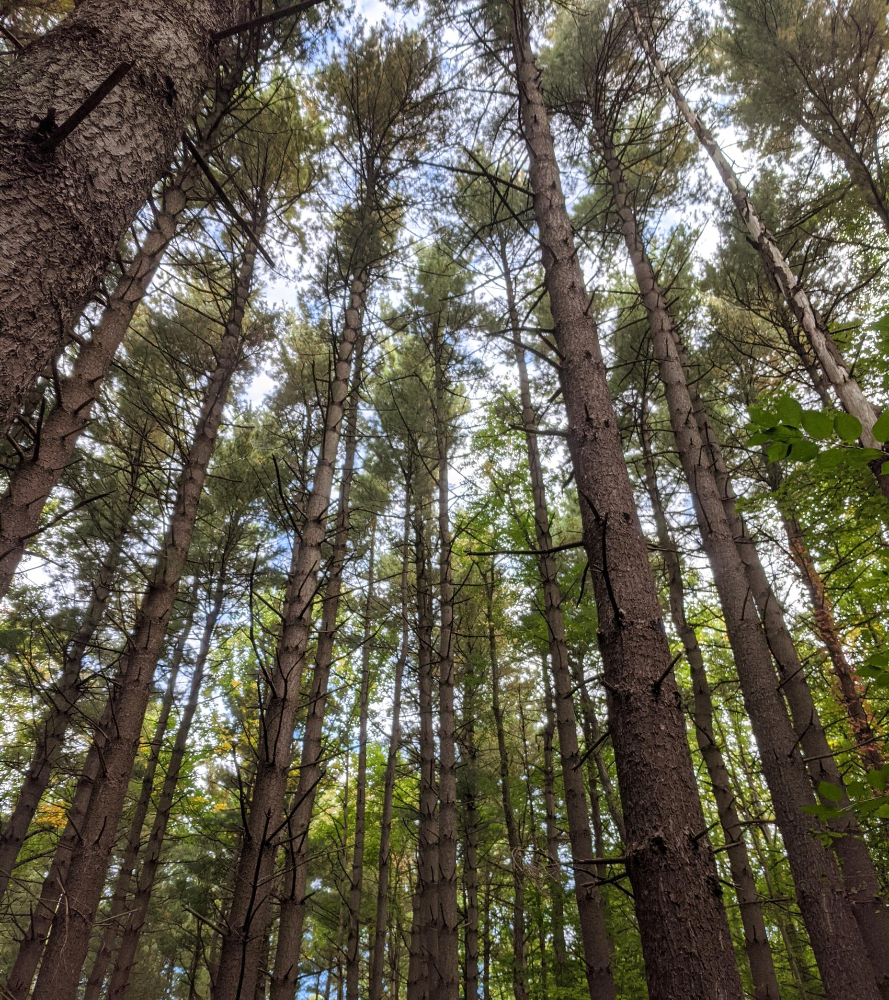
Preconstruction Procedures (all entities)
Application, fees & SWP3 submittal, review and approval, & pre-construction meetings
Our database
Ohio EPA Review Checklist
Meet RLD Manual Standards
Send review letter or approval
Clearing plans, grading plans, or SWP3
Typical findings noted: No JD letter, misuse of sediment controls, lack of temporary seeding, provided vs. required dewatering volume

Slide 12
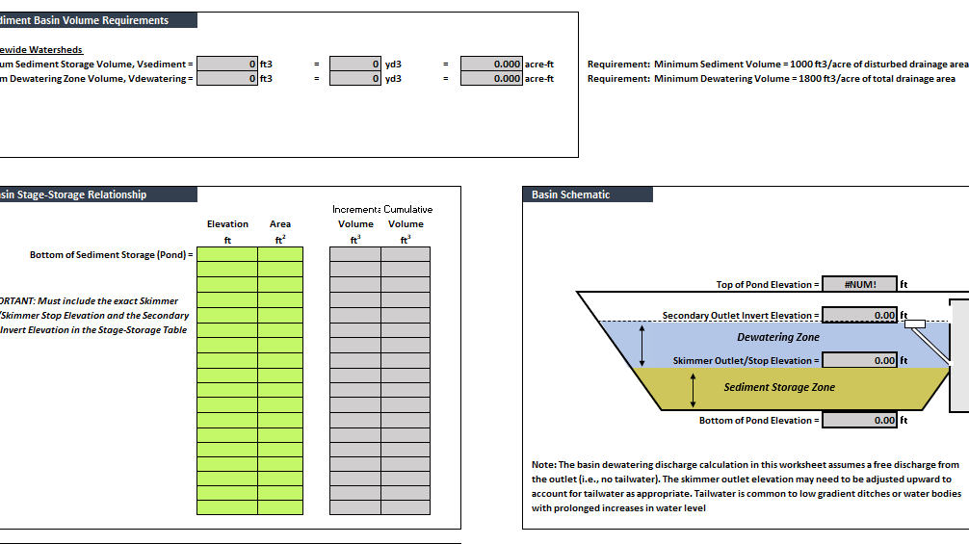
Review Tools
Rainwater Land Development Manual
Sediment Basin Compliance Tool
Review Checklist
Q & A documents

Slide 13
Inspections
Default to a minimum of once per month inspection schedule
Inspections continue until the site is stabilized and post-construction control measures are installed (City exception, 90 days)
Database, software program (all entities)
The inspection frequency may occur more frequently due to:
  Non-compliance (NOVs)
  Complaints
  Mass grading
  Proximity to surface water

Slide 14
Enforcement Tools
Immediate Stop Work Order (ISWO) & Stop Work Order (SWO)
NOVs & Re-inspection fee ($250.00)
ORC 307.79
Additional sanctions outlined in the code:
  Bonds
  Denying plat approval
  Suspension of occupancy permits
  Suspension of other permits
  Denying other inspections

Slide 15
TMDLs Requirement Increased Inspection Schedule
Construction activities started without approval
Failure to install sediment basin
No controls are installed
Dewatering activities resulting in turbid discharges

Slide 16
Annual Reporting Requirements
If using a software program, this information is easy to mine!
We are not the MS4 manager, export data and send to manager
For the cities and villages, we export and send data to the assigned MS4 manager

Slide 17
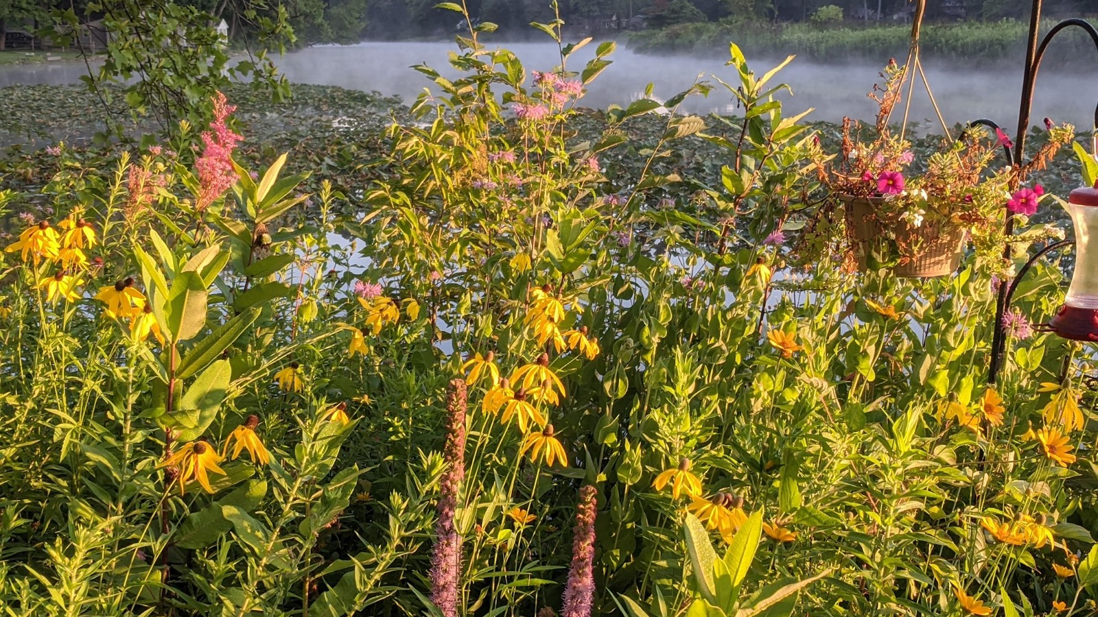
Minimum Control Measure #5 Post Construction

Slide 18
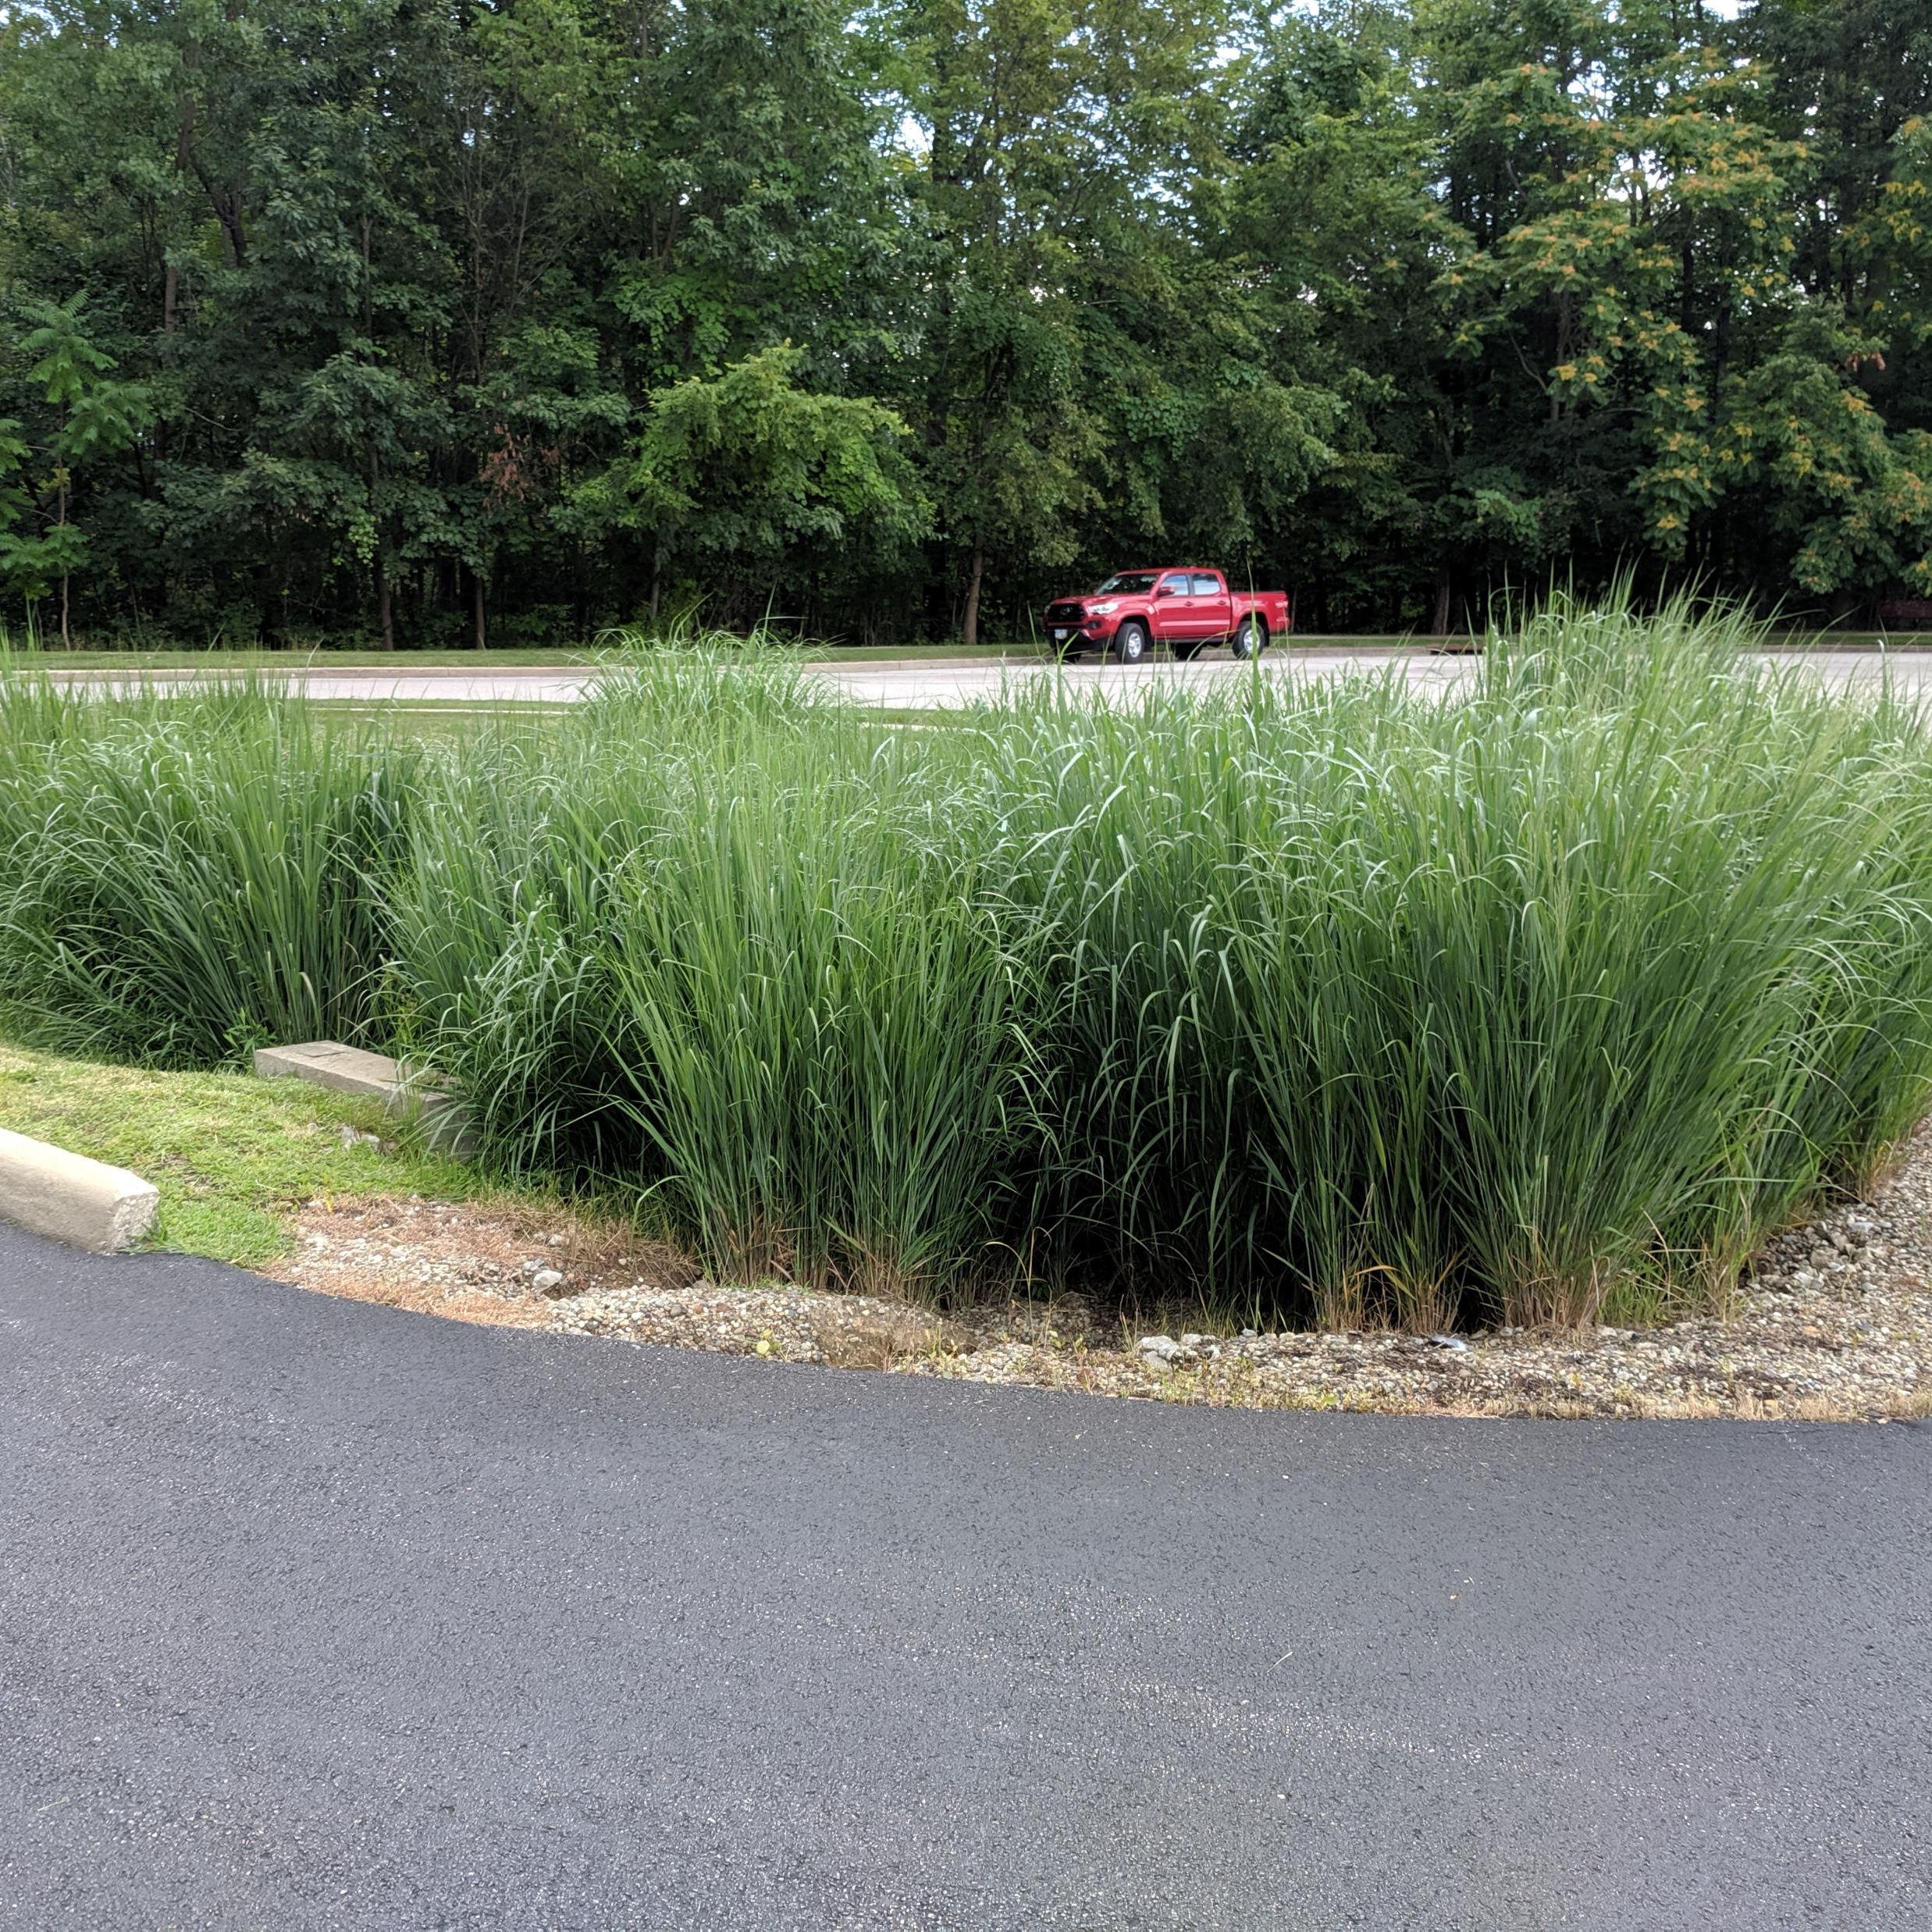
Performance Standards:
How your program address stormwater runoff from development
How your program will be tailored for your local community
nonstructural post-construction runoff controls in your program
structural post-construction runoff controls in your program
Regulatory mechanisms
Ensure long-term operation and maintenance (O&M)
TMDL Performance Standard

Slide 19
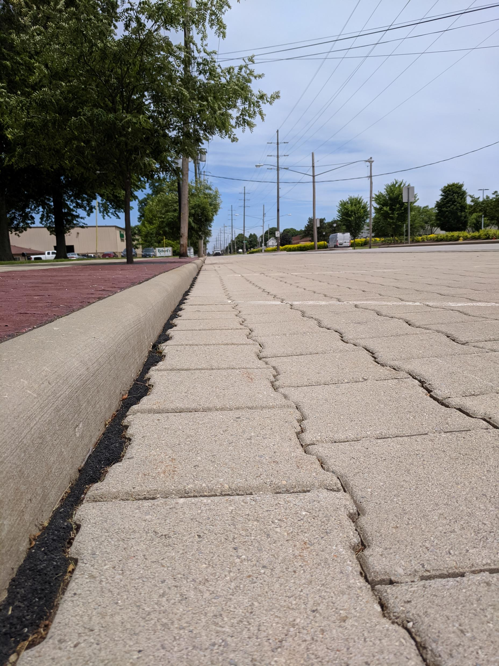
Stormwater Runoff from Projects
SCCO 941 and 943 set post construction requirements
Allows for structural and nonstructural Stormwater Control Measures (SCMs)
Promoted Table 4B (Low impact design, or green infrastructure practices)
Limit minimum WQ_{o} Size to 2” in county manual

Slide 20
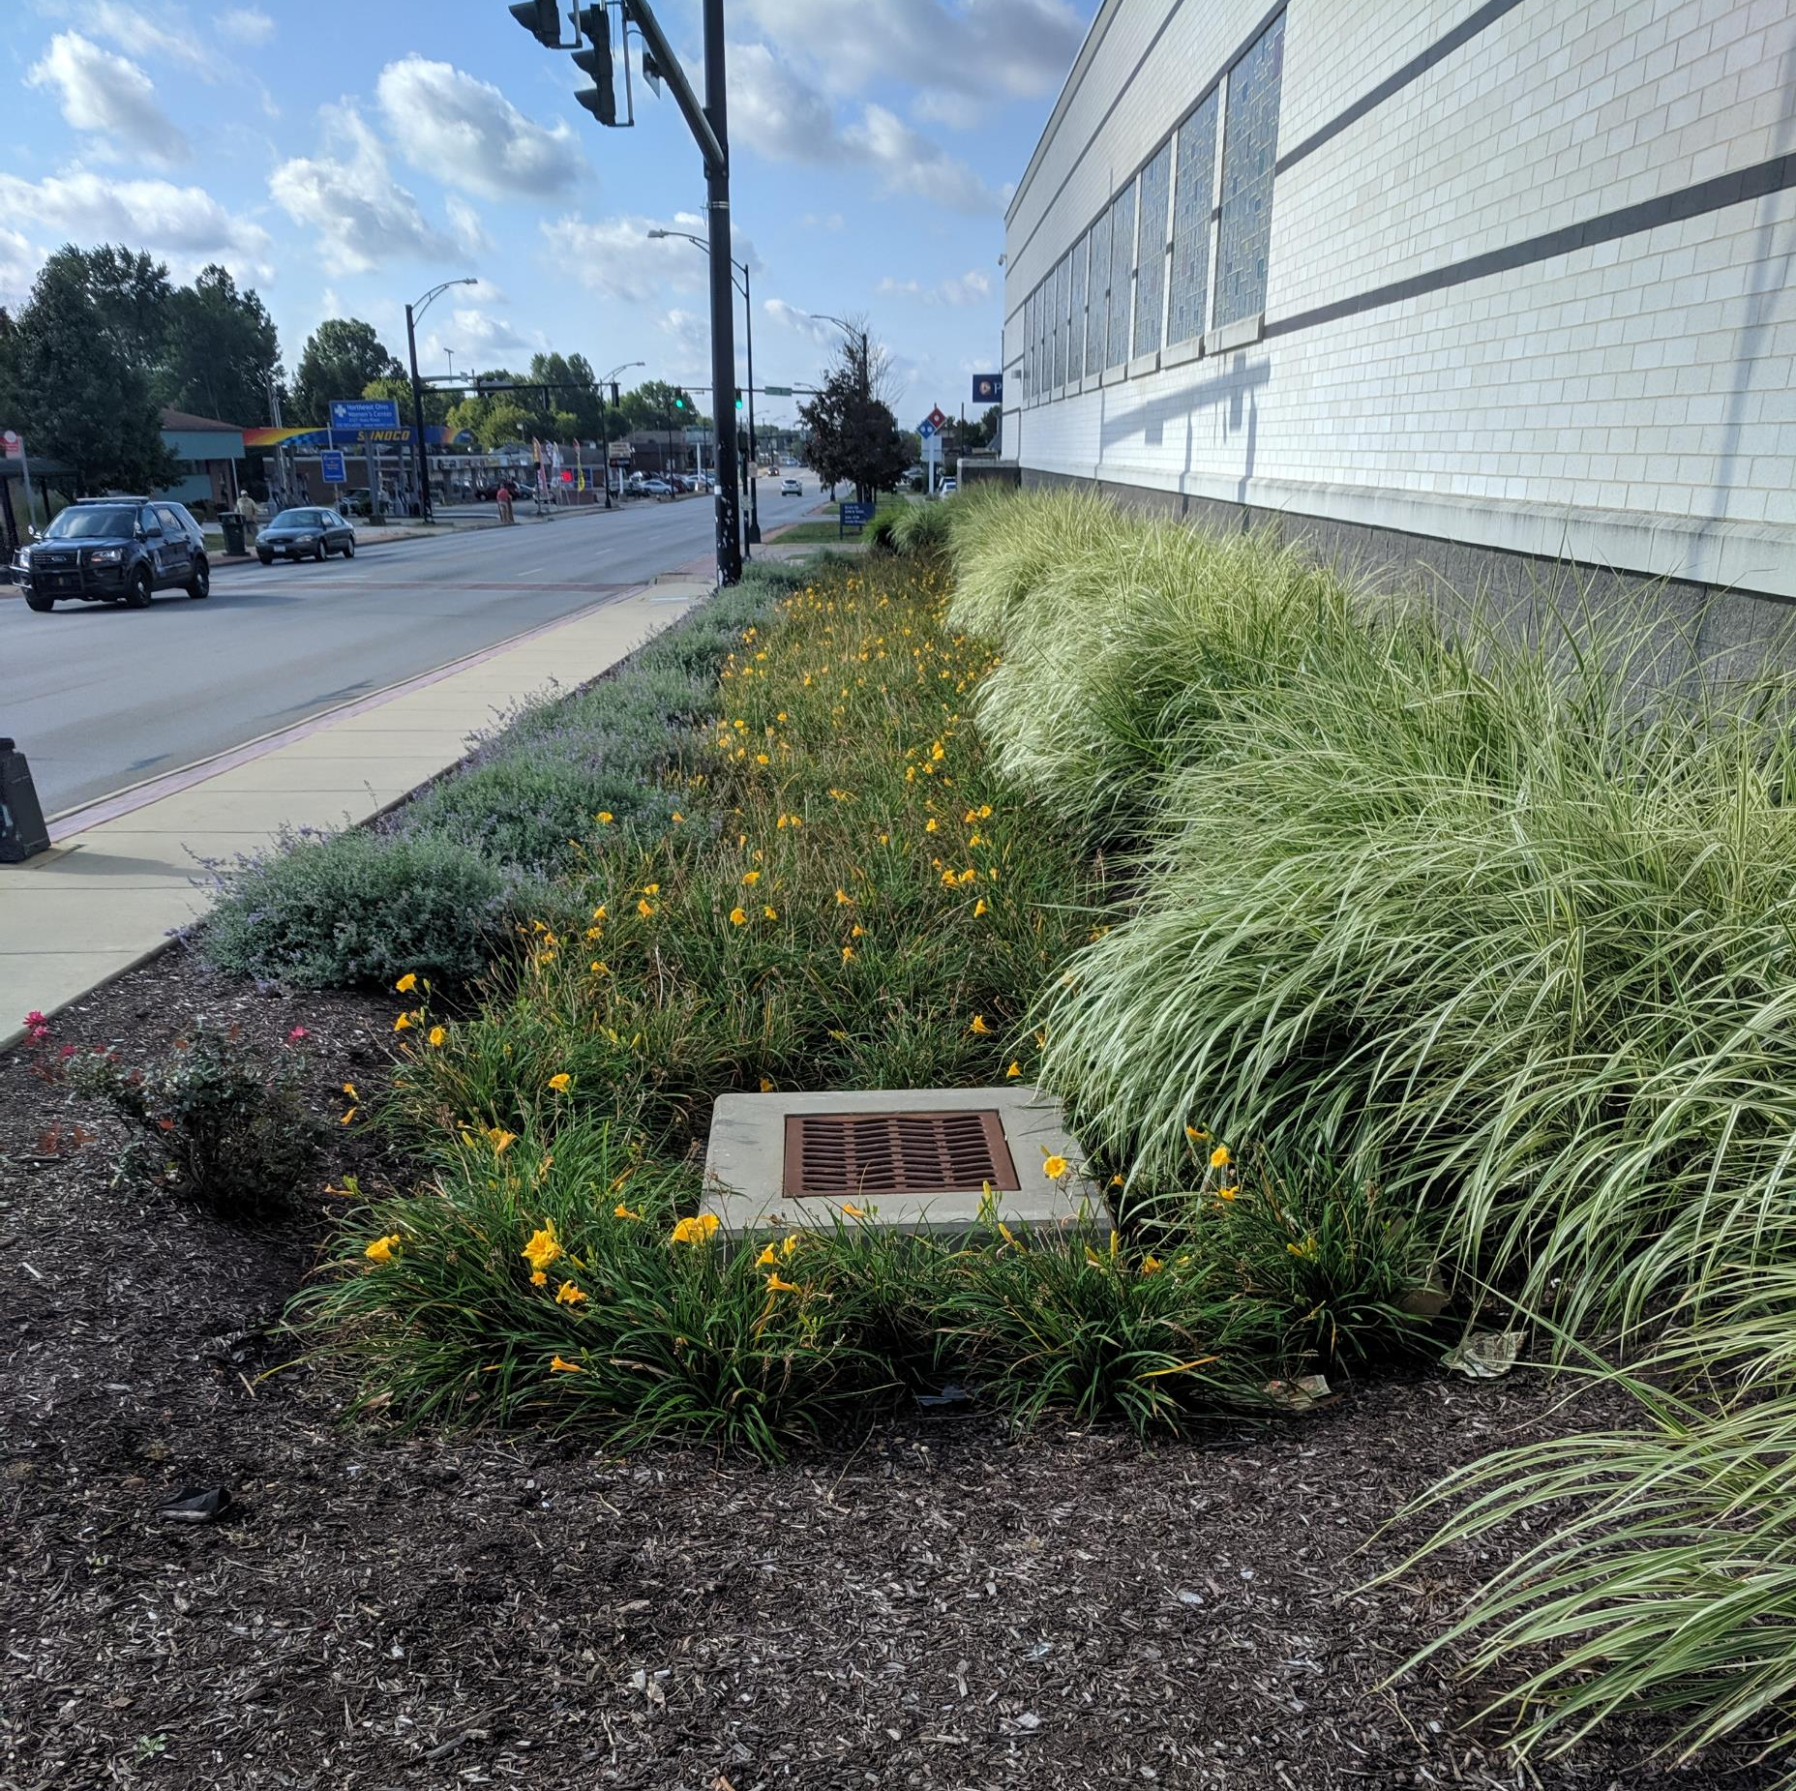
Post Construction Continued…
Required to meet the general construction permit
Design criteria of the Rainwater Land Development Manual
Meet the requirements in the county drainage manual
SCCO 937 - Riparian Setbacks
Most cities adopted the above

Slide 21
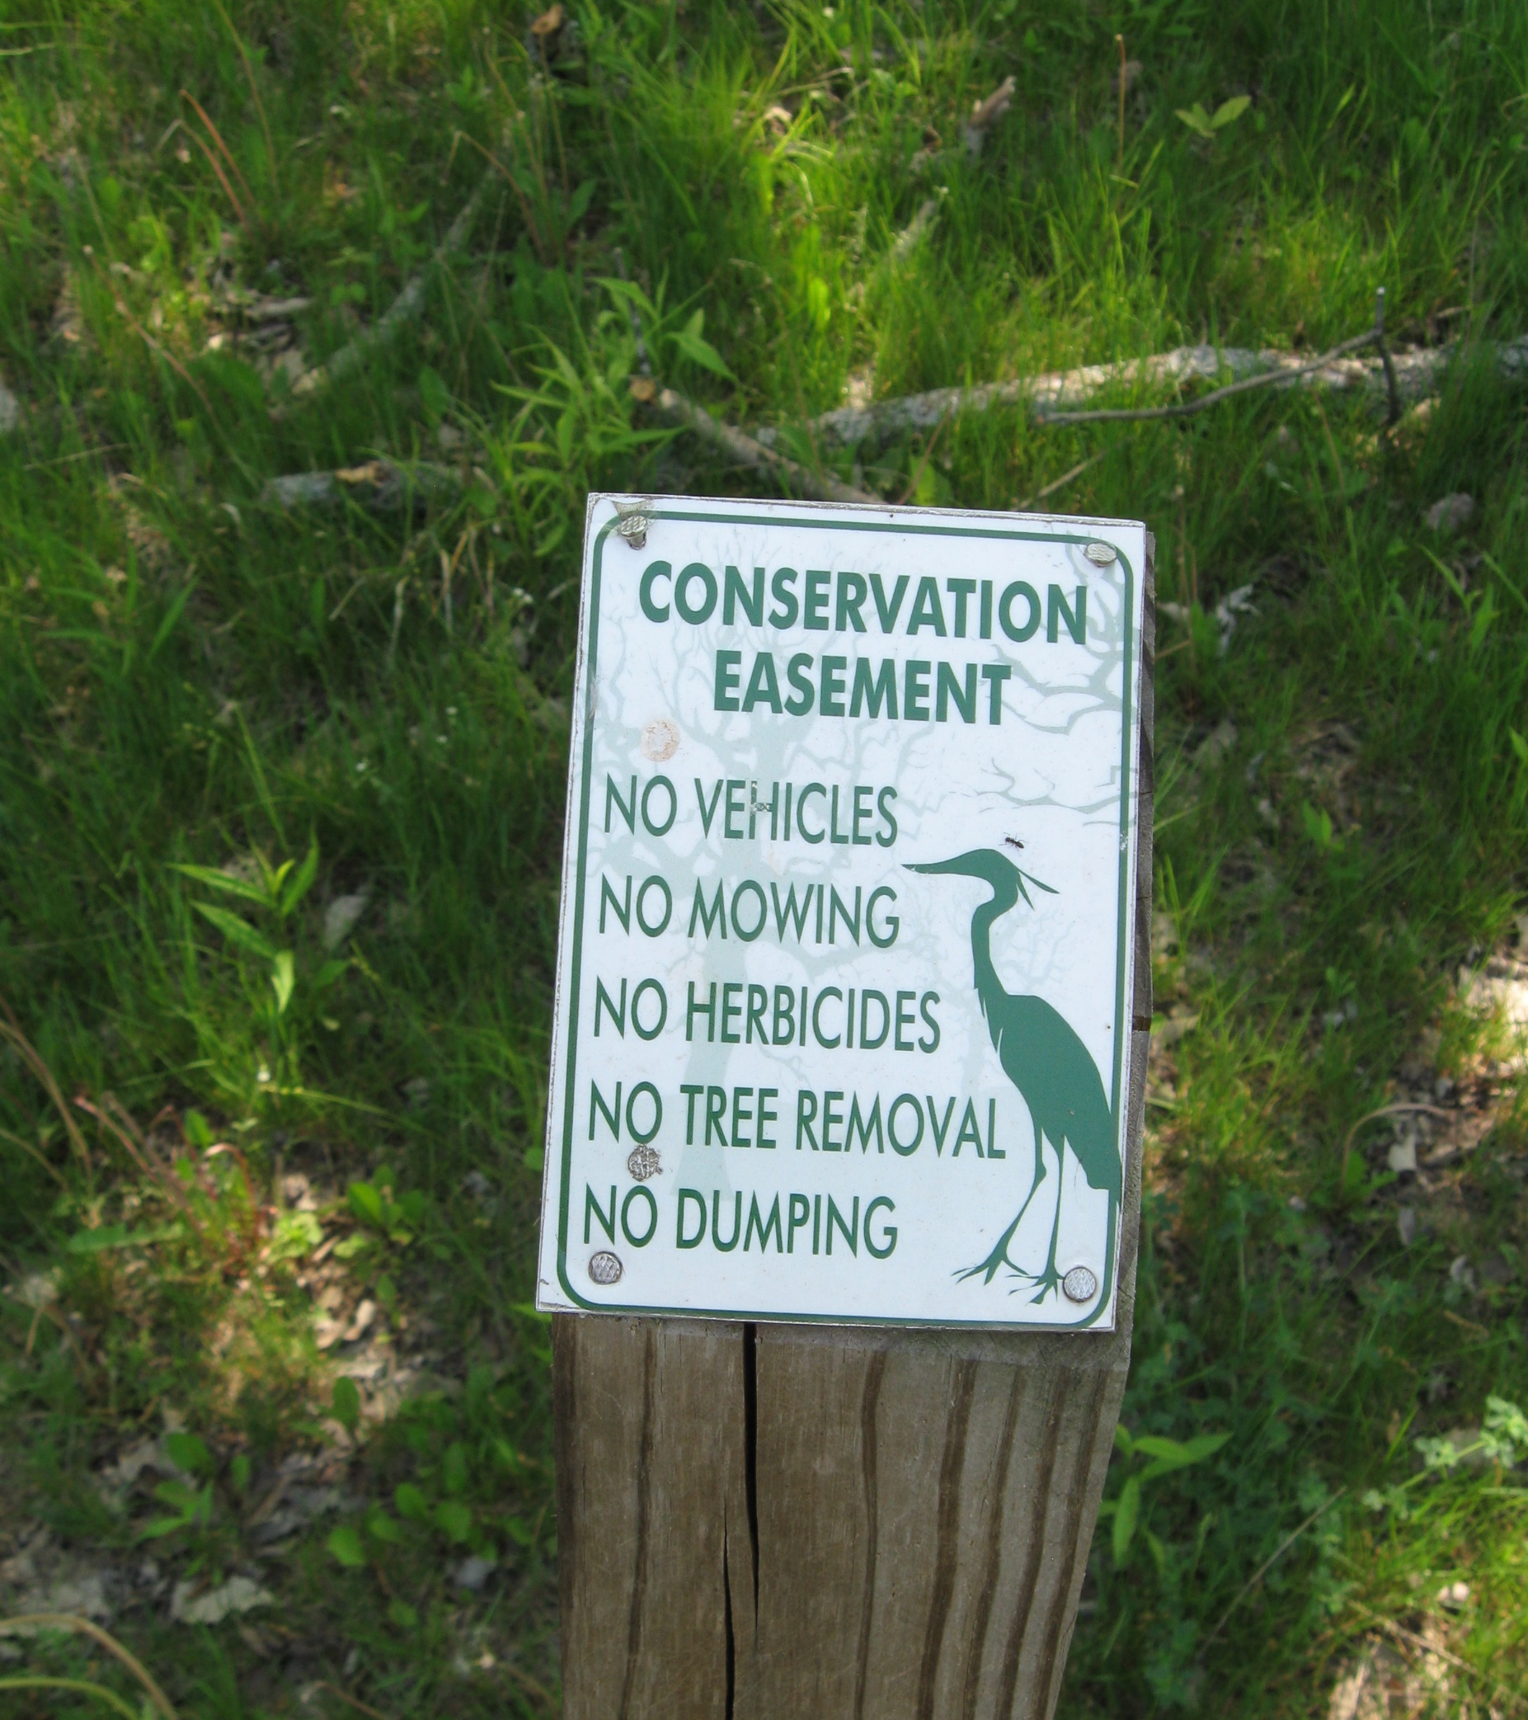
Nonstructural Controls
Sites that meet the definition of small sites and less than 1 acre of impervious surface
Riparian setbacks
County subdivision regulation and local zoning regulations
Balance growth plans
Preservation via Clean Ohio Funds
Obtain Conservation Easements

Slide 22
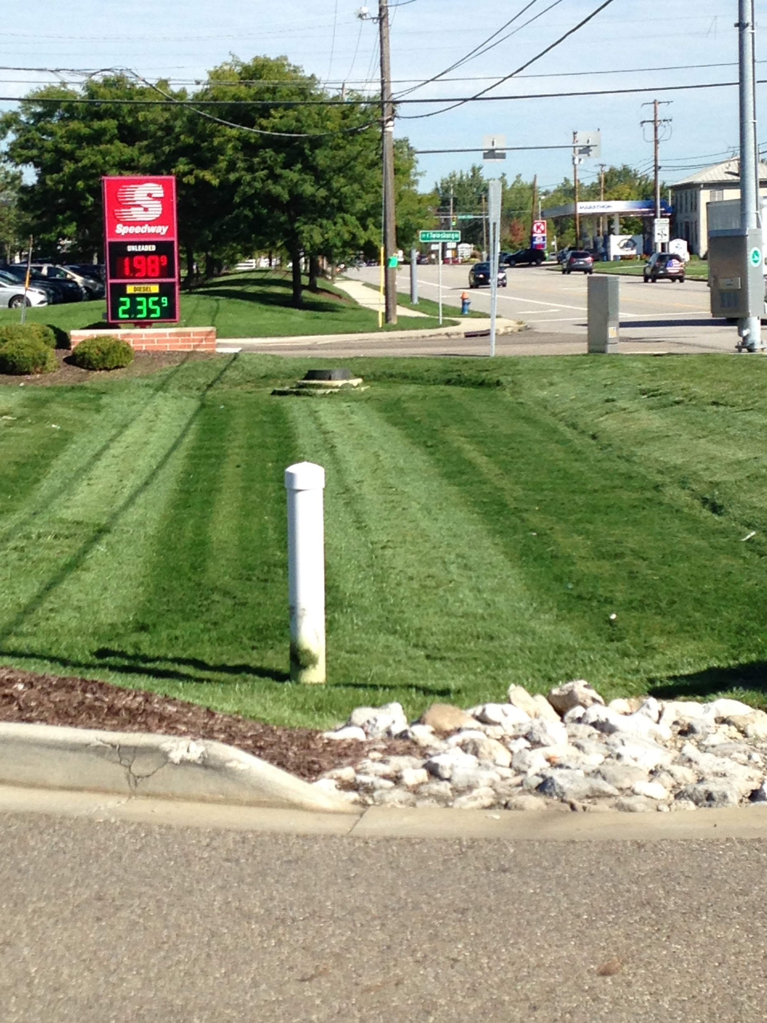
Structural Controls
County Drainage Manual promotes infiltration practices or table 4B
Allows for all SCMs listed in the GCP & RLD
Limiting minimum WQ_{o} size to 2” on extended detention basins but must meet drain times

Slide 23
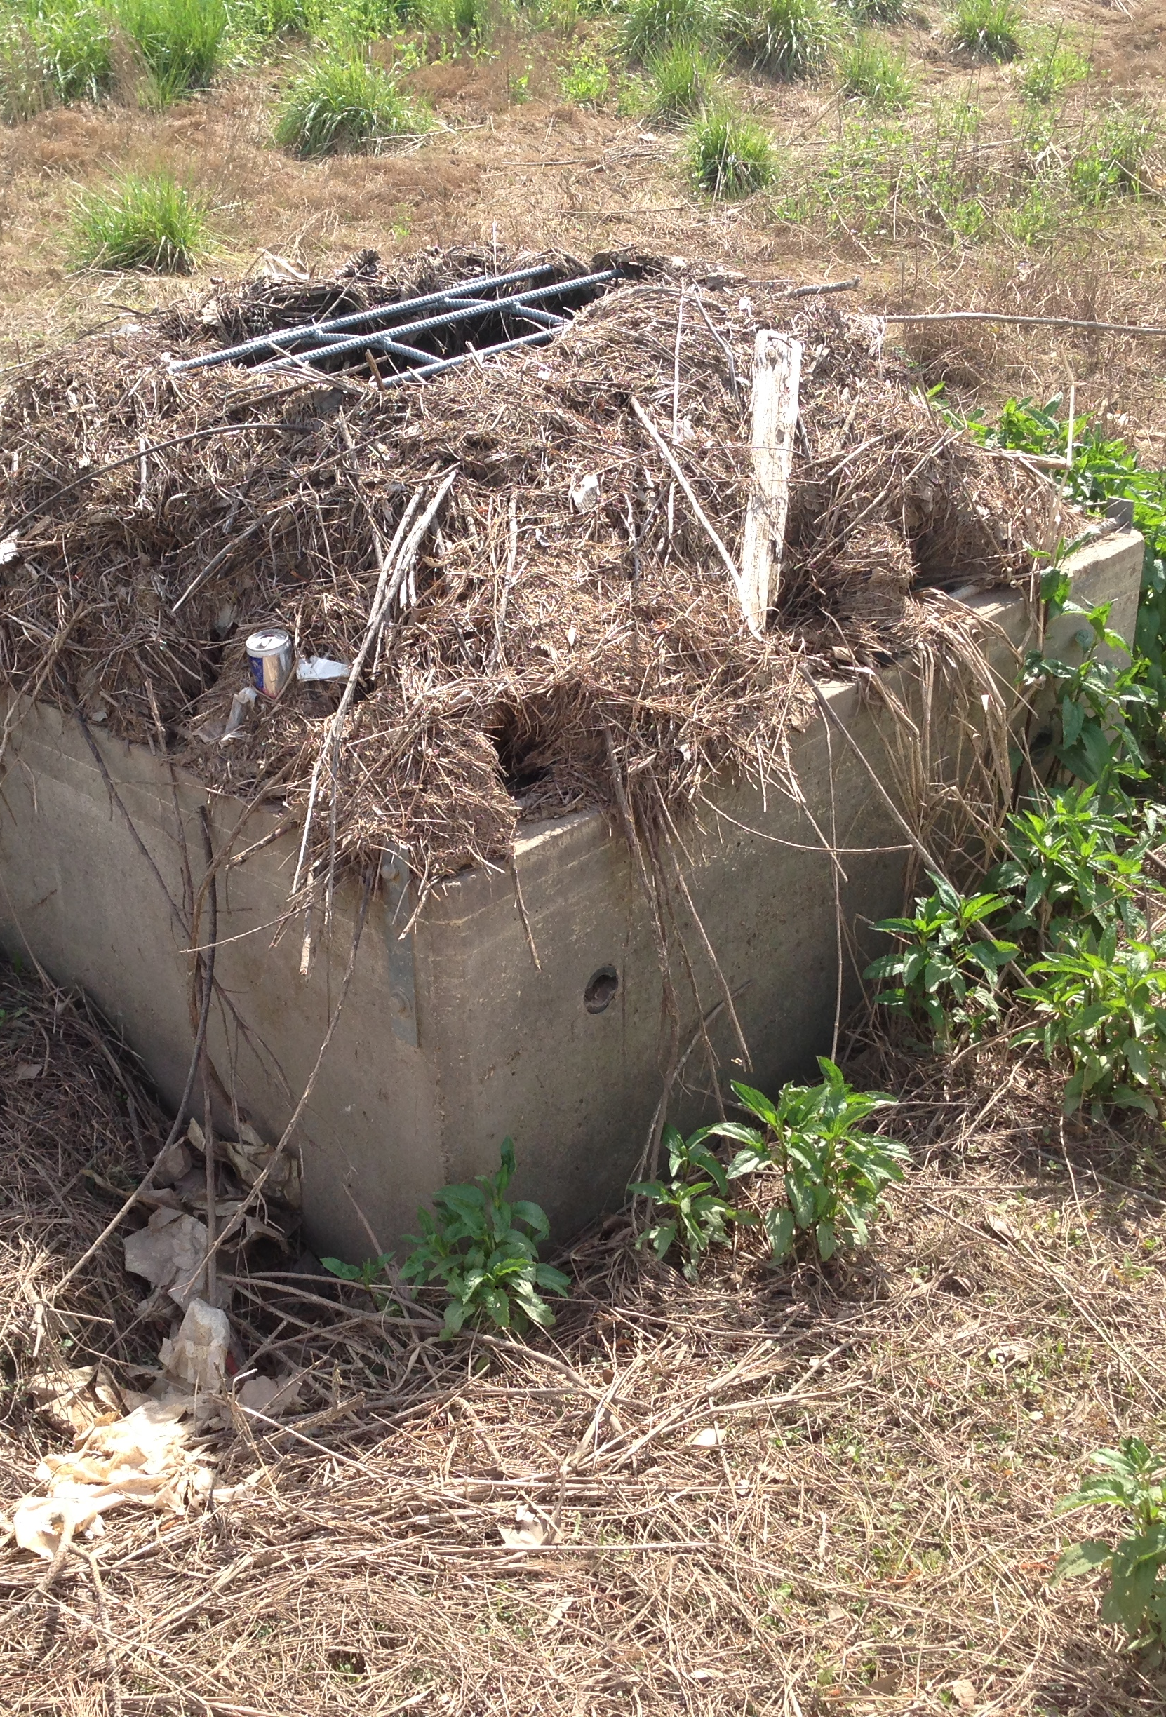
Operation and Maintenance Program
Private sites require long-term maintenance agreements (LTMA) to be executed prior to construction
The LTMA is recorded with SC Recorder’s Office
Inspected once per permit term or more often
Owner or operator are required to submit annual reports
Assessed subdivision drainage maintenance service
LTMAs cover structural, nonstructural and reduction of impervious surfaces SCMs

Slide 24
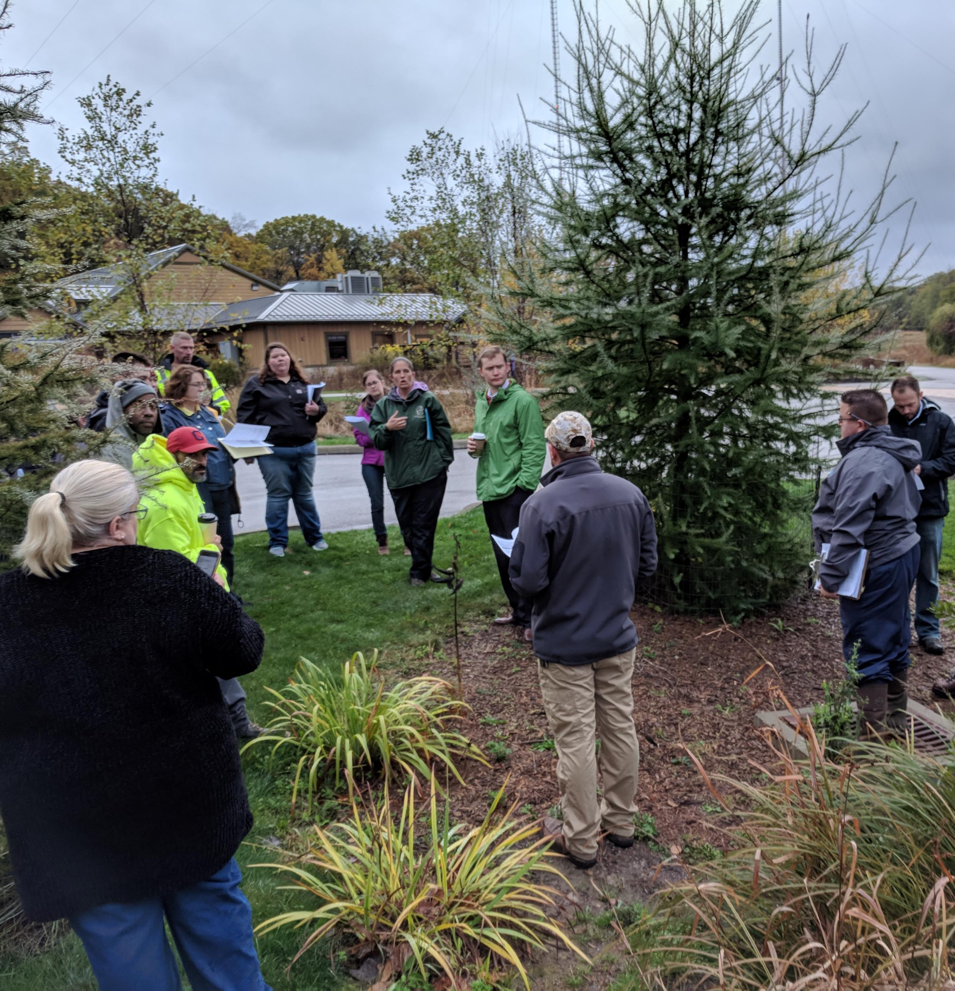
TMDL Performance Standard
Table 4B Workshop, field day or education event
Retrofit an existing flood control practice
Perform 300’ of stream restoration
Update your ordinance to require Table 4B practices
Install a Table 4B practice to treat a minimum of (1) acre of untreated impervious surface

Slide 25
Tools & Resources for MCM #5
BMP Compliance worksheet
WQv Calculator
Runoff Reduction Worksheet
Post-Construction Q&A Documents
Rainwater and Land Development Manual
ODOT Location & Design Manual V. 2
Chagrin River Watershed Partners Model Ordinance
Maintaining SCMs Guidance for Private Owners & Operators Manual

Slide 26

SSWCD’s Additional Program Requirements
Bioretention soil lab results
Table 4B pre-installation meetings

Slide 27
Future Tools Under Consideration…
Soil restoration testing SOP
Sign-off forms
  Underground or premanufactured systems form
  Bioretention soil lab form
  As Built compliance form
Delaware Skimmer Requirement
Biofiltration practice for <2 acre sites (small sites)

Slide 28
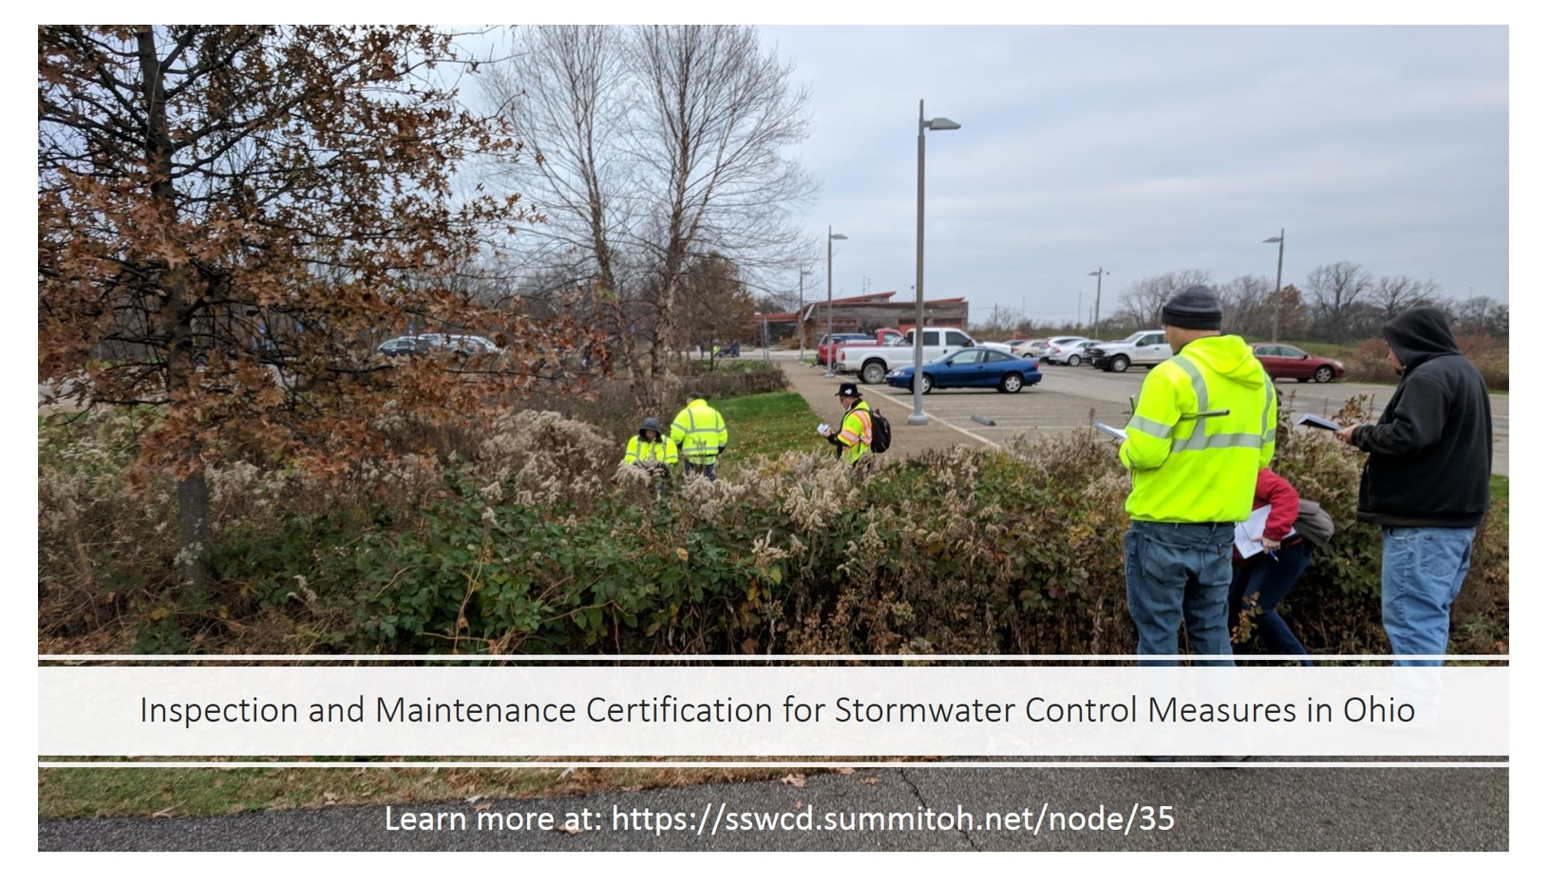

Slide 29
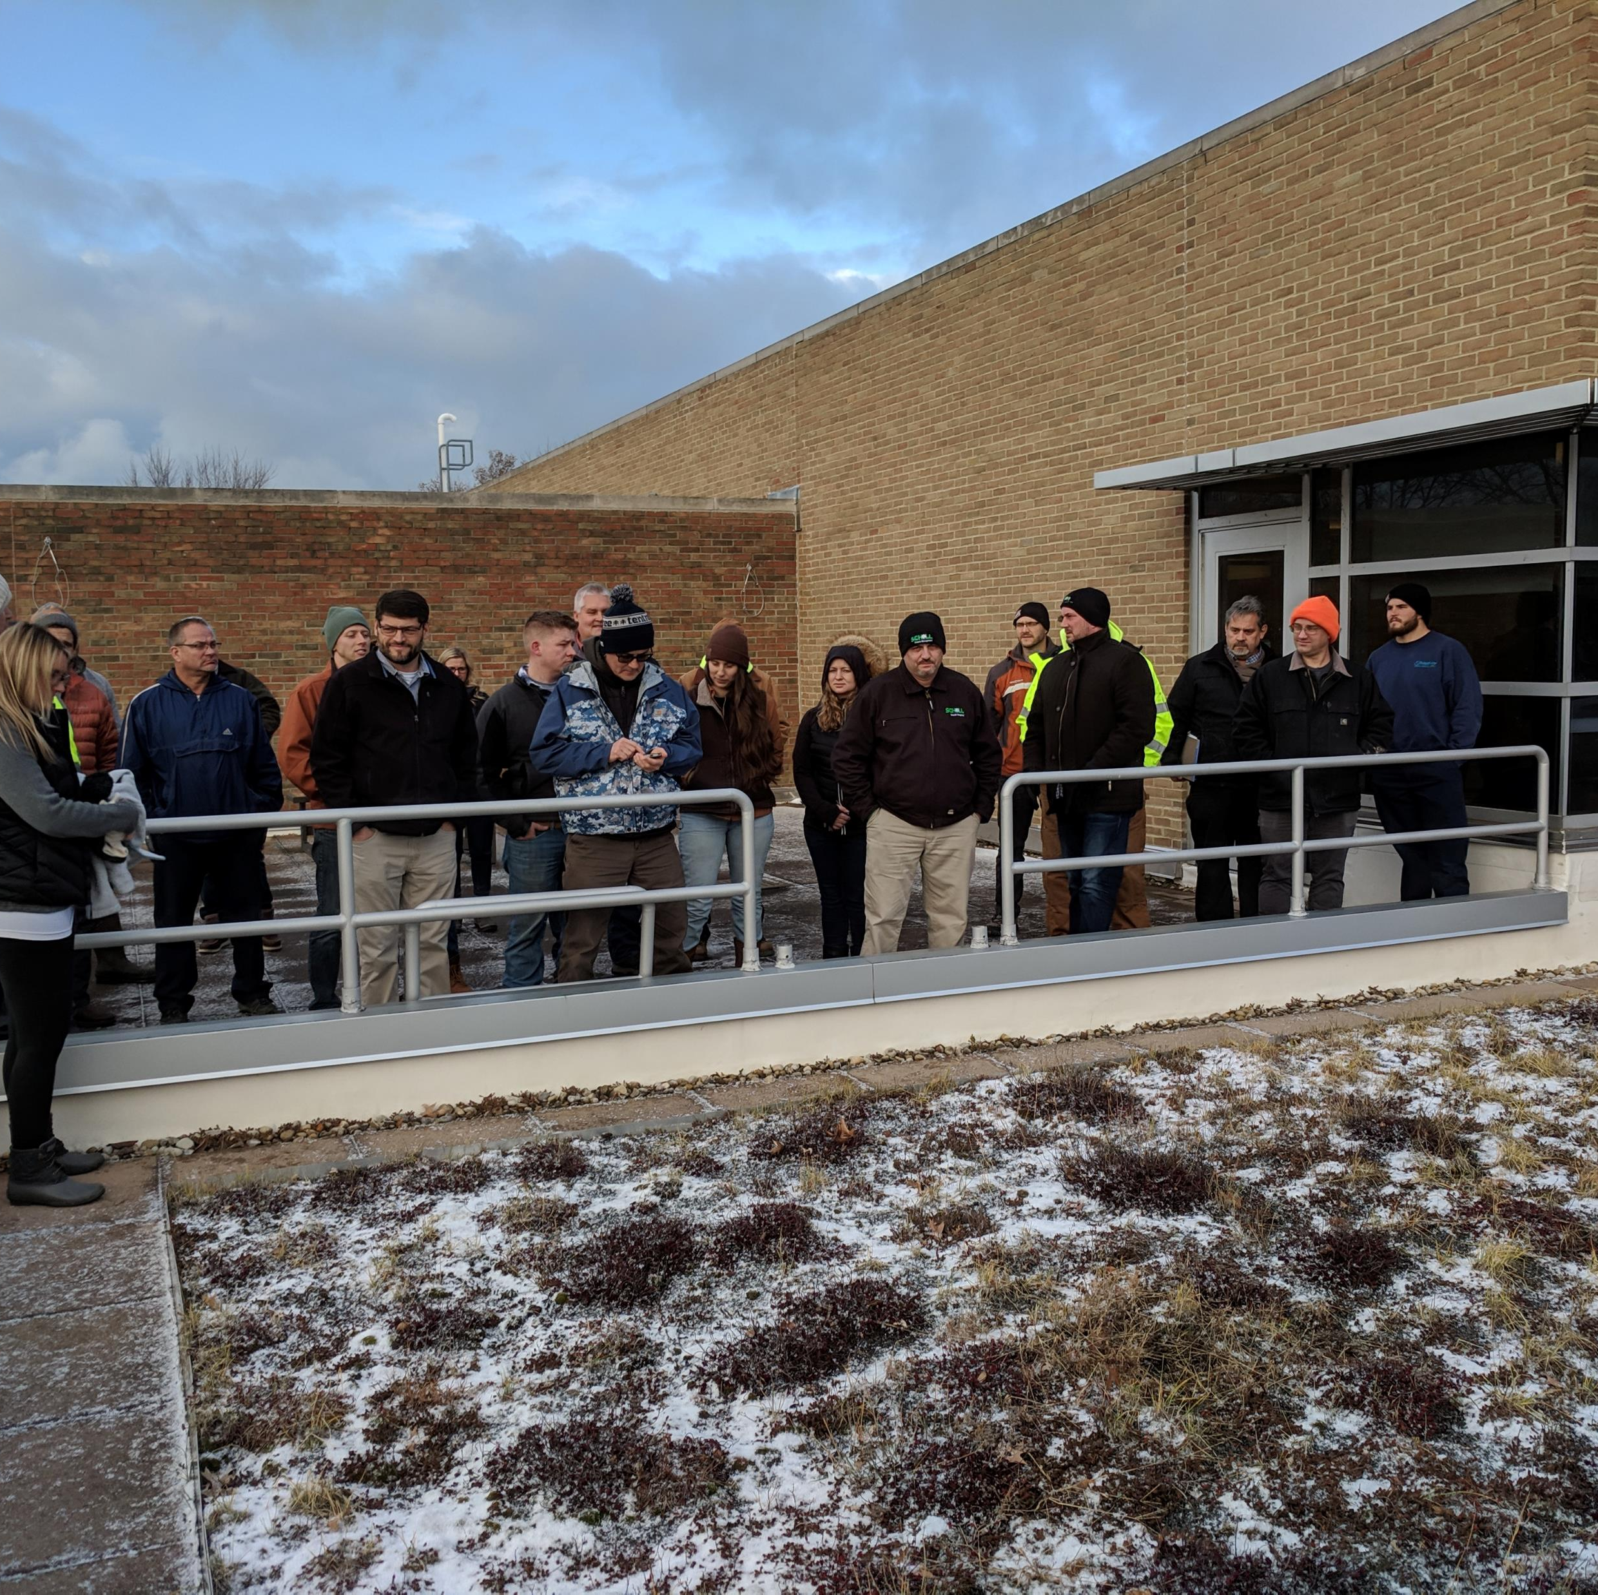
Inspection & Maintenance Certification for SCMs in Ohio
Summit SWCD & the Ohio State University developed a statewide certification program
Based on Ohio’s standards & SCM’s
2-day course, lecture, mock inspections & exam
Over 500 certified professionals (government, parks, consultants, NGOs, property managers & contractors)
Certified contractor list
Certification good for 3 years, no membership fees

Slide 30
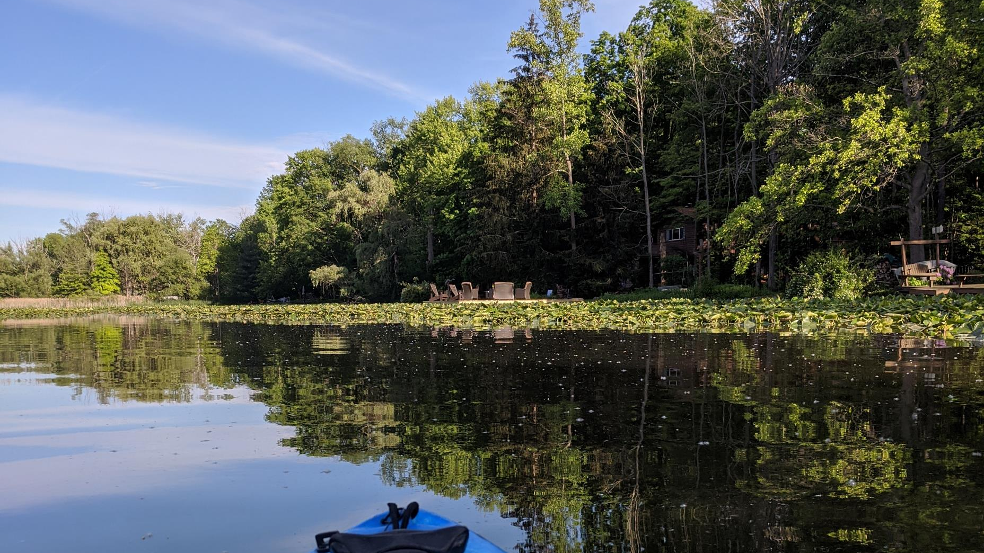
Class Learning Objectives:
identify different SCMs and how they function
identify common deficiencies or issues and make corrective measures
document issues and maintenance activities performed
monitor vegetation and manage undesirable vegetation
identify appropriate maintenance frequency
communicate with the local agency and provide proficient reports
identify ways to lessen maintenance cost

Slide 31

Questions?
Brian Prunty, CPSWQ
bprunty@summitoh.net
330.926.2448
www.summitswcd.com

