Slide 1




The Benefits of Having a Combined Permit System
For both the Customer and Permitting Agencies
Hamilton County, Ohio
Notes:
The new permit system was developed to replace a 30-year-old system. It took 5 years to develop and was rolled out in February of 2025. All open permits from the old system were rolled over into the new system. All records which were in the old system are still archived in the old system which is still available to view.

Slide 2
Hamilton Counties Permitting System
Users of Permitting System:
  Zoning Permits
  Building Permits
  Electrical Permits
  Plumbing Permits
  FEMA Flood Hazard Permits
  Sewer Permits
  Water Permits
  Earthwork Permits - MCM4
  Stormwater Permits - MCM5
  Stream corridor review
Notes:
The combined permitting system for Hamilton County is used by multiple agencies for many different permit types. These include the listed permit types.

Slide 3
Hamilton Counties Permitting System
Permit System serves:
  All 12 townships
  18 jurisdictions for Stormwater and Erosion and Sediment control
  12 jurisdictions for Building Permits
This permit system does not include the City of Cincinnati and other cities and villages who have opted to do permitting on their own. Cincinnati does use the same program; they just do their own permitting.
Notes:
The new system is used by all 12 townships and jurisdictions who have chosen to use the county system. The City of Cincinnati does not use the county system but uses the same programs as the county for their permitting system. There are other jurisdictions in the county who opt to do their own thing. These include some members of the Stormwater District.
The Hamilton County Stormwater District was created to streamline MS4 compliance and pool resources for those jurisdictions who wanted to join. All 12 townships and 18 jurisdictions are currently members. We have found this to be more effective than working off MOU’s.

Slide 4

User Benefits:
Web-Based System: Apply anytime, anywhere—no special apps or software needed
Online Payments: Make secure online credit/debit card or eCheck payments
Efficiency: A streamlined process that reflects our commitment to innovation
Self-Service Capabilities: Complete preparation and applications at your convenience
Reusable Accounts: Create an account once and save time on future projects
Project Status Tracking: Stay informed at every stage of the approval process
Collaborative Access: Share data seamlessly across your organization
Unified Communication: Get updates from multiple County agencies in one central location
Notes:
Additionally with the new system being web based, no special apps or software are needed by the public. People who utilize the permit system on a regular basis reuse one account which saves time entering data and allows them to track multiple jobs at the same time. You can also have multiple users that share access to permits for better collaboration and visibility.

Slide 5
Agency Benefits
Electronic applications
Cross agency visibility
Enable cross agency sign-off on permits
Ability to review through the entire application process
Applications are distributed with due dates to all applicable agencies
Additional enforcement opportunities
Online inspection scheduling based off inspector availability
Inspections documented electronically and reports sent automatically
Fees are calculated automatically and are invoiced electronically
Web based so access is available in the field
Complaints entered into the county system will also be assigned and tracked through the permit system
Notes:
For the agencies using the permit system, electronic applications mean less paperwork,. For records retention auto archiving of the entire project ensures compliance. With each requirement being added to the appropriate permits, sign off on permits requires all aspects to be completed before final approval. For me this means no C of O’s without stabilization! Projects can be tracked from initial concept through to completion by all parties involved.

Slide 6

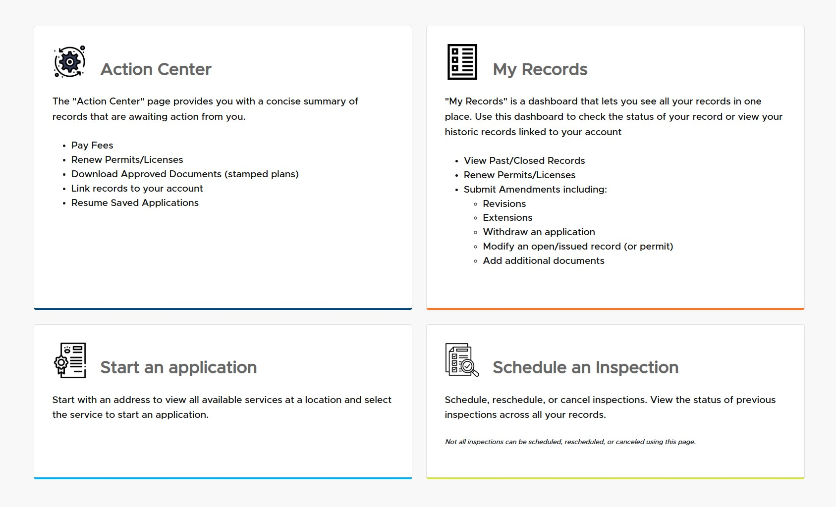
Customer Facing Platform: ezTrak
Notes:
The permit system has two components, the customer facing website: ezTrak and the agency website: Edge. EzTrak is set up to have four main categories on interaction. The action center where you can pay fees, continue a saved application, download documents, and renew permits. My Records where you can view all of your records in one place, submit revisions, add additional documents, and modify or withdraw a permit application. Start an application is self explanatory. And finally schedule inspections. This cross references your inspector's availability to only allow inspections when they are available. No more calling the office to schedule an inspection or have to leave a VM if no one is in.

Slide 7
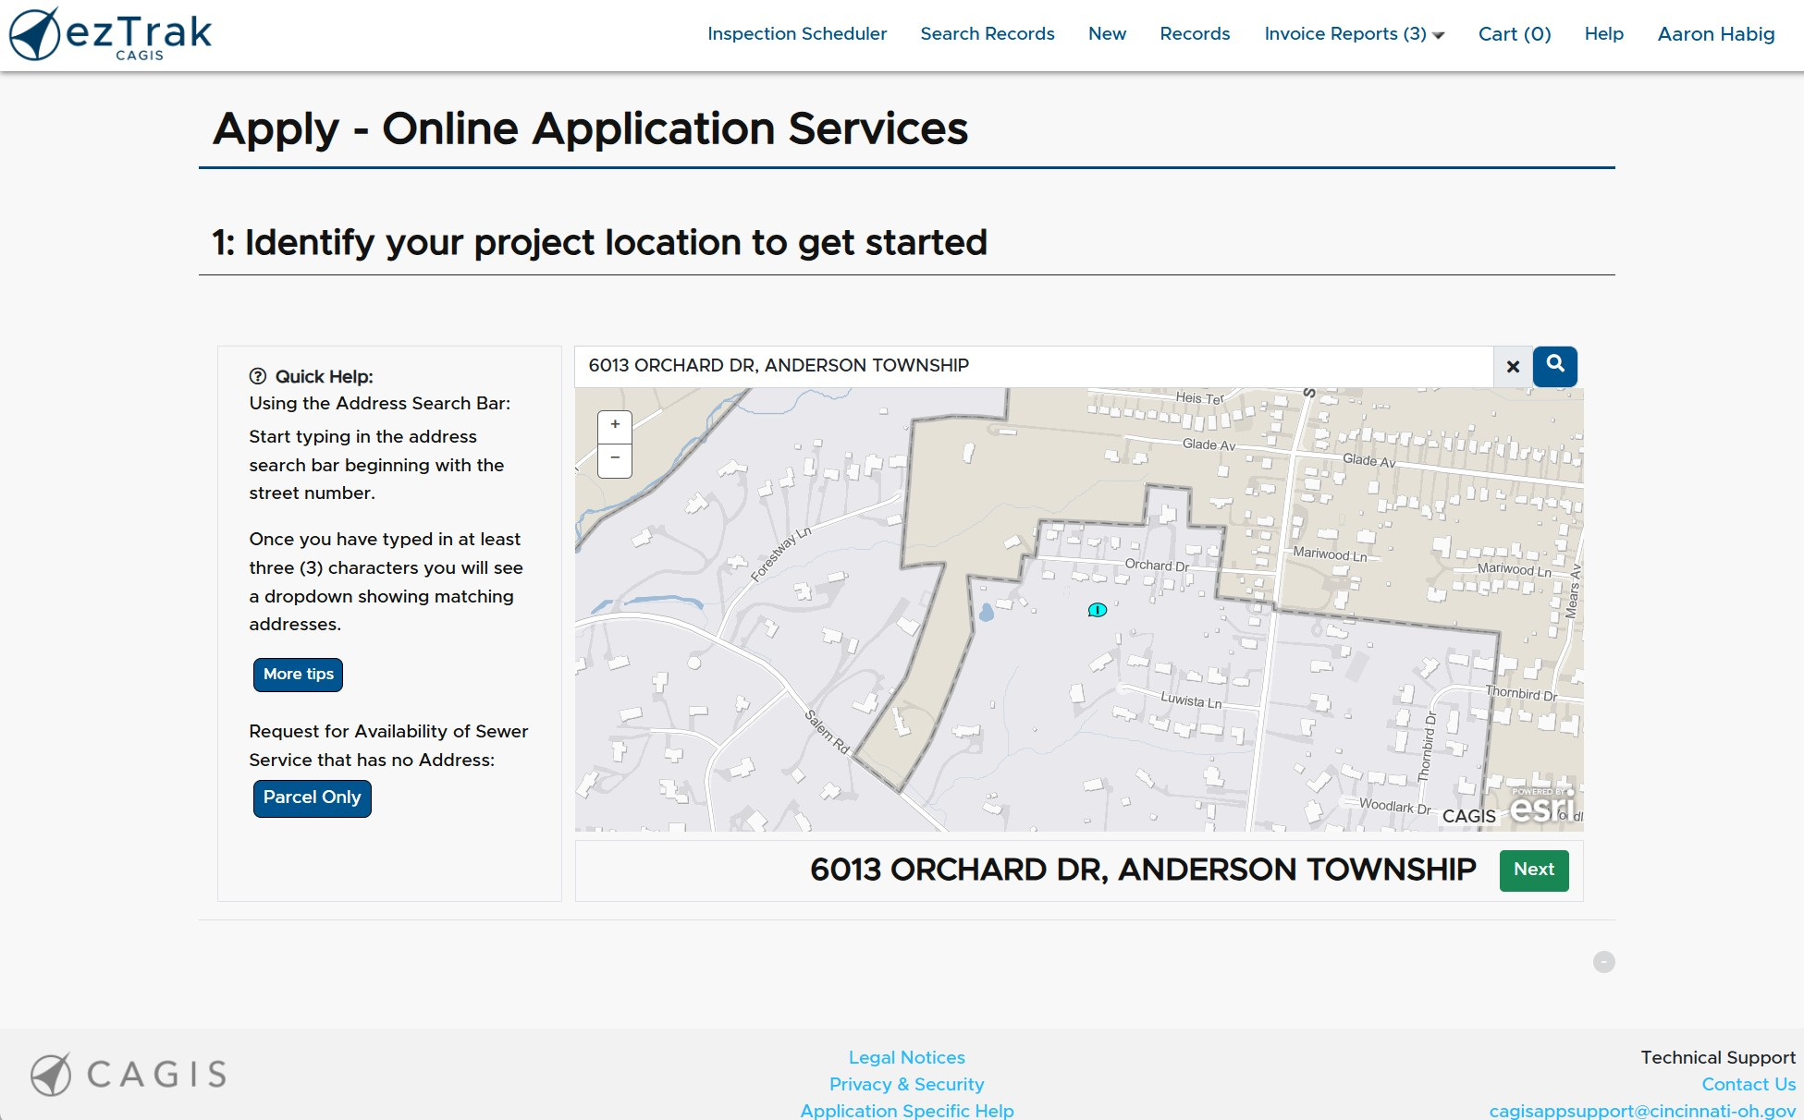
Customer Facing Platform: ezTrak
Notes:
When you start the application, you first enter in an address (or parcel number for sewer service) to see if the project is in an area covered by this permit system. If it is then you will be prompted to choose your permit type. Only the permit types available in that area will be displayed. For example, if I pick a site in a jurisdiction that does their own development services (zoning, building permits, MS4) then only the items serviced by the system users will show. i.e. sewer and water. If you are in the City of Cincinnati, you will be put into their permit system. (They use the same program but separate from the county).

Slide 8
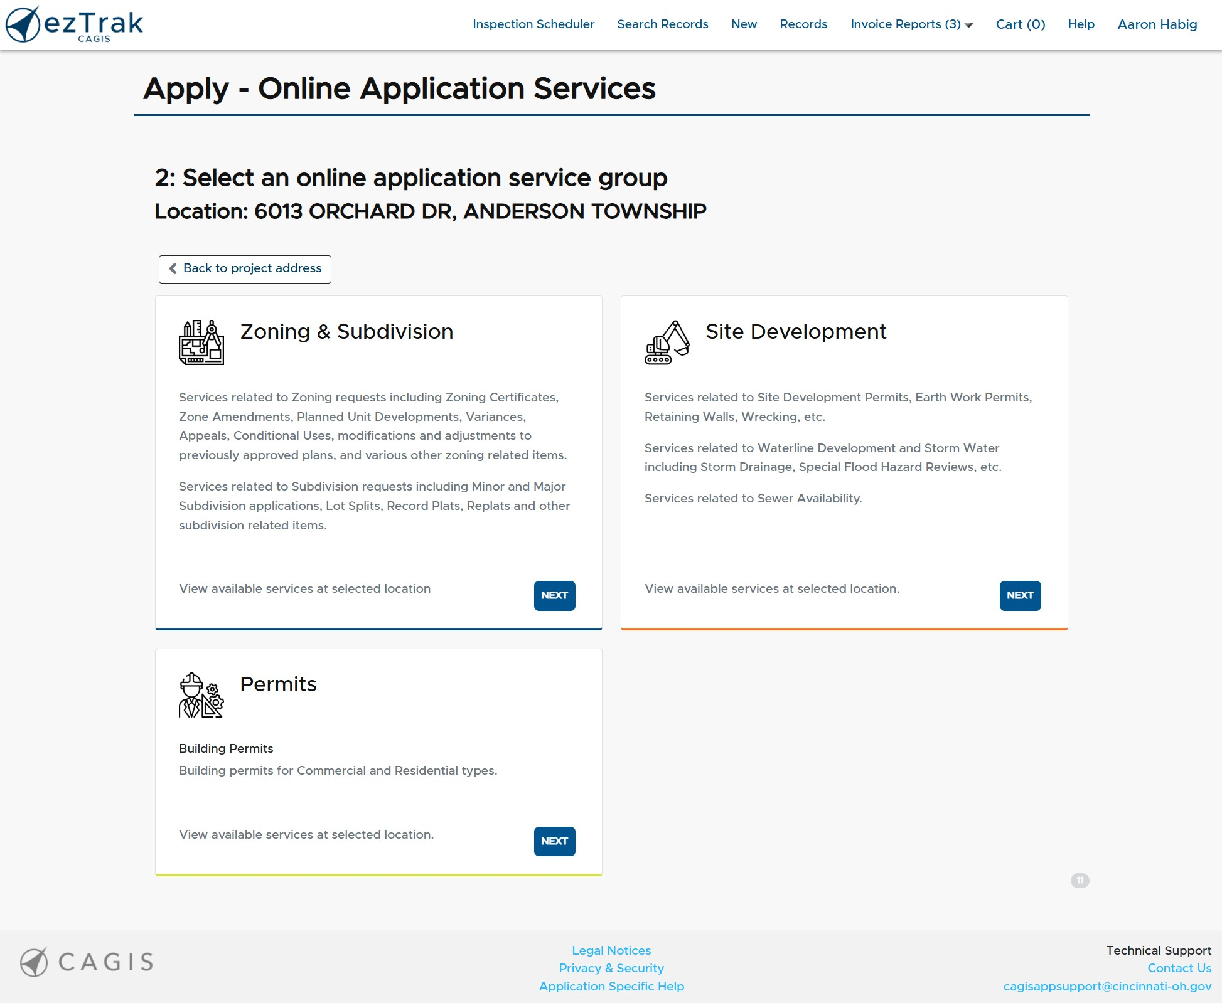
Customer Facing Platform: ezTrak
Notes:
Permit types page is broken down into Zoning and subdivision, site development, and permits. Site development includes Earthwork, Water, Sewer and Stormwater Permits. When selecting a permit type and starting the application process, the system will ask if you already have applied for a corresponding permit. If so, it will relate the permits, if not, it will create a temporary permit for the required permit type that you can then go back and resume an application and have most of the information prepopulated for the second permit.

Slide 9
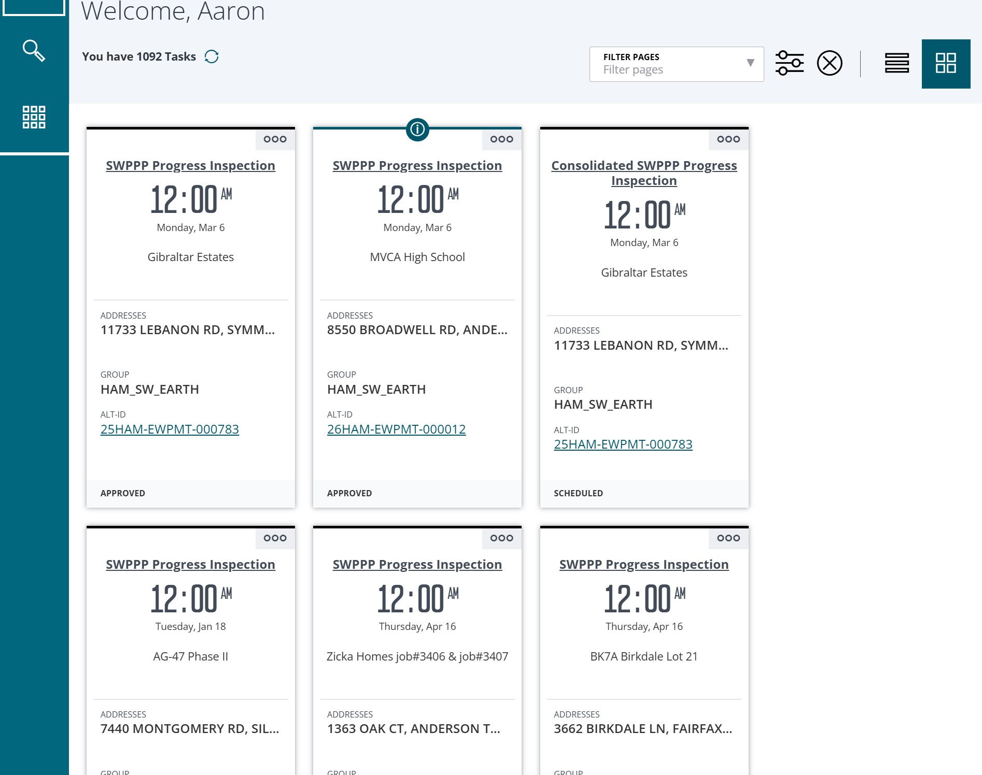
Agency Platform:
Edge
Notes:
The agency platform is Edge. When logging in the home screen will show projects that need attention. You can also sort projects by application type, status, assigned date, date due, permit number, etc. You can also sort by your tasks, department tasks, and unclaimed department tasks.

Slide 10
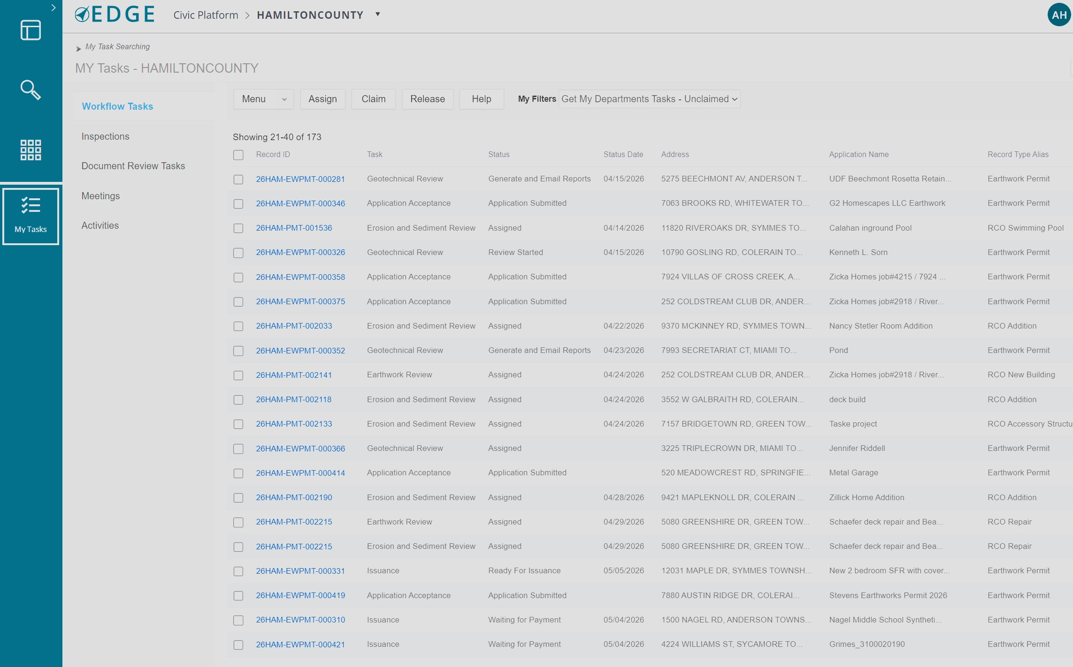
Agency Platform:
Edge
Notes:
The agency platform is Edge. When logging in the home screen will show projects that need attention. You can also sort projects by application type, status, assigned date, date due, permit number, etc. You can also sort by your tasks, department tasks, and unclaimed department tasks. From here you can choose a permit to work on. You can review plans, email people connected, approve, request revisions, input inspections (can also be done in the fields on Accela Mobile), whatever needs to be done to the permit is done from here. If the permits are related, approvals to one permit can update a related permit automatically reducing time and errors.

Slide 11
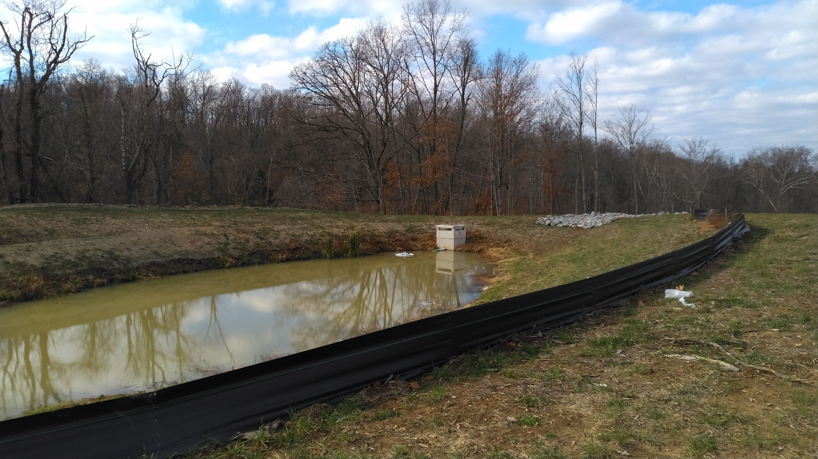
Benefits of the permit system for MCM 4 & MCM 5
Construction Site Runoff Control and Post Construction Runoff Management
Provides the ability to start the conversations about requirements during the zoning process
Permit requirements can be tied to multiple permits to ensure compliance before approval of an individual permit
Inspection reports are completed in the system and emailed to the appropriate contacts. Automatic records retention for these reports
All permit requirements must be complete before Record Plat or Certificate of Occupancy can be approved. This can not be overridden
System archive provides reporting features to help with end of year MS4 reporting requirements
The ability to use soft enforcement of holding permit approvals in addition to Notice of Violations (Check with your prosecutor about legality in your area)
Notes:
Benefits specific to the MCM4 and 5 are the ability to start seeing a proposed project as it starts the pre-application/zoning process. Approval requirements can be line items on multiple permits so that approvals are not given without full visibility of what is required. This also allows for soft enforcement capabilities of holding approvals on different permits if all requirements are not being met. No more having one department sign off on a project while another still has outstanding issues. ORC 307.79 only spells out the NOV process of 30/15/SWO Civil fines. Holding permits can supplement this process. Inspection reports get to the correct people in a timely manor so any issues can be addressed. Reporting allows counting of number of inspections, types of inspections, types and numbers of deficiencies, Notices of Violations, etc. We are still working on consolidated reports for subdivisions.

Slide 12
Feed Back on the New System
Positive:
Engineers and others who use the permitting system on a regular basis are happy with the ability to submit online, not print out plans, and the ability to do revisions online
People like being able to schedule inspections online
Applicants like having information pre-populated and geolocation based on address or parcel to verify jurisdiction
Application status easily trackable online to see progress and any additional information required
Time savings from not having to travel to apply for permits or submit revisions
The ability to access from anywhere if you have internet (customer or employee)
Negative:
It is change; people don’t like change
People who are not computer literate are not happy and have issues navigating the system. Our phone calls for technical help with submitting permits have risen
People do not complete all required permit applications even through they receive emails letting them know additional applications are needed
The system is still glitchy at times. Bugs are still being worked out. We do have a dedicated help line and email for issues
Ensuring the proper people are listed as contacts on each permit so they will receive communications since it has been automated. The account owner and any county personnel can add or edit contacts
Notes:
For the agencies using the permit system, electronic applications mean less paperwork,. For records retention auto archiving of the entire project ensures compliance. With each requirement being added to the appropriate permits, sign off on permits requires all aspects to be completed before completion. For me this means No C of O without stabilization! Projects can be tracked from initial concept through to completion by all parties involved.

Slide 13
Benefits of Having a Combined Permit System
Key Take Aways:
One system covers most of the county jurisdictions
Full visibility across agencies for better communications
All online, can be accessed from anywhere
Reporting, permit issuance, reviews, & revisions are all electronic
Additional soft enforcement mechanisms
System must have all agencies input on the front end so it will meet everyone's needs
Notes:
The majority of county residents can use the one ezTrak log in to get the permits they need. Web based system ensures easy access for both customers and employees. Electronic distribution of plans, permits, and reports is efficient and less costly than mailing items. Soft enforcement by leveraging all permits and approvals helps gain compliance without issuing NOV’s. Local regulations need to be worded properly for this to be effective, and you must have good working relationships between departments. This type of permit system took some time to develop and required all of the using agencies to spend time on putting together workflows and testing the system. It is not perfect, but is a big improvement over the last system that we used.

Slide 14
Questions?
Aaron Habig
Urban Technician II
Hamilton County Conservation District
Notes:
The new system was developed to replace a 30 year old system. It took 5 years to develop and was rolled out in February of 2025. All open permits from the old system were rolled over into the new system. All records which were in the old system are still archived in the old system.

