Slide 1
The Complaint Files:
Stormwater, MS4s, & Real-World Lessons
Lynette Hablitzel, P.E.
Division of Surface Water
May 6, 2026
Notes:
Welcome! I’m Lynette Hablitzel, with Ohio EPA’s Division of Surface Water Stormwater Program. Today we’ll explore MS4 requirements using real Ohio EPA complaints.

Slide 2
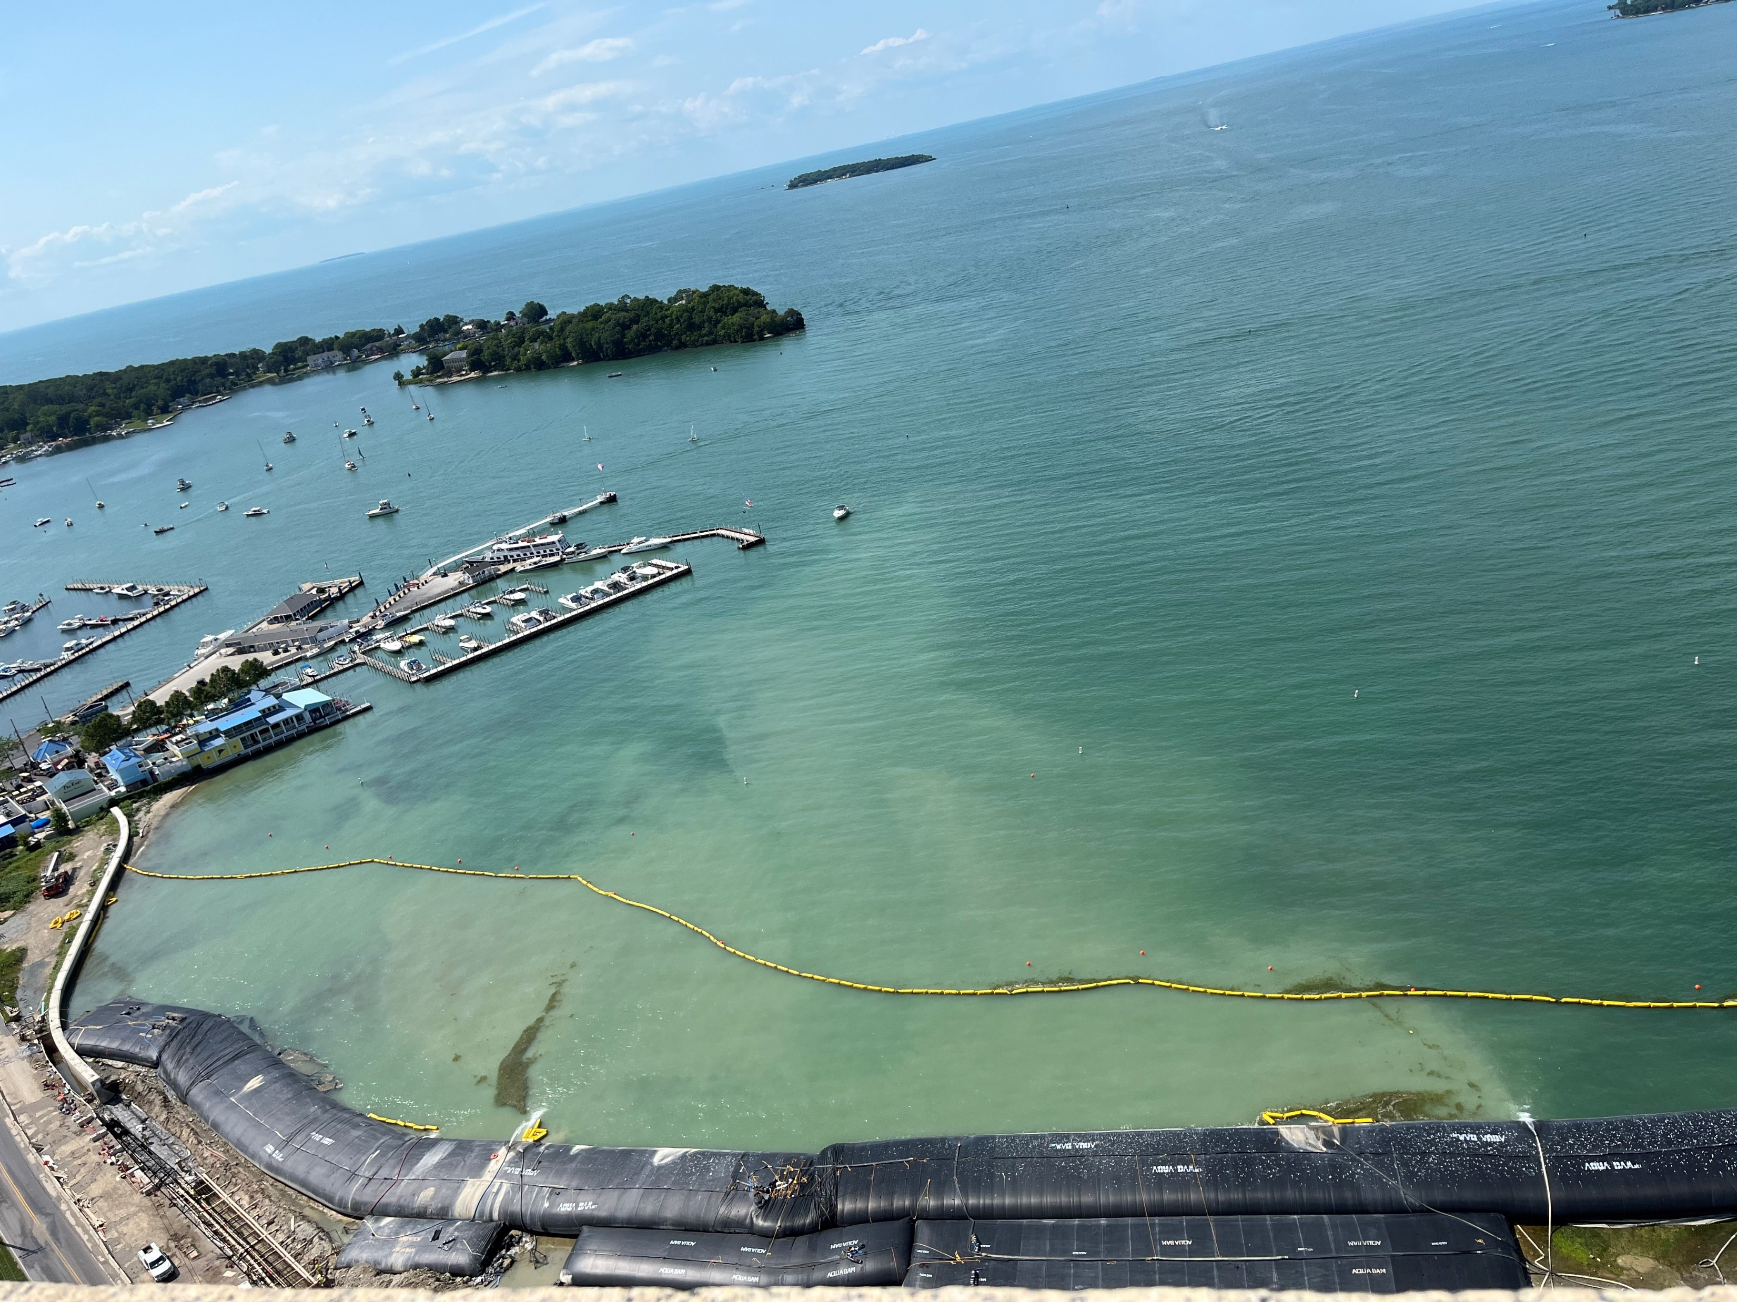
The “Why”
Protect water quality
Prevent pollution
Reduce flooding and infrastructure damage
Maintain safe, clean communities
Taken by Lynette Hablitzel, Ohio EPA
Notes:
Why do stormwater regulations exist? They exist because uncontrolled runoff carries pollutants and causes real harm - environmentally, financially, and socially. Our activities increase the exposure of pollutants to runoff. Soil compaction and the construction of impervious surfaces increase runoff volume, while installing drainage systems creates a more efficient delivery system for those pollutants. Changes in runoff volume and frequency lead to in-stream erosion and flooding.
Ohio EPA has authority over the first two items: pollution prevention and water quality protection. Local governments are tasked with managing flooding, infrastructure, and overall public welfare. Many best management practices (BMPs) that focus on improving water quality also have a positive impact on the other areas.

Slide 3
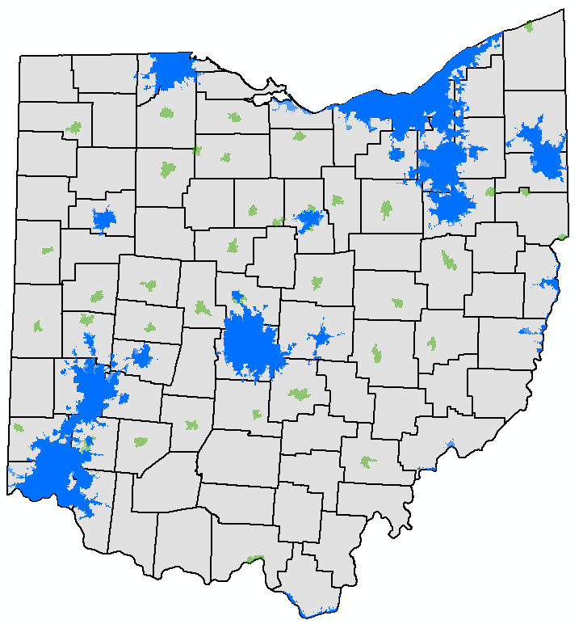
What’s an MS4?
A conveyance, or system of conveyances (including roads, catch basins, curbs, gutters, ditches, man-made channels or storm drains):
  Owned or operated by a public body
    Traditional (city, county, township, sewer district)
    Non-Traditional (e.g. OSU, ODOT, SWCD, NASA, Park Districts)
  Designed and used for collecting/conveying stormwater
  Is not a combined sewer
  Is not part of a POTW
Notes:
It’s a Municipal Separate Storm Sewer System.
It is publicly owned or operated; designed to carry stormwater. If it’s not rain, it doesn’t belong in the drain.
An MS4 is not a wastewater system, not a combined sewer, and definitely not a convenient place to dump oil, cat litter, or any of the label-said-it ’s-biodegradable liquid.
Tip- Drainage located downstream of the CSS regulator is part of the MS4.

Slide 4
Why permit an MS4?
Sources: High density of human activity
Ability: Scale & Proximity
MS4s are in the know on local issues, resources
Have authority over activities that impact pollution
Delivery: Drainage systems move water quickly
Impact: Water Quality
Lawsuits, US EPA Phase I & II rules, Ohio EPA rules
Influence large areas
Notes:
I could bore you with a lot of dates and citations. But I won’t. The short story is studies show stormwater runoff urban areas contribute to poor water quality and BMPs can mitigate that. There were lawsuits and congressional amendments to the CWA. Consequently, US EPA was mandated to pass Phase I and Phase II of the stormwater regulations. The regulations require NPDES permits for stormwater discharges from construction activities that cumulatively disturb an acre or more when considering the larger common plan of development or sale, certain types of industries, and certain MS4s. MS4s were selected due to dense human activity and highly developed drainage systems, which swiftly transport polluted runoff to surface waters. MS4s engage in a wide range of activities that directly influence the delivery of pollutants. Given their scope of services, authority, and localized knowledge, these municipal entities are uniquely positioned to positively impact water quality.

Slide 5
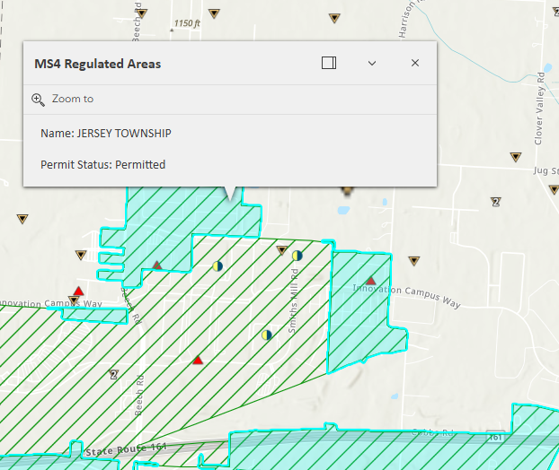
Who needs an MS4 NPDES permit?
MS4s w/ pop. ≥ 100,000 per 1990 Census
“Urbanized Area” per 1990, 2000, 2010 Census
“Urban Area with a Population of 50,000 or More” per 2020 Census
  *Ohio EPA notified newly regulated MS4s
MS4s with a pop. ≥ 10,000; pop. density ≥ 1000; and discharge to an impaired water
Ohio EPA’s Interactive Map
Waiver: regulated area population < 1,000 & Integrated Report does not list urban runoff, storm sewers, land development, etc., as a cause of impairment
Notes:
There are MS4s everywhere, right? If your MS4 is basically a village with one stoplight and a bait shop, do you need permit coverage? Not necessarily. Only certain ones are regulated.
US EPA’s rules used Census data as part of their criteria for deciding which MS4 are required to obtain an NPDES permit. Small MS4s in Urbanized Areas as determined by the Census are considered designated by rule. As of the 2020 Census, the Census Bureau is no longer identifying Urbanized Areas. US EPA then had to reword their rule. The Urbanized Area Clarification rule that became effective in 2023, and replaces the term urbanized area with “Urban Areas with a population of 50,000 or more people”. This wording does not change how the regulated areas are determined. It does not change anything for MS4 areas that were previously regulated.
Ohio’s stormwater rules are found in Ohio Administrative Code (OAC) 3745-39. They are almost identical to U.S. EPA’s rules.
We called each new MS4 (25 of them), explained what MS4 regulation means, confirmed contacts, and sent follow-up letters. Some were thrilled. A few were resigned. Most had questions. We have had several phone call and meetings with new MS4s. We are happy to talk with you, so please feel free to reach out.
Some MS4’s may qualify for waivers if population <1000 and no stormwater‑related impairments.
Ohio EPA has an interactive map on the Stormwater Program webpage. It shows the boundaries of the regulated MS4s, the locations of construction and industrial sites under general stormwater permits, and those with an individual NPDES permit or that have submitted a No Exposure certification in lieu of obtaining an NPDES permit. All info which you may use to respond to complaints, to determine if someone has an unpermitted, and therefore illicit discharge. The map now also includes a parcel layer, new filter functions, and, when you click the arrow at the bottom of the map, an attribute table with more options for filtering and downloading data to an Excel spreadsheet. The incorporated area layer is updated annually, so it may not always reflect current corporation limits due to annexations.

Slide 6
How does the permit reduce pollution?
Stormwater Management Program (SWMP)
  Implement Best Management Practices (BMPs)
    Structural and operational
  Address 6 Minimum Control Measures (MCMs)
  Set measurable goals & timelines
    Tracks BMP effectiveness. Drives continuous improvement.
  Define responsible party/contact
    Clear accountability for each BMP
  Meet permit’s Performance Standards, including TMDL
    Align local actions with watershed pollutant reduction targets.
Annual Report – Feedback loop & shows compliance
  Submit via eBusiness Center by April 1st
Notes:
How does the permit reduce pollution? Amesha will dive into the details of SWMP development later on today. In short, an MS4 permit requires the permittee to develop, implement, and enforce to the extent allowable under state law a Stormwater Management Program. The SWMP is both a decision document and an SOP that documents the best management practices an MS4 will implement to reduce pollutants in its discharges. BMPs must address 6 different areas, which we call Minimum Control Measures or MCMs, and meet the performance standards in the permit. PE, PI, IDDE, Construction, Post Construction, and pollution prevention and good housekeeping for municipal operations.
The permit contains additional performance standards for watersheds with an approved TMDL. A TMDL, or Total Maximum Daily Load, is a pollutant budget created to restore an impaired water body. Small MS4 general permit Appendix A lists those MS4s with an approved TMDL, and the impacted watershed and related pollutant.
A good SWMP is proactive not reactive. If we only act when a complaint comes in, we will always be behind. So with an eye towards pollution prevention, the permit requires the SWMP to outline the BMPs it will implement across 6 areas, which are called the 6 Minimum Control Measures.

Slide 7
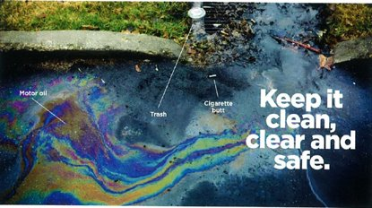
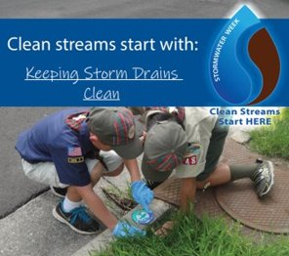
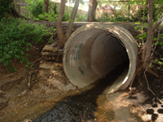
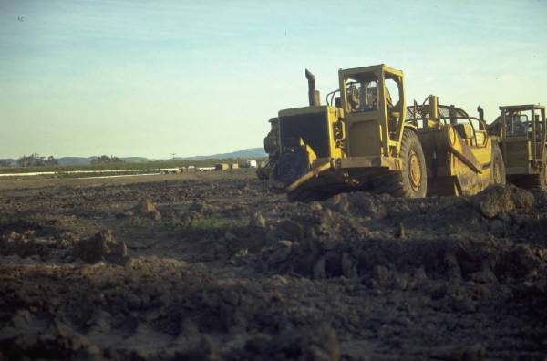
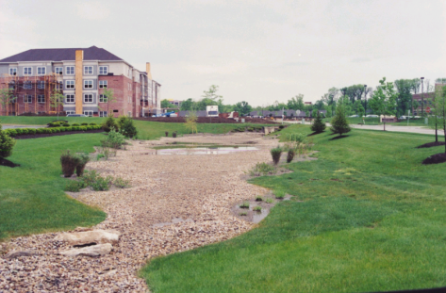
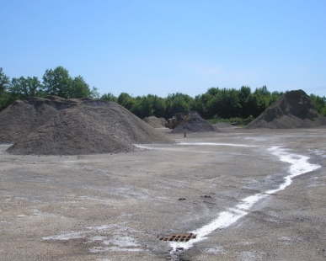
Permit: 6 MCMs
Public Education & Outreach
Public Involvement & Participation
Illicit Discharge Detection & Elimination
Construction Site Runoff Control
Post-Construction SW Management
Pollution Prev. / Good Housekeeping
Notes:
Here are the 6 MCMS

Slide 8
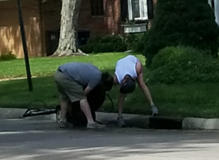
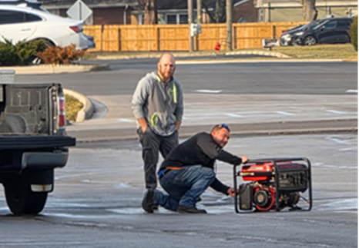
What can we learn from complaints?
They help identify illicit discharges
They help us improve public outreach & employee training
They show where better BMPs are needed
Complaint: “There is a white foam… where the water comes over the dam. This has been going on for a while... Someone needs to … determine what toxic substance is in the water. I have environmental background so I know there is something in the water that shouldn't be.”
  Natural foam: light white, off-white, brown or yellow. A light earthy or no odor. Light, persistent, not slimy to touch.
  Manmade: often bright white. Chemical or aromatic odor.
Complaint: “Resident using hose to clean lawn mower next to a curb inlet.”
Complaint: “Rental store refused to accept equipment with fuel remaining. Gentleman emptied it into parking lot catch basin.”
Taken by Lynette Hablitzel
Notes:
Our job is to work with humans. And humans are great, they are wonderful, they are fun, sometimes they are fun, and occasionally they are crazy funny. Every year Ohio EPA receives about 6500 complaints through our complaint management system. The stormwater program deals with about 1000 of those. If they fall within an area subject to an MS4 SWMP, we will refer it to the MS4 and request that they investigate and report back.
Here are a few examples of complaints we have received.
Education is our first line of defense. If residents know storm drains aren’t trash portals, we have fewer problems

Slide 9
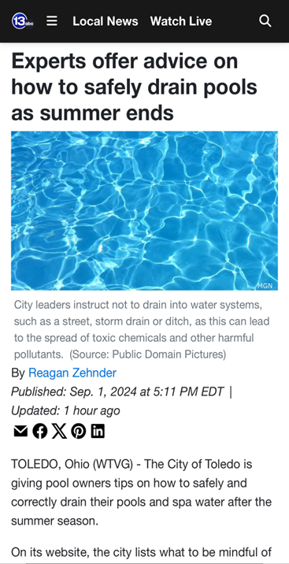
MCMs 1 & 2: PE/PI Performance Standards
Education Goal: Increase public understanding about stormwater pollution and ways to reduce it
  5 messages/themes over permit term
  Use more than one delivery mechanism
  Reach 50% of regulated population
Involvement Goal: Comply with public notice requirements
and involve the public in stormwater management decisions
  5 activities over 5 years
PIPE TMDL: Target each TMDL pollutant at least once in that watershed.
  Counts towards five stormwater messages.
  One activity can address multiple pollutants
Notes:
Ideally we are looking for behavior changes, such as an end to dumping in a neighborhood, a reduction in litter or oil found during MS4 maintenance, an increase in good behaviors like recycling or construction site compliance levels.
Resources are plenty. Just surf the web. US EPA has Getting in Step. A guide to setting up an effective educational program. It includes free designs that can be adapted.

Slide 10
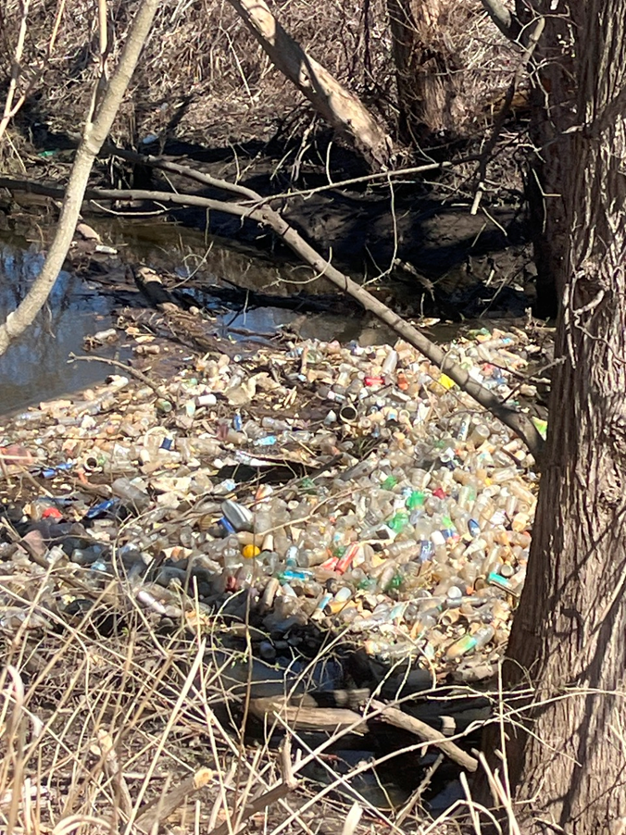
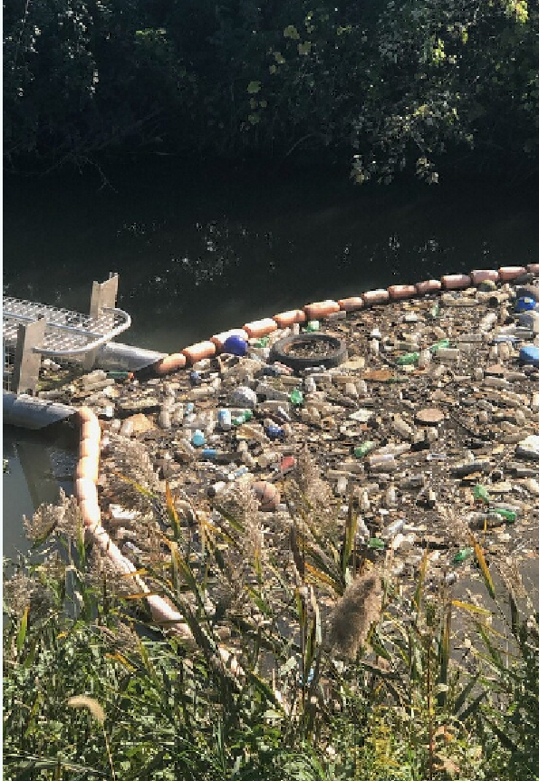
Case Study — Trash‑Filled Stream
Complaint: “Creek full of plastic bottles.”
Citizen reports help identify hotspots.
Is there a single source?
  Educate or structural control
Widespread issue?
  Education campaign
  Opportunity for a stream clean-up
  Litter League
  Instream trash trap
Notes:
How would you approach this situation?

Slide 11
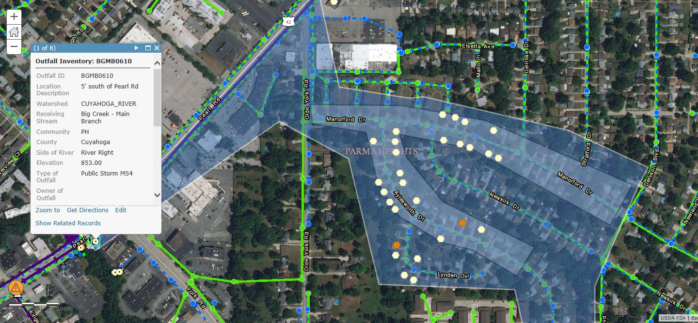
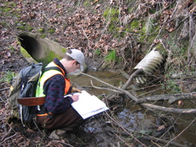
MCM 3: Illicit Discharge Detection & Elimination (IDDE)
Goal: To proactively find and eliminate sources of pollution to the MS4.
Notes:
Public involvement is great — until it becomes TMI, like the resident who reported a neighbor’s outdoor urinal funnel. Yes, that was real.
Which leads us into MCM3, illicit discharges. IDDE is where the most interesting complaints fall.
Katie and Todd will provide IDDE tips and tricks later. Let’s review the permit requirements now.

Slide 12
IDDE Performance Standards
Prohibit illicit discharges to the MS4
  Regulatory mechanism, e.g., ordinance or resolution
    Include definition of MS4, allowable non-Stormwater discharges and, identify those occasional non-Stormwater discharges you will allow (see Parts I.B.3.b, III.B.3.g and IIII.B.3.h of MS4 Permit)
  Establish legal authority to conduct inspections and monitoring, i.e., right-of-entry, to investigate suspected sources
  Establish enforcement tools and sanctionsemployee training on illicit discharge detection and elimination topic(s);

Slide 13
Differences in Legal Authority
Legal authority depends on the form of government. See Ohio Revised Code (ORC). Ex: Ordinances/Resolutions
Non-traditional MS4s use policies/ SOPs/contracts.
What If the MS4 lacks legal authority?
U.S. EPA has stated that small MS4s are “expected to utilize the authority they do possess and to seek cooperative arrangements”
- EPA 833-F-00-012, January 2000 (revised December 2005), U.S. EPA Fact Sheet 2.10
Notes:
A word about legal authority. Sometimes we are asked why MS4s approach things differently. One factor is that they have different legal authorities under state law, which dictate the method of enforcement that they can use. We do expect each MS4 to use the authority it has to gain compliance. This concept applies to IDDE, construction site management and post-construction stormwater management
See Ohio Revised Code (ORC)
Title III: Counties – ORC 307
2 Chartered Counties (ORC 302)
Title V: Townships – ORC 503
30 Limited Home Rule Townships (ORC 504)
Title VII: Municipal Corporations – ORC 715 and 717

Slide 14
IDDE Performance Standards
Develop and annually update comprehensive MS4 map
  Include HSTSs connected to MS4
  Include private post-construction BMPs installed to satisfy MCM 5 and their type
Identify home sewage treatment systems (HSTS) that discharge due to design or failure to the MS4
Work with local/state authorities on HSTS elimination, replacement, and NPDES permitting

Slide 15
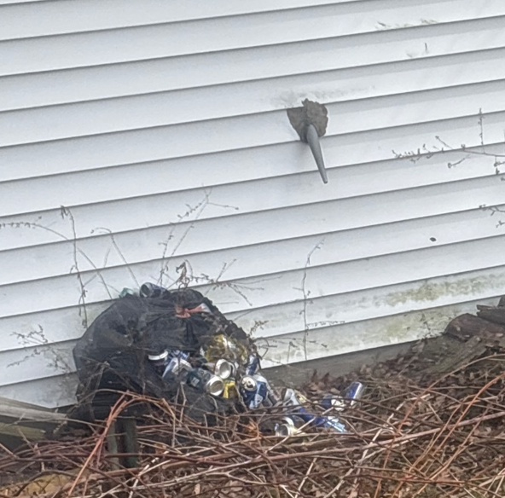
Case Study – The Beer Funnel
Complaint: “My neighbor has had a bag of beer cans spilling out for over a year, as well as beer cans scattered along the property line. He also has a funnel through the wall of his garage that I believe he uses as an outdoor urinal.”
Complaint: “Lateral sewer line running into road. Appears to be private from an apartment complex but nobody is taking ownership of the line.”
Notes:
Is this an HSTS?
If delegating to another department or agency, track it until resolved.

Slide 16
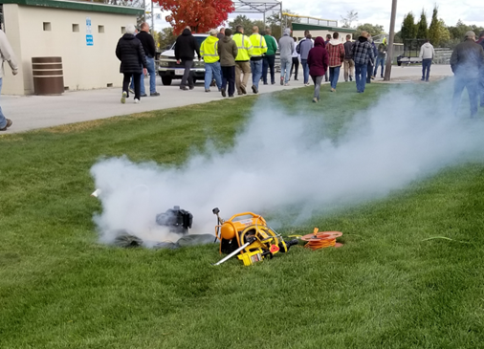
IDDE Performance Standards
First permit = Initial dry weather screening of all outfalls
Then, schedule proactive surveillance
  Take action to eliminate verified sources of illicit discharge
Notify Ohio EPA within 24 hrs. when industrial, commercial, or multi-family illicit sanitary cross connections, or leaking/broken sanitary sewers, discharge to the MS4.
If P, N, or ammonia; e. coli/bacteria; DO or organic enrichment TMDL, then annual employee IDDE training
Notes:
How to report?
Call the Spill Hotline if the situation presents a danger to human health or the environment. Please do not report contrails – this happens more often than you think.
Use 24 hr email report when…
If they believe it is strictly stormwater/stormwater permitting, we prefer that they contact their district person directly by email or phone
For steam/wetland fills use complaint tracker

Slide 17
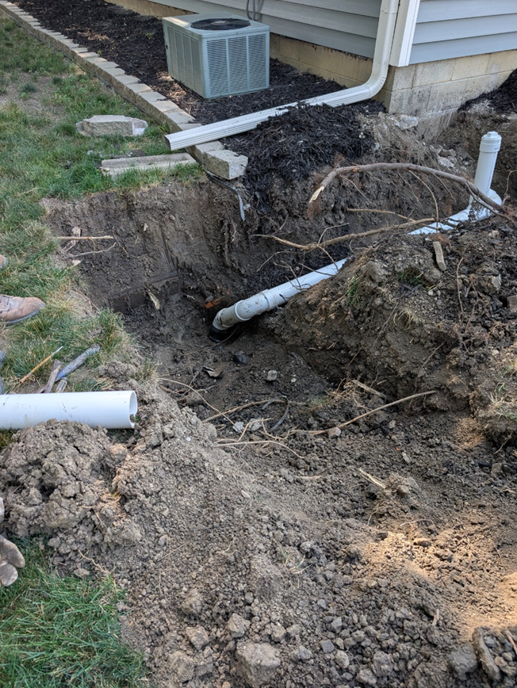
Illicit Discharges are More than Failing Septic Systems
It may be your aging sanitary sewers or cross-connections.
  Do you have a working relationship with your sanitary sewer provider to address these?
Dry weather flow? Determine the source.
  Don’t assume clear flow, or e. coli < 1030 MPN/100 mL, is allowable.
  Follow-up on suspected sources referred to sanitary or health departments.
Notes:
Are you coordinating with other divisions and agencies? E.g. Fire Department, Public Works, Health Department?

Slide 18
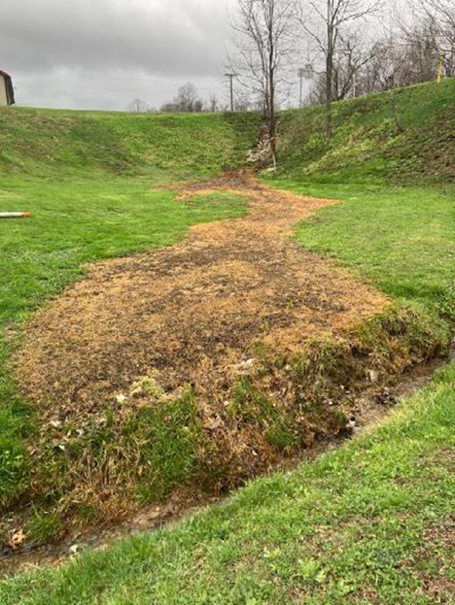
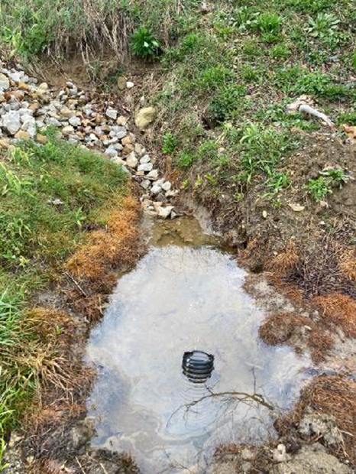
Case Study: Follow the Yellow Brick Road
Complaint: “Runoff from gas line is killing grass and crayfish in stream and yard.”
* Look for other signs, not just pipe flow.
Notes:
Look for other evidence of illicit discharges such as dead veg and staining.

Slide 19
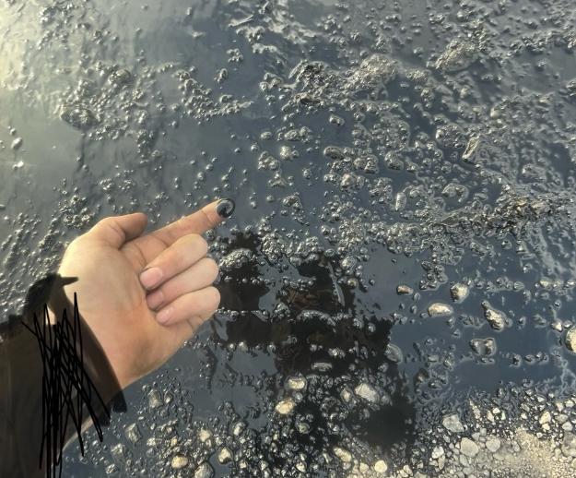
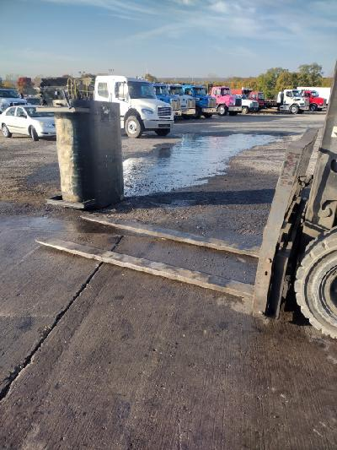
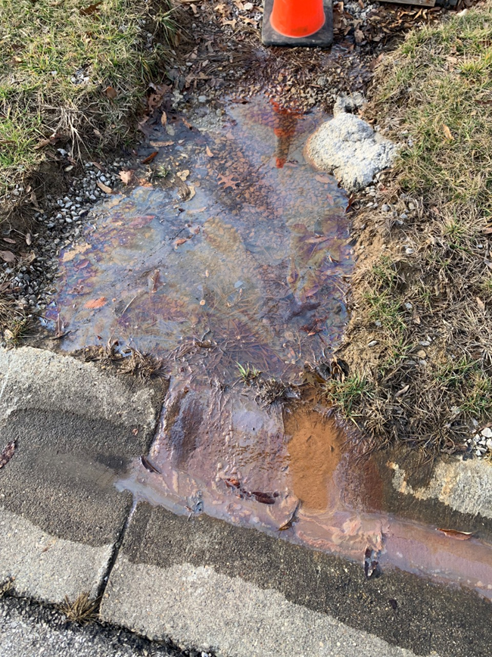
Case Study — Oil is Everywhere
Complaint: “Used oil intentionally dumped… when it rains it flows from top of lot down into drains.”
Complaint: “Oily-looking water coming from below a fire hydrant and a sidewalk below a field in my neighborhood. It flows down the curb and sidewalk, staining both, and is entering a storm sewer.”
Notes:
Any thoughts on the second complaints?
Iron Bacteria decomposition – breaks into blocky pieces. Does not join back together quickly

Slide 20
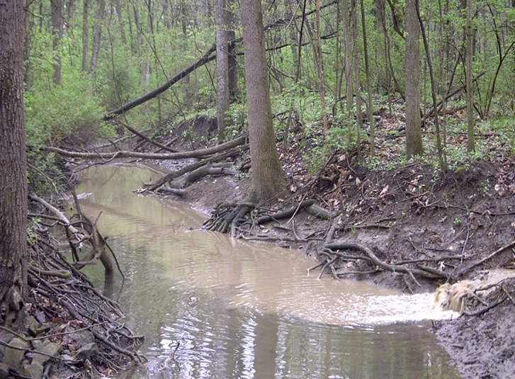
MCM 4 & 5: Construction & Post-Construction
Goal: Reduce pollution from construction sites ≥ 1 acre (larger common plan of development or sale). Ensure long-term management of stormwater runoff to minimize pollution and protect water quality.
Ordinance/regulatory mechanism is at least equal to Ohio EPA CGP technical requirements
  Establish authority to review plans, inspect sites, take enforcement
  Ensures long-term O&M of post-construction stormwater BMPs, including when there is a change in ownership.
  Update within 1 year of MS4 permit renewal.
Notes:
Sediment, especially our fine Ohio clays- is like glitter—once it’s loose, it gets everywhere. Sediment is the #1 pollutant by volume in Ohio’s waterways. Nutrients are right up there. Every cubic yard of sediment that leaves a site becomes someone’s costly problem. Often, it’s the MS4’s.
Brian will discuss how Summit implements MCMs 4 & 5
Chagrin River Watershed Partnership Model Ordinances
Legal authority is based, and can be limited by, the form of government. See Ohio Revised Code (ORC)
Title III: Counties – ORC 307
2 Chartered Counties (ORC 302)
Title V: Townships – ORC 503
30 Limited Home Rule Townships (ORC 504)
Title VII: Municipal Corporations – ORC 715 and 717

Slide 21
MCM 4 & 5: Performance Standards
Preconstruction SWP3 review and approval
Initial inspection & at least once ≤ 31 days.
For sites in a suspended solids or nutrient TMDL area, increase frequency to ≤ 14 days, if:
  No MS4 approved SWP3, or
  No sediment/erosion controls, or
  Required sediment basin not installed, or
  Dewatering causes a turbid discharge.
  Resume normal frequency after site returns to compliance
Use objective tool for SWP3 review and MS4 compliance inspections.

Slide 22
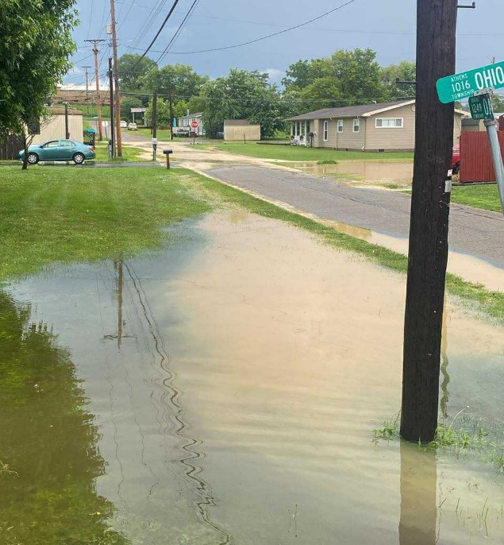
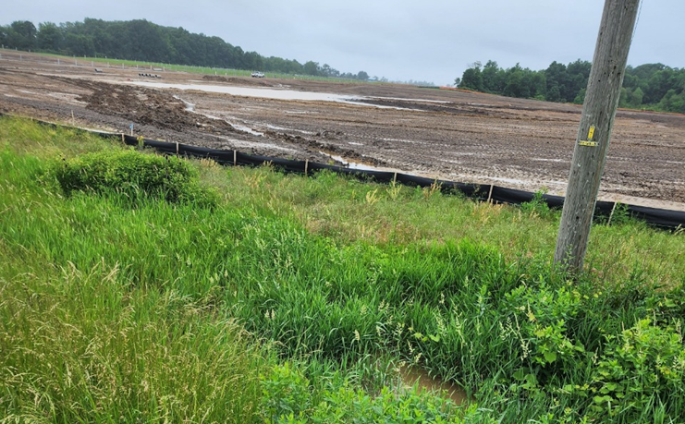
Case Study — A Sedimental Journey
Complaint: “During rain events, the area below the construction site at the high school gets covered with mud. This has happened a couple times before yesterdays unusually heavy rain.”
*Investigated the site and found no sed pond.
Complaint: “Construction site being drained/channeled to a public ditch.”
Notes:
Construction sites are just complaint factories when controls fail. Routine inspections both by the operator and the MS4, prevent these issues.
How would the permit require us to respond?

Slide 23
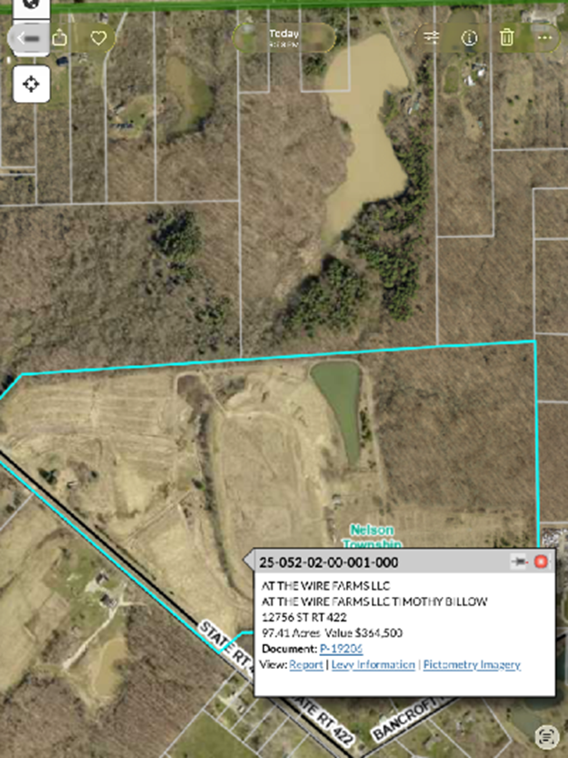
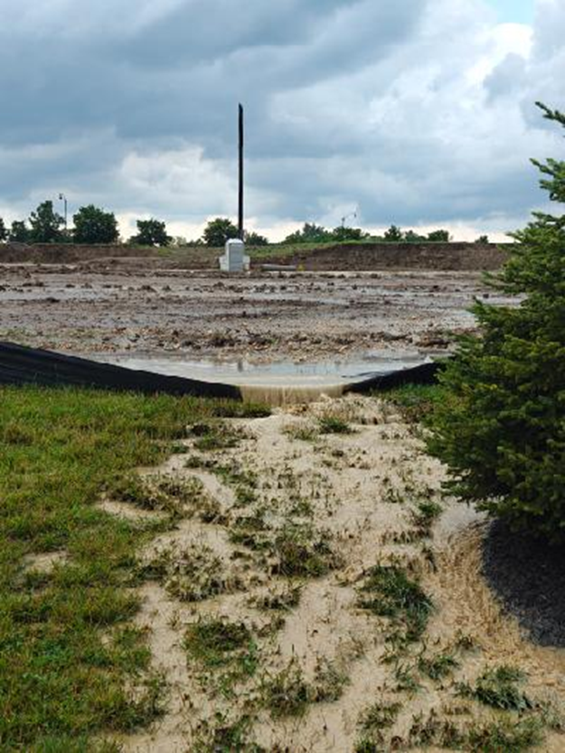
Case Study – Here Comes the Rain
Complaint: “Runoff from the stream due to the excavation of the property fills our pond, including significantly reduced water depth, increased nutrient loading that fuels excessive algae growth, and potential oxygen depletion. Just a muddy mess.”
Complaint: “Silt fence on southern property line has collapsed or is failing in several parts. Sedimented water is flowing over the fence in concentrated flow into storm drains or into the existing stream/wetland. Fence has been collapsed for multiple rainfall events over the last 2 weeks.
Notes:
What are we looking for on these? Why is offsite pond muddy but onsite is clear? Are Sed pond and perimeter controls missing? Soil Stabilization?
Second complaint – concentrated flows, maintenance are possible issues. But BMPs can only take so much rain…

Slide 24
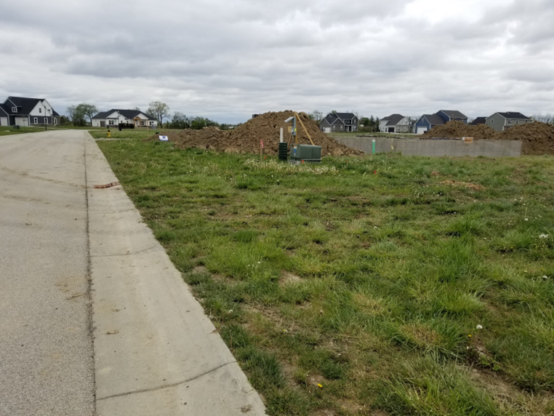
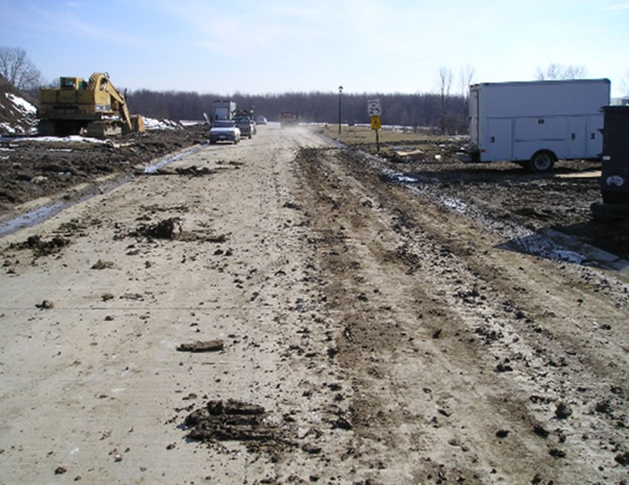
Stormwater Controls Add Value
Notes:
Good stormwater management isn’t just about compliance—it’s good business. A site that looks cared for is easier to maintain, easier to sell, and reflects well on everyone involved. Tracking is one of the most visible issues. Not everyone notices a missing silt fence, They absolutely notice the stream turning brown or when their car looks like it drove through a hog wallow. And they let us know—sometimes with photos, sometimes with… colorful language. These complaints remind us that the public is watching—and they expect MS4s and Ohio EPA to act.

Slide 25
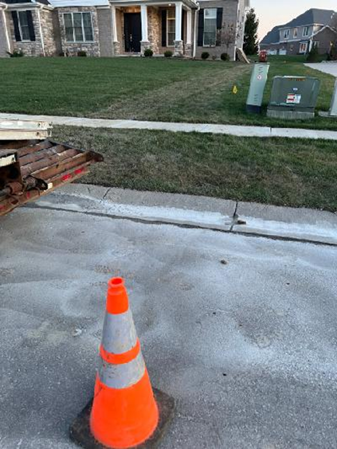
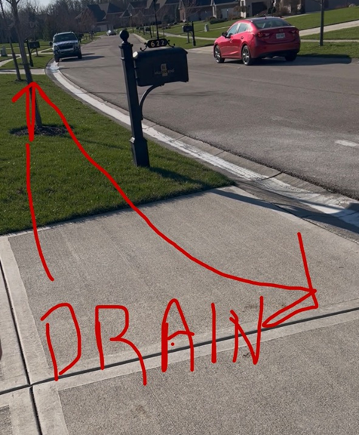
Case Study — Concrete Slurry
Complaint: “Contractor dumped slurry into drains.”
Also receive complaints on wash waters, fuel/oil leaks from equipment, spills, and dust
Notes:
Training contractors is critical — concrete washouts are a common violation.

Slide 26
Long Term BMP O&M is Key
MCM 5 Performance Standard:
Long-term Operations & Maintenance program for post-construction BMPs
  Require a long-term O&M plan and maintenance agreement
  Inspect initially to ensure installed per approved plan (checklist)
  Develop and implement a program to ensure on-going, long-term BMP maintenance
  A minimum of one on-site inspection by you or a third party of each post-construction runoff control during this permit term
Notes:
Keep the BMP functioning as intended. Prevent complaints and property damage.

Slide 27
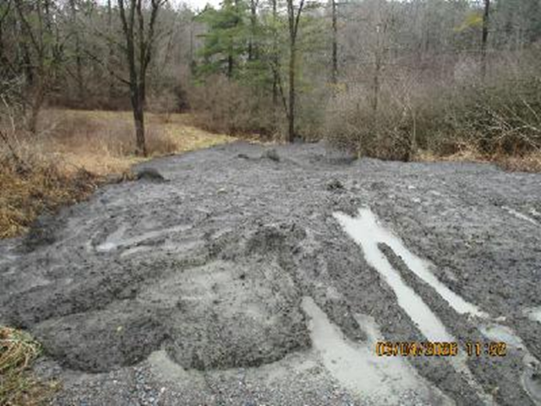
Case Study: Dirty Deeds?
Complaint: Gray sludge being dumped all day today. It is an empty lot and they are dumping it down an embankment into the creek.
* Co. Engineer responded; dredge material from pond possibly less than an acre. Have copy of their letter to landowner documenting phone call.
Complaint: Pond not holding water; trash in cattails.
Maintenance matters & MS4s must ensure long‑term function.

Slide 28
Non-Compliance & Enforcement
MS4s must ensure operators comply
Common Compliance Issues
  No CGP/expanded disturbed area
  Started without approved SWP3
  SWP3 not followed/not current
  BMPs absent (perimeter and sed ponds)
  BMP not maintained in a timely manner
  Soil stabilization timing
  Tracking
  Mismanaged washout/dewatering
  Sediment/pollutants leaving the site
  Inspections not documented
  No stabilization log
Escalate enforcement when needed - No quota!
Factors to consider for escalating enforcement:
  Severity, Impact, Frequency, Duration
  Weather!
Toolbox may include:
  Verbal warning (documented), Written Notice of Violation (NOV),
  Orders/Fines/Bonds, Stop Work Order (SWO)
  Contractual penalties

Slide 29
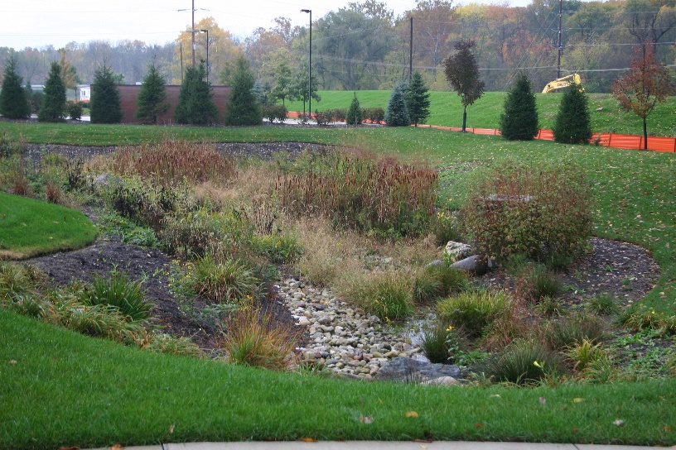
MCM 5 Performance Standard
TMDL for TSS, Sediment, Siltation or Nutrients (incl P, N, and Ammonia) then:
Provide an educational opportunity on CGP Table 4b/green infrastructure practices.
And include one of the following:
Retrofit 1 peak-discharge stormwater practice during the permit term;
Restore 300 ft. channelized stream
Require Table 4b practices and/or green infrastructure practices where feasible.
Install a Table 4b practice to treat 1 acre of existing impervious area developed prior to 2003
Post-Construction SW Management
Notes:
The final performance standard for this MCM.
If in a suspended solids or nutrient TMDL area:
o hold an educational opportunity on CGP Table 4b stormwater infiltration practices for contractors, SWP3 designers, or MS4 employees. AND,
· retrofit 1 existing peak discharge BMP, or
· restore ≥ 300 ft channelized stream where natural channel stability and floodplain restoration will reduce stream erosion, or
· update ordinance/regulatory mechanism to require CGP Table 4b practices where feasible, or
· install a Table 4a BMP to treat 1 acre of impervious surface developed before 2003.

Slide 30
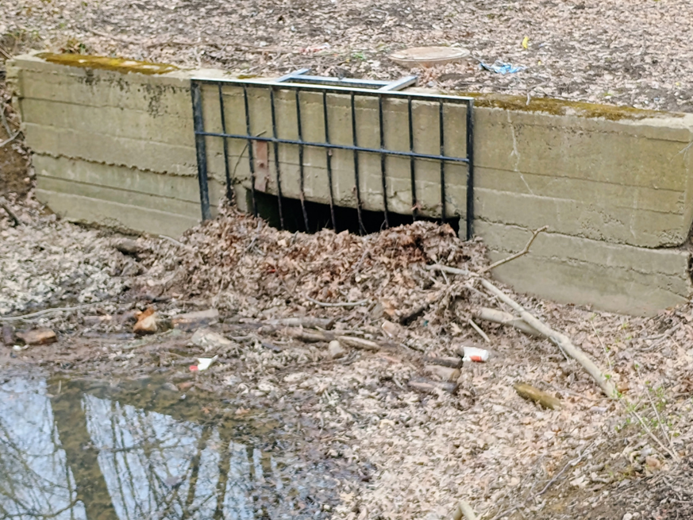
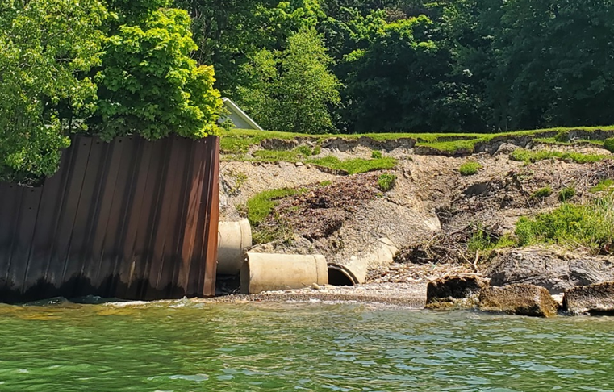
Case Study — City Flooding
Complaint: “City failing to maintain stormwater system.”
*Maintenance protects water quality and reduces angry phone calls.
Notes:
These might be retrofit or streambank restoration opportunities.
We sometimes receive complaints that appear to be about flooding, or something else and it turns out they could fall within MS4 permit requirements. These complaints could fall under Post Construction or under Pollution Prevention for Municipal Operations.

Slide 31
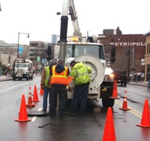
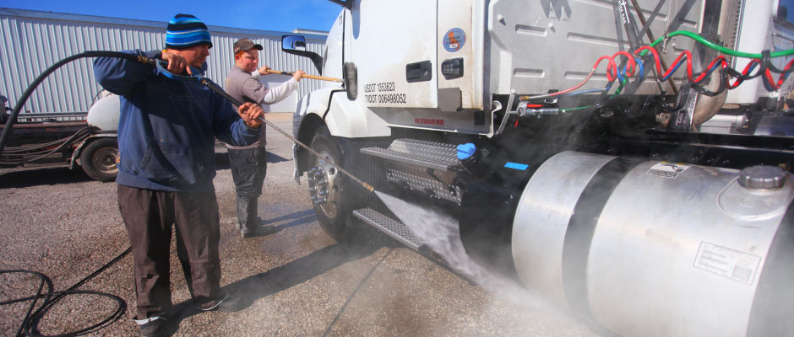

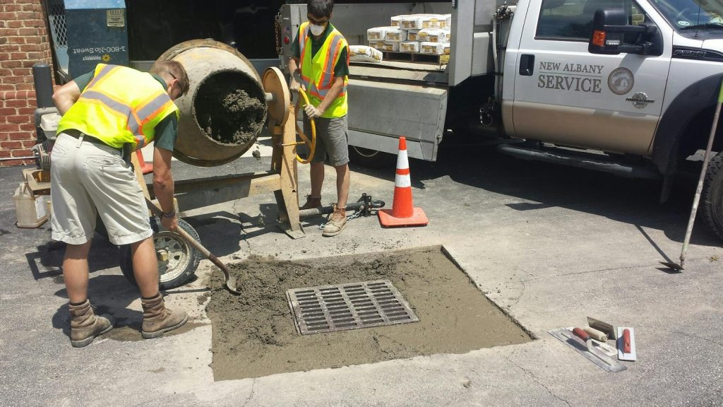
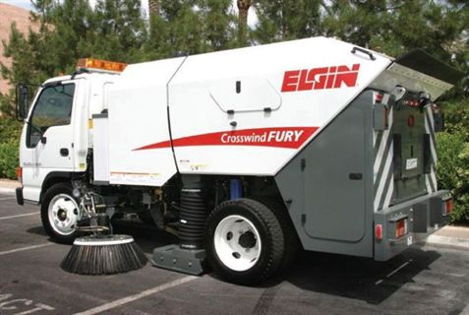
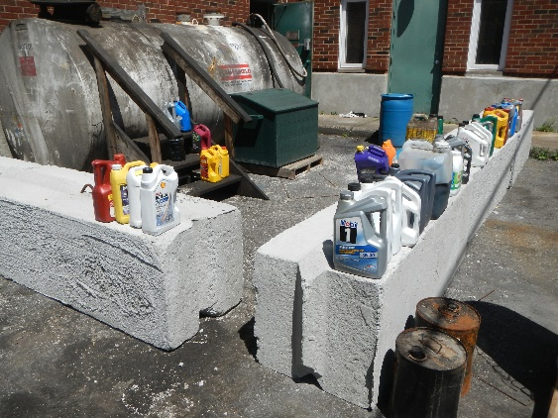
MCM 6: Pollution Prevention & Good Housekeeping (P2GH)
Notes:
Our last MCM. The goal is to implement pollution prevention for municipal activities. Why does P2 matter? Municipal yards can be like teenagers’ rooms: messy and full of surprises. If we are going to critique construction sites and other entities, we need to be accountable. Pollution prevention starts at home.

Slide 32
P2GH Overview
Ensure all materials and wastes are appropriately handled and disposed.
Assess flood management projects for water quality impacts & retrofit opportunities.
Facility inventory, permit status
Develop industrial Stormwater Pollution Prevention Plan (SWPPP) for vehicle maintenance facilities, bus terminals, composting facilities, impoundment lots, and waste transfer stations.
Implement O&M program to prevent/reduce pollution from municipal operations.
Notes:
Goal: Implement pollution prevention for municipal activities. Why does P2 matter? Municipal yards can be like teenagers’ rooms: messy and full of surprises. If we are going to critique construction sites and other entities, we need to be accountable. Pollution prevention starts at home.

Slide 33
P2GH Performance Standards
Develop & implement facility-specific SWPPP
  Municipal facilities regulated under industrial Stormwater program
    Examples: WWTP ≥ 1 MGD, landfills, airports, marinas, steam electric power plants
  Service facilities with vehicle maintenance operations
  Municipally-operated bus terminals, composting facilities, impound lots and waste transfer stations
SWPPP must meet technical requirements of Ohio EPA’s industrial stormwater general permit (MSGP).
Notes:
Amy, Carly and Mallory – MCM 6 - SWPPPs

Slide 34
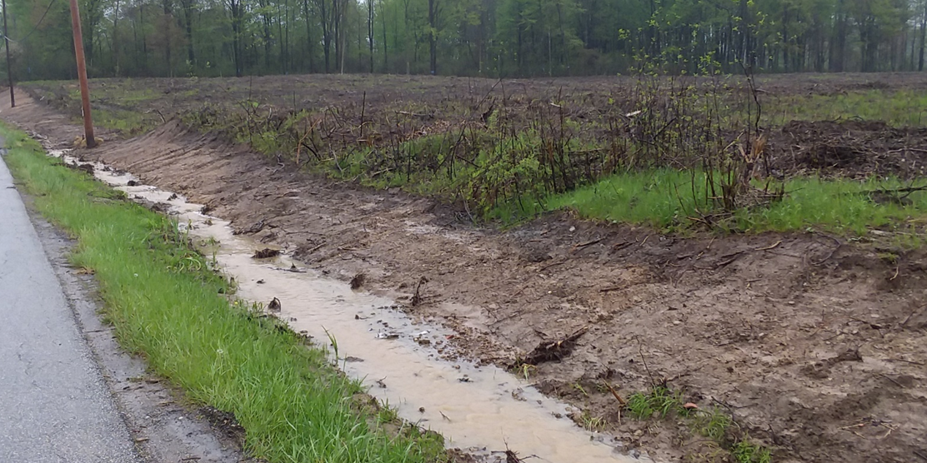
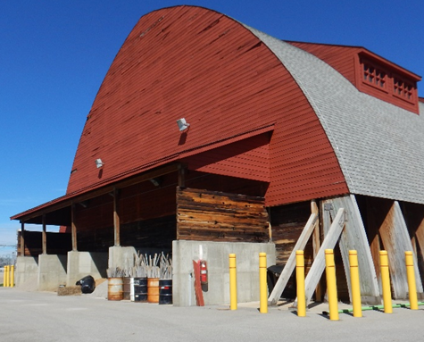
P2GH Performance Standards
Annual employee training on SWPPP & P2GH.
Document procedures, controls, and schedules for municipal operations and maintenance activities.
Store salt covered, with no run-on and runoff.
Secondary containment or traffic barriers for liquid road treatments.
Initiate soil stabilization per CGP timeframes on municipal ditch/MS4 maintenance projects.
Notes:
So if within 50 ft of a surface water within 2 days. Beyond 50 ft = 7 days.

Slide 35
P2GH Performance Standards
TMDL for TSS/sediment/siltation); Nutrients/P/N/ammonia; E. coli; Bacteria; Metals; or Dissolved Oxygen and Organic Enrichment?
Then implement one of the following:
  Develop a street sweeping program (curbed streets 2/yr); or
  Develop a catch basin cleaning program (1/5yrs);
  Develop and implement a leaf/yard waste collection program; or
  Perform and document inspections (1/qtr) on your facilities that require a SWPPP.

Slide 36
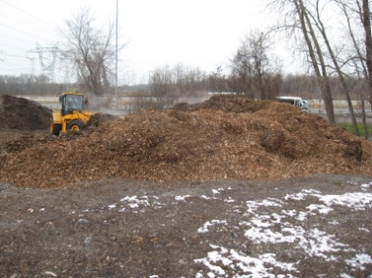
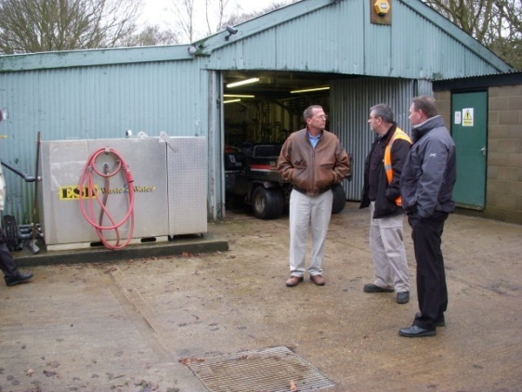
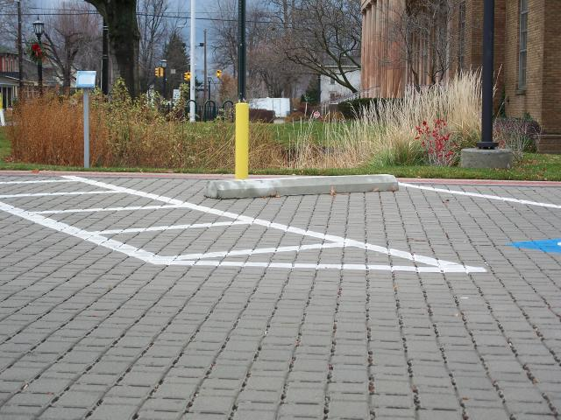
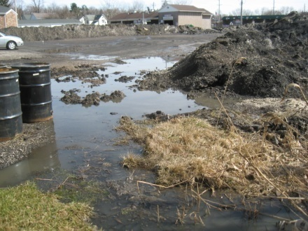
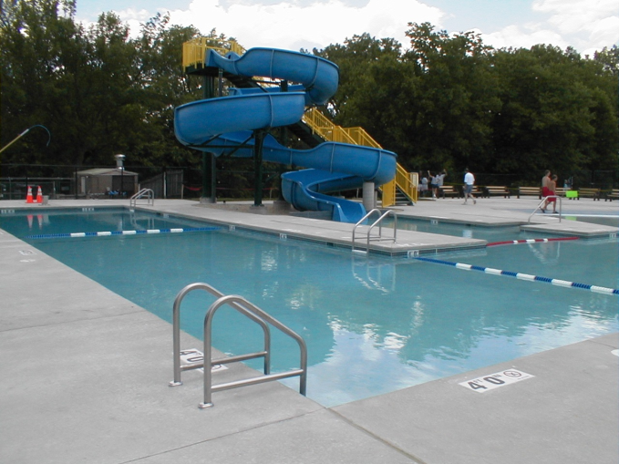
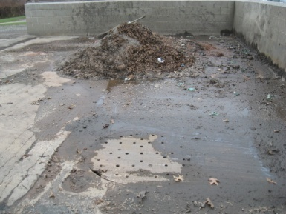


Other Municipal Ops Subject to P2GH
Snow Disposal Lots
Pools/Splash Pad
Leaf/Woody Debris Collection Yards
Maintenance Facilities at Golf Courses, Cemeteries & Parks
Public Parking Lots/Streets:
Paving, Striping, Patching
    Building Maintenance
    (washing, painting, sealing)
Street Sweepings/Catch Basin Debris Management Areas
Road Kill Management Area
Notes:
We are pausing on this slide which shows MS4 operations that are commonly overlooked in the SWMP.

Slide 37
P2GH Complaints
Complaint: City illegal dumping of refrigerators into dumpsters without recovering refrigerant. Last year’s leaf pile not properly disposed. Vehicles leaking on parking lot. Chemicals for spraying are mixed next to storm drain. Wash out area and wash bay overflows to storm drains.
Complaint: Working at water works plant. A transformer has leaked a large amount of oil onto the ground.
Notes:
And we do receive complaints directly about MS4 operations.

Slide 38

Complaints Outside Ohio EPA Authority
Flooding, Junky yards vs. Junk Yards, and Contrails
  “Stop these streaks of strontium, barium and aluminum oxide in our skies. Go after these obvious criminals, now. Do your job.”
  “The caller called in to file a complaint against the US Government. He reported that Cambridge, Ohio usually has good weather but was experiencing chemical trails that makes clouds last longer.”
  “Why are you allowing Jet spraying in our skies!! Why are you doing it? What chemicals are in these sprays. There are currently LINES all over in every which way in my sky in TOLEDO this morning!!”
Notes:
Then there are many complaints we have no authority over, but we may refer to the MS4 if we feel it could still be within their ability to address.

Slide 39

When does Ohio EPA inspect?
US EPA- Compliance Monitoring Strategy
10% Construction Sites/yr
Other Factors
Complaints, releases, MS4’s response
NOVs for other issues
Non-renewal of NPDES permit coverage. Non submittal of Annual Report
MS4 Inspection 1/5 yrs.
MS4 Audit 1/7 yrs.
Notes:
When do we assess compliance? And When might we inspect or audit an MS4? Complaints outside a regulated MS4 we typically take the lead on. Also, U.S. EPA has delegated authority to Ohio EPA to administer the NPDES stormwater program in Ohio. As a condition of that, we are committed to conducting a certain number of compliance inspections each year.
For construction sites and industrial sites, we inspect at least 10% of the universe. For MS4, we are committed to inspecting or auditing @ 58 each year.
We do not have a master schedule. Based on past efforts and compliance history, Ohio EPA staff and supervisors discuss a plan for the Federal fiscal year, which runs October 1st through September. But that plan is dynamic. Our goal based on US EPA’s Compliance monitoring Strategy is to inspect or perform a desktop review 1/5 yrs and complete a review of all 6 MCMs 1/7 yrs. These criteria combined with compliance issues: such as complaints, an MS4’s response to complaints or releases, Notice of violation, or NOVs, for other issues such as non-submittal of AR or renewal of permit coverage, may trigger an inspection or audit.

Slide 40
What happens after an Ohio EPA Inspection/Audit?
Ohio EPA staff review photos, notes, and other documentation
They issue:
Inspection Summary letter; and/or
Likely will have recommendations to improve program
Notice of Violation (NOV) letter
Will request a written response by a set date
Notes:
After reviewing all documentation, photos, and notes, Ohio EPA will generate an inspection summary letter and/or an NOV.
An inspection summary typically includes an overview of findings and recommendations. It may request that the permittee submit follow-up information, or request them to take an action and report back to ensure a deficiency has been rectified and did not become a violation.
Always respond on time. Include dates, photos, etc. whatever can be resolved immediately: do.
If something will take a bit longer, give reasonable but prompt timelines for completion.
Keep in mind that until a violation is resolved, the permittee is in non-compliance. This is a liability. The CWA allows third party lawsuits. US EPA could decide to intervene.
NOVs are tracked. Inspectors are to update their status monthly. If progress towards compliance is not occurring, a second NOV or escalated enforcement may occur.
Once the permittee has demonstrated a return to compliance on all noted violations, the agency will issue a Resolution of Violation letter, or ROV.

Slide 41

Small MS4 General Permit Status
Draft 2026 Small MS4 general permit - Public Notice?
2021 permit is administratively continued
All currently covered MS4s remain authorized
Public notice draft → Hearing(45 days later) → Final Issuance
New MS4s, NOI+SWMP (likely 180 days to apply)
Existing MS4s, NOI (likely 90 days to renew)
Notes:
Yes, the permit is still in the oven. No, we don’t have a timer. But once it’s out, you’ll have ~180 days to submit your application and SWMP if you’re newly regulated. 90 days to renew.
Aaron and James (from Hamilton) and Eric will talk about co-permittees and collaboration.

Slide 42
Draft Small MS4 General Permit
Existing MS4s submit updated SWMP w/ April 1, 2027, Annual Report
PE – Include one message to residential or commercial/institutional facilities on salt storage, handling, and application
Construction & Post-Construction
  Update to meet current CGP, OHC000006.
  Final SWP3 approval shall be documented by letter or email
  Initial construction inspection w/in 14 days of start of earth disturbance
  Provide inspection findings to site operator, & document (e.g., emails; letters; or via phone/verbally with date, time, participants’ names and discussion summary).
P2 – Annual Inspection at SWPPP facilities.

Slide 43
Final Thoughts
Stormwater regs protect H2O, infrastructure, and people
PIPE and Employee Training get us out of the gate
Inspections are essential (Construction,
Post– C, P2)
An MS4 must use its authority
IDDE: Be Proactive.
Document, follow-through, and adapt
Notes:
Inspections are essential to align BMPs with dynamic real-world conditions. AN MS4 has many tools to gain compliance, and it must use its full authority when needed. to compel compliance.

Slide 44

Resources to get new staff up to speed
Ohio eBusiness Center > STREAMS service
Ohio EPA’s eDOC for public records
Ohio EPA’s Stormwater Program webpage
  MS4 permit, interactive map, model ordinances & ordinance checklist
  SWPPP/SWP3 Templates, videos, Fact Sheets, Rainwater and Land Development Manual
Notes:
We are here to help and have many resources.
If you are new or find yourself needing to address an NOV, Be sure to check out the Stormwater Program webpage.

Slide 45

Ohio EPA’s Stormwater Program Staff
Compliance/Inspections
Central Ohio
Sullivan Rogers 614.448.1416
Loren Gormley 614.728.3803
Northeast Ohio
Ed Wilk 330.963.1172
Laura Shriver 330.963.1136
Northwest Ohio
Brittany Brockmann 419.373.3021
Eric Kostecky 419.352.8461
Southeast Ohio
Joseph Jarvis 740.279.1495
Southwest Ohio
Michelle Flanagan 937.285.6440
Daniel Hoit 937.285.6104
Program Administration
Technical Assistance
Justin Reinhart 614.705.1149
Emily Coffin 614.644.2884
Permitting Specialists
Mike Joseph 614.752.0782
Anthony Robinson 614.728.3392
Lead Worker
Lynette Hablitzel 419.373.3009
Management
Jason Fyffe 614.728.1793
Wesley Sluga 614.644.2141
Firstname.Lastname@epa.ohio.gov
epa.ohio.gov/stormwater
Division of Surface Water
Notes:
If you have questions, please feel free to reach out to our staff. Ohio EPA operates through 5 offices located across the state, each staffed with Stormwater Program personnel. Be sure to check out the Stormwater Program webpage, where you can find copies of the CGP and MS4 permits, SWP3 and inspection templates, and checklists.
If you are attending the Ohio Stormwater Conference in person, Ohio EPA has a booth. If you have eDMR or STREAMS questions, feel free to stop by. There is also an Ohio EPA roundtable on Friday.

