Slide 1




Please Scan QR Code to complete the
Morning attendance confirmation
Welcome Attendees
Notes:
Welcome
Hosts Introductions
Thank you Bootcamp Planning Committee & Speakers

Slide 2
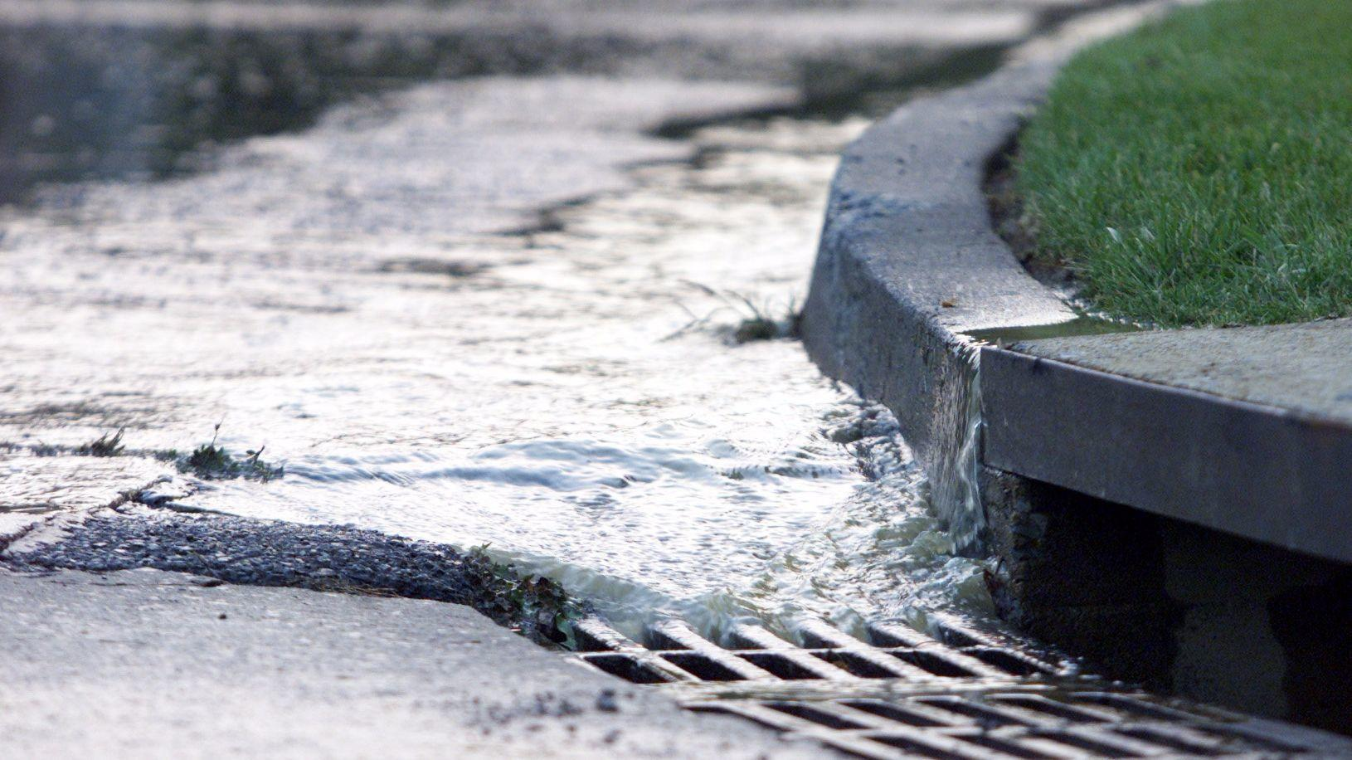

OSWA Organization Overview
Dedicated to advancing the management of stormwater and related natural resources through education, leadership, watershed-based coordination and technical assistance in Ohio.
Not-for-profit, non-political
A division of the Water Management Association of Ohio
Photo source: www.trbimg.com, th.bing.com
Notes:
Ohio Stormwater Association is a non-profit and non-political organization that is dedicated to advancing the management of stormwater and related natural resources through education, leadership, watershed-based coordination and technical assistance in Ohio.

Slide 3
Board of Directors
President: Regina Collins, City of Toledo
Vice-President: Theresa McGeady, City of Dayton
Secretary: Dana Stayer, StormTrap
Treasurer: Bob Lentz, Butler County Storm Water District
Past President: Kelly Kuhbander, Strand Associates, Inc.
Board Members
Harry Stark, City of Aurora
Ana Burns, Davey Resource Group
Jon Prier, Ohio Department of Transportation
Leslie Schehl, Cincinnati MSD
Joe Gearing, Allen County
Mark McCabe, ms consultants
Justin Czekaj, City of Streetsboro
Kelsey Richards, City of Loveland
Emeritus Board Members
Kathy Wade-Dorman, Village of Indian Hill (retired)
Dave Reutter, Franklin County SWCD
Administrative Director
Angela Manuszak
Notes:
OSWA Board of Directors include: Regina Collins as President, Theresa McGeady as Vice President, Dana Stayer as the Secretary, Bob Lentz as the Treasurer and Kelly Kuhbander as the Past President. Additional OSWA board members and Emeritus Board members are also listed here.

Slide 4
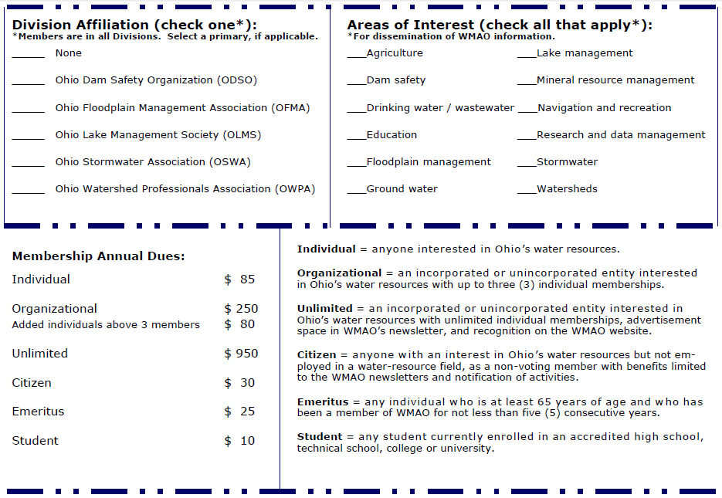

Join the Ohio Stormwater Association!
www.OhioSWA.com
www.WMAO.org
Notes:
Water Management Association of Ohio (or WMAO) is OSWA’s parent organization; In order to join OSWA, you must become a member of WMAO first, then select Ohio Stormwater Association as your division. Some benefits of joining OSWA include: Free quarterly stormwater webinars, Discounted registration at the annual MS4 Bootcamp Training in May, Discounted registration at the annual watershed Workshop presented in collaboration with the Ohio Water Environment Association and additional discounts offered to OSWA members by our affiliates.
For more information about OSWA member benefits, go to our website Ohioswa.com; Under the Get Involved Tab; Select Become a member

Slide 5
Join a Committee!
Conference
Education
Marketing and Membership
Regulatory
Technical Resources
Industrial
Extreme Weather
Education
Marketing
Transportation
OSWA Executive Board
Conference
Industrial
Regulatory
Extreme Weather
Extreme Weather
Notes:
OSWA has 7 committees anyone can join: Conference, Education, Marketing and Membership, Regulatory, Technical Resources, Industrial and Extreme Weather. You do not need to be a member to join a committee. You can find additional information about OSWA’s committees on our website: Ohioswa.com; Under the About Us tab, select committees.

Slide 6
MS4 Bootcamp Objectives
Provide insight on the NPDES program
Provide helpful information and tools MS4 communities need to manage a successful program, compliant with the Ohio Stormwater General Permit.
Serve as a platform where existing successful MS4 communities will share their perspectives on the program elements.

Slide 7
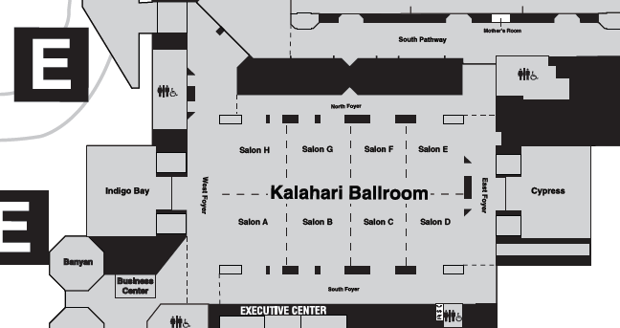

Logistics and Housekeeping
  Please refrain from using mobile phones in the training room and keep them on silent
  Breaks and Lunch
  Program Agenda & CEUs
Notes:
Logistical issues
Please note the locations of the bathrooms on the map.
Please keep mobile phones silent
Program Agenda
Volunteers will be taking photos throughout the day and Kelsey and Kerry from the Marketing Committee do short interviews
Breaks and Lunch
There will be two 15 minute breaks and 30 minutes allotted for lunch
Though there are scheduled breaks; should you need to, please feel free to step out of the room at any time.

Slide 8

CEUs, PDHs and Certificate Info
Attendees will received PDHs for this training.
To certify attendance for CEUs, attendees are required to sign in the AM and again in the PM, after lunch This will serve as your attendance confirmation.
Certificates of Attendance will be emailed after the event.
Notes:
The following fields are required.
Email
First and last name
Session attended
If you have not done so already, please confirm your morning attendance.

Slide 9
Thank you for your
attention!

Slide 10
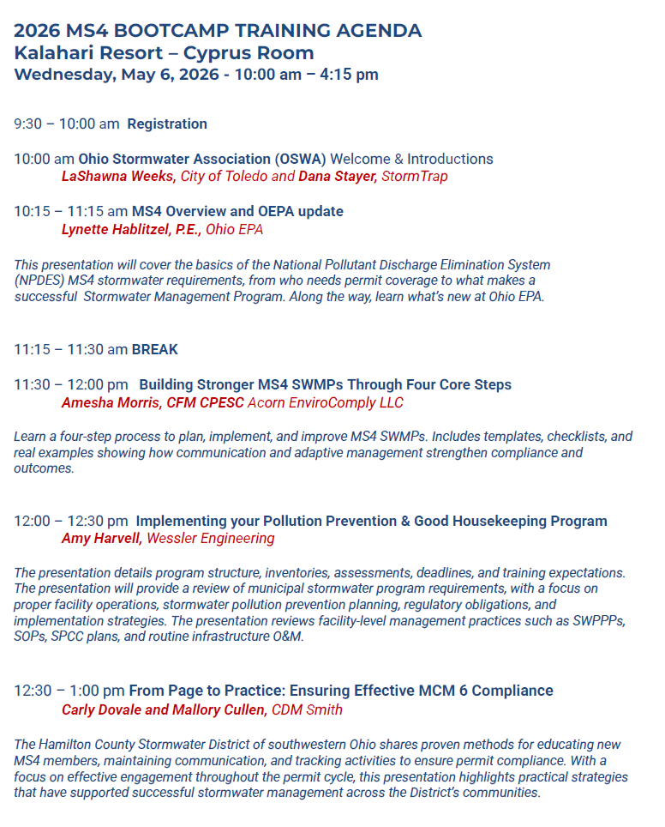
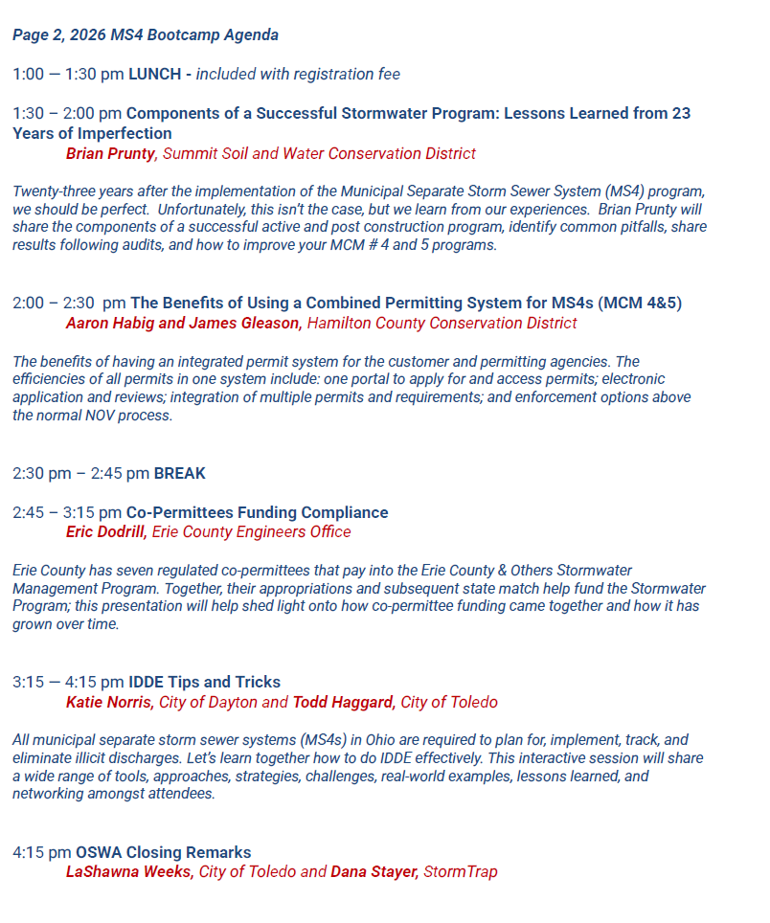
MS4 Bootcamp Agenda
Notes:
Show during Breaks

Slide 11
REMINDER
Please Scan QR Code to
complete the
Morning attendance confirmation
MS4 Bootcamp Agenda (Morning)
Notes:
Show during Breaks

Slide 12

Please Scan QR Code to complete the
Afternoon attendance confirmation
Welcome Attendees
Notes:
Remind attendees to scan afternoon session confirmation after lunch.

Slide 13
REMINDER
Please Scan QR Code to
complete the
Afternoon attendance confirmation
MS4 Bootcamp Agenda (Afternoon)
Notes:
Show during Breaks

Slide 14
2026 MS4 BOOTCAMP TRAINING
Kalahari Resort – Cypress
Closing Remarks
LaShawna Weeks
OSWA Education Committee Co-Chair
Senior Environmental Specialist
City of Toledo
lashawna.weeks@toledo.oh.gov

Slide 15

OSWA Education Committee
  Represent Phase I communities, Phase II communities, industry, and consultants.
  Host educational statewide webinars at no or minimal cost at least 4 times per year.
  Provide educational and networking opportunities for people focused on reducing the negative impacts of stormwater runoff.
  Provide educational meetings on topics of interest to our members.
Notes:
The OSWA Education Committee
Purpose statement: The education committee plans and organizes educational and networking events for stormwater professionals throughout the State of Ohio.
Plans, coordinates and hosts these training opportunities and educational resources for Ohio’s MS4 communities and other stormwater professionals.
Hosts up to 4 webinars annually
Membership benefits - no charge for webinars.
Nominal fee for non-members.
Our trainings provide the opportunity for attendees to obtain CEUs or PDHs, for any certifications they may hold.
Working with all other committees to provide educational updates to members as appropriate.
Providing certificates of completion to event attendees.
Providing access to webinar, workshop and other presentation or training materials.
We hosts up to four statewide webinars at no or minimal cost each year.
These webinars cover a variety of topics some of which include:
With input from the other OSWA committees’
General Stormwater information
Regulatory updates from state agencies and resources for compliance assistance
Topics on environmental law
Extreme weather
Transportation related topics
– networks with our affiliates to hosts co-sponsored webinars to our member.
4 Webinars planned for 2023
Working with each OSWA committee to formulate topics and speakers
Joint webinar in the works with Stormwater University
Will solicit assistance from OEPA for MS4 Bootcamp (day before the Ohio Stormwater Conference)
Continue to update OSWA website with educational opportunities
Work closely with OSWA Marketing Committee to promote events
In addition to providing webinars the Education committee collaborates with its partners to provide in person events regionally in 3 regions of the state at least 1 time per year.
provide at least three training sessions per year (in addition to the Annual Conference hosted in conjunction with Tinker’s Creek Watershed Partners), providing online resources, and developing tools to aid MS4s in complying with local and state stormwater regulations.
Purpose statement: The education committee plans and organizes educational and networking events for stormwater professionals throughout the State of Ohio.
The Education Committee’s responsibilities include:
Providing educational statewide webinars at no or minimal cost at least 3 times per year.
Providing in person events regionally in 3 regions of the state at least 1 time per year.
Providing an in person statewide training workshop at least once per year.
Working with all other committees to provide educational updates to members as appropriate.
Providing certificates of completion to event attendees.
Providing access to webinar, workshop and other presentation or training materials.
Working with all other committees to provide educational updates to members as appropriate.
Providing certificates of completion to event attendees.
Providing access to webinar, workshop and other presentation or training materials.
We hosts up to four statewide webinars at no or minimal cost each year.
These webinars cover a variety of topics some of which include:
With input from the other OSWA committees’
General Stormwater information
Regulatory updates from state agencies and resources for compliance assistance
Topics on environmental law
Extreme weather
Transportation related topics
– networks with our affiliates to hosts co-sponsored webinars to our member.
In addition to providing webinars the Education committee collaborates with its partners to provide in person events regionally in 3 regions of the state at least 1 time per year.
provide at least three training sessions per year (in addition to the Annual Conference hosted in conjunction with Tinker’s Creek Watershed Partners), providing online resources, and developing tools to aid MS4s in complying with local and state stormwater regulations.
The Education Committee’s responsibilities include:
Providing educational statewide webinars at no or minimal cost at least 3 times per year.
Providing in person events regionally in 3 regions of the state at least 1 time per year.
Providing an in person statewide training workshop at least once per year.
Working with all other committees to provide educational updates to members as appropriate.
Providing certificates of completion to event attendees.
Providing access to webinar, workshop and other presentation or training materials.

Slide 16
Get Involved: Join a Committee
The Ohio Stormwater Association is seeking volunteers to serve on various committees
  Current Committees:
  Transportation
  Marketing
  Conference
  Education
  Regulatory
  Industrial
  Extreme Weather
  Contact any OSWA Board member to express interest or email Regina.collins@toledo.oh.gov for more information.
Notes:
OSWA has 6 committees anyone can join: Education, Marketing and Membership, Regulatory, Transportation, Industrial and Extreme Weather. You do not need to be a member to join a committee. You can find additional information about OSWA’s committees on our website: Ohioswa.com; Under the About Us tab, select committees.
Joining an OSWA committee is a great way to become involved, network and even just to learn more about OSWA. You do not need to be a member to join a committee. Please contact Kelly Kuhbander to express interest or to learn more about our committees. We are currently seeking an Industrial Committee Chair, so please reach out to Kelly if you are interested or pass this information along to someone who might be interested.

Slide 17

Get Involved:
Join the Ohio Stormwater Association!
www.OhioSWA.com
www.WMAO.org
Notes:
The Water Management Association of Ohio (or WMAO) is OSWA’s parent organization.
OSWA is organized formally as the stormwater division of the Water Management Association of Ohio which maintains a 501©3 status.
To join OSWA, you must become a member of WMAO first, then select Ohio Stormwater Association as your division.
Water Management Association of Ohio (or WMAO) is OSWA’s parent organization; In order to join OSWA, you must become a member of WMAO first, then select Ohio Stormwater Association as your division. Some benefits of joining OSWA include: Free quarterly stormwater webinars, Discounted registration at the annual MS4 Bootcamp Training in May, Discounted registration at the annual watershed Workshop presented in collaboration with the Ohio Water Environment Association.
Members also receive discounts on all maps listed on US River Maps and on online training provided by
Stormwater University;
National Stormwater Center;
American Stormwater Institute;
StormwaterONE;
and the
National Registry of Environmental Professionals:
For more information about OSWA member benefits, go to our website Ohioswa.com; Under the Get Involved Tab; Select Become a member

Slide 18
Get Involved:
Sponsorship Opportunities Available!
We would love to have your support.
Organization Partner Levels
Tier I - $5,000
Tier II- $2,500
Tier III - $1,000
Tier IV - $500
https://ohioswa.com/

Slide 19

2026 Webinar Dates
Thursday, February 19
Preparing for an MS4 Audit
Thursday, April 16
Extreme Weather Webinar
Wednesday, July 15
Industrial Stormwater
Thursday, September 10
Regulatory Update
Notes:
We are announcing the dates and topics for our 2026 webinars. So mark your calendars and watch for more details in coming months.

Slide 20

Thank you to our Presenters
Presenters:
Lynette Hablitzel, P.E., Ohio EPA
Amesha Morris, CFM CPESC Acorn EnviroComply LLC
Amy Harvell, Wessler Engineering
Carly Dovale, CDM Smith
Mallory Cullen, CDM Smith
Brian Prunty, Summit Soil and Water Conservation District
Aaron Habig, Hamilton County Conservation District
James Gleason, Hamilton County Conservation District
Eric Dodrill, Erie County Engineers Office
Katie Norris, City of Dayton
odd Haggard, City of Toledo
Dana Stayer, StormTrap

Slide 21

Notes:
The Ohio Stormwater Association would like to thank our 2026 partners who help make this webinar and other OSWA resources available.

Slide 22






Thank YOU OSWA Affiliates!
Notes:
OSWA would like to thank our Affiliates
Stormwater University, National Stormwater Center, American Stormwater Institute, StormwaterONE and the National Registry of Environmental Professionals.
for offering discounts to our members.
Members receive discounts on all maps listed on US River Maps and on online training provided by
Stormwater University;
National Stormwater Center;
American Stormwater Institute;
StormwaterONE;
and the
National Registry of Environmental Professionals:

Slide 23
CEUs and PDHs and Certificate Info
Attendees will received PDHs for this training.
Certificates of Attendance will be emailed after the event.
Notes:
The following fields are required.
Email
First and last name
Session attended

Slide 24
THANK YOU!!!!
For joining us at the
2026 OSWA MS4
BOOTCAMP TRAINING
Kalahari Resort – Cypress
May 6, 2026
https://ohioswa.com/
Notes:
Welcome
Hosts Introductions
Thank you Bootcamp Planning Committee & Speakers

