Slide 1
WHAT MAKES STORMWATER BMPS WORK?
REVIEW OF BMP TREATMENT MECHANISMS
JON PRIER, P.E. - ODNR

Slide 2
Main Points
DESIGN
MAINTENANCE
PERFORMANCE
Ohio EPA requires BMPs to keep working, even after construction – MS4 Permit
Notes:
What are we doing to help keep our BMPs working?

Slide 3
Overview
BMP Treatment Mechanisms
Characteristics Necessary for Treatment
Common Issues that Cause Treatment to Fail
  Vegetated Filter Strip (Grass Slope)
  Vegetated Biofilter (Grass Swale)
  Manufactured Systems
  Detention Basin
  Bioretention Cell
  Infiltration Trench

Slide 4
Treatment Mechanisms
Processes that remove pollutants from stormwater runoff
  Filtration
  Sedimentation by Gravity (Settling)
  Infiltration
  Plant Uptake and Microbial Activity
  Hydrodynamic Separation

Slide 5
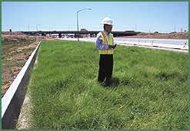
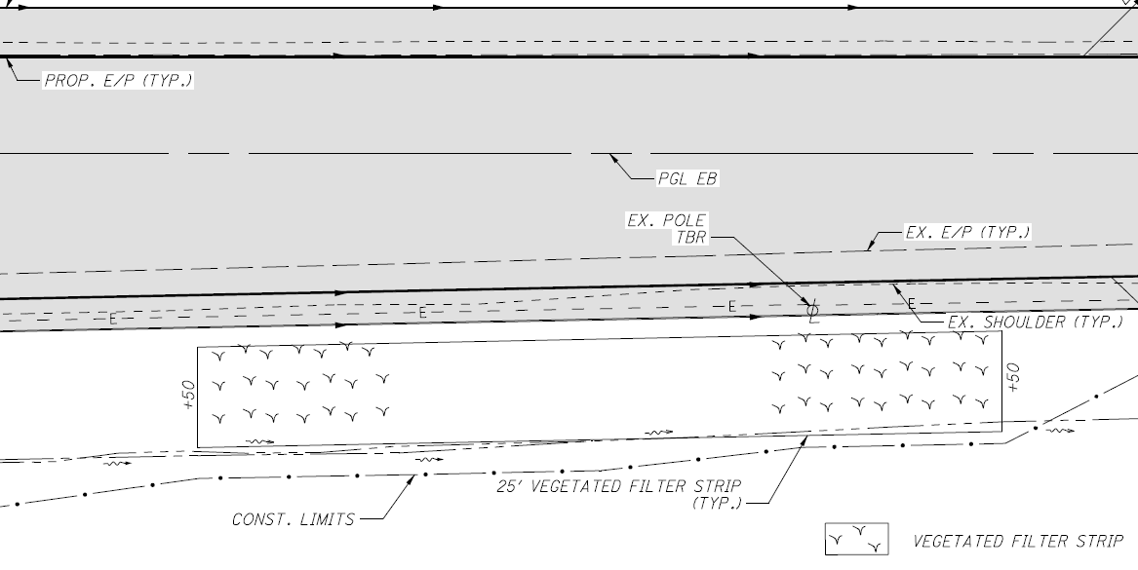
Vegetated Filter Strip
Grassed roadway shoulder or foreslope

Slide 6
Vegetated Filter Strip –
Treatment Mechanisms
Filtration
  Allow runoff to pass through vegetation to filter sediment
Sedimentation
  Slow runoff so that sediment settles out
Infiltration
  Allow runoff to pass over pervious surfaces to promote infiltration
Plant Uptake
  Allow runoff to come into contact with vegetation to promote plant uptake and microbial activity

Slide 7
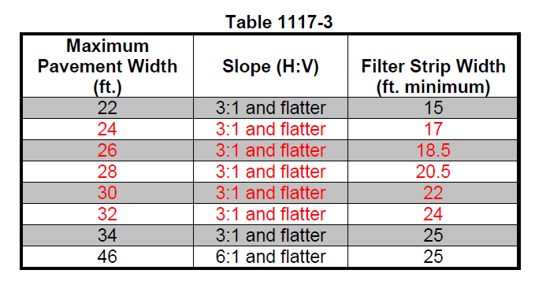
Vegetated Filter Strip –
Necessities for Treatment
Maintain sheet flow and avoid concentrated flow
  Item 670 slope erosion protection
  Avoid steep slopes or high velocities
Maximize water contact with vegetation
  Keep runoff depth within grass
Maximize infiltration
  Use topsoil or soil amendments
Maintain grass

Slide 8
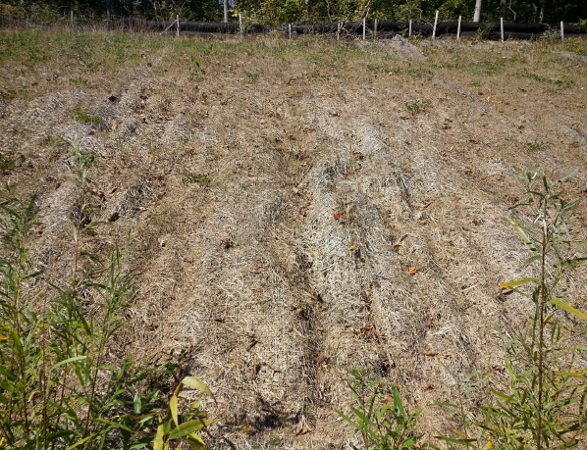
Vegetated Filter Strip –
Treatment Failures
Allow concentrated flow from pipes or low points
  Gullies, scour
Less than 80% vegetative cover
  Gullies, no filtering
Use compacted clay soils with no topsoil
  No infiltration

Slide 9
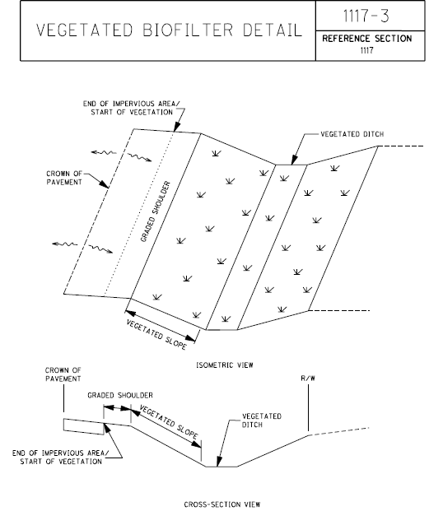
Vegetated Biofilter
Flat-bottom, grassed swale

Slide 10
Vegetated Biofilter –
Treatment Mechanisms
Filtration
  Allow runoff to pass through vegetation to filter sediment
Sedimentation
  Slow runoff so that sediment settles out
Infiltration
  Allow runoff to pass over pervious surfaces to promote infiltration
Plant Uptake
  Allow runoff to come into contact with vegetation to promote plant uptake and microbial activity

Slide 11
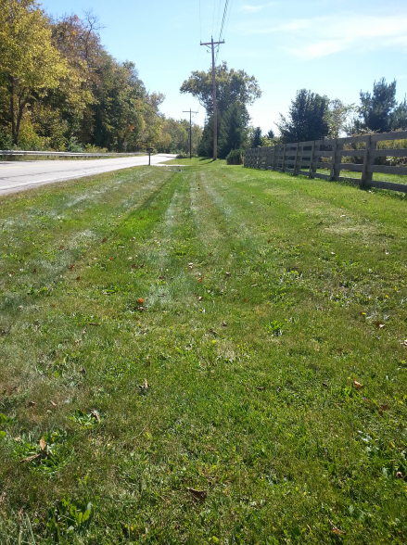
Vegetated Biofilter –
Necessities for Treatment
Minimize velocity in swale
  Spread water out
  Longitudinal slopes 0.5 – 5%
Maximize water contact with vegetation
  Keep runoff depth within grass
Maximize infiltration
  Use topsoil or soil amendments on slopes

Slide 12
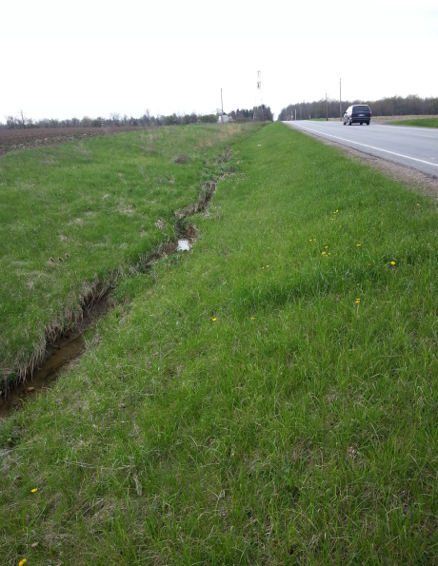
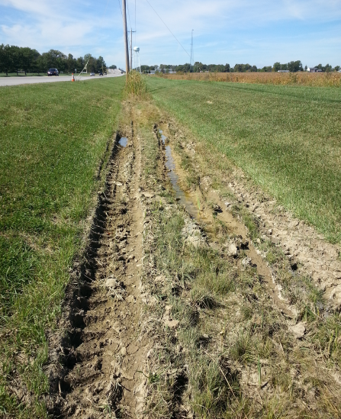
Vegetated Biofilter –
Treatment Failures
Scour Velocities
  Gullies, scour
Less than 80% vegetative cover
  Gullies, no filtering
Maintenance vehicle tracks
Inappropriate maintenance of accumulated sediment

Slide 13
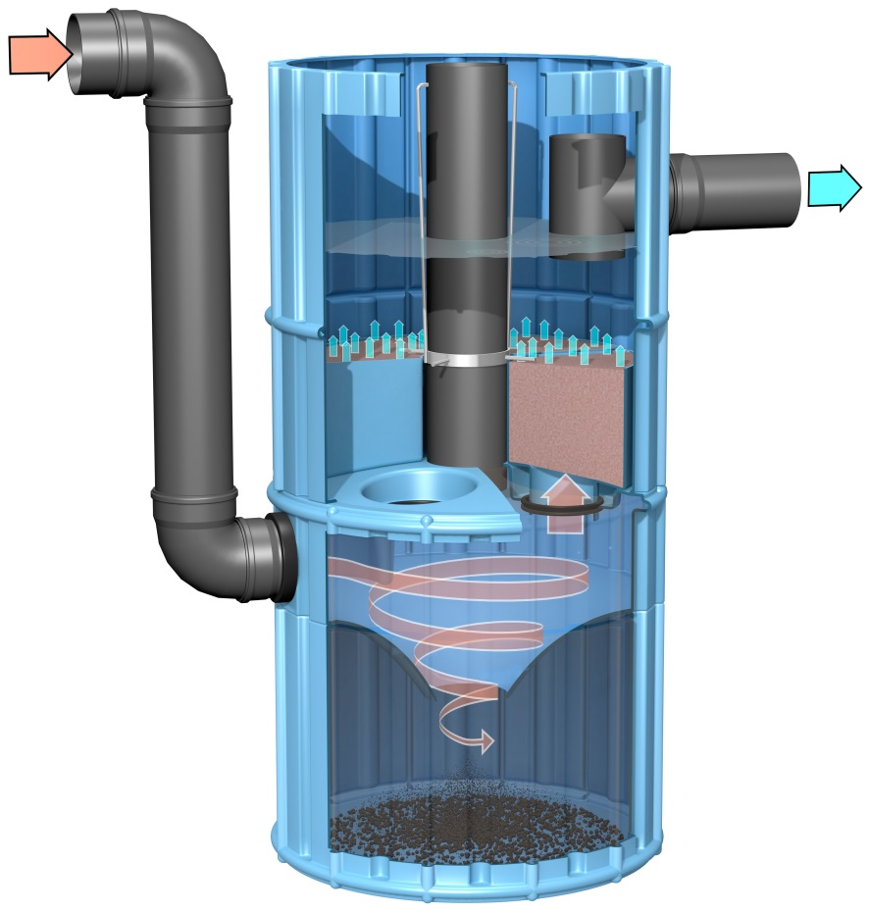
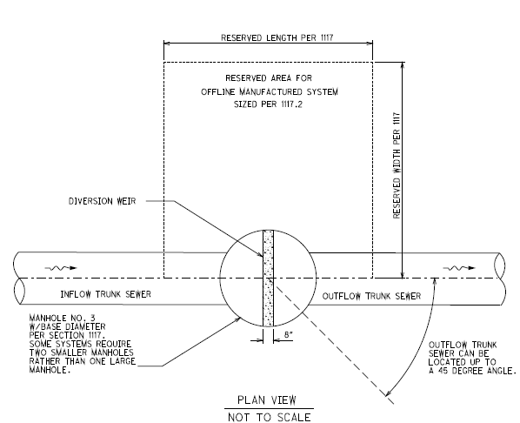
Manufactured Systems
Underground structures that normally fit in line with the drainage system
Image: 3P Technik UK

Slide 14
Manufactured Systems –
Treatment Mechanisms
Hydrodynamic Separation
  Centrifugal force pushed sediment to walls, then drop
Gravity Sedimentation
  Slow runoff so that sediment settles out
Floatables / Oil Separation
  Allow floatables to float to top and take effluent from below water surface
Membrane or Media Filtrations (some)
  Make runoff pass through filtering device

Slide 15
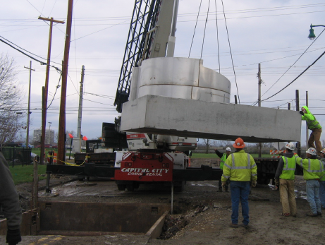
Manufactured Systems –
Necessities for Treatment
Not meant for high flow rates
  < 6 cfs
Check often
Clean out often
Maintenance access

Slide 16
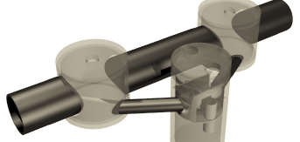
Manufactured Systems –
Treatment Failures
Route flow rates that are too high
  Re-suspend collected sediment
Forget it exists (no maintenance)
  Sediment storage will fill
  Floatable storage will fill
  May be ineffective after 4 – 12 months
Site system under road
  Road closures make maintenance less likely

Slide 17
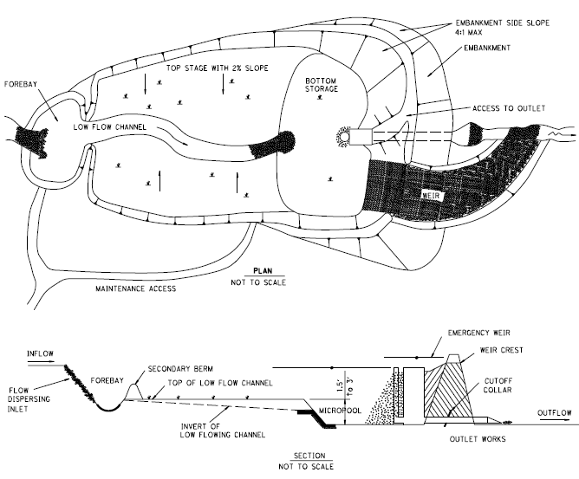
Detention Basin
Dry pond (mostly) that holds back the water quality volume

Slide 18
Detention Basin –
Treatment Mechanisms
Sedimentation
  Slow runoff so that sediment settles out
  48 hours drawdown requirement for water quality volume
  20% water quality volume constant standing water
Flow Rate Attenuation – Stream Stability
  Reduces some peak flow rates from runoff
Sometimes paired with local flood control requirements
Also some Filtration, Infiltration, and Plant Uptake

Slide 19
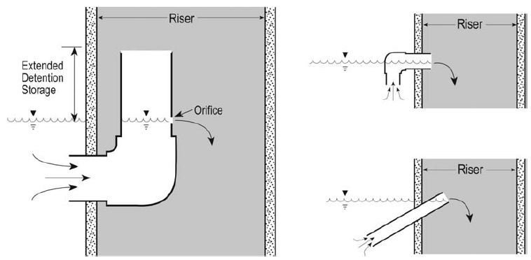
Detention Basin –
Necessities for Treatment
Ensure 48 hour drawdown time
Utilize outlets that are less prone to clogging
Plan on regular maintenance for clogging outlets
Keep dry part of the basin vegetated
Consider safety for constant ponding

Slide 20
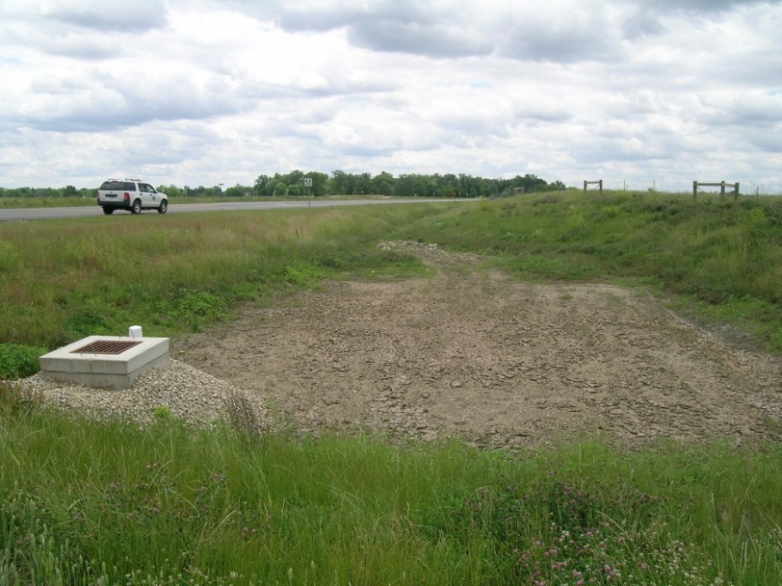
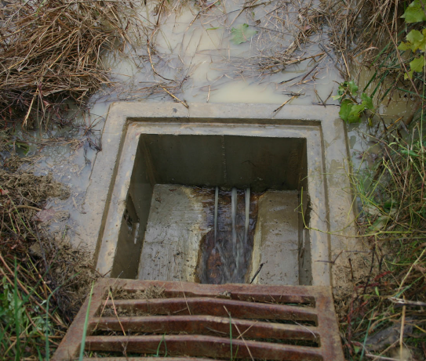
Detention Basin –
Treatment Failures
Bare soil
Difficult maintenance access to outlet
No maintenance schedule
Trash accumulation
No inlet energy dissipation
No slope stabilization
No erosion protection

Slide 21
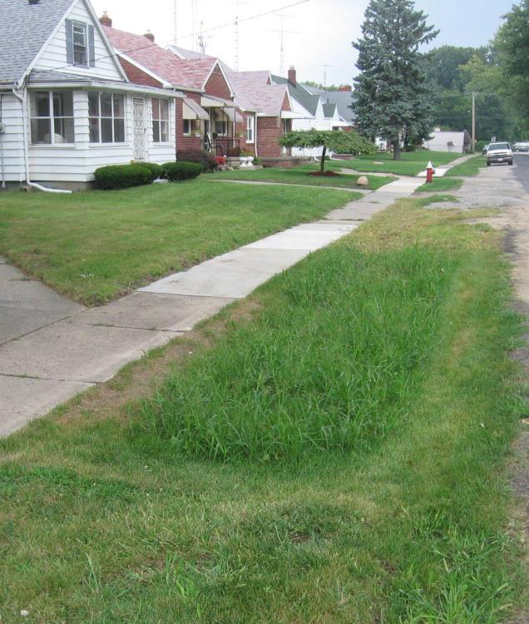
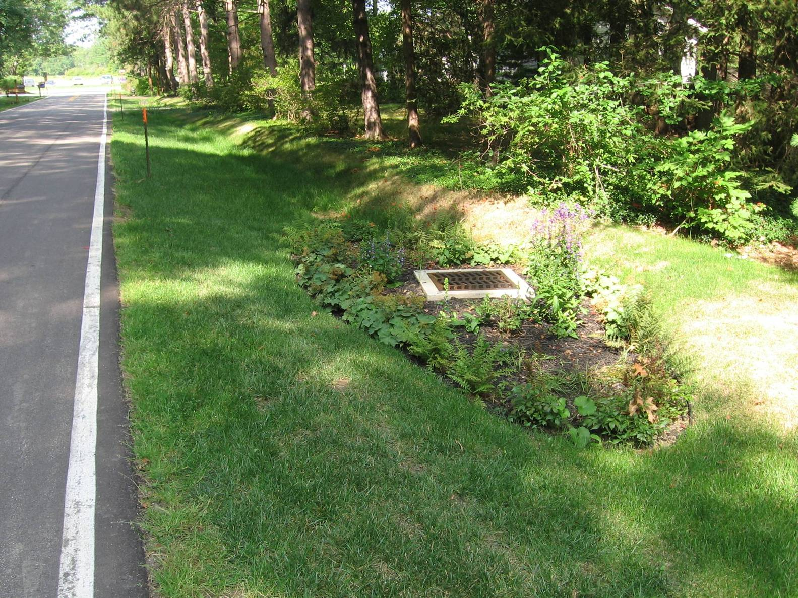
Bioretention Cell
Depressed areas that allow shallow ponding and filtering through engineered soil

Slide 22
Bioretention Cell –
Treatment Mechanisms
Filtration
  Runoff percolates down through engineered soil
Sedimentation
  Slow runoff so that sediment settles out
Infiltration
  Runoff may infiltrate into surrounding soil
Plant Uptake
  Allow runoff to come into contact with vegetation to promote plant uptake and microbial activity
Flow Rate Attenuation – Stream Stability
  Reduces some peak flow rates from runoff

Slide 23
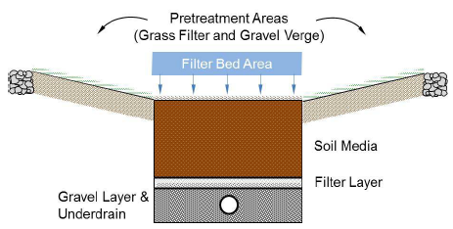
Bioretention Cell –
Necessities for Treatment
Stabilize surrounding soil
Normally provide underdrains
Plan on regular maintenance
  Trash / debris removal
  Some sediment removal
Provide some pretreatment
Energy dissipation at inlet

Slide 24
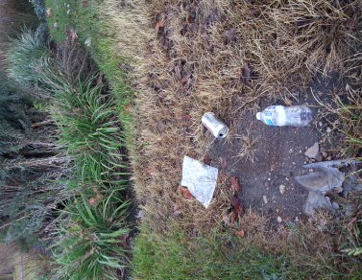
Bioretention Cell –
Treatment Failures
Overload with sediment
  Construction sediment
No pretreatment
Scour velocity
Compact soil
  Heavy equipment
No maintenance

Slide 25
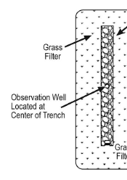
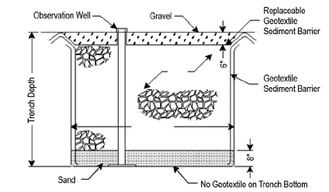
Infiltration Trench
Excavated trench filled with aggregate that allows runoff to infiltrate into the soil

Slide 26
Infiltration Trench –
Treatment Mechanisms
Infiltration
  Runoff infiltrates into surrounding soil
Filtration
  Runoff percolates down through aggregate
Flow Rate Attenuation – Stream Stability
  Reduces some peak flow rates from runoff

Slide 27
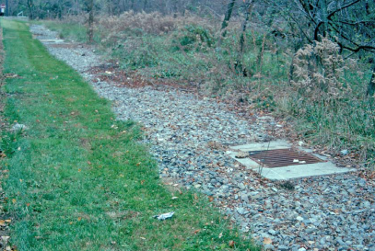
Infiltration Trench –
Necessities for Treatment
Confirm soil infiltration rates
  0.5 – 2.4 in/hr
  HSG A or B
Stabilize surrounding soil
Plan on regular maintenance
  Trash / debris removal
  Some sediment removal
Provide some pretreatment
Energy dissipation at inlet

Slide 28
Infiltration Trench –
How to Reduce Treatment
Overload with sediment
  Construction sediment
No pretreatment
Scour velocity
Compact soil
  Excavation Methods
No maintenance

Slide 29
Summary
Design impacts BMP performance
Design impacts ease of maintenance
Ongoing maintenance impacts BMP performance
Some BMPs require more maintenance than others
All BMPs require regular inspection and maintenance to continue functioning
Appropriate design and maintenance should facilitate treatment mechanisms
MS4 Permit Compliance

Slide 30

QUESTIONS?
Jon Prier
Natural Resources Engineer
ODNR, Soil & Water Resources
(614) 265-6680
jon.prier@dnr.state.oh.us

